Slide 1

Data Management in the Research Environment
RSM 574/674 Spring 2016
Timothy Norris – tnorris@miami.edu
Angela Clark – aclark@rsmas.miami.edu

Slide 2
Todays Topics
Quick Review
File System Organization
Command Line

Slide 3
File Formats
Text: doc, docx, rtf, odt, pages
Tabular: xls, xlsx, numbers, dbf
Stat: spss, sas, jmp, rdata
Images: jpg, tiff, svg, png, gif, bmp
Geographic: shp, geotiff, kml, kmz, gdb
Video: mp4, mov, avi, ogg
Music: mp3, wav, m4a, aiff
Plain text: txt, csv, json, html, xml
General formats
proprietary
mixed
open
Compression
lossy
depends
lossless
Notes:
Joint photographic experts group

Slide 4
Recommended Formats for Long-term Access and Sharing
Non-proprietary – no software purchase to open the file
Lossless – uncompressed with all of the original data
Indexable – if possible a plain text format that is both human and machine readable
Best file format???
PAPER!

Slide 5
Image File Formats
How are file size and image quality related to:
Resolution (image dimensions)
Color model
Compression
Vector or Raster

Slide 6
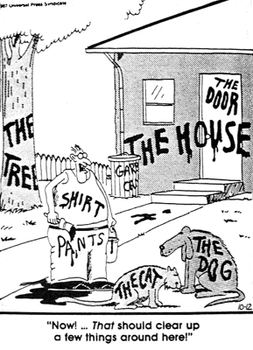
Data Organization
File Structures
Naming Conventions
Tagging
Cartoon from The Far Side by Gary Larson

Slide 7

Think about Time and Space
Data Organization
Directory Structure
File Naming Conventions
Save Time and Space

Slide 8
This will get personal . . . .

Slide 9
So . . .
Take a moment, think about your file naming for your articles that you save
Are you consistent?
Is it easy to find what you want several months later?
Now think about your file structure for your downloaded articles
Where are the actual files on the computer?
How many folders are you using?
Are they logically organized?

Slide 10
The benefits of consistent data file labeling are:
- Data files are distinguishable from each other within their containing folder - Data file naming prevents confusion when multiple people are working on shared files - Data files are easier to locate and browse - Data files can be retrieved not only by the creator but by other users - Data files can be sorted in logical sequence - Data files are not accidentally overwritten or deleted - Different versions of data files can be identified - If data files are moved to other storage platform their names will retain useful context
http://datalib.edina.ac.uk/mantra/organisingdata/

Slide 11
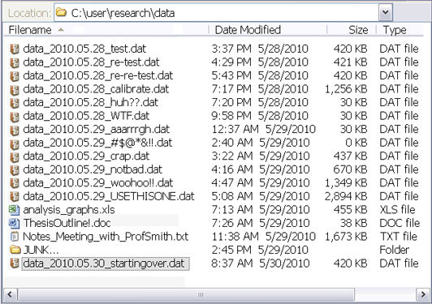
http://phdcomics.com/comics.php?f=1531

Slide 12
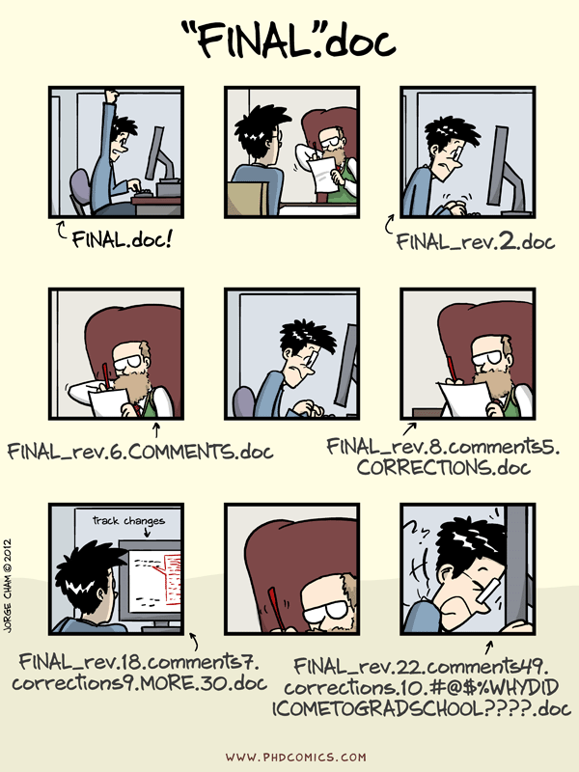
http://phdcomics.com/comics.php?f=1531

Slide 13
Retraction Watch
“A problem with a malfunctioning computer and image storage and mislabeling led to the assembling by one of the co-authors of images that were previously published by our research group. I didn’t detect the problem when the manuscript was sent for publication. Although the conclusions were not compromised in any of the two papers, we retract the papers precisely because some images were wrongly used.”
Principal investigator Jorge Leitão
http://retractionwatch.com/2014/10/17/this-situation-left-me-ashamed-and-infuriated-with-myself-scientist-retracts-two-papers/

Slide 14
“I the 2011 paper (http://jb.asm.org/content/196/22/3980), it was first submitted to other 2 journal (JBC and RNA Biology), whom requested a lot of modifications, and therefore, we accumulated a lot of processed data files. In between the process, the hard-drive of the computer that was used to store the data files (which is shared by 5 research groups) stopped working due data overloading. Nonetheless, we were able to retrieve the original data, or so we thought. At the time, I was responsible for composing the final figures of each paper that we produced, and asked the team members to give me the files. In Figure 8 of this paper, it seemed that there has been a labeling error in the source files, and I did not realize that some images where duplicated in the experiment that was being represented, neither that parts of the image had already been published. I should stress that that the images were produced in our lab and represent our data.”
First author Christian Ramos
http://retractionwatch.com/2014/10/17/this-situation-left-me-ashamed-and-infuriated-with-myself-scientist-retracts-two-papers/

Slide 15
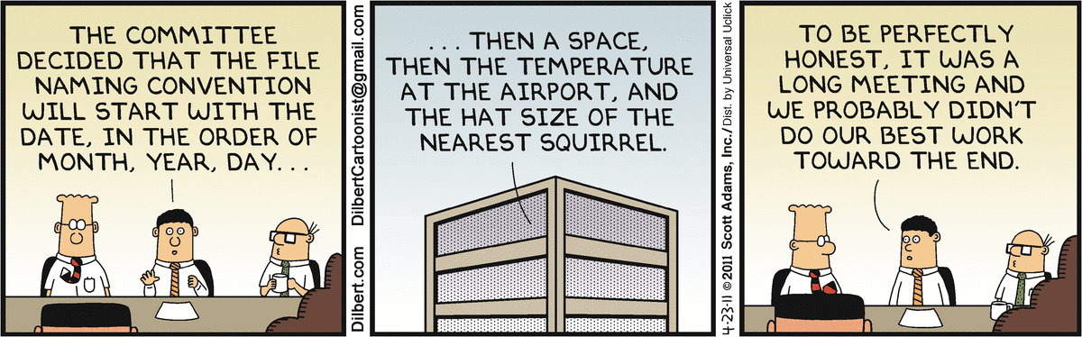
File Naming Best Practices
DO
DON’T
useCamelCasing.docx
use_underscores.txt
2015_put_The_Date_First.csv
20150214_useTwoDidgitDateNumbers.xls
startASeriesWithLeadingZeros_001.doc
20150214_UM_date-place.shp
useFileExtensions.jpg
Leave spaces in the file name.xls
Use the default save name from MS word that is simply the long first sentence in your file.doc
January 5 2015 Samples with the month first.xls
Label as final version.doc
special characters: & , * % # ; * ( ) ! @$ ^ ~ ' { } [ ] ? < > - + /
No more than about 25 characters
Mac file extensions:
finder->preferences: show all filename extensions (check)
PC file extensions:
explorer->organize->folder and search options:
View tab: Hide Extensions for known file types (uncheck)
http://assets.amuniversal.com/42ec27b03718012ea5cb00163e41dd5b
Notes:
Mac file extensions: finder->preferences: show all filename extensions
PC file extensions:

Slide 16
File Naming Best Practices
DO
DON’T
BE CONSISTENT
useCamelCasing.docx
use_underscores.txt
2015_put_The_Date_First.csv
20150214_useTwoDidgitDateNumbers.xls
startASeriesWithLeadingZeros_001.doc
20150214_UM_date-place.shp
useFileExtensions.jpg
Leave spaces in the file name.xls
Use the default save name from MS word that is simply the long first sentence in your file.doc
January 5 2015 Samples with the month first.xls
Mac file extensions: finder->preferences: show all filename extensions (check)
PC file extensions: explorer->organize->folder and search options:
View tab: Hide Extensions for known file types (uncheck)
http://assets.amuniversal.com/42ec27b03718012ea5cb00163e41dd5b
Notes:
Mac file extensions: finder->preferences: show all filename extensions
PC file extensions:

Slide 17
Information in the File Name
- Version number - Date of creation - Name of creator - Description of content - Name of research team/department associated with the data - Publication date - Project number
metadata
http://datalib.edina.ac.uk/mantra/organisingdata/

Slide 18
Quick Review
Organization
Context
Consistency
YYYYMMDD_projectID_place_001.ext

Slide 19
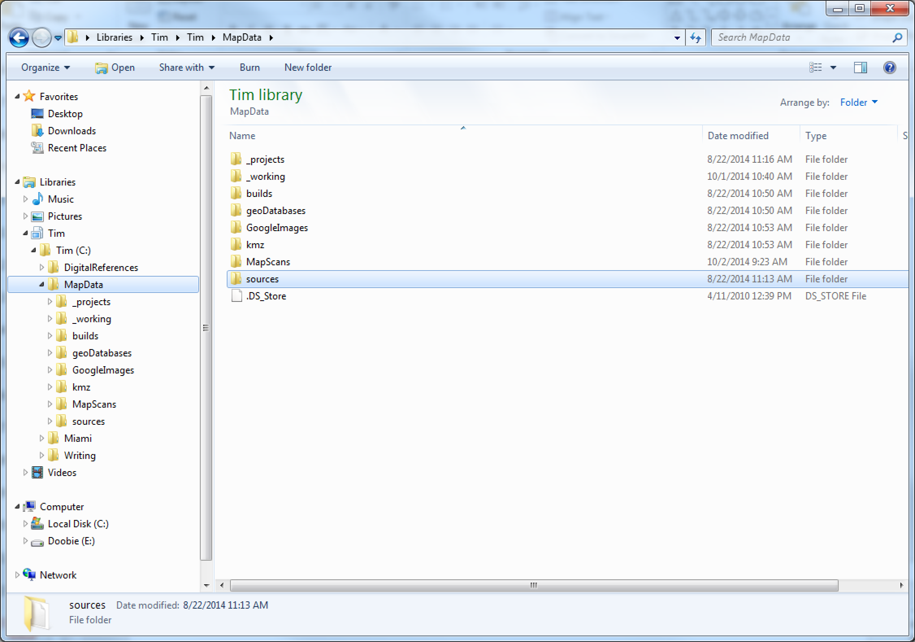

Slide 20
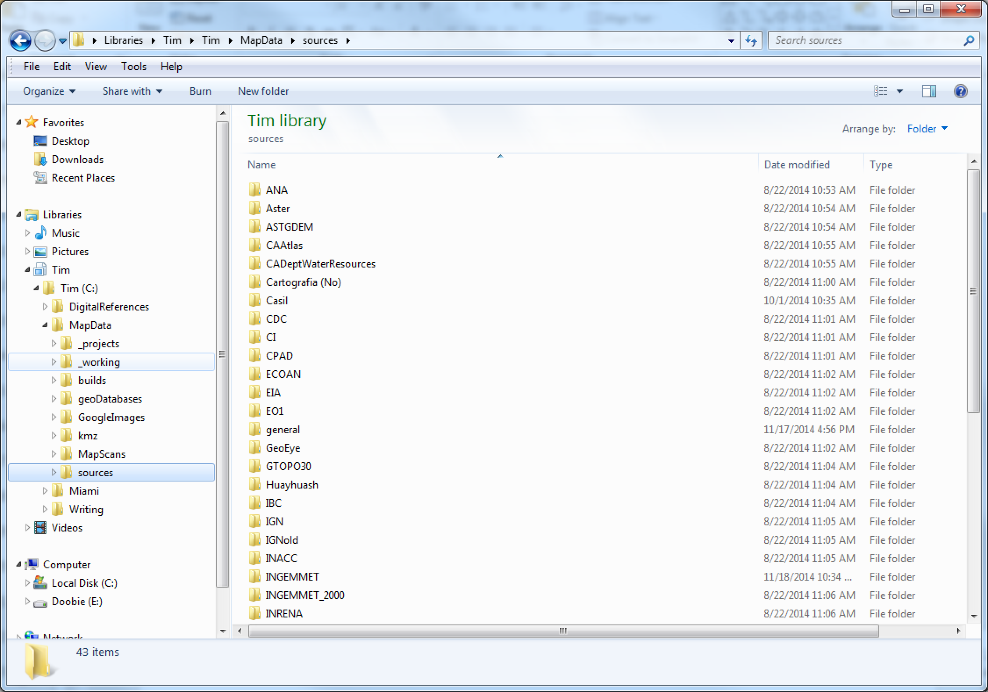

Slide 21
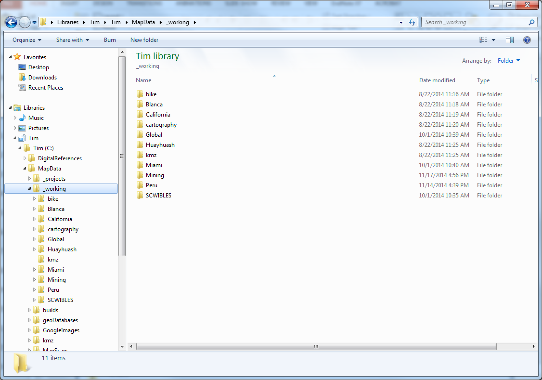

Slide 22
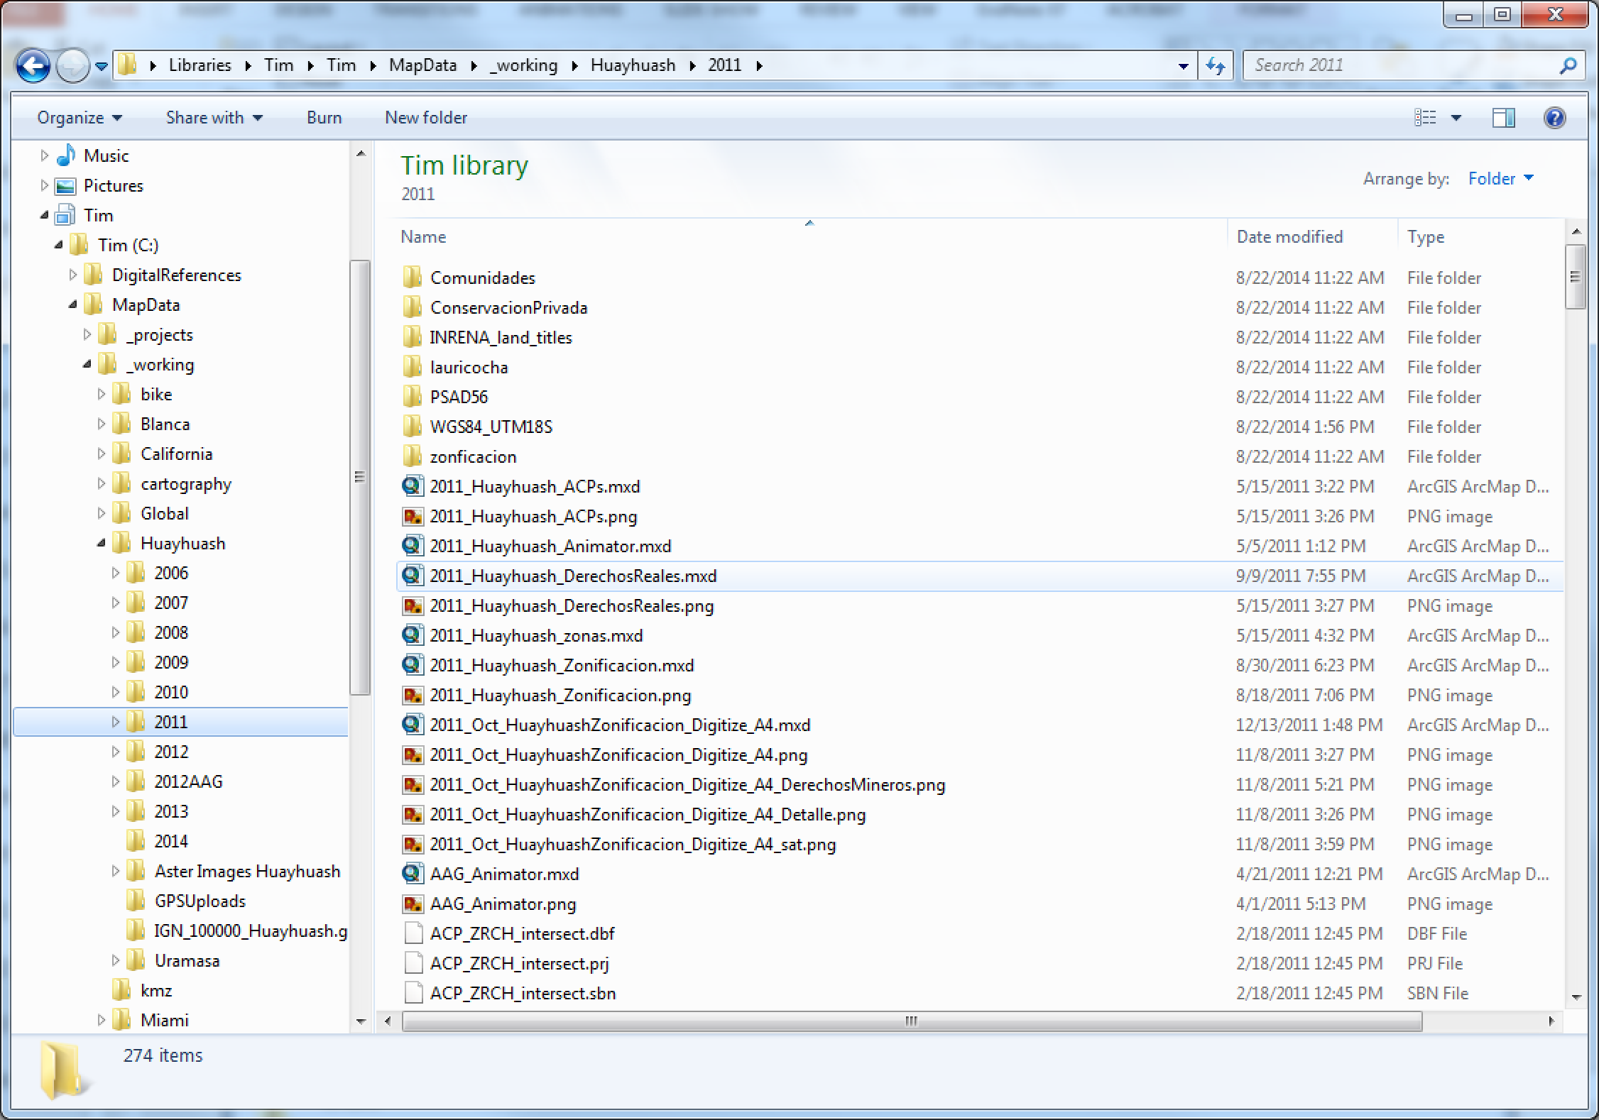

Slide 23
File naming strategies
Order by date:
19550412_notes_MassObs.docx
19550412_questionnaire_MassObs.pdf
19631215_notes_Gorer.docx
19631215_questionnaire_Gorer.pdf
Order by subject:
Gorer_notes_19631215.docx
Gorer_questionnaire_19631215.pdf
MassObs_notes_19550412.docx
MassObs_questionnaire_19550412.pdf
Order by type:
Notes_Gorer_19631215.docx
Notes_MassObs_19550412.docx
Questionnaire_Gorer_19631215.pdf
Questionnaire_MassObs_19550412.pdf
Forced order with numbering:
01_MassObs_questionnaire_19550412.pdf
02_MassObs_notes_19550412.docx
03_Gorer_questionnaire_19631215.pdf
04_Gorer_notes_19631215.docx
Whitmire, Amanda L. (2014). Research Data Management Curriculum, Lecture 4: Data Organization Oregon State University Libraries. Retrieved 11/04/2015 from: http://figshare.com/articles/GRAD521_Research_Data_Management_Lectures/1003835
Notes:
Once you have a file naming convention sorted out, think about the order of information in the file name. There is no right or wrong way to do this – just order the information in a way that works for you, be consistent, and WRITE IT DOWN so that others will understand it.

Slide 24
On using number order in file names…
US standard | MM/DD/YY | DD/MM/YY | YYYY-MM-DD
January 12, 2011 | 01/12/11 | 12/01/11 | 2011-01-12
February 15, 2011 | 02/15/11 | 15/02/11 | 2011-02-15
March 27, 2011 | 03/27/11 | 27/03/11 | 2011-03-27
April 11, 2011 | 04/11/11 | 11/04/11 | 2011-04-11
May 20, 2011 | 05/20/11 | 20/05/11 | 2011-05-20
June 6, 2011 | 06/06/11 | 06/06/11 | 2011-06-06
July 18, 2011 | 07/18/11 | 18/07/11 | 2011-07-18
August 7, 2011 | 08/07/11 | 07/08/11 | 2011-08-07
September 9, 2011 | 09/09/11 | 09/09/11 | 2011-09-09
October 14, 2011 | 10/14/11 | 14/10/11 | 2011-10-14
November 24, 2011 | 11/24/11 | 24/11/11 | 2011-11-24
December 18, 2011 | 12/18/11 | 18/12/11 | 2011-12-18
January 19, 2012 | 01/19/12 | 19/01/12 | 2012-01-19
February 27, 2012 | 02/27/12 | 27/02/12 | 2012-02-27
March 15, 2012 | 03/15/12 | 15/03/12 | 2012-03-15
April 27, 2012 | 04/27/12 | 27/04/12 | 2012-04-27
May 11, 2012 | 05/11/12 | 11/05/12 | 2012-05-11
June 17, 2012 | 06/17/12 | 17/06/12 | 2012-06-17
July 16, 2012 | 07/16/12 | 16/07/12 | 2012-07-16
August 4, 2012 | 08/04/12 | 04/08/12 | 2012-08-04
September 14, 2012 | 09/14/12 | 14/09/12 | 2012-09-14
October 26, 2012 | 10/26/12 | 26/10/12 | 2012-10-26
November 26, 2012 | 11/26/12 | 26/11/12 | 2012-11-26
December 8, 2012 | 12/08/12 | 08/12/12 | 2012-12-08
January 22, 2013 | 01/22/13 | 22/01/13 | 2013-01-22
February 20, 2013 | 02/20/13 | 20/02/13 | 2013-02-20
March 26, 2013 | 03/26/13 | 26/03/13 | 2013-03-26
April 18, 2013 | 04/18/13 | 18/04/13 | 2013-04-18
May 23, 2013 | 05/23/13 | 23/05/13 | 2013-05-23
Dates listed in order of collection
Notes:
It’s easy to sort by date in Excel, because it is possible to assign a number format in each cell that Excel understands means ‘date’.
However, if you put the date in the filename, your computer will sort these dates as TEXT, not as date-formatted numerical values.
Let’s look at how this plays out in filenames, under different number order schemes. (pretend that all ‘/’ are ‘-’, for the sake of consistency)

Slide 25
On using number order in file names…
US standard | MM-DD-YYYY | DD-MM-YYYY | YYYY-MM-DD
January 12, 2011 | 01-12-2011 | 12-01-2011 | 2011-01-12
January 19, 2012 | 01-19-2012 | 19-01-2012 | 2012-01-19
January 22, 2013 | 01-22-2013 | 22-01-2013 | 2013-01-22
February 15, 2011 | 02-15-2011 | 15-02-2011 | 2011-02-15
February 20, 2013 | 02-20-2013 | 20-02-2013 | 2013-02-20
February 27, 2012 | 02-27-2012 | 27-02-2012 | 2012-02-27
March 15, 2012 | 03-15-2012 | 15-03-2012 | 2012-03-15
March 26, 2013 | 03-26-2013 | 26-03-2013 | 2013-03-26
March 27, 2011 | 03-27-2011 | 27-03-2011 | 2011-03-27
April 11, 2011 | 04-11-2011 | 11-04-2011 | 2011-04-11
April 18, 2013 | 04-18-2013 | 18-04-2013 | 2013-04-18
April 27, 2012 | 04-27-2012 | 27-04-2012 | 2012-04-27
May 11, 2012 | 05-11-2012 | 11-05-2012 | 2012-05-11
May 20, 2011 | 05-20-2011 | 20-05-2011 | 2011-05-20
May 23, 2013 | 05-23-2013 | 23-05-2013 | 2013-05-23
June 6, 2011 | 06-06-2011 | 06-06-2011 | 2011-06-06
June 17, 2012 | 06-17-2012 | 17-06-2012 | 2012-06-17
June 26, 2013 | 06-26-2013 | 26-06-2013 | 2013-06-26
July 16, 2012 | 07-16-2012 | 16-07-2012 | 2012-07-16
July 18, 2011 | 07-18-2011 | 18-07-2011 | 2011-07-18
July 22, 2013 | 07-22-2013 | 22-07-2013 | 2013-07-22
August 4, 2012 | 08-04-2012 | 04-08-2012 | 2012-08-04
August 7, 2011 | 08-07-2011 | 07-08-2011 | 2011-08-07
August 8, 2013 | 08-08-2013 | 08-08-2013 | 2013-08-08
September 9, 2011 | 09-09-2011 | 09-09-2011 | 2011-09-09
September 14, 2012 | 09-14-2012 | 14-09-2012 | 2012-09-14
September 19, 2013 | 09-19-2013 | 19-09-2013 | 2013-09-19
October 14, 2011 | 10-14-2011 | 14-10-2011 | 2011-10-14
October 26, 2012 | 10-26-2012 | 26-10-2012 | 2012-10-26
If we sort by MM/DD/YY,
dates are out of order.
Notes:
Filenames listed in the typical “US” fashion will be out of order, as all January data files will be listed first, then February, and so on. If this sort order is necessary for some reason, then use it. But be aware that multi-year data will be out of order.

Slide 26
On using number order in file names…
US standard | MM-DD-YYYY | DD-MM-YYYY | YYYY-MM-DD
August 4, 2012 | 08-04-2012 | 04-08-2012 | 2012-08-04
June 6, 2011 | 06-06-2011 | 06-06-2011 | 2011-06-06
August 7, 2011 | 08-07-2011 | 07-08-2011 | 2011-08-07
August 8, 2013 | 08-08-2013 | 08-08-2013 | 2013-08-08
December 8, 2012 | 12-08-2012 | 08-12-2012 | 2012-12-08
September 9, 2011 | 09-09-2011 | 09-09-2011 | 2011-09-09
December 10, 2013 | 12-10-2013 | 10-12-2013 | 2013-12-10
April 11, 2011 | 04-11-2011 | 11-04-2011 | 2011-04-11
May 11, 2012 | 05-11-2012 | 11-05-2012 | 2012-05-11
January 12, 2011 | 01-12-2011 | 12-01-2011 | 2011-01-12
September 14, 2012 | 09-14-2012 | 14-09-2012 | 2012-09-14
October 14, 2011 | 10-14-2011 | 14-10-2011 | 2011-10-14
February 15, 2011 | 02-15-2011 | 15-02-2011 | 2011-02-15
March 15, 2012 | 03-15-2012 | 15-03-2012 | 2012-03-15
July 16, 2012 | 07-16-2012 | 16-07-2012 | 2012-07-16
June 17, 2012 | 06-17-2012 | 17-06-2012 | 2012-06-17
April 18, 2013 | 04-18-2013 | 18-04-2013 | 2013-04-18
July 18, 2011 | 07-18-2011 | 18-07-2011 | 2011-07-18
December 18, 2011 | 12-18-2011 | 18-12-2011 | 2011-12-18
January 19, 2012 | 01-19-2012 | 19-01-2012 | 2012-01-19
September 19, 2013 | 09-19-2013 | 19-09-2013 | 2013-09-19
February 20, 2013 | 02-20-2013 | 20-02-2013 | 2013-02-20
May 20, 2011 | 05-20-2011 | 20-05-2011 | 2011-05-20
January 22, 2013 | 01-22-2013 | 22-01-2013 | 2013-01-22
July 22, 2013 | 07-22-2013 | 22-07-2013 | 2013-07-22
May 23, 2013 | 05-23-2013 | 23-05-2013 | 2013-05-23
November 24, 2011 | 11-24-2011 | 24-11-2011 | 2011-11-24
March 26, 2013 | 03-26-2013 | 26-03-2013 | 2013-03-26
June 26, 2013 | 06-26-2013 | 26-06-2013 | 2013-06-26
If we sort by DD/MM/YY,
dates are out of order.
Notes:
Even if you store your date in sequential order (day-month-year), it will sort based on ‘day’ and again produce an out of sequence list of data files.

Slide 27
On using number order in file names…
US standard | MM-DD-YYYY | DD-MM-YYYY | YYYY-MM-DD
January 12, 2011 | 01-12-2011 | 12-01-2011 | 2011-01-12
February 15, 2011 | 02-15-2011 | 15-02-2011 | 2011-02-15
March 27, 2011 | 03-27-2011 | 27-03-2011 | 2011-03-27
April 11, 2011 | 04-11-2011 | 11-04-2011 | 2011-04-11
May 20, 2011 | 05-20-2011 | 20-05-2011 | 2011-05-20
June 6, 2011 | 06-06-2011 | 06-06-2011 | 2011-06-06
July 18, 2011 | 07-18-2011 | 18-07-2011 | 2011-07-18
August 7, 2011 | 08-07-2011 | 07-08-2011 | 2011-08-07
September 9, 2011 | 09-09-2011 | 09-09-2011 | 2011-09-09
October 14, 2011 | 10-14-2011 | 14-10-2011 | 2011-10-14
November 24, 2011 | 11-24-2011 | 24-11-2011 | 2011-11-24
December 18, 2011 | 12-18-2011 | 18-12-2011 | 2011-12-18
January 19, 2012 | 01-19-2012 | 19-01-2012 | 2012-01-19
February 27, 2012 | 02-27-2012 | 27-02-2012 | 2012-02-27
March 15, 2012 | 03-15-2012 | 15-03-2012 | 2012-03-15
April 27, 2012 | 04-27-2012 | 27-04-2012 | 2012-04-27
May 11, 2012 | 05-11-2012 | 11-05-2012 | 2012-05-11
June 17, 2012 | 06-17-2012 | 17-06-2012 | 2012-06-17
July 16, 2012 | 07-16-2012 | 16-07-2012 | 2012-07-16
August 4, 2012 | 08-04-2012 | 04-08-2012 | 2012-08-04
September 14, 2012 | 09-14-2012 | 14-09-2012 | 2012-09-14
October 26, 2012 | 10-26-2012 | 26-10-2012 | 2012-10-26
November 26, 2012 | 11-26-2012 | 26-11-2012 | 2012-11-26
December 8, 2012 | 12-08-2012 | 08-12-2012 | 2012-12-08
January 22, 2013 | 01-22-2013 | 22-01-2013 | 2013-01-22
February 20, 2013 | 02-20-2013 | 20-02-2013 | 2013-02-20
March 26, 2013 | 03-26-2013 | 26-03-2013 | 2013-03-26
April 18, 2013 | 04-18-2013 | 18-04-2013 | 2013-04-18
May 23, 2013 | 05-23-2013 | 23-05-2013 | 2013-05-23
If we sort by YY/MM/DD,
dates are in order.
Notes:
Finally, if we use descending sequential numbering for dates in file names (year-month-day), the data files, when sorted by file name, will be in the correct date order (ascending or descending depending on what you want).

Slide 28
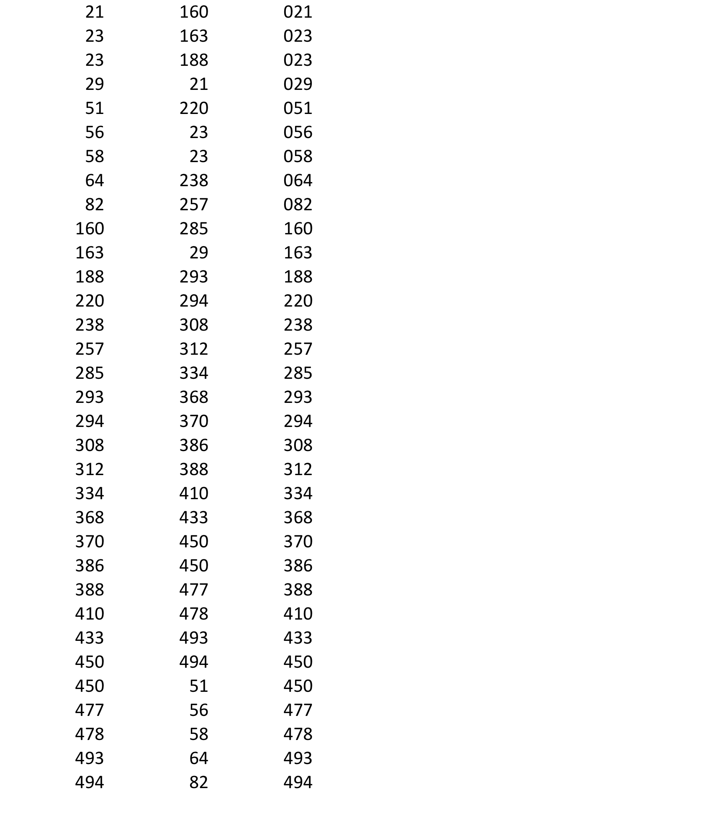
On using leading zeroes in file names…
Notes:
Left column: the numbers sorted as numeric values, as they would be in Excel.
Middle column: same numbers, sorted as text, as they would be in a file name.
Right column: same numbers, sorted as text with leading zeroes, as they would be in a file name.

Slide 29
File Versioning?
Turn on versioning or tracking in collaborative documents
Word documents, excel, etc
Learn by doing!
Turn on versioning for storage utilities
Wikis
GoogleDocs
Consider using version control software
Subversion (apache foundation), TortoiseSVN (commerical subversion), git (Linus Torvalds), bitbukkit and/or github (really both commercial versions of git)
Mostly designed for collaborative coding, but . . .
Check with your lab/colleagues as to their preference
Notes:
Note that my favorite is git (for now), but I have heard a lot about SVN,

Slide 30
Batch Naming
Photos
Instrument data
Moving files across languages (human)

Slide 31
Tools for File Management: bulk rename
Windows:
Ant Renamer (www.antp.be/software/renamer)
RenameIT (sourceforge.net/prpjects/renameit)
Bulk Rename Utility (www.bulkrenameutility.co.uk/)
Mac:
Renamer4Mac (renamer4mac.com/)
Name Changer (mrrsoftware.com/namechanger/)
Name Mangler (http://manytricks.com/namemangler/)
Linux:
GNOME Commander (www.nongnu.org/gcmd/)
GPRename (http://gprename.sourceforge.net/)
Unix: The use of the grep command to search for regular expressions
http://datalib.edina.ac.uk/mantra/organisingdata/

Slide 32
File-tagging: a *new* approach?
Think about your music library
Think about article keywords
Part of the semantic web conversation
mac:
Native on mac (colors)
pc
Native in Office (file->info)
Notes:
If you know of these, make sure to get

Slide 33
Lose a File? Use file tagging systems to better keep track
-> for tagging files as they are created and then the tags are indexed
-> good for not losing things in the first place.
MAC -> “Yep” (Ironic software)
-> http://www.ironicsoftware.com/yep/
PC% “tabbles”
-> http://tabbles.net/
-> Omero (microscropy) - http://www.openmicroscopy.org/site/products/omero

Slide 34
Wednesday
Frazer, Meghan (2013). An Elevator Pitch for File Naming Conventions. http://acrl.ala.org/techconnect/post/an-elevator-pitch-for-file-naming-conventions.
Alexandra Simperler, Greg Wilson (2015). Software Carpentry get more done in less time. http://arxiv.org/abs/1506.02575.
Extra Reading
JISC Digital Media. Choosing a File Name [Managing]. Jisc. http://www.jiscdigitalmedia.ac.uk/guide/choosing-a-file-name
MIT Libraries. Data management and publishing: Organize your files. Massachusetts Institute of Technology. http://libraries.mit.edu/data-management/store/organize

Slide 35
Wednesday
Assignment #2: The Unix Shell.
DO UP TO and INCLUDING “CREATING THINGS” UNDER TOPICS BEFORE COMING TO CLASS ON WEDNESDAY
http://swcarpentry.github.io/shell-novice/

Slide 36
Lose a File? Learn to use GREP an old Unix-based search tool
Built in on Mac and Linux
Windows users get it here:
http://gnuwin32.sourceforge.net/packages/grep.htm
(you may need to add the install path to your PATH variable)
Grep searches within the files and is better than _{built in search}
-> grep [<options>] <search_string> <file>
-> grep walden * returns all case sensitive occurrences in all files in current directory that contain walden
-> grep –r walden * returns all case sensitive occurrences in all files in current directory and sub-directories than contain walden
-> grep –rw walden * returns all case sensitive occurrences in all files in the current directory and sub-directories that contain the whole word walden
-> grep –irw walden * returns all occurrences (any case) in all files in the current directory and sub-directories that contain the whole word walden
-> grep –il walden * returns only file names that contain an occurrence of walden (any case) in all files in the current directory
-> grep –le “Walden Pond” * returns only file names that contain an occurrence of the exact phrase “Walden Pond” in all files in the current directory
globally search a regular expression and print
* is a “wild-card” character – in this case it means look at all files with any name
Notes:
globally search a regular expression and print

Slide 37
Built in on Mac/Linux and PC
Lose a File? Learn to use Dir (PC) or Find (Mac/Linux)
These tools search filenames and are better than _{built in search}
MAC% find <location> [<options>] <search_string>
-> find References –name *Coase*.* returns all files in the directory References (including sub-folders) with “Coase” somewhere in the name
PC% dir <location>\<search_string> [<options>]
-> dir References\*Coase*.* /S returns all files in the directory References (including sub-folders) with “Coase” somewhere in the name
Mac help% man find
PC help>dir /?
* is a “wild-card” character – in this case it means any character or characters can be here

Slide 38
Documentation
Write down everything . . . Or ELN

Slide 39


