Slide 1
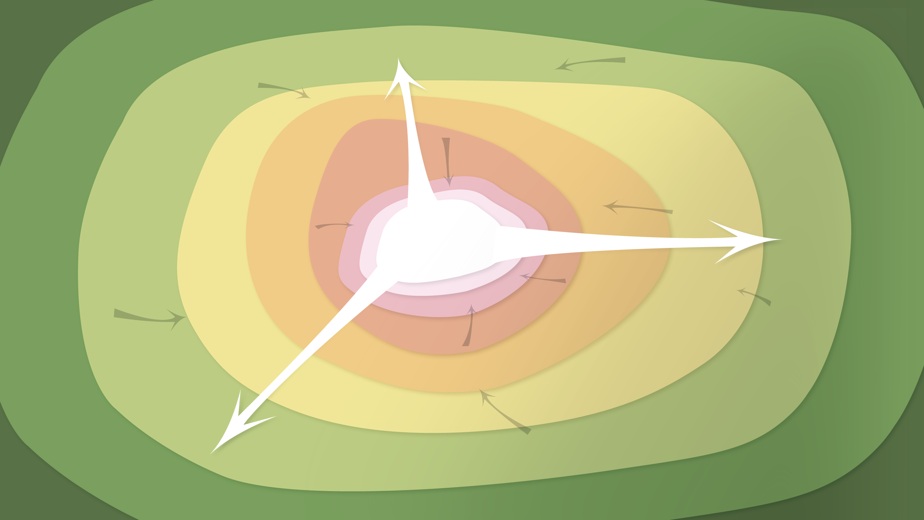
Data Management in the Research Environment
RSM 574/674 Spring 2016
Timothy Norris – tnorris@miami.edu
Angela Clark – aclark@rsmas.miami.edu

Slide 2
Todays Topics Security
When do you need security
Human Subjects and PII
Best Practices

Slide 3
Security: corruption and access
Theft of valuable data.
Breach of confidentiality agreements and privacy laws.
Premature release of data, which can void intellectual property claims.
Release before data have been checked for accuracy and authenticity.
You need to consider the following questions for securing your research data:
How will you manage access arrangements and data security?
How will you enforce permissions, restrictions and embargoes?
Other security issues such as sensitive data, off-network storage, storage on mobile devices (laptops, smartphones, flash drives, etc), policy on making copies of data, etc. where relevant.
http://datalib.edina.ac.uk/mantra/storageandsecurity/

Slide 4
Spinning (metal) disk: Laptop or Desktop
Pros
High level of control over file system, naming, and physical location of disk
Easy to backup
convenient
Cons
Risk of malware (virus)
Risk of theft, damage, loss, etc
System can eventually corrupt the disk (especially pcs)
Finite lifespan
SECURITY CONSIDERATIONS:
Virus control
Theft and damage
Disk failure

Slide 5
Spinning (metal) disk: Network Server
Pros
High level of control over file system, naming, and physical location of disk
Likely has backup and maintenance schedule
Possible duplicate (mirror) images – RAID systems
Safe physical location
Cons
Expensive to maintain
Migration can be difficult
Susceptible to catastrophic events
Redundant Array of Inexpensive Disks
SECURITY CONCERNS
Use SSL connections
Good control (physical location)
Encryption?

Slide 6
external storage: memory and drives
SECURITY CONCERNS:
Theft and damage
Good control (physical location), but you are responsible
Encryption?
Virus protection
Pros
Drives are cheap (sort of) and portable
Convenient
Memory is cheap and portable
Cons
Connection technologies change (USB, Firewire, SATA, and so on)
Drive failure (both spinning drives and memory devices)
Easily damaged, stolen or lost
Finite space for large projects multiple drives may be necessary
Malware can be propagated (think unsafe sex)
Does anyone use CDs anymore??? ZIP disks??? NOT recommended!!

Slide 7
Networked drives: personal cloud
Pros
Drives are cheap (sort of) and portable
Convenient access from anywhere
Easy to install and sync
Private: password protected
Cons
Upload/download bottlenecks
Susceptible to acts catastrophic events
Needs permanent power
Needs IP address
SECURITY CONCERNS
Use SSL connections
Theft or damage
Encryption?
Western Digital, Seagate . . .
Perhaps buy online, out of state?

Slide 8
Networked drives: the “Cloud”
Includes: Repositories, Online Versioning and Sharing
Pros
No failure or backup worries (they do it)
Can be secure (depends)
Convenient
Good for catastrophic events
Cons
Upload/download bottlenecks
Fees?
Long-term? No standards?
How to get copies of all your data (try this for google drive)
No control
SECURITY CONCERNS
Check the service agreement for encryption algorithm
Use SSL connections
No control

Slide 9
Security and Privacy
Data derived from human subjects research
Must meet federal compliance requirements for security and privacy
As examples: HIPAA, FERPA, FISMA
University of Miami Human Subjects Research Office
http://uresearch.miami.edu/regulatory-compliance-services/hsro
Personally Identifiable Information (PII)
Name, SSN, Date of Birth, Drivers License, Address, IP Address, Phone Number, anything that can uniquely identify a person
NIH Guide for Identifying Sensitive Information
http://datacenter.cit.nih.gov/interface/interface241/PIIguide.html
Notes:
If you know of these, make sure to get

Slide 10
UM Information Technology Secure Storage Options
Box is HIPAA Compliant
Qualtrics survey tool to build and manage secure online surveys.
http://www.miami.edu/it/index.php/services/survey_tools/

Slide 11
UM Office of Research
Velos: http://uresearch.miami.edu/research-resources/velos
Velos eResearch Clinical Trials Management Software is a tool for managing clinical trials data.
REDcap: http://uresearch.miami.edu/research-resources/redcap
Research Electronic Data Capture is an application that allows users to build and manage online surveys and databases quickly and securely.

Slide 12
Storage and Backup
If you need serious space at the University of Miami go to the Center for Computational Science (CCS)
They sell space using the condo model
~28 TB for $7,000 (2015) – in perpetuity
Not necessarily backed up (but it is raided)
Talk to Joel Zysman at CCS

Slide 13
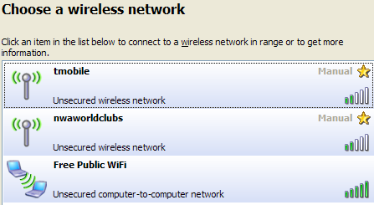
Not all data has security or privacy “needs”, BUT . .
Use automatic updates (mostly for virus issues)
Use anti-virus software (also anti-intrusion)
Use a firewall (also password protect file-sharing)
Never connect to untrusted wireless connections
Computer disposal?
Know HTTPS, SSH/SCP, sFTP
Understand certificate errors
Do not send confidential email
Public computers
Always log out
Never leave data/files
http://www.cnet.com/news/a-word-of-warning-about-free-public-wi-fi/

Slide 14
Password lock all devices (in case of theft or loss)
Set screen to lock
This is not foolproof, any hacker knows how to get past a password. See: http://pogostick.net/~pnh/ntpasswd/ for example.
Encryption
UM Policy: http://www.miami.edu/it/index.php/policies/
Mac: System Preferences: Security and Privacy: FileVault
PC: Control Panel: BitLocker Drive Encryption
Empty trash securely
Mac: Finder->Preferences: Advanced Tab, “Empty Trash Securely”
PC: Eraser (open source GPL): http://eraser.heidi.ie/
Notes:
If you know of these, make sure to get

Slide 15
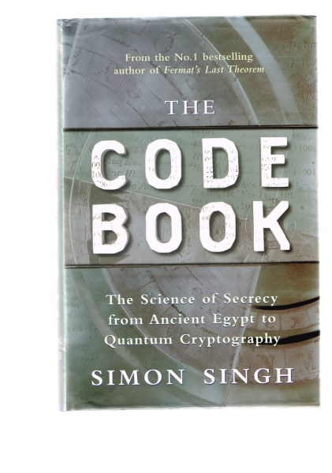
Encryption
$ openssl
$ openssl des3 -in test.txt -out encrypted.txt
$ openssl des3 -d -in encrypted.txt -out testout.txt
NOTE: encryption mistakes are irreversible
Singh, S. 1999. The Code Book: the science of secrecy from ancient Egypt to quantum cryptography. Fourth Estate, London.

Slide 16
Once again
This gets personal . . .
Access and passwords
Online Habits

Slide 17
Access Terms
User ID / Password
your UM account
Limited Network Access -or- local area network (LAN)
some research labs, many government offices, many business offices
usually limited to physical presence within the network
virtual private networks (VPN)
Role-Based Access Rights
your computer login (administrator, standard, sharing only, guest)

Slide 18
Password Management
Mistakes leading to weak passwords (Do not make these mistakes when choosing a password):
your username as a password (even backwards or mixed up).
using any name, or any word in any language.
obvious personal information (your year of birth, phone number, national insurance number, address, etc.).
all digits, or just one letter.
real words with only one or two obvious digit substitutions, like 'p4ssword' or '5ecret'.
fewer than eight characters ("brute force" attack cracks 7 letters in a few minutes).
any word you might find in a dictionary (including foreign language dictionaries).
characters from books, films, etc. (Gandalf, Sherlock), band names, song titles etc. (no matter how obscure).
passwords that are too easy or too difficult to type: an easy password can be guessed by anyone who sees you type it, and you will only be able to type a difficult password slowly - with the same result.

Slide 19
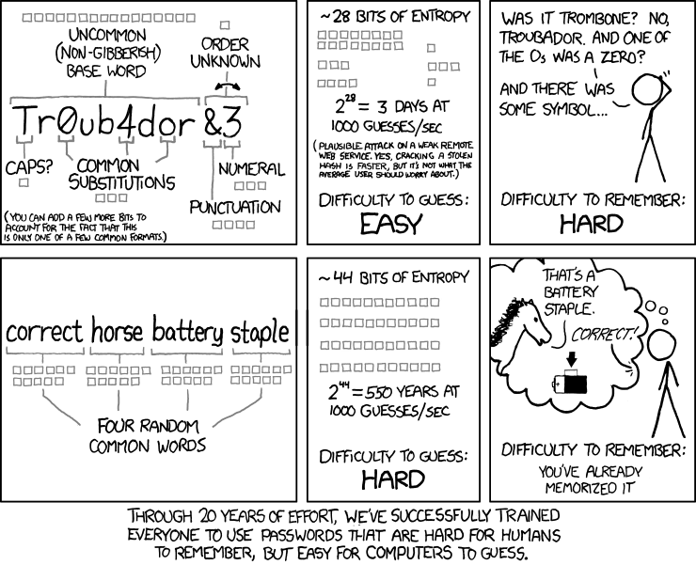
http://www.explainxkcd.com/wiki/index.php/936:_Password_Strength

Slide 20
Passwords should be long
http://www.explainxkcd.com/wiki/index.php/936:_Password_Strength

Slide 21
7 common cloud missteps
You lost control of your data because of the fine print in a user agreement.
Do a google search “<theNewCloudService> shady user agreement”
You sent out a public link to a Google Doc so others could view and edit.
Invite people through emails
Your cloud account gets hacked (bad password).
Better password management
You use the same password for every app on your phone.
See above
Web trackers are storing information on the sites you visit online.
Private browsing? Don’t stay logged in to google all the time?
You granted an application (smartphone) every permission under the sun.
Be thoughtful when you install and run new apps
A small mobile app startup you know nothing about has access to your banking data.
Let you bank manage your banking data
http://cloudtweaks.com/2015/11/7-common-cloud-security-missteps/

Slide 22
*** break ***

Slide 23
Course Overview
Why manage data / what is data management
Data lifecycle and data management plans
Data types, stages and formats
Data organization / tips, tools and techniques
Research data profiles
Contextual metadata
Software carpentry: git bash command line, tools, and basic scripting
Intellectual property and licensing
Sharing data, data repositories and data preservation

Slide 24
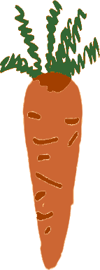
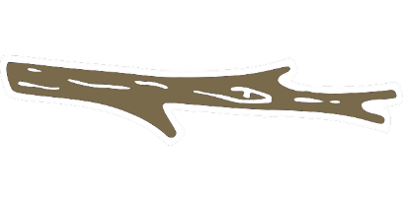
Why manage data?
Lots of data, what to do with it?
Many researcher benefits of data management
Greater exposure of research
Easier workflows, less frustration, more productivity
Many scientific/social benefits of data management
Sharing and re-use
New discoveries
Not managing data is NOT an option
Cost are to high (both personal and professional)
values?
Is there more?

Slide 25
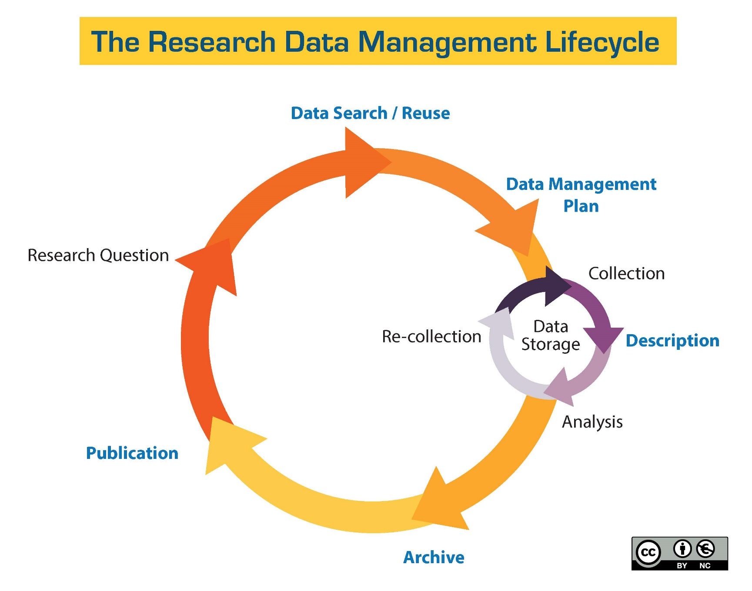
DMP
Information about Data and Data Formats
Metadata Content and Format
Policies for access sharing and re-use
Long-term storage and preservation
Budget
http://guides.library.ucsc.edu/datamanagement/
Notes:
Note that data and data formats includes workflows, version control, backup strategies, and security

Slide 26
Data
Types
quant/qual – structured/unstructured – captured/derived – indexical/attribute/metadata – primary/tertiary
Levels
unprocessed – processed/derived – analyzed - published
Formats
proprietary/open/mixed – lossy/lossless – text/images/other
Notes:
Under formats text includes numbers

Slide 27
Organization
File System Structure
time/space (project) – data levels/types/formats
File Naming Conventions
time/space (project) – human/machine

Slide 28
Storage and Security
Storage and Backup Sustainability
Migration – value/time – feasibility
Security
Corruption and access – privacy and IP value

Slide 29
Midterm Assignment
Listen to the data story
Write a critique of practices that you observe
Expectations
Introduce the research
critical issues and keywords are used and discussed in the critique
describe the components of the research data lifecycle you addressed
thoughtfully address strengths and weaknesses
make recommendations
minimum 1000 words : maximum 1500 words

Slide 30
Try to arrange for the interview
Try to arrange for the interview
Assignment
Due, Fri
March 4th

Slide 31
Backup Terminology
 | Incremental Backup | Differential Backup | Full Backup
What is it | A backup of all changed and new files since the last backup | A backup of all changed and new files since the last full backup | A backup of all files in a specified backup set or job
Backup Speed | Fastest | Faster | Slowest
Restore Speed | Slowest | Faster | Fastest
Storage Needed | Least | More | Most
http://typesofbackup.com/incremental-vs-differential-vs-full-backup/

