Slide 1
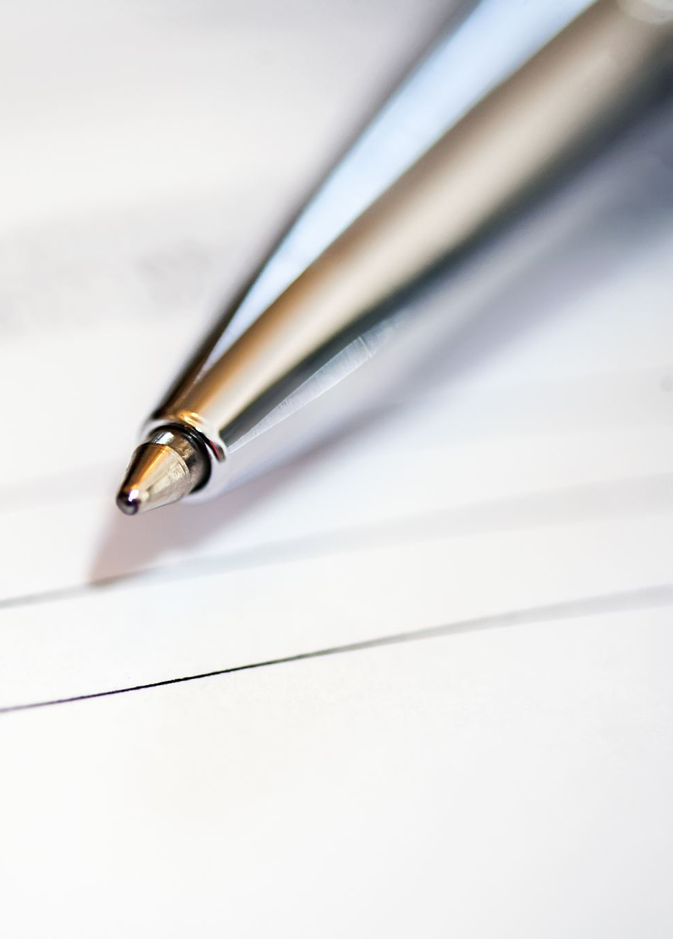
Project Overview: Document Q&A Agent
- Upload and read PDF documents
- Extract and chunk text using LangChain
- Create searchable index using FAISS
- Accept user queries
- Use Groq LLM to generate accurate answers

Slide 2
Workflow of the Document Q&A Agent
1. Upload PDF document
2. Extract text using PyMuPDF
3. Split text into chunks
4. Generate vector index with FAISS
5. Ask question via command line
6. Retrieve relevant chunks
7. Generate response using Groq API

Slide 3
Models & Technologies
- Text Extraction: PyMuPDF (fitz)
- Text Chunking: LangChain (RecursiveCharacterTextSplitter)
- Embedding Model: all-MiniLM-L6-v2 (HuggingFace)
- Vector Store: FAISS
- LLM: Groq API (LLaMA 3.1 8B Instant)
- Codebase: Python

Slide 4
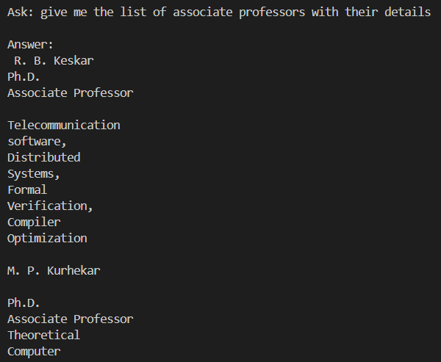
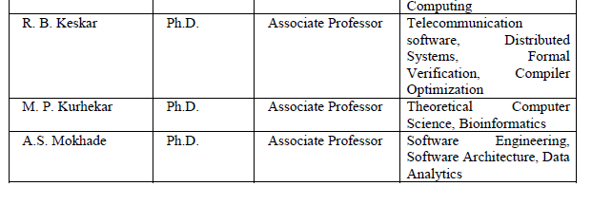

Slide 5
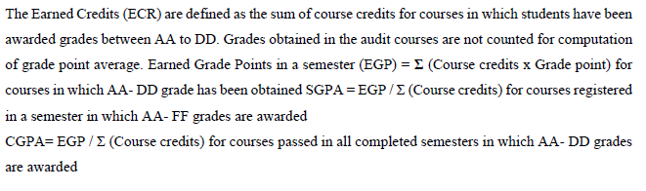

Slide 6
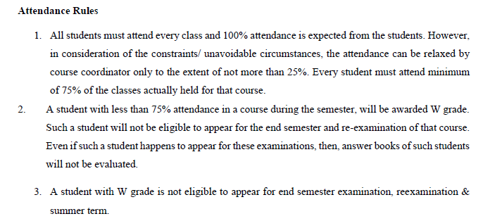

Slide 7
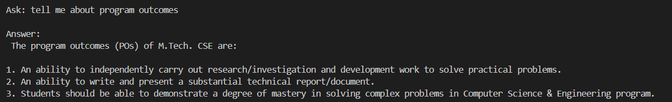
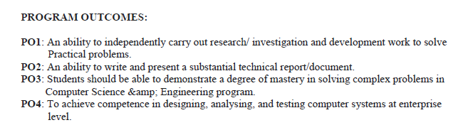

Slide 8
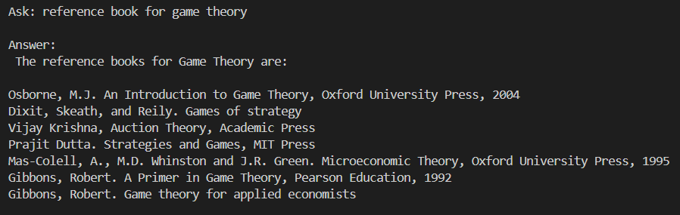
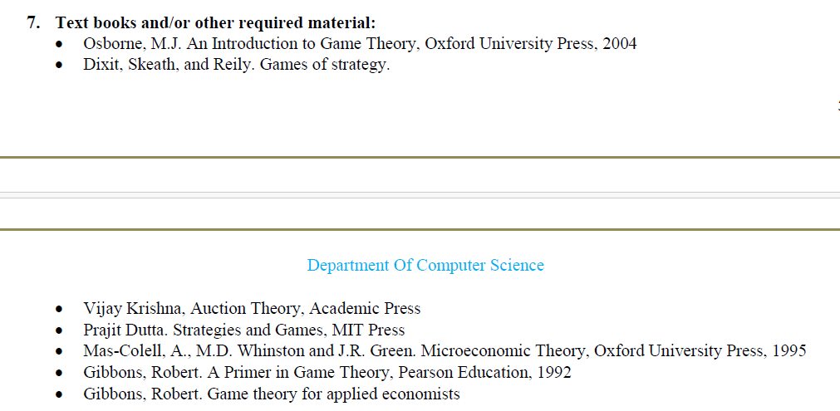

Slide 9
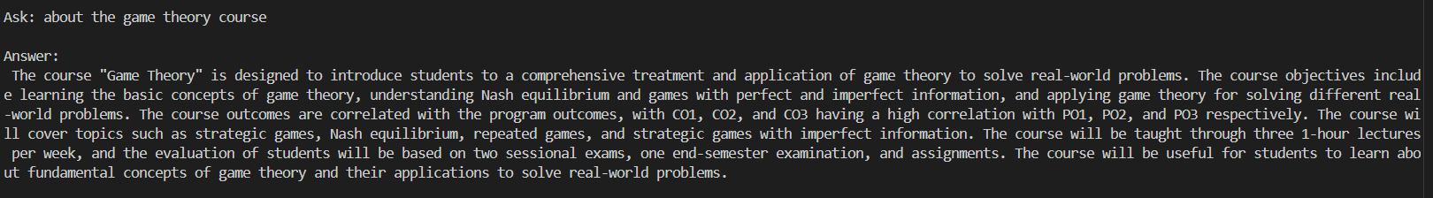
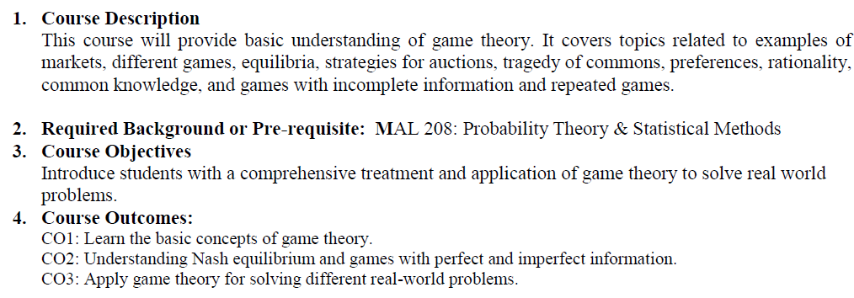

Slide 10
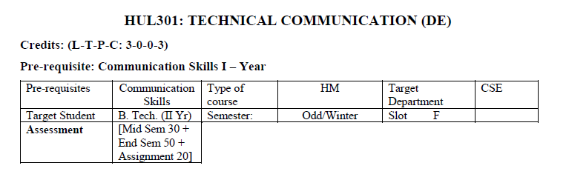
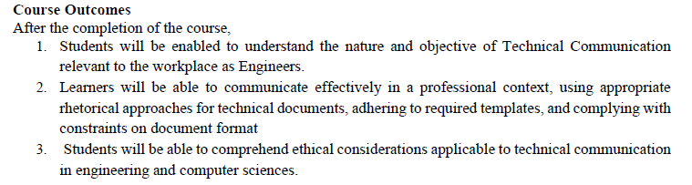
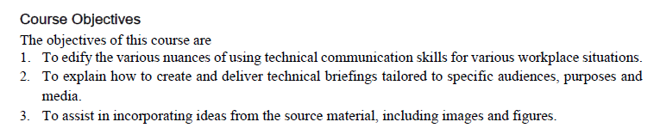

Slide 11
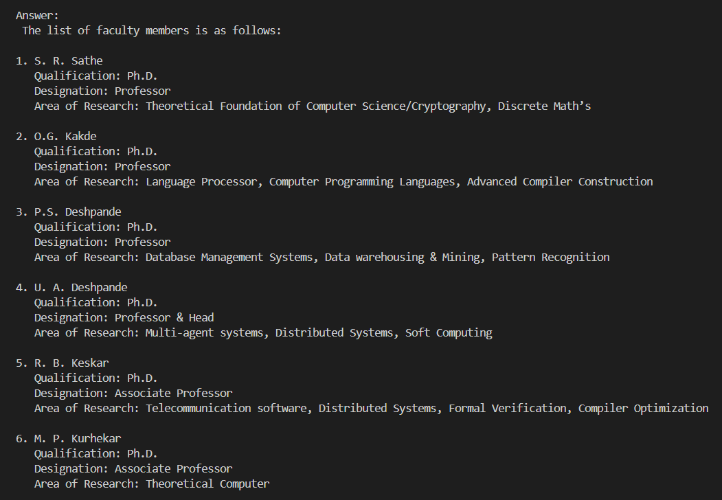
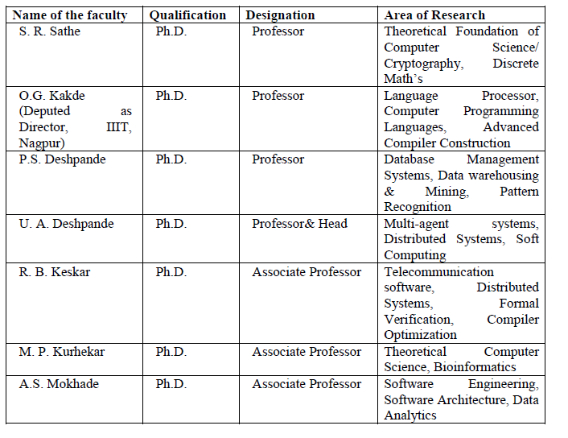

Slide 12
