Slide 1
Credit Card Fraud Detection Project Presentation
By Tibebu Sime
August , 2021
Seattle Metropolitan Area
Coding Dojo: Data Science & Machine Learning

Slide 2
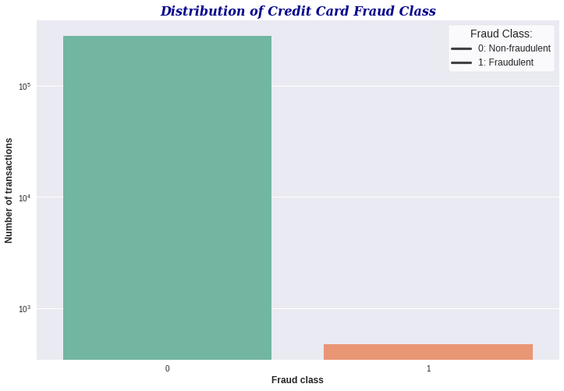
Introduction
The goal of this project is to build a model that classifies whether a transaction is fraudulent or not. The data analysis is based on a historical dataset which contains transactions made by credit cards in September 2013 by European cardholders.This dataset presents online transactions that occurred in 2 days, where there are 473 detected frauds out of a total of 283276 transactions. We can see that this dataset is severely imbalanced. So, we have to do something to deal with the class imbalance, otherwise our model will not be good.
More background information about this dataset:
Since the original features(except Time and Amount) were not provided due confidentiality issues, it is impossible to interpret them. A total of 28 features have been anonymized and transformed into numerical variables with PCA. No more data visualization.
Distribution of Credit Card Fraud Class

Slide 3
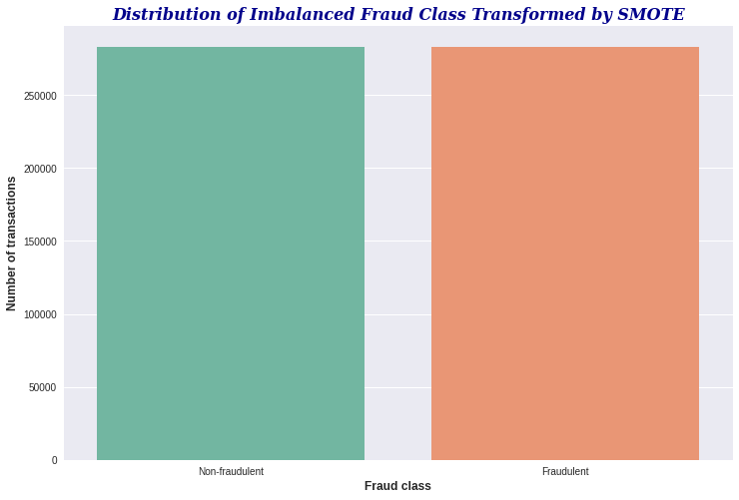
Resampling Techniques
There are a bunch of resampling techniques to deal with this type of highly imbalanced dataset, such as
Undersampling
Oversampling
SMOTE(Synthetic Minority Oversampling Technique) -- this is the technique I used to balance out the minority class with the majority class. Instead of introducing the exact copies of the minority class samples, this technique will generate more diverse synthetic samples.

Slide 4
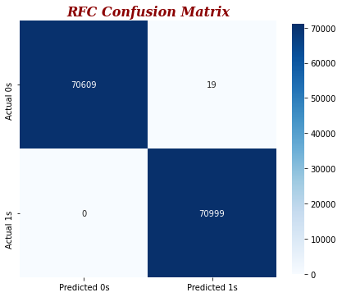
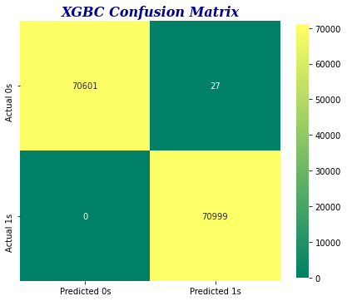
Model Evaluation
Although accuracy is not a recommended metric to evaluate the performance of a classification model for highly imbalanced dataset, I’ve managed to beat the model baseline accuracy(99.80%) with Random Forest and XGBoost models.
Random Forest training accuracy: 100%
Random Forest testing accuracy: ~99.99%
Logistic Regression training accuracy: ~95.86%
Logistic Regression testing accuracy: ~95.77%
Gradient Boosting training accuracy: ~98.87%
Gradient Boosting testing accuracy: ~98.83%
XGBoost training accuracy: ~100%
XGBoost testing accuracy: ~99.98
One more thing: I have zero false negatives with these two models. Meaning no single fraudulent transaction has been able to crack through our fraud detection system. The false positives are also very low( less than 30 transactions). That is, very few customers are annoyed with our overly aggressive fraud prevention service :)

Slide 5
...Continued from model evaluation
For Random Forest:
Sensitivity(True Positive Rate): 100%
Specificity(True Negative Rate): ~99.97%
Precision(Positive Predictive Value): ~99.97%
For eXtreme Gradient Boosting(XGBoost):
Sensitivity(True Positive Rate): 100%
Specificity(True Negative Rate): ~99.96%
Precision(Positive Predictive Value): ~99.96%

Slide 6
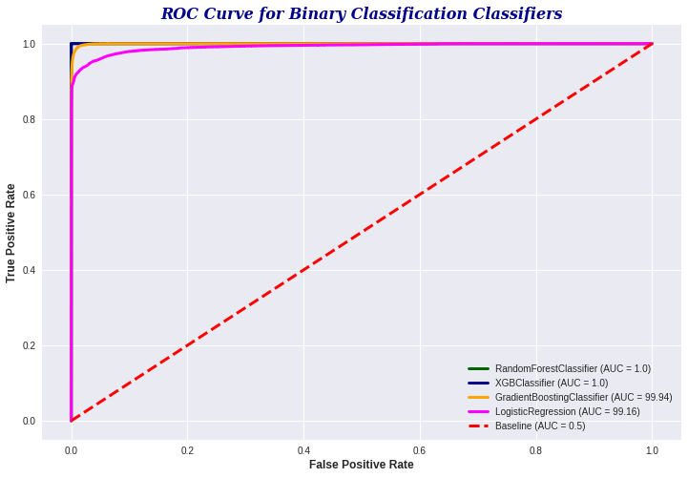
ROC Curve
The most commonly used metrics to evaluate a classification model for highly imbalanced dataset are:
Sensitivity
Specificity
Precision
AUC
→ A good binary classification model stays as far away from the model baseline as possible toward the top-left corner. AUC value less than 0.5 is very very bad!

Slide 7
Summary of the Results & Recommendations
There is a tradeoff between false negatives and false positives—flagging too many transactions as potentially fraudulent may generate too many false positives, meaning genuine users and transactions are being blocked incorrectly.
Recommendation: Adopt one more than fraud detection system to find an optimal balance between fraud prevention and seamless customer experience because it is unlikely that a single technology can result in absolutely zero false negatives and false positives.

Slide 8

The End…!
Thank You!

