Slide 1
Sales Prediction Project Presentation
By Tibebu Sime
July 18, 2021
Seattle Metropolitan Area
Coding Dojo: Data Science & Machine Learning

Slide 2
Introduction
The goal of this project is to develop a predictive model and forecast the sales of each product at a particular store. The analysis is based on the historical data which were collected by data scientists at Big Mart. I have used these three algorithms to conduct my analysis: Linear Regression, KNN Regressor and Random Forest Regressor.
We know that sales prediction is an essential task for the management of a store. Without proper sales prediction, business planning and decisions will be based on dubious estimates which can lead to many inefficiencies and missed opportunities. So, predictive models can help store managers answer the following questions:
How many more staff should be hired?
Do we have enough inventory to meet the weekly demands? If not, how much stock should be ordered to meet the growing demands?
How much revenue do we expect in this month or the following month?

Slide 3
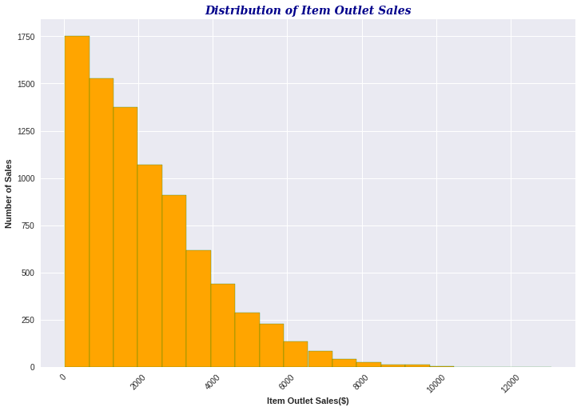
Data Visualization: Distribution of the Sales
From this graph we can see that the sales distribution deviates from the normal distribution. It is tailed to the right -- meaning most of the sales (lower sales) are concentrated on the left side. But No negative sales , so we’re good to go.

Slide 4
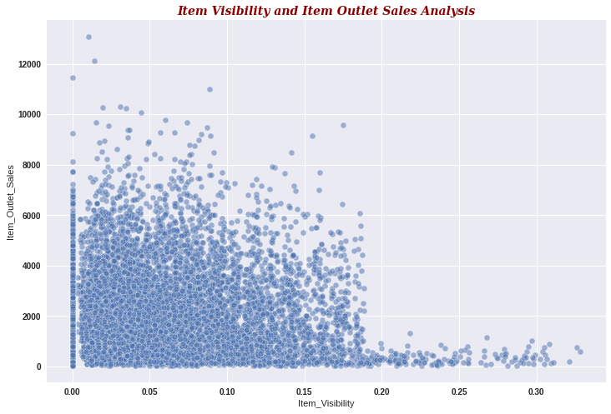
Data Visualization: Impact of Item Visibility on the Sales
The location of product in a store will impact the sales. The obvious assumption is that products with higher visibility are likely to sell more because products which are kept at the entrance of the store will catch the shoppers attention rather than the ones in the back. But from the correlation matrix generated earlier and now this plot, we can see that the more visible a product is the less higher its sales will be. This might be due to the fact that a great number of daily used products, which in fact do not need high visibility, control the top of the sales chart.
.

Slide 5
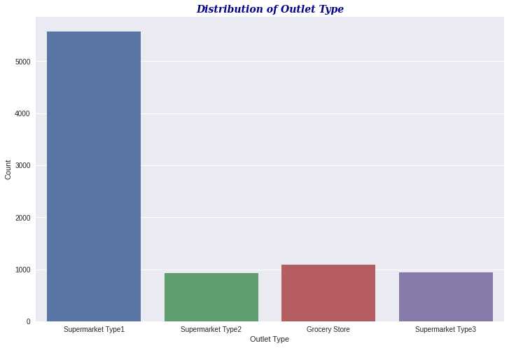
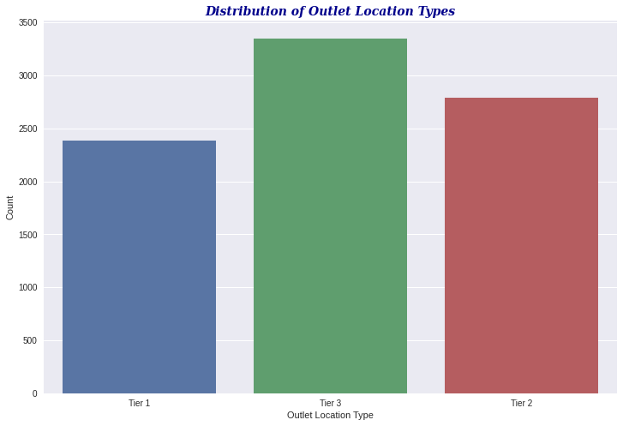
Distribution of Outlet Types and Outlet Location Types
Notes:
Supermarket Type1 has the highest distribution. More stores are located in densely populated cities.

Slide 6
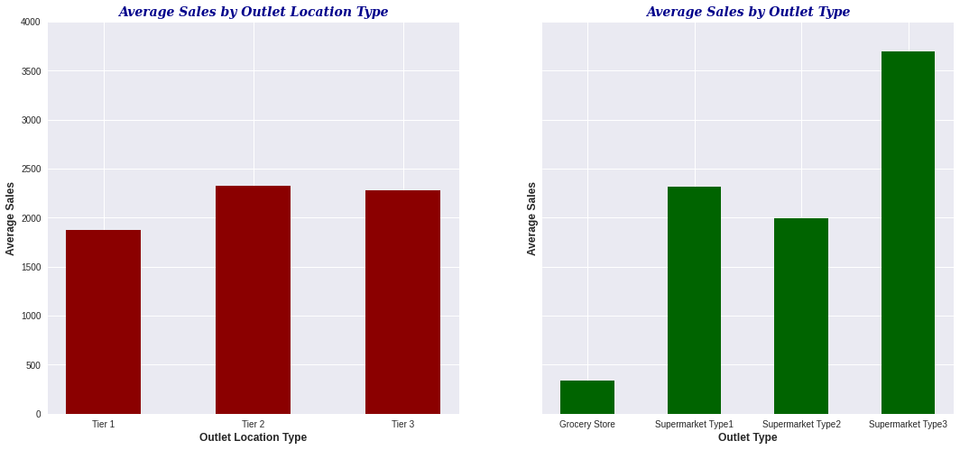
Data Visualization: Impact of store locations and outlet types on the sales
More items are being sold in stores which are located in less densely populated cities. This is actually in with the distribution of the stores.
Supermarket Type3 has the highest average sales even though its distribution is much less than Supermarket Type1. Grocery Store has the least sales.

Slide 7
Models Performance Evaluation: Performance score R2
LRG training R2: 0.5544536260526491
LRG testing R2: 0.5900393833521596
KNN training R2: 0.5870112626717922
KNN testing R2: 0.5890014065072519
RFG training R2: 0.6087463007379363
RFG testing R2: 0.6223139819671555
Interpretation of R2 score(Coefficient of Determination R2): is how well the regression model fits the observed data. Generally a higher R-squared indicates a better fit for the model.
What is the acceptable R2 value? The ideal value is 1 (100%).
0.3< R2 value<0.5: weak model
0.5< R2 value<0.7: moderate model
R2 value>0.7: strong model
Based on these performance scores:
Our models are not overfit since they all perform better on the testing data subset. In all of the cases, the R2 values are higher in the testing data subset than in the training data subset.
Random Forest Regressor is our best model because we have the highest R2 value. There is a lot of improvement in our performance score.

Slide 8
Models Performance Evaluation: Error Metrics
RMSE_lr_training: 1139.8109171305882
RMSE_lr_testing: 1090.253268820084
RMSE_knn_training: 1097.376004638942
RMSE_knn_testing: 1091.6325991731178
RMSE_rfg_training: 1068.109023283575
RMSE_rfg_testing: 1046.457951594882
What is the mean error? It is the average of all errors in the dataset, that is the average of the difference between true values and measured values. Its ideal value is 0! This is practically impossible because we may have a model that perfectly predicts our training data, but which is very unlikely to perfectly predict any other unseen data.
From these error metric results, we can confirm that our models are not overfit. The results are inline with the performance values we have seen in the previous slide.
Note: Overfit model has very low RMSE for training and higher RMSE for testing/validation/unseen data

Slide 9
Summary of the Results & Recommendations
All of the three models I have developed for the sales prediction project are considered to be moderate but there is a lot of improvement in the coefficient of determination R2 with the Random Forest Regressor model.
Contrary to the general hypothesis, products with less visibility in the store are likely to sell more. I encourage the store management to improve the visibility of the products which are in high demand so that they can easily be noticed by the shoppers. This is how they can further boost the sales.
Stores located in less densely populated cities have the highest sales. Of course the presence of stores in those areas is also high. It is also possible to boost the sales in highly populated cities where there could be high income residents by making their visuals appealing to customers, promoting your products on social media or TVs and providing consistently high-standard customer service.

Slide 10
The End!!

