Slide 1
Restaurant revenue prediction
Machine Learning Project
Tiberio Marras 0001006943

Slide 2
Task description
The aim of the project is to create a reliable mathematical model able to predict the revenue of 100.000 restaurants.
The model is trained using a dataset of 137 restaurant describing the location, the kind of city where the restaurant is located, the type of restaurant, the age of the restaurant and three categories of obfuscated data (commercial, real estate and demographic data).
The model to find is a regressor which, given the input features, outputs the revenue of the restaurant.
The metric used to compare the results is Root Mean Squared Error between the predicted revenues and the true revenues.

Slide 3
Background
The regression is an approach for modelling the relationship between a scalar response and one or more explanatory variables.
The relationships between the dependent and the indipendent variables are modeled using predictor functions whose unknown model parameters are estimated from the data.
In particular, solving regression problems is one of the most common tasks of machine learning, where the output is a continuous variable.

Slide 4
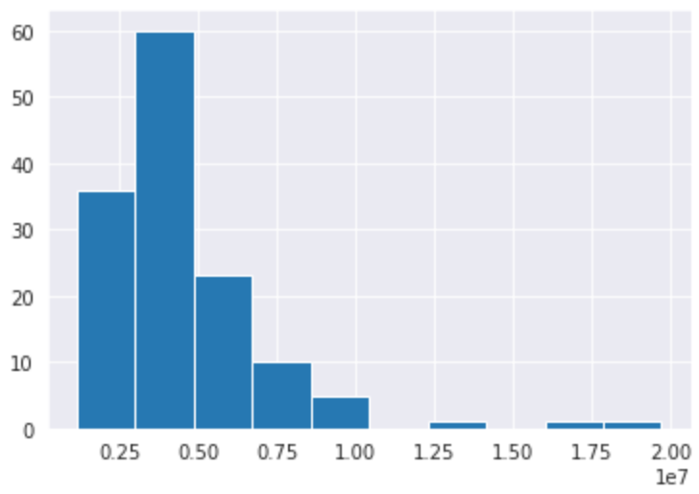
The dataset
In the project there are 2 datasets, a training set for the training and a test set for the predictions.
The training set is composed of 137 rows, one for each restaurant.
Each row has 42 attributes for the training and 1 target variable.
The attributes for each row are: ID, Open Date, City, City Group, Type and 37 attributes for obfuscated data (Commercial, Real estate and Demographic data).
The revenue target is not a real dollar value but a transformed one.
The revenue for each restaurant

Slide 5
Preprocessing
For the classic regressors and the neural network I performed two slightly different preprocessing.
For both cases I used SimpleImputer to fill the missing values with the median of the available data.
Then I transformed the numerical data, I used StandardScaler for the regressors and MinmaxScaler for the neural network.
For both cases I used OrdinalEncoder for the City group and OneHotEncoder for the Type of restaurant.
In both cases I used PCA to reduce the number of features (0.99 components for regressors and 0.95 for the neural network) reducing the number of features to 27 for the regressors and 13 for the neural network.

Slide 6
Methods
To find the best regression model I performed GridSearchCV over various regressors (included neural network) and I compared the results.
The regressors I tuned on are: Support Vector Regressor, AdaBoost Regressor, Kneightbors Regressor, SGD Regressor, Ridge and Lasso.
Once I tuned on the best parameters I compared the results of each best model for each regressor, then I compared the best regressor with the neural network.
For the neural network I tuned on Batch size, Epochs, Learning rate, Momentum and Dropout rate.

Slide 7
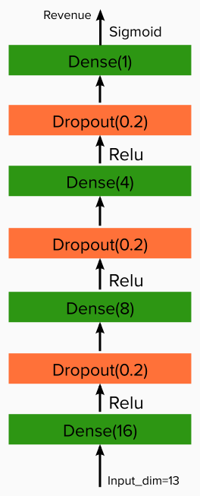
Methods (2)
The best architecture I found for the neural network is composed of 4 Dense layers, respectively with 16, 8, 4, and 1 nodes, and 3 dropout layers.
The activation function for the hidden layers is Relu and for the output layer is Sigmoid.
For the cross-validation of GridSearchCV I used 5 folds and I used Negative Root Mean Squared Error as scoring.

Slide 8
The environment
The environment I used is a Python 3 notebook with Colab.
I mounted the project on Google Drive in order to retrieve the training and the test set.
I created a sub-directory of the project where I placed the dataset and where I output the prediction on 100.000 restaurants.
The Colab environment has 2 Intel® Xeon® processors with 1 core each.
The processors have a frequency clock of 2200.218 MHz and a cache size of 56320 Kb.

Slide 9
Results
The best model resulted to be Kneightbors Regressor with a Negative Root Mean Squared Error of -5795686580515.1.
The best parameters for this regressors are Metric: ‘Manhattan’, n_neightbors: 15 and Weights: ’distance’.
The worst regressor is Lasso with a Negative Root Mean Squared Error of -3170407.2124743764

Slide 10
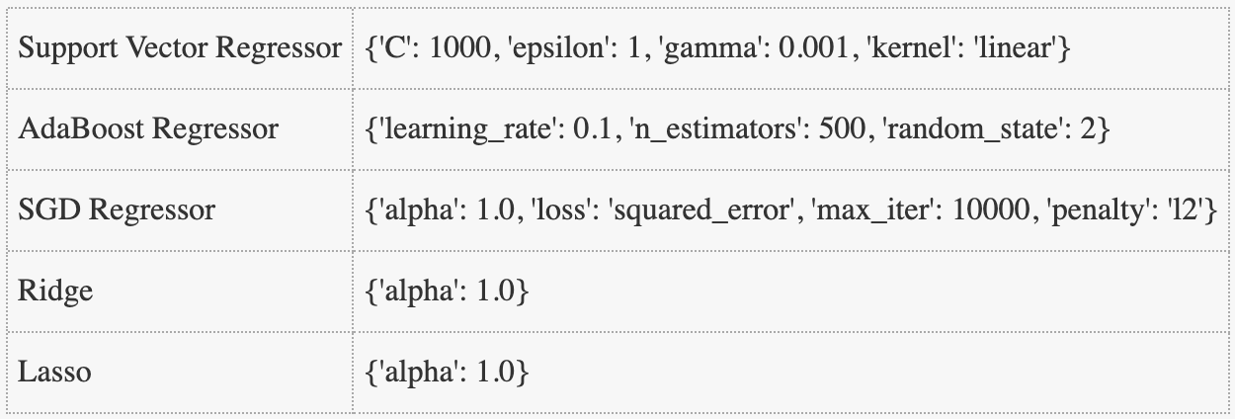
Results(2) – Best parameters

Slide 11
Conclusion
The classic regressors seem to perform quite good compared to the neural network, which has the 5th best result.
The training set is really small compared to the test set, and since neural networks are hungry of data this could really influence the results.
However this seems the best approach to tackle this kind of problem, also because the use of GridSearchCV makes the result score more reliable.
The worst models are Ridge and Lasso which, although they have the same alpha of SGD, they perform much worse.

