Slide 1
Bio-Inspired Hybrid Technique for Generating Food Menu Recommendations Using Cuckoo Search Optimization
Technical University of Cluj-Napoca
Computer Science Department
Student: Akos-Tiberiu Boros
Supervisor: Prof. Dr. Eng. Ioan SALOMIE
Lecturer Dr. Eng. Viorica CHIFU
Junior lecturer Dr. Eng. Cristina POP
July 2015

Slide 2
Agenda
Introduction
Objectives and Contributions
Related Work
Problem Definition
Cuckoo Search Technique
Experimental Prototype
Experimental Results
Conclusions

Slide 3
Introduction (I)
Context
In Europe over 15% of the elderly population is affected by malnutrition
Recent studies have shown that the ratio of retirees to workers in Europe will double to 0.54 by 2050
The growth of senior population will result a need of medical care services that the current medical care systems cannot withstand

Slide 4
Introduction (II)
Motivation
Prevent malnutrition amongst the senior population
Reduce heath care costs by using the proposed automated carer for nutrition
Improve the overall medical care experience

Slide 5
Agenda
Introduction
Objectives and Contributions
Related Work
Problem Definition
Cuckoo Search Technique
Experimental Prototype
Experimental Results
Conclusions

Slide 6
Objectives and Contributions
Development of a hybrid technique inspired from the breeding behavior of the cuckoo birds for generating personalized food menu recommendations.
Development of an ontology model to fit the medical and nutritional domain
Design of a database fit to the nutritional domain and population with authentic food ingredients together with their nutritional information
Development of hybrid cuckoo search based technique
Development of an experimental prototype
Testing and evaluating the classic version of the algorithm and the hybrid versions using the developed experimental prototype

Slide 7
Agenda
Introduction
Objectives and Contributions
Related Work
Problem Definition
Cuckoo Search Technique
Experimental Prototype
Experimental Results
Conclusions

Slide 8
Related Work
Approach | Description
Genetic algorithm based techniques [Gall 2005] | Generates food menu recommendations for preventing cardio-vascular conditions Takes the user’s profile and preferences into consideration
Clustering based technique [Usthasopha 2010] | Generates food menu recommendations for the main meals of a day. Takes the user’s profile and preferences into consideration
Method based on rough sets theory [Kashima 2011] | Generates personalized food menu recommendations. Takes the user’s preferences into consideration by use of questionaires

Slide 9
Agenda
Introduction
Objectives and Contributions
Related Work
Problem Definition
Cuckoo Search Technique
Experimental Prototype
Experimental Results
Conclusions

Slide 10
Problem Definition Overview
Given a repository of food packages (i.e. set of food items corresponding to breakfast, lunch, dinner or snack) provided by several food providers, find an optimal combination of food packages that represent the meals of the day taking into account:
User’s profile (age, weight, height, gender, physical activity level)
User’s preferences (likes and dislikes)
User’s allergies
Medical prescription
Nutrients (daily recommended nutrient values)
Micro-nutrients: vitamin A, B, C, D, iron, sodium, calcium
Macro-nutrients: carbohydrates, proteins, fats
Kilocalories
Cost and delivery time

Slide 11

Problem Definition Solution Representation (I)
Solution Representation
Solution
fP_{b}, fP_{s1}, fP_{l}, fP_{s2} and fP_{d} - food packages for breakfast, the first snack, lunch, the second snack and dinner
Food package
fI_{i} - food item (dish)
m – number of food items (dishes) contained in a food package

Slide 12
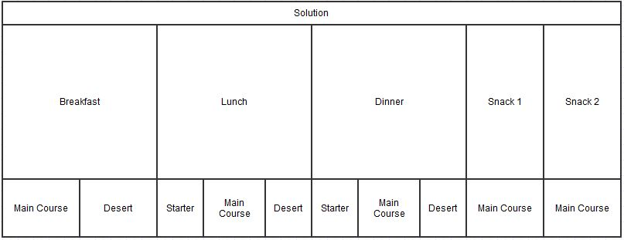
Problem Definition Solution Representation (II)
Figure 1. Solution representation diagram

Slide 13

Problem Definition Solution Evaluation (I)
Solution Evaluation Function
Evaluated by the Fitness Function
$Fitness function ∈\left[0, 1\right]$
Fitness function is maximized
Solution Evaluation Criteria
Nutrients
Kilocalories
Macro-nutrients: carbohydrates, proteins, fats,
Micro-nutrients: vitamin A, B, C, D, calcium, iron, sodium
Deviation of the quantities of the previously mentioned items from the desired ones;
Doctor's prescription;
Patient's preferences;
Cost and delivery time of food packages

Slide 14

Problem Definition Solution Evaluation (II)
Fitness Function
Where
fitness₁ evaluates the quality of a solution from the nutritionist’s recommended diet perspective,
fitness₂ evaluates the quality of a solution from the older adult’s culinary preferences, and
fitness₃ evaluates the quality of a solution from the older adult’s cost and delivery time constraints.
Fitness function level | Evaluation by
fitness1 | Deviation of kilocalories, macro and micro-nutrients from the desired values
fitness2 | Existence/absence of required/restricted or (un)desired food items
fitness3 | Cost and delivery time

Slide 15
Agenda
Introduction
Objectives and Contributions
Related Work
Problem Definition
Cuckoo Search Technique
Experimental Prototype
Experimental Results
Conclusions

Slide 16
Cuckoo Search Technique Overview
Objectives
Generate food menu recommendations
Adapt and hybridize the Cuckoo Search meta-heuristic [Yang 2010]
Combines principles from
Cuckoo Search
Genetic algorithms
Tabu Search, Hill Climbing and Uniform Crossover heuristics
Cuckoo Search Algorithm Principles
Each cuckoo lays one egg at a time, and dumps its egg in a randomly chosen nest;
The best nests with high quality of eggs will carry over to the next generation;
The number of available hosts nests is fixed, and the egg laid by a cuckoo is discovered by the host bird with a probability pa ∈ (0,1). Discovering operate on some set of worst nests, and discovered solutions dumped from farther calculations.

Slide 17
Cuckoo Search Technique Cuckoo Search Model
Core Component - Mapping
Biological Concepts | Concepts from our Optimization Problem
Egg from a nest | Food package (a day’s meal that can be breakfast, lunch, etc)
Cuckoo egg | Same
Nest | Solution containing all the 5 meals of a day. Each nest contains 5 eggs which correspond to the meals of a day: breakfast, lunch, etc
Best Nest | The solution with the highest fitness value
Cuckoo | Cuckoo generates new eggs that will replace the eggs from a nest
Breeding | Crossover strategies applied between a combination of food packages and the current optimal combination of food packages
Building a new nest | Hill Climbing, Tabu Search-based strategies for improving a combination of food packages

Slide 18
Cuckoo Search Technique Cuckoo Search Model
Hybridization Components
For the Cuckoo Generation Strategy
Random Levy Flights Solution Generation
Crossover between selected nest and best nest
Tabu Search heuristic applied on current nest
For the New Nest Generation Strategy
Random Levy Flights Solution Generation
Crossover between selected nest and best nest
Hill Climbing heuristic applied on current nest

Slide 19
Cuckoo Search Technique Cuckoo Search Algorithm
Input:
Cuckoo Search Optimization
nestNumber – represents the number of nests
maxIterations – represents the maximum number of iterations
PA – is the coefficient by which a host bird discovers the intrusion
Hill Climbing Heuristic
hillNeighSize – size of Hill Climbing neighborhood
Tabu Search Heuristic
maxIterations – max number of iterations
tabuSize – size of tabu search
tabuNeighSize – size Tabu Search neighborhood
Output
Solution – the output will be the best solution that has been reached

Slide 20
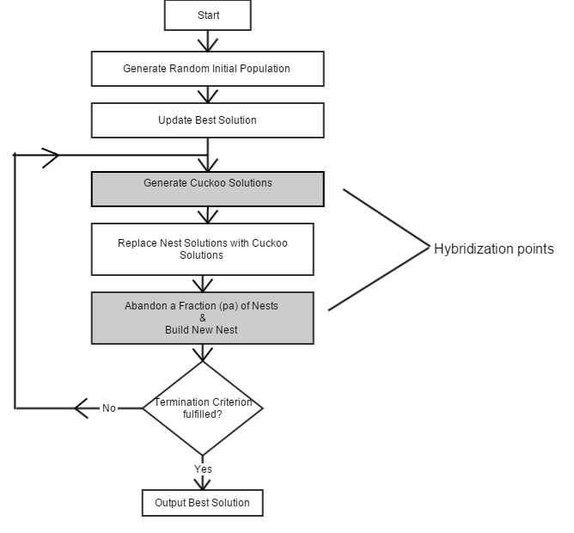
Cuckoo Search Technique Cuckoo Search Algorithm

Slide 21
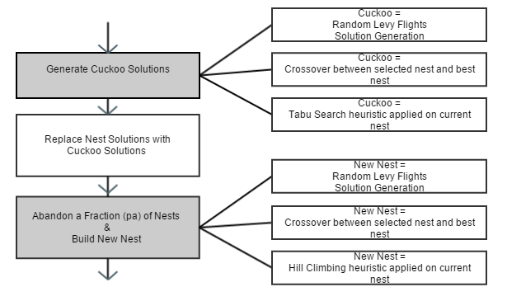
Cuckoo Search Technique Cuckoo Search Algorithm
Hybridization strategies

Slide 22
Proposed Solution Cuckoo Search Hybrid Versions
Cuckoo Generation Strategy | New Nest Generation Strategy | Acronym
Random Levy flight solution generation | Random Levy flight solution generation | RLRL, the classic version
Uniform Crossover between current nest and best solution | Uniform Crossover between current nest and best solution | UCUC
Uniform Crossover between current nest and best solution | Hill Climbing heuristic applied on old nest | UCHC
Tabu Search heuristic applied on current nest | Hill Climbing heuristic applied on old nest | TSHC

Slide 23
Agenda
Introduction
Objectives and Contributions
Related Work
Problem Definition
Cuckoo Search Technique
Experimental Prototype
Experimental Results
Conclusions

Slide 24
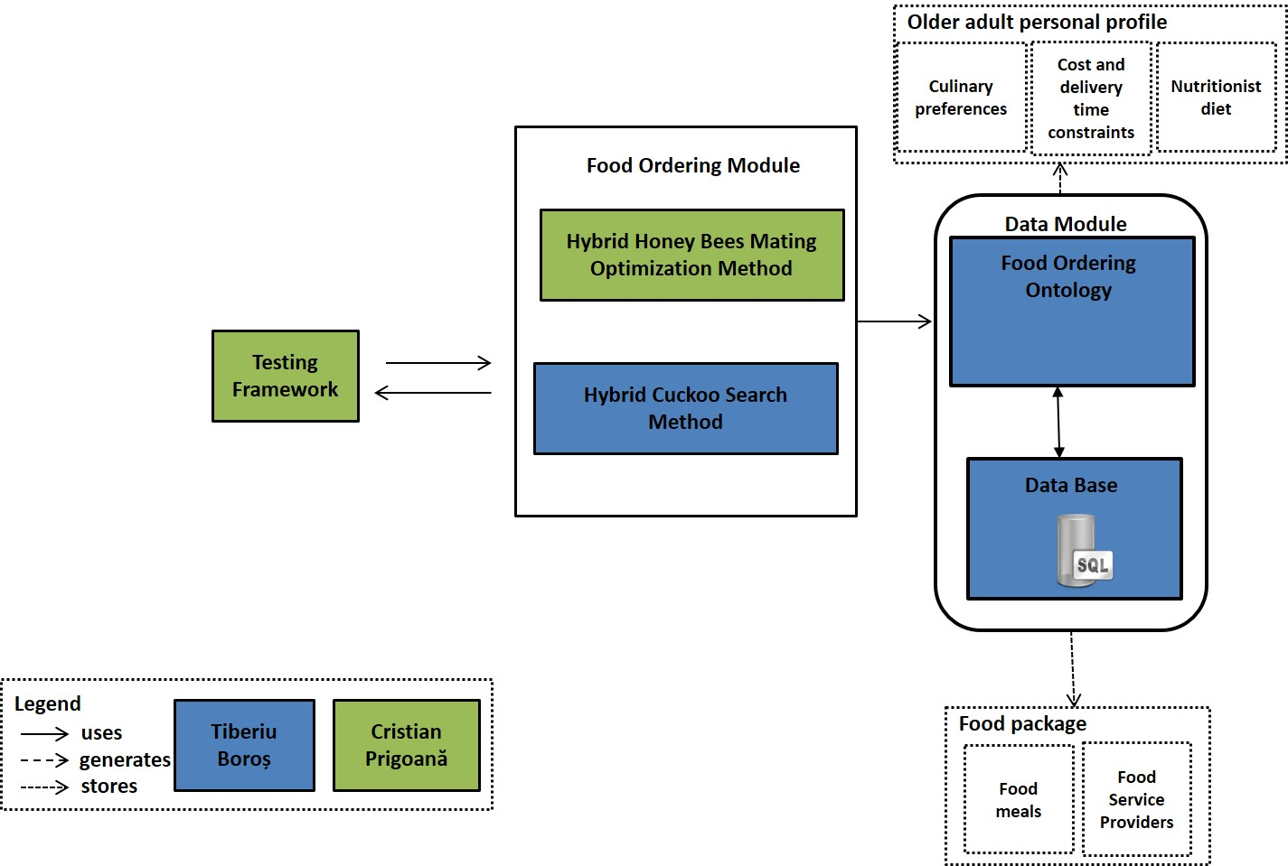
Experimental Prototype System Architecture

Slide 25
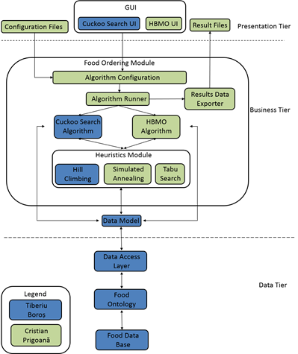
Experimental Prototype Detailed System Architecture

Slide 26
Experimental Prototype Ontology Classes
The ontology holds information about food providers, food packages, meal variants, dishes, recipes, ingredients, nutritional values and medical restrictions
The hierarchy of the ontologies is presented below:
• Nutrition care process ontology. This ontology is composed of four ontologies: nutrition assessment, nutrition diagnostic, nutrition intervention and nutrition monitoring
• Nutrition assessment ontology. This ontology holds information about food recipes, dishes, dish types and basic food ingredients.
• PIPS food ontology. This ontology contains a hierarchy of foods categorized by type (egg products, fruits, grain products, etc )
• Nutrition intervention ontology. This ontology contains data about the nutrition prescription, nutrition education and food ordering.
• Nutrition monitoring ontology. This ontology represents the care process ontology and contains information specific for an elder such as: anthropometric measurements, biochemical data, food intake, health profile, mediteranean diet adherence, p[ersonal data and physical activity
// Specifica doar ce ai folosit tu, nu ne intereseaza restul + core luat

Slide 27
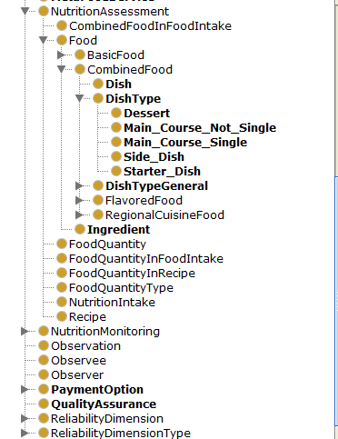
Experimental Prototype Ontology Classes

Slide 28
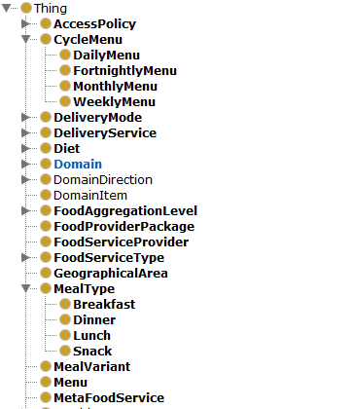
Experimental Prototype Ontology Classes

Slide 29
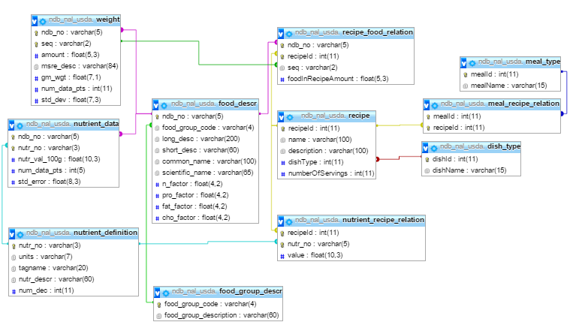
Experimental Prototype Database Design (I)

Slide 30
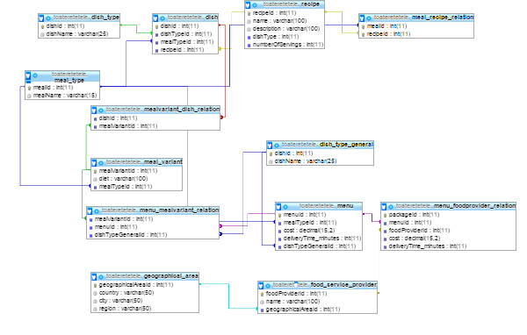
Experimental Prototype Database Design (II)

Slide 31
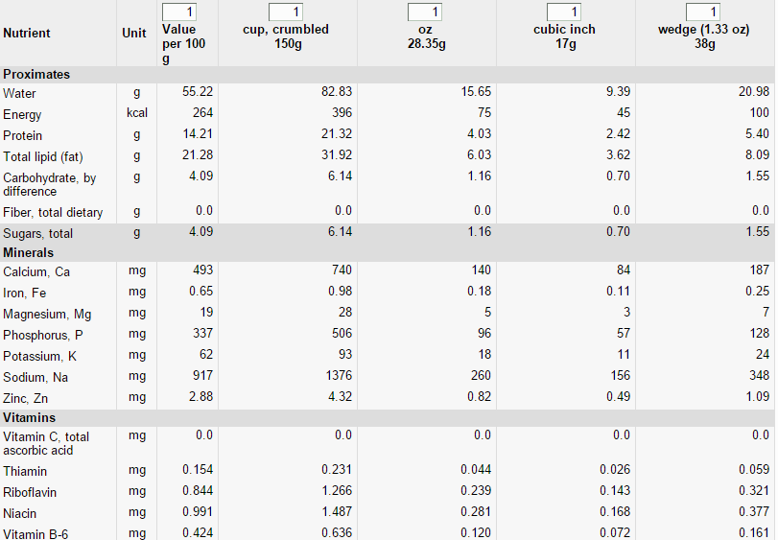
Experimental Prototype Database Source
Nutritional Information of Feta Cheese from USDA
[http://ndb.nal.usda.gov/ndb/search]

Slide 32
Agenda
Introduction
Objectives and Contributions
Related Work
Problem Definition
Cuckoo Search Technique
Experimental Prototype
Experimental Results
Conclusions

Slide 33
Experimental Results
The purpose of the experiments are to:
Validate results
Obtain Best setup of adjustable parameters – tuning the algorithm
Tests have used combinations of 3 adjustable parameters
For each combination of adjustable parameter 10 runs have been made
Search space:
394 breakfast meals
144.242 lunch meals
5041 dinner meals
137 snack meals
Thus all possible combinations are
394 * 144.242 * 5041 * 137 = 39.248.695.061.716

Slide 34
Experimental Results System Configuration
System Configuration
Processor: Intel® Core™ i7 2670QM/2630QM Processor
Memory: 8096MB DDR3
OS: Microsoft Windows 8 64bit

Slide 35
Experimental Results Test Scenario
Test Scenario
Personal Profile
Optimal Nutritional Values
User Parameter | Value
Age | 70 years
Gender | Male
Height | 78 kg
Weight | 172 cm
PAF | 1.5
Likes | Lettuce, apricot
Dislikes | Pepper
Preferred delivery time | 40 minutes
Preferred cost | 65 RON
Nutrient | Value | UM
Energy | 2287 | KCal
Carbohydrates | 314 | G
Proteins | 128 | G
Lipids | [114, 200] | G
Calcium | 1200 | Mg
Sodium | 1500 | Mg
Iron | 8 | Mg
Vitamin A | 900 | µg
Vitamin B | 1.3 | Mg
Vitamin C | 90 | Mg
Vitamin D | 20 | µg

Slide 36
Experimental Results Result Comparison
Comparative analysis based on the fitness value and duration
AlgVersion | Nest Size | Max Iterations | PA | Hill-Climb negih size | TabuSearchIters | Tabu Size | Tabu neigh size | Fitness Avg | Duration Avg
VersionRLRL | 25 | 100 | 0.3 | 10 | 10 | 5 | 10 | 0.756908 | 50.5
VersionUCUC | 25 | 100 | 0.3 | 10 | 10 | 5 | 10 | 0.823004 | 44.2
VersionUCHC | 25 | 100 | 0.3 | 10 | 10 | 5 | 10 | 0.854769 | 253.1
VersionTSHC | 25 | 100 | 0.3 | 10 | 10 | 5 | 10 | 0.855817 | 574.9
Comparative analysis based on the fitness value and duration with equilibrium tradeoff - ce inseamna echilibru?
AlgVersion | Nest Size | Max Iterations | PA | Hill-Climb negih size | TabuSearch Iterations | Tabu Size | Tabu neigh size | Fitness Avg | Duration Avg
VersionRLRL | 25 | 500 | 0.8 | 10 | 50 | 30 | 10 | 0.789369 | 201.5
VersionUCUC | 25 | 500 | 0.8 | 10 | 50 | 30 | 10 | 0.837552 | 189.3
VersionUCHC | 25 | 500 | 0.8 | 10 | 50 | 30 | 10 | 0.856327 | 433.6
VersionTSHC | 25 | 500 | 0.8 | 10 | 50 | 30 | 10 | 0.858957 | 1891.5

Slide 37
Experimental Results Test Scenario

Slide 38
Experimental Results Test Scenario

Slide 39
Agenda
Introduction
Objectives and Contributions
Related Work
Problem Definition
Cuckoo Search Technique
Experimental Prototype
Experimental Results
Conclusions

Slide 40
Conclusions and Future Development
A technique which adapts and hybridizes the Cuckoo Search meta-heuristic [ref] for generating food menu recommendations has been developed
An experimental prototype has been developed
Experimental results have been made on different user profiles
Care varianta hibrida este mai buna (concluzii din prisma rezultatelor obtinute)
Contributions
In collaboration with the Distributed Systems Research Laboratory collective, together with my collegue Cristian Prigoana have contributed to the elaboration of the article entitled “Hybrid Honey Bees Mating Optimization Method for Generating Healthy Menus for Older Adults” that has been submitted to the 11th (ICCP) International Conference on Intelligent Computer Communication and Processing

Slide 41
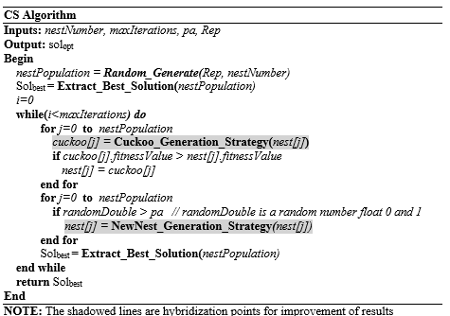
Cuckoo Search Technique Cuckoo Search Algorithm

Slide 42
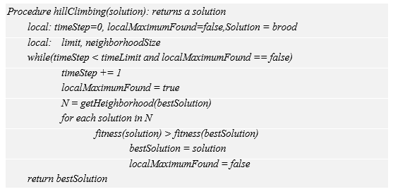
Cuckoo Search Technique Hill Climbing Heuristic for Solution Optimization

Slide 43
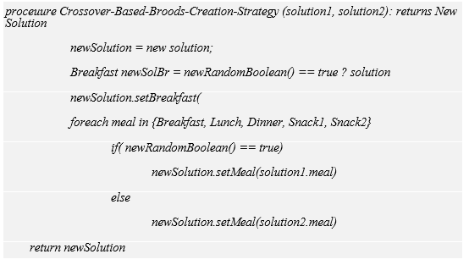
Cuckoo Search Technique Crossover based creation of new solution

Slide 44
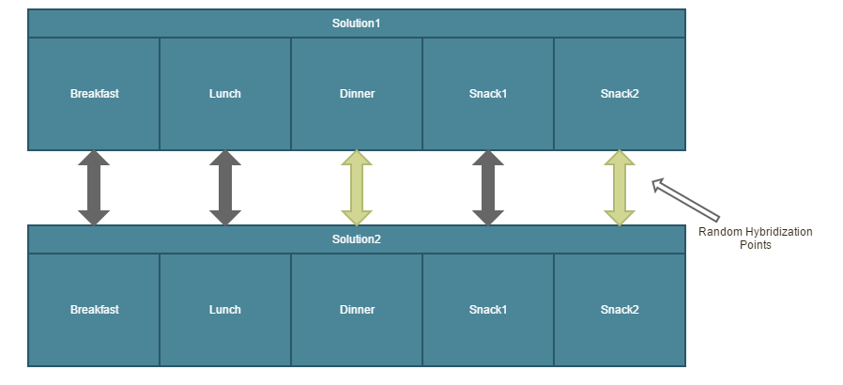
Cuckoo Search Technique Crossover based creation of new solution

