Slide 1
Bio-Inspired Hybrid Technique for Generating Food Menu Recommendations Using Cuckoo Search Optimization
Technical University of Cluj-Napoca
Computer Science Department
Student: Akos-Tiberiu Boros Supervisor: Prof. Dr. Ing. Ioan SALOMIE
S.l. Dr. Ing. Viorica CHIFU
Dr. Ing. Cristina POP
July 2015

Slide 2
Agenda
Introduction
Objectives and Contributions
Related Work
Problem Definition
Cuckoo Search Technique
Experimental Prototype
Experimental Results
Conclusions

Slide 3
Introduction
Context
In Europe over 15% of the elderly population is affected by malnutrition
Recent studies have shown that the ratio of retirees to workers in Europe will double to 0.54 by 2050
The growth of senior population will result a need of medical care services that the current medical care systems cannot withstand

Slide 4
Introduction
Motivation
Prevent malnutrition amongst the senior population
Reduce heath care costs by using the proposed automated carer for nutrition
Improve the overall medical care experience

Slide 5
Agenda
Introduction
Objectives and Contributions
Related Work
Problem Definition
Cuckoo Search Technique
Experimental Prototype
Experimental Results
Conclusions

Slide 6
Objectives and Contributions
Development of a hybrid technique inspired from the breeding behavior of the cuckoo birds for generating personalized food menu recommendations.
Development of an ontology model to fit the medical and nutritional domain
Design of a database fit to the nutritional domain and population with authentic food ingredients together with their nutritional information
Development of hybrid cuckoo search based techniques
Development of an experimental prototype
Testing and evaluating the classic version of the algorithm and the hybrid versions

Slide 7
Agenda
Introduction
Objectives and Contributions
Related Work
Problem Definition
Cuckoo Search Technique
Experimental Prototype
Experimental Results
Conclusions

Slide 8
Related Work
Approach | Description
Genetic algorithm based techniques [Gall 2005] | Generates food menu recommendations for preventing cardio-vascular conditions Takes the user’s profile and preferences into consideration
Clustering based technique [Usthasopha 2010] | Generates food menu recommendations for the main meals of a day. Takes the user’s profile and preferences into consideration
Method based on rough sets theory [Kashima 2011] | Generates personalized food menu recommendations. Takes the user’s preferences into consideration by use of questionaires

Slide 9
Agenda
Introduction
Objectives and Contributions
Related Work
Problem Definition
Cuckoo Search Technique
Experimental Prototype
Experimental Results
Conclusions

Slide 10
Problem Definition Overview
Given a repository of food packages (i.e. set of food items corresponding to breakfast, lunch, dinner or snack) provided by several food providers, find an optimal combination of food packages that represent the meals of the day taking into account:
User’s profile (age, weight, height, gender, physical activity level)
User’s preferences (likes and dislikes)
User’s allergies
Medical prescription
Nutrients (daily recommended nutrient values)
Micro-nutrients: vitamin A, B, C, D, iron, sodium, calcium
Macro-nutrients: carbohydrates, proteins, fats
Kilocalories
Cost and delivery time

Slide 11

Problem Definition Solution Representation
Solution Representation
In this case, a solution of the optimization problem is formally represented as follows:
where fP_{b}, fP_{s1}, fP_{l}, fP_{s2} and fP_{d} are the food packages selected for breakfast, the first snack, lunch, the second snack, and dinner respectively
A food package is formally represented as:
where fI_{i} is a food item (e.g. noodle soup) and m is the number of food items part of the food package, each food item being classified as either a starter, main course, or a dessert. Additionally, each food item has a recipe associated as well as a set of values corresponding to the nutrients that are being considered.

Slide 12
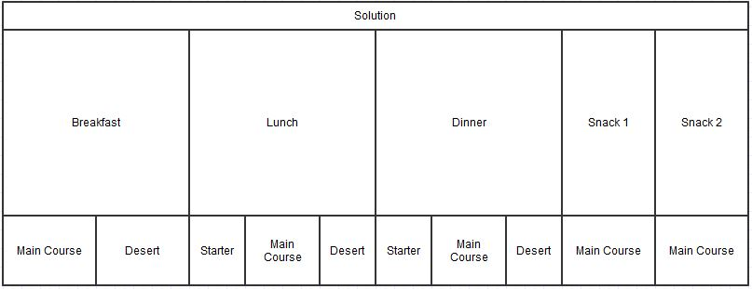
Problem Definition Solution Representation
Figure 1. Solution representation diagram

Slide 13
Problem Definition Solution Evaluation
Solution Evaluation
The solution is evaluated by the Fitness Function.
For the diet of a person, the fitness function models the quality of the menu, in terms of following factors:
Nutrients
Kilocalories
Macro-nutrients: carbohydrates, proteins, fats,
Micro-nutrients: vitamin A, B, C, D, calcium, iron, sodium
Deviation of the quantities of the previously mentioned items from the desired ones;
Doctor's prescription;
Patient's preferences;
Cost and delivery time of the food package.

Slide 14

Problem Definition Solution Evaluation
The fitness function returns a value from 0 to 1 and is maximized, i.e. the ideal or optimal value is 1, and 0 is the worst.
Where
fitness₁ evaluates the quality of a solution from the nutritionist’s recommended diet perspective,
fitness₂ evaluates the quality of a solution from the older adult’s culinary preferences, and
fitness₃ evaluates the quality of a solution from the older adult’s cost and delivery time constraints.
Fitness function level | Evaluation by
fitness1 | Deviation of kilocalories, macro and micro-nutrients from the desired values
fitness2 | Existence/absence of required/restricted or (un)desired food items
fitness3 | Cost and delivery time

Slide 15
Agenda
Introduction
Objectives and Contributions
Related Work
Problem Definition
Cuckoo Search Technique
Experimental Prototype
Experimental Results
Conclusions

Slide 16
Cuckoo Search Technique Overview

Slide 17
Cuckoo Search Technique Cuckoo Search Model
Core Component
The core component of the model is the Cuckoo Search Optimization-based component which is defined by mapping the concepts from the state of the art Cuckoo Search Optimization algorithm to the concepts associated to the problem of generating the optimal combination of food packages for the meals of the day as follows.

Slide 18
Cuckoo Search Technique Cuckoo Search Model
Biological Concepts | Concepts from our Optimization Problem
Egg from a nest | Food package (a day’s meal that can be breakfast, lunch, etc)
Egg from a cuckoo | Same
Nest | Solution containing all the 5 meals of a day. Each nest contains exactly 5 eggs which correspond to the meals of a day: breakfast, lunch, dinner, snack1 and snack2
Best Nest | The solution with the highest fitness value
Cuckoo | Cuckoo generates new eggs that will replace the eggs from a nest
Breeding | Crossover strategies applied between a combination of food packages and the current optimal combination of food packages
Building a new nest | Hill Climbing, Tabu Search-based strategies for improving a combination of food packages

Slide 19
Cuckoo Search Technique Cuckoo Search Model
Hybridization Components
The hybridization components that will be injected in the model’s core component are classified in two categories according to the point in which they can be injected.
Cuckoo Generation Strategy
Random Levy Flights Solution Generation
Crossover between selected nest and best nest
Tabu Search heuristic applied on current nest
New Nest Generation Strategy
Random Levy Flights Solution Generation
Crossover between selected nest and best nest
Hill Climbing heuristic applied on current nest

Slide 20
Cuckoo Search Technique Cuckoo Search Algorithm
Input:
nestNumber – represents the number of nests
maxIterations – represents the maximum number of iterations
PA – is the coefficient by which a host bird discovers the intrusion
Output
Solution – the output will be the best solution that has been reached

Slide 21
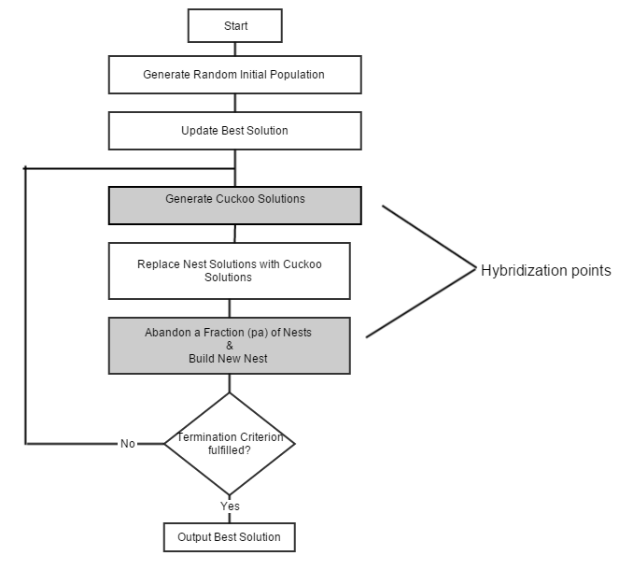
Cuckoo Search Technique Cuckoo Search Algorithm

Slide 22
Proposed Solution Cuckoo Search Hybrid Versions
Cuckoo Generation Strategy | New Nest Generation Strategy | Acronym
Random Levy flight solution generation | Random Levy flight solution generation | VersionRLRL
Uniform Crossover between current nest and best solution | Uniform Crossover between current nest and best solution | VersionUCUC
Uniform Crossover between current nest and best solution | Hill Climbing heuristic applied on old nest | VersionUCHC
Tabu Search heuristic applied on current nest | Hill Climbing heuristic applied on old nest | VersionTSHC

Slide 23
Agenda
Introduction
Objectives and Contributions
Related Work
Problem Definition
Cuckoo Search Technique
Experimental Prototype
Experimental Results
Conclusions

Slide 24
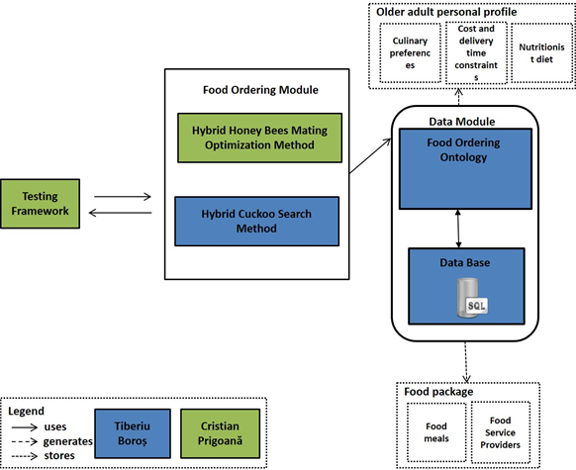
Experimental Prototype

Slide 25
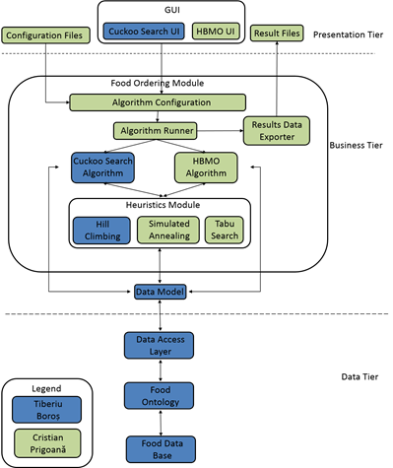
Experimental Prototype

Slide 26
Experimental Prototype Ontology Classes
The ontology holds information about food providers, food packages, meal variants, dishes, recipes, ingredients, nutritional values and medical restrictions
The hierarchy of the ontologies is presented below:
• Nutrition care process ontology. This ontology is composed of four ontologies: nutrition assessment, nutrition diagnostic, nutrition intervention and nutrition monitoring
• Nutrition assessment ontology. This ontology holds information about food recipes, dishes, dish types and basic food ingredients.
• PIPS food ontology. This ontology contains a hierarchy of foods categorized by type (egg products, fruits, grain products, etc )
• Nutrition intervention ontology. This ontology contains data about the nutrition prescription, nutrition education and food ordering.
• Nutrition monitoring ontology. This ontology represents the care process ontology and contains information specific for an elder such as: anthropometric measurements, biochemical data, food intake, health profile, mediteranean diet adherence, p[ersonal data and physical activity

Slide 27
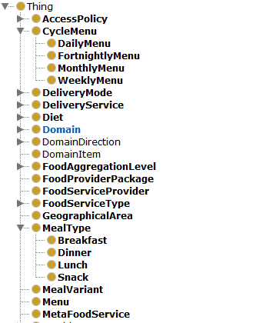
Experimental Prototype Ontology Classes

Slide 28
Experimental Prototype Ontology Classes

Slide 29
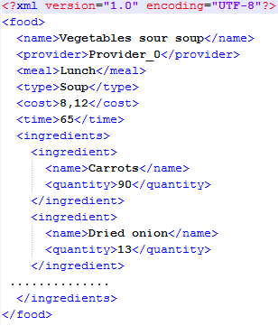
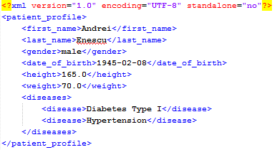
Prototip experimental (III)
Exemplu de oferta alimentara
Exemplu de profil personal

Slide 30
Agenda
Introduction
Objectives and Contributions
Related Work
Problem Definition
Cuckoo Search Technique
Experimental Prototype
Experimental Results
Conclusions

Slide 31
Rezultate experimentale (I)
Experimentele au fost efectuate pe diverse tipologii de utilizatori, avand urmatoarele afectiuni
Hipertensiune arteriala
Hipertensiune arteriala si diabet de tip I
Testele au folosit 20 de combinatii ale parametrilor ajustabili
Pentru fiecare combinatie de parametri ajustabili au fost efectuate 20 de rulari
Dimensiunea spatiului de cautare este de 684 * 10¹⁷ combinatii de oferte alimentare.

Slide 32
Rezultate experimentale (II)
Configuratia calculatorului:
Model procesor: Pentium(R) Dual-Core CPU;
Frencventa procesorului: 2.10 GHz ;
Arhitectura: 64 biți;
Memorie RAM: 3,00 GB.

Slide 33
Rezultate experimentale (III)
Scenariu de test
Profil personal |  |  | Valori optime nutritionale
Nume | Pop |  | Calorii | 1800kcal
Prenume | Ioan |  | Proteine | 123g
Vârstă | 64ani |  | Lipide | 50g
Greutate | 66kg |  | Carbohidrați | 202,4g
Înălțime | 160cm |  | Fier | 8-45mg
Sex | Masculin |  | Sodiu | 500-1500mg
Nivel de activitate | Activitate moderată |  | Vitamina A | 1,2-7,5mg
Afectiuni | Hipertensiune |  | Vitamina B1 | 1,6-5mg
Ingredient preferat | Fructele de pădure |  | Vitamina C | 75-1000mg
Ingredient nedorit | Brânza

Slide 34
Rezultate experimentale (IV)
Analiza comparativa bazata pe valoarea functiei de fitness
Analiza comparativa bazata pe un compromis intre timpul de procesare si valoarea functiei de fitness
algoritm | noIt | noNests | noCuck | trMut | repNest | noCstIt | diffIt | it_{tabu} | fit_{avg} | t_{avg}(s)
CS | 25 | 30 | 20 | 0,8 | 0,4 | 6 | 0,01 | - | 0,588 | 6,65
CSU | 25 | 25 | 20 | 0,8 | 0,4 | 6 | 0,01 | - | 0,679 | 25,6
CSURG | 25 | 30 | 20 | 0,6 | 0,4 | 6 | 0,01 | - | 0,685 | 24
CSUCGM | 25 | 30 | 20 | 0,6 | 0,4 | 6 | 0,01 | 2 | 0,751 | 16,8
algoritm | noIt | noNests | noCuck | trMut | repNest | noCstIt | diffIt | it_{tabu} | fit_{avg} | t_{avg}(s)
CS | 20 | 30 | 15 | 0,6 | 0,4 | 6 | 0,01 | - | 0,584 | 3,75
CSU | 20 | 25 | 20 | 0,8 | 0,4 | 6 | 0,01 | - | 0,673 | 22,1
CSURG | 20 | 25 | 15 | 0,6 | 0,4 | 10 | 0,001 | - | 0,669 | 20,1
CSUCGM | 25 | 25 | 20 | 0,6 | 0,4 | 6 | 0,01 | 2 | 0,731 | 12,3

Slide 35
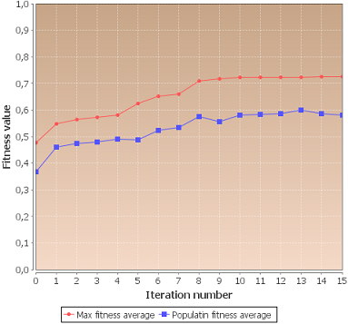
Rezultate experimentale (V)
Evaluarea pentru cea mai buna configuratie a parametrilor pentru algoritmul CSCGM, folosind metrica fitness graph.

Slide 36
Agenda
Introduction
Objectives and Contributions
Related Work
Problem Definition
Cuckoo Search Technique
Experimental Prototype
Experimental Results
Conclusions

Slide 37
Concluzii si dezvoltari ulterioare
S-a dezvoltat o tehnica hibrida inspirate din comportamentul de reproducere al cucilor pentru generarea de recomandări de meniuri alimentare personalizate
A fost dezvoltat un prototip experimental
Au fost efectuate experimente pentru diverse tipologii de utilizatori
Contributii
In colaborare cu colectivul Laboratorului de Cercetare pentru Sisteme Distribuite, am contribuit la elaborarea articolului „Hybrid Invasive Weed Optimization Method for Generating Healthy Meals” care a fost acceptat la conferinţa the 6th IEEE International Workshop on Soft Computing Applications, Timișoara, Romania și va fi publicat în Springer, ISI proceedings.

