Slide 1
Bio-Inspired Hybrid Technique for Generating Food Menu Recommendations Using Cuckoo Search Optimization
Technical University of Cluj-Napoca
Computer Science Department
Student: Akos-Tiberiu Boros Supervisor: Prof. Dr. Ing. Ioan SALOMIE
S.l. Dr. Ing. Viorica CHIFU
Dr. Ing. Cristina POP
July 2015

Slide 2
Agenda
Introduction
Objectives and Contributions
Related Work
Proposed Solution
Experimental Prototype
Experimental Results
Conclusions

Slide 3
Introduction
Context
In Europe over 15% of the elderly population is affected by malnutrition
Recent studies have shown that the ratio of retirees to workers in Europe will double to 0.54 by 2050
The growth of senior population will result a need of medical care services that the current medical care systems cannot withstand

Slide 4
Introduction
Motivation
Prevent malnutrition amongst the senior population
Reduce heath care costs by using the proposed automated carer for nutrition
Improve the overall medical care experience

Slide 5
Objectives and Contributions
Development of a hybrid technique inspired from the breeding behavior of the cuckoo birds for generating personalized food menu recommendations.
Development of an ontology model to fit the medical and nutritional domain
Design of a database fit to the nutritional domain and population with authentic food ingredients together with their nutritional information
Development of the hybrid cuckoo search model
Development of the hybrid cuckoo search algorithm
Development of an experimental prototype
Testarea si evaluarea algoritmului clasic precum si a versiunilor hibride;
Testing and evaluating the classic version of the algorithm and the hybrid versions
Analysis of the experimental results

Slide 6
Related Work
Approach | Description
Genetic algorithm based techniques [Gall 2005] | Generates food menu recommendations for preventing cardio-vascular conditions Takes the user’s profile and preferences into consideration
Clustering based technique [Usthasopha 2010] | Generates food menu recommendations for the main meals of a day. Takes the user’s profile and preferences into consideration
Method based on rough sets theory [Kashima 2011] | Generates personalized food menu recommendations. Takes the user’s preferences into consideration by use of questionaires

Slide 7
Proposed Solution Problem Definition
Problem Definition
“Given a repository of food packages (i.e. set of food items corresponding to breakfast, lunch, dinner or snack) provided by several food providers, find the optimal combination of food packages for each of the meals of a day such that they meet an older adult’s profile (containing information about its preferred food and allergies), price and delivery time constraints, and recommended diet”.

Slide 8

Proposed Solution Solution Representation
In this case, a solution of the optimization problem is formally represented as follows:
where fP_{b}, fP_{s1}, fP_{l}, fP_{s2} and fP_{d} are the food packages selected for breakfast, the first snack, lunch, the second snack, and dinner respectively
A food package is formally represented as:
where fI_{i} is a food item (e.g. noodle soup) and m is the number of food items part of the food package, each food item being classified as either a starter, main course, or a dessert. Additionally, each food item has a recipe associated as well as a set of values corresponding to the nutrients that are being considered.

Slide 9
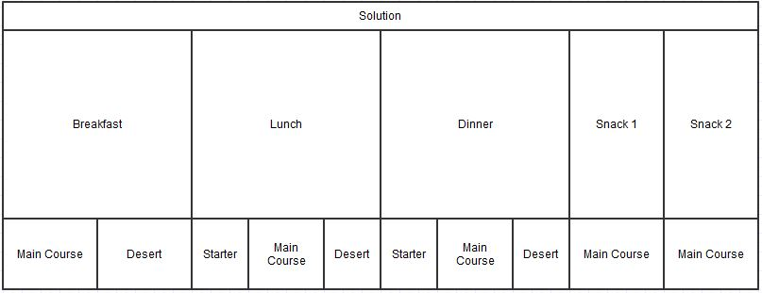
Proposed Solution Solution Representation
Figure 1. Solution representation diagram

Slide 10
Proposed Solution Core Component
The core component of the model is the Cuckoo Search Optimization-based component which is defined by mapping the concepts from the state of the art Cuckoo Search Optimization algorithm to the concepts associated to the problem of generating the optimal combination of food packages for the meals of the day as follows.
Biological Concepts | Concepts from our Optimization Problem
Egg from a nest | Food package (a day’s meal – breakfast, lunch etc)
Egg from a cuckoo | Same
Nest | Solution containing all the 5 meals of a day. Each nest contains exactly 5 eggs which correspond to the meals of a day: breakfast, lunch, dinner, snack1 and snack2
Best Nest | The solution with the highest fitness value

Slide 11
Proposed Solution Core Component
Biological Concepts | Concepts from our Optimization Problem
Cuckoo | Cuckoo generates new eggs that will replace the eggs from a nest
Breeding | Crossover strategies applied between a combination of food packages and the current optimal combination of food packages
Building a new nest | Hill Climbing, Tabu Search-based strategies for improving a combination of food packages

Slide 12
Proposed Solution Hybridization Component
The hybridization components that will be injected in the model’s core component are classified in two categories according to the point in which they can be injected.
Cuckoo Generation Strategy
Random Levy Flights Solution Generation
Crossover between selected nest and best nest
Tabu Search heuristic applied on current nest
New Nest Generation Strategy
Random Levy Flights Solution Generation
Crossover between selected nest and best nest
Hill Climbing heuristic applied on current nest

Slide 13
Proposed Solution Input/Output
Input:
nestNumber – represents the number of nests
maxIterations – represents the maximum number of iterations
PA – is the coefficient by which a host bird discovers the intrusion
Output
Solution – the output will be the best solution that has been reached

Slide 14
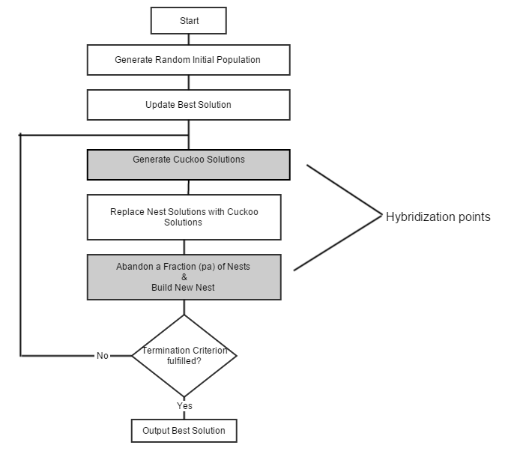
Proposed Solution Cuckoo Search Flow Diagram

Slide 15
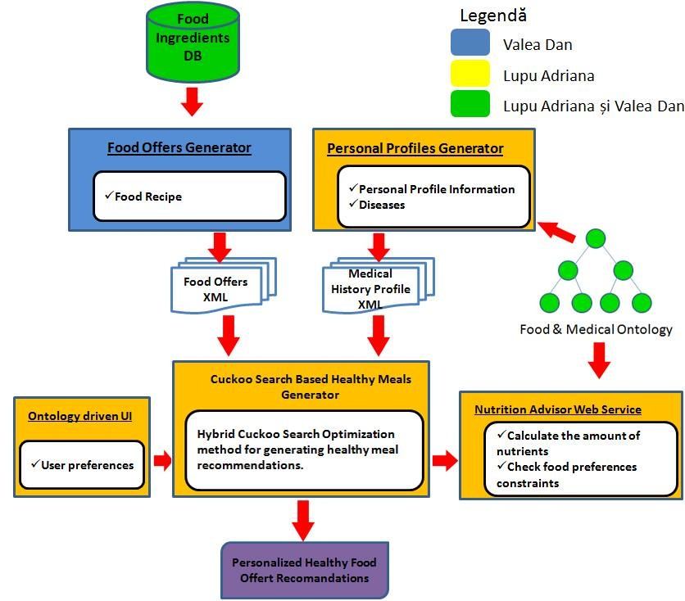
Prototip experimental (I)

Slide 16
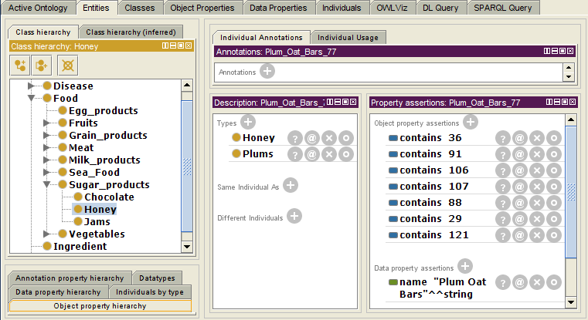
Prototip experimental (II)
Ontologie de domeniu care conține informații despre feluri de mâncare, ingrediente, valori nutriționale și restricții medicale specifice diferitelor boli.

Slide 17
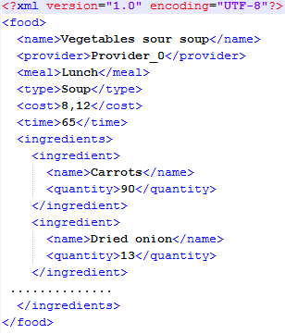
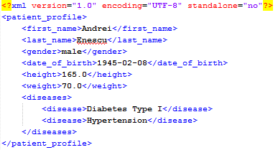
Prototip experimental (III)
Exemplu de oferta alimentara
Exemplu de profil personal

Slide 18
Rezultate experimentale (I)
Experimentele au fost efectuate pe diverse tipologii de utilizatori, avand urmatoarele afectiuni
Hipertensiune arteriala
Hipertensiune arteriala si diabet de tip I
Testele au folosit 20 de combinatii ale parametrilor ajustabili
Pentru fiecare combinatie de parametri ajustabili au fost efectuate 20 de rulari
Dimensiunea spatiului de cautare este de 684 * 10¹⁷ combinatii de oferte alimentare.

Slide 19
Rezultate experimentale (II)
Configuratia calculatorului:
Model procesor: Pentium(R) Dual-Core CPU;
Frencventa procesorului: 2.10 GHz ;
Arhitectura: 64 biți;
Memorie RAM: 3,00 GB.

Slide 20
Rezultate experimentale (III)
Scenariu de test
Profil personal |  |  | Valori optime nutritionale
Nume | Pop |  | Calorii | 1800kcal
Prenume | Ioan |  | Proteine | 123g
Vârstă | 64ani |  | Lipide | 50g
Greutate | 66kg |  | Carbohidrați | 202,4g
Înălțime | 160cm |  | Fier | 8-45mg
Sex | Masculin |  | Sodiu | 500-1500mg
Nivel de activitate | Activitate moderată |  | Vitamina A | 1,2-7,5mg
Afectiuni | Hipertensiune |  | Vitamina B1 | 1,6-5mg
Ingredient preferat | Fructele de pădure |  | Vitamina C | 75-1000mg
Ingredient nedorit | Brânza

Slide 21
Rezultate experimentale (IV)
Analiza comparativa bazata pe valoarea functiei de fitness
Analiza comparativa bazata pe un compromis intre timpul de procesare si valoarea functiei de fitness
algoritm | noIt | noNests | noCuck | trMut | repNest | noCstIt | diffIt | it_{tabu} | fit_{avg} | t_{avg}(s)
CS | 25 | 30 | 20 | 0,8 | 0,4 | 6 | 0,01 | - | 0,588 | 6,65
CSU | 25 | 25 | 20 | 0,8 | 0,4 | 6 | 0,01 | - | 0,679 | 25,6
CSURG | 25 | 30 | 20 | 0,6 | 0,4 | 6 | 0,01 | - | 0,685 | 24
CSUCGM | 25 | 30 | 20 | 0,6 | 0,4 | 6 | 0,01 | 2 | 0,751 | 16,8
algoritm | noIt | noNests | noCuck | trMut | repNest | noCstIt | diffIt | it_{tabu} | fit_{avg} | t_{avg}(s)
CS | 20 | 30 | 15 | 0,6 | 0,4 | 6 | 0,01 | - | 0,584 | 3,75
CSU | 20 | 25 | 20 | 0,8 | 0,4 | 6 | 0,01 | - | 0,673 | 22,1
CSURG | 20 | 25 | 15 | 0,6 | 0,4 | 10 | 0,001 | - | 0,669 | 20,1
CSUCGM | 25 | 25 | 20 | 0,6 | 0,4 | 6 | 0,01 | 2 | 0,731 | 12,3

Slide 22
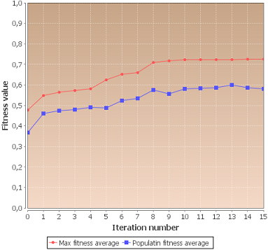
Rezultate experimentale (V)
Evaluarea pentru cea mai buna configuratie a parametrilor pentru algoritmul CSCGM, folosind metrica fitness graph.

Slide 23
Concluzii si dezvoltari ulterioare
S-a dezvoltat o tehnica hibrida inspirate din comportamentul de reproducere al cucilor pentru generarea de recomandări de meniuri alimentare personalizate
A fost dezvoltat un prototip experimental
Au fost efectuate experimente pentru diverse tipologii de utilizatori
Contributii
In colaborare cu colectivul Laboratorului de Cercetare pentru Sisteme Distribuite, am contribuit la elaborarea articolului „Hybrid Invasive Weed Optimization Method for Generating Healthy Meals” care a fost acceptat la conferinţa the 6th IEEE International Workshop on Soft Computing Applications, Timișoara, Romania și va fi publicat în Springer, ISI proceedings.

