Slide 1
Movie Recommendation System
Tiberiu Simion Voicu

Slide 2
Aims
Research into Deep Neural Networks
Research into recommendation systems
Build scalable web application

Slide 3
Recommendation system
Collaborative filtering
Content based
Model based recommendation

Slide 4
System Architecture
Notes:
Microservices architecture designed to be scalable.
Each service exposes a json api, this allows api consumer to remain agnostic to inner service implementation changes as long as the api contract is stable.
Each service can be deployed, modified and scaled by itself.
Allows use of different frameworks and even languages in this cases the rec engine is written in python using flask and keras for serving recommendations while the others are written in node js suing express

Slide 5
Gateway Service
Manage sessions
Authentication
Json web token

Slide 6
Movie Service
Searching
Paginated Results
Interface with engine service

Slide 7
User Service
Manage user data
Manage ratings
Interface with movie and engine service

Slide 8
Engine Service
Training model
Retraining model
Serves recommendations
Interfaces with movie and user service

Slide 9
System flow
Client
Establish session
Gateway
1
Send JWT
Client
JWT
Movie
2
Retrieve Movies
Client
JWT
User
3
Rate movie
Client
recommend
Engine
user ratings
User
4

Slide 10
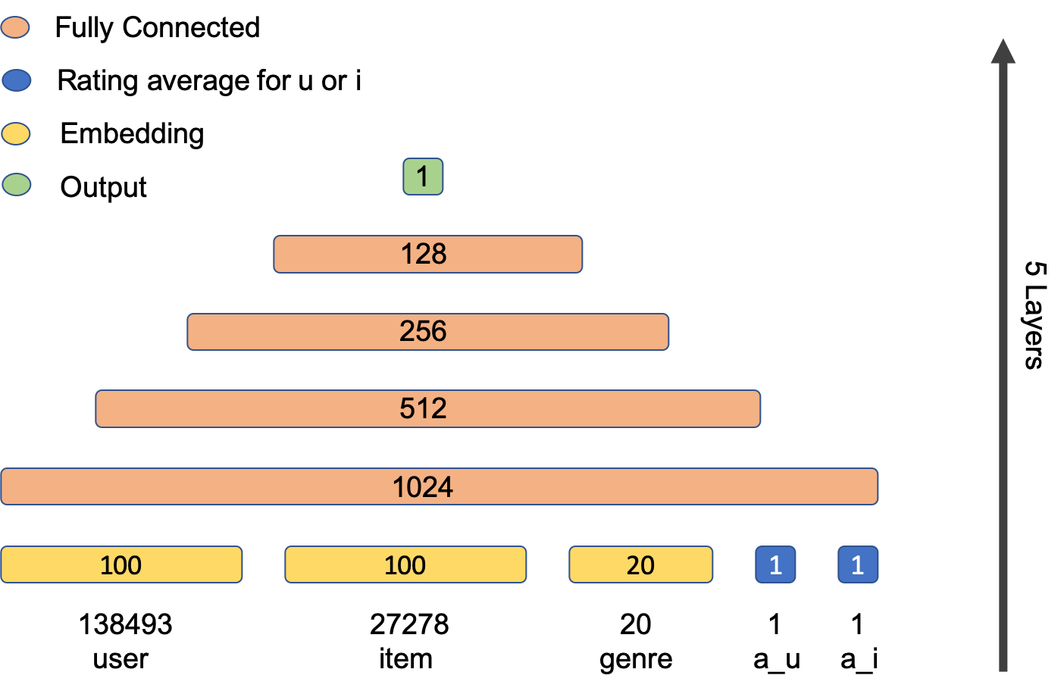
Network Architecture
Neural Network collaborative filtering with side information
Notes:
Classic tower model architecture, work well in literature.
Inputs to the network are embeddings of users, items and genres and discrete variables, average ratigns of user and movie repectively this helps model the inherent bias of user and movie (eg one user will genereally give high ratings and a movie generally receives low ratings)
Output layer has identity activation, just the result of multiplying weights together and adding the biases

Slide 11
Dense layers
L2 kernel regularizer
Leaky ReLU activation
Dropout
Batch normalization
Notes:
Leaky relu is based on relu activation but allows a small negative value to counteract the dying relu problem.
L2 kernel regularizer also known as weight decay is useful in keeping the weight matrices at each layer from getting too big which in turn help against overfiting.
Dropout is the process of randomly droping nodes in a network with predefined probability p this reduces the iterdependance of nodes.
Batch normalization is provides a small regularization effect but its not the main purpose.

Slide 12
Training
Optimizer Nadam
Batch normalization
Multi-gpu
Batch size
Learning rate
Notes:
Nadam is a variant of the highly used adam optimizer combined with nesterov momentum . In practice it allows more stability and speed of convergance.
Normalizing the activation leads to a inner covariance shift in the network which in turn improves training speed. Moreover it has a similar effect to normalizing the inputs to the network in that there are no dominant features.
In practice some combinations of batch size, learning rate and multi-gpu processing worked very poorly and didn’t converge. After experimentation good values where lr = 0.0002, batch size 512 divided by the number of gpus

Slide 13
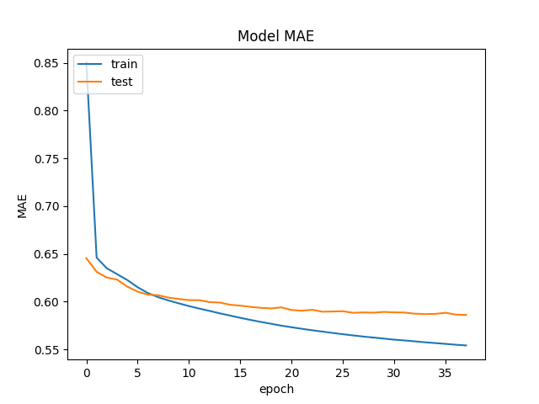
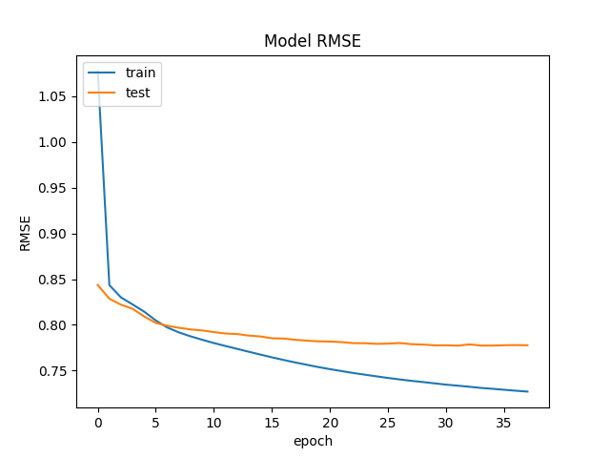
Training

Slide 14
Experiments
SVD and NMF models
Different embeddings factors
Different number of layers
Notes:
Comparison with singular value decomposition and non negative matrix factorization models.
Embedding latent factors experiment tried values of 50 – 75 – 100 – 125 – 200.
Number of layers 7, include 2 x 2048 and 2 x 1024 total params 50m.

Slide 15
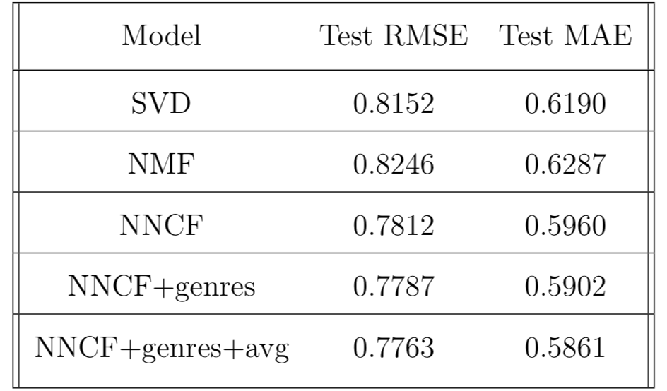
Results

Slide 16
Future work
Incorporate more side information
01
Use a wider and deeper architecture
02
Use recurrent layers
03

Slide 17
The end
Thanks for your time
Any questions ?

