Slide 1
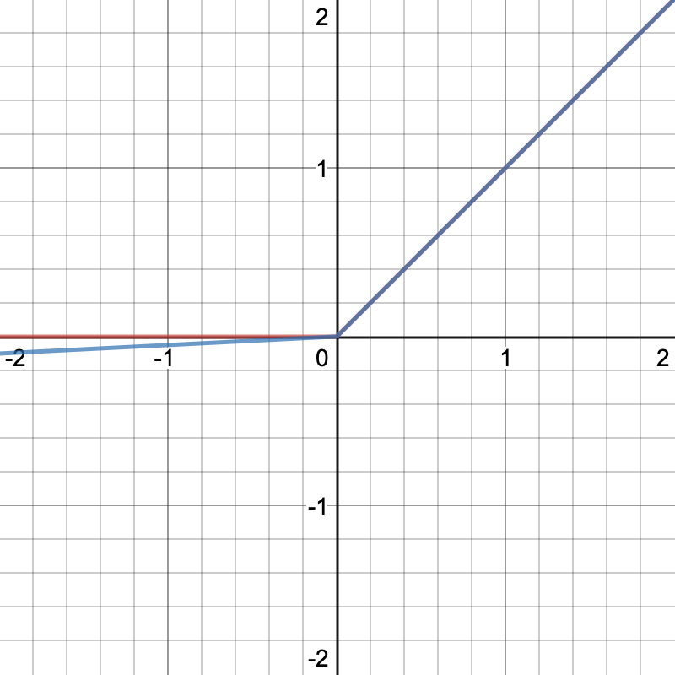
Tanh
Sigmoid
Leaky ReLU
ReLU
Leaky ReLU
ReLU

