Slide 1
Movie Recommendation System
Tiberiu Simion Voicu

Slide 2
Aims
Research into Deep Neural Networks
Research into recommendation systems
Build scalable web application

Slide 3
Recommendation system
Collaborative filtering
Content based
Model based recommendation

Slide 4
System Architecture

Slide 5
Gateway Service
Manage sessions
Authentication
Json web token

Slide 6
Movie Service
Searching
Paginated Results
Interface with engine service

Slide 7
User Service
Manage user data
Manage ratings
Interface with movie and engine service

Slide 8
Engine Service
Training model
Retraining model
Serves recommendations
Interfaces with movie and user service

Slide 9
System flow
Client
Establish session
Gateway
1
Send JWT
Client
JWT
Movie
2
Retrieve Movies
Client
JWT
User
3
Rate movie
Client
recommend
Engine
user ratings
User
4

Slide 10
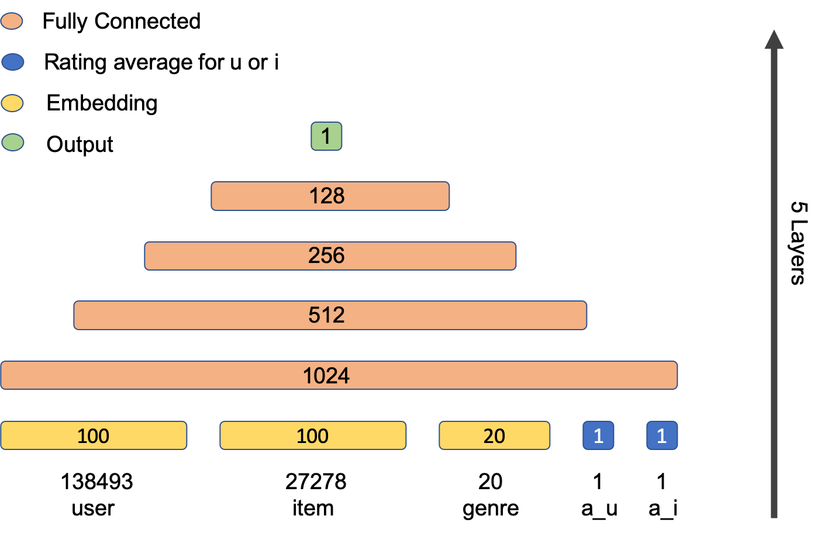
Network Architecture
Neural Network collaborative filtering with side information

Slide 11
Dense layers
L1 kernel regularizer
Leaky ReLU activation
Dropout
Batch normalization

Slide 12
Training
Optimizer Nadam
Batch normalization
Multi-gpu
Batch size
Learning rate

Slide 13
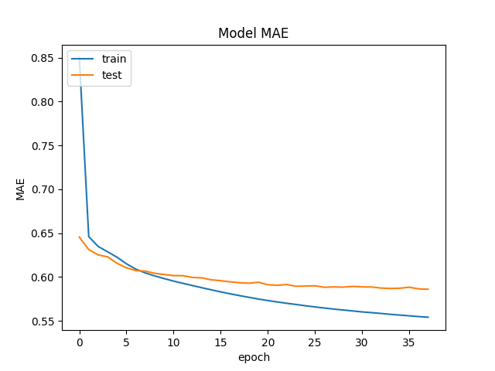
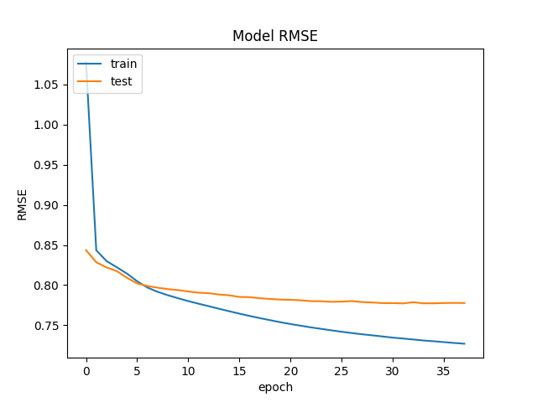
Training

Slide 14
Experiments
SVD and NMF models
Different embeddings factors
Different number of layers

Slide 15
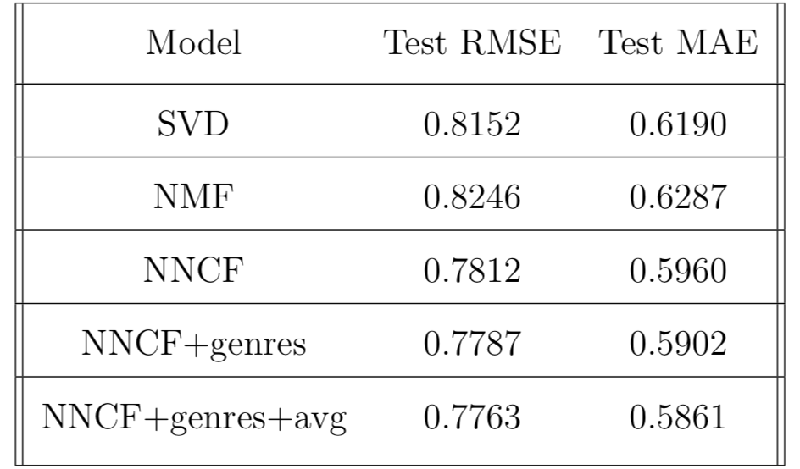
Results

Slide 16
Future work
Incorporate more side information
01
Use a wider and deeper architecture
02
Use recurrent layers
03

Slide 17
The end
Thanks for your time
Any questions ?

