Slide 1
Insulin Pump Project
Final Presentation
Group One!

Slide 2
Agenda
Project Organization
Process Model
Behavioral Models
Body Simulation
Insulin Pump
Demonstration
End

Slide 3
Project Organization
Groups
  Diabetes
  Food
  Insulin
Wiki
Subversion

Slide 4
Process Model
Spiral Model
  Behavioral Models
  Body Simulation
  Insulin Pump Simulation

Slide 5
Behavioral Models
Diabetes
Food
Insulin

Slide 6
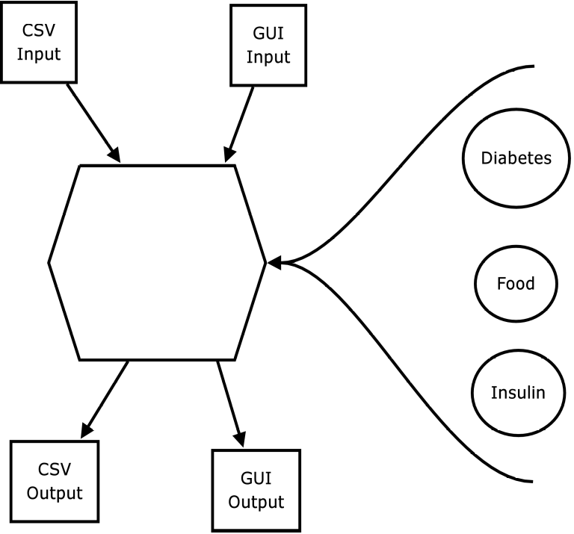
Body Simulation (BS)
Integrates Behavioral Models
MVC approach

Slide 7
Insulin Pump (IP)
Seamless Integration into BS
  MVC

Slide 8
Insulin Pump (IP)
Calulation Models
  ...

Slide 9
Demonstration

