Slide 1
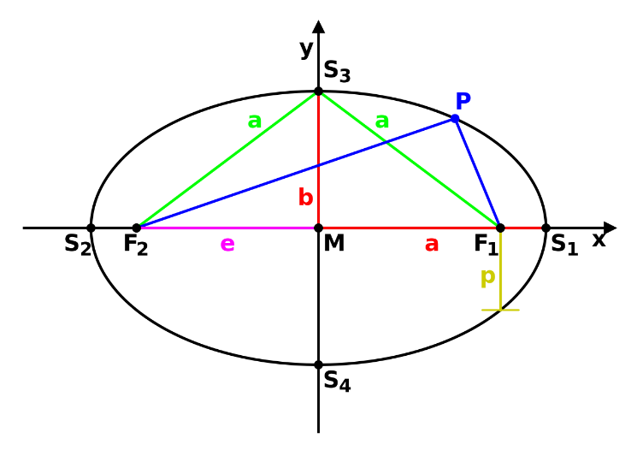
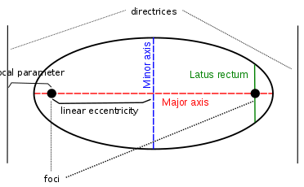
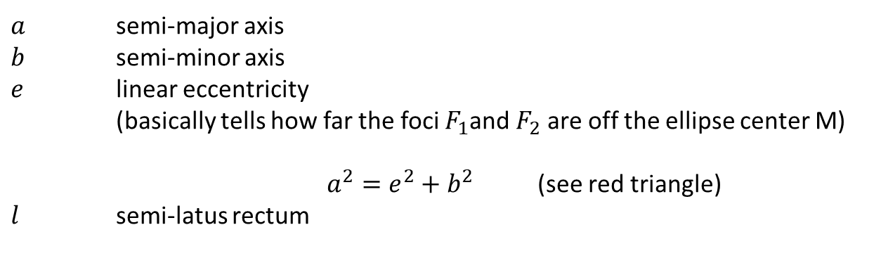
Ellipse basics
$a$ semi-major axis
$b$ semi-minor axis
$e$ linear eccentricity (basically tells how far the foci $F_{1}$and $F_{2}$ are off the ellipse center M)
$a^{2}=e^{2}+b^{2}$ (see red triangle)
$l$ semi-latus rectum

Slide 2
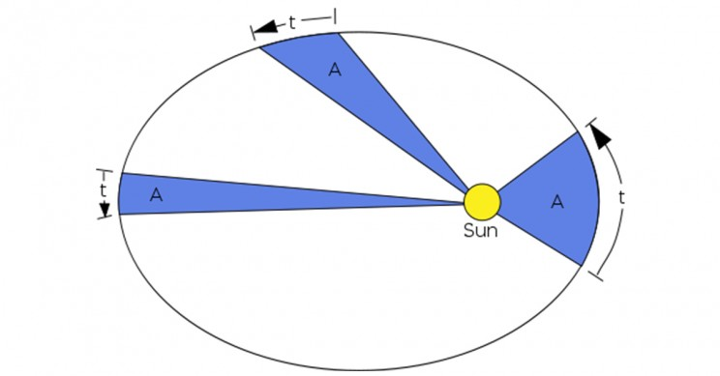


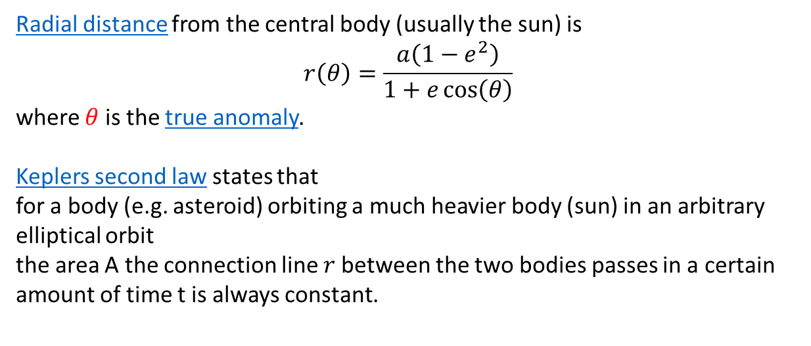
The elliptic orbit shape as a function in polar coordinates
$$r$$
$$θ$$
Radial distance from the central body (usually the sun) is
$$r\left(θ\right)=\frac{a\left(1−e^{2}\right)}{1+e\cos\left(θ\right)}$$
where $θ$ is the true anomaly.
Keplers second law states that for a body (e.g. asteroid) orbiting a much heavier body (sun) in an arbitrary elliptical orbit the area A the connection line $r$between the two bodies passes in a certain amount of time t is always constant.

Slide 3
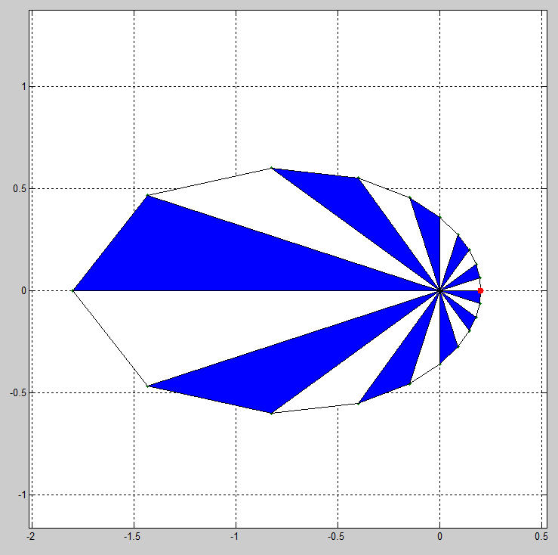
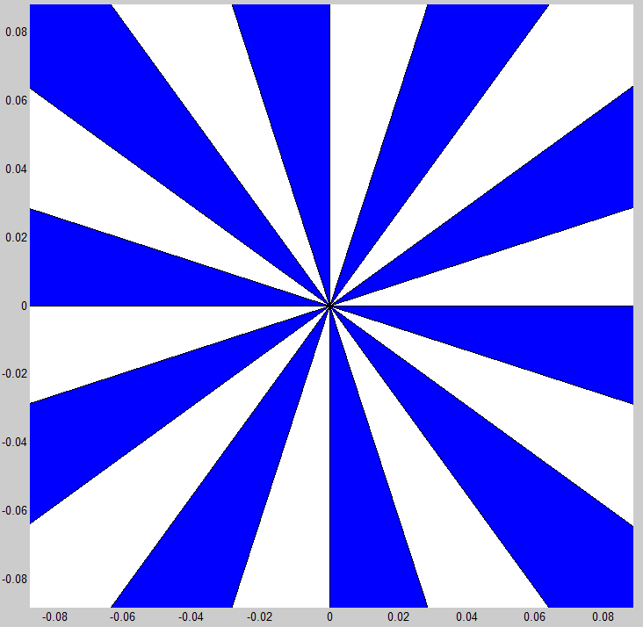
Problem with orbit animation so far
I use same-sized angle steps
Same size angles lead to a fast speed far away from the focal point (sun) and slow speeds close to the focal point → the exact opposite is the case in reality because: same sized angles with every angle section being shown with the same amount of time violates Keplers second law
≠

Slide 4
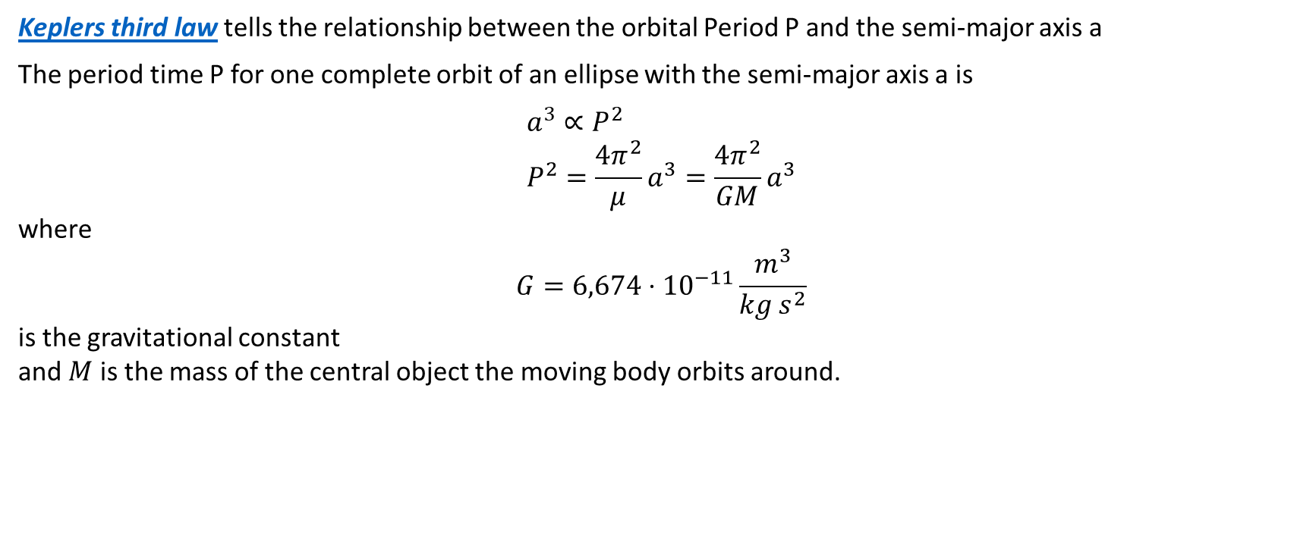



Keplers third law tells the relationship between the orbital Period P and the semi-major axis a
The period time P for one complete orbit of an ellipse with the semi-major axis a is
$$a^{3}∝P^{2} \\ P^{2}=\frac{4π^{2}}{μ}a^{3}=\frac{4π^{2}}{GM}a^{3}$$
where
$$G=6,674⋅{10}^{−11}\frac{m^{3}}{kg{ s}^{2}}$$
is the gravitational constant and $M$ is the mass of the central object the moving body orbits around.
$$b$$
$$a$$
$$t=P$$

Slide 5
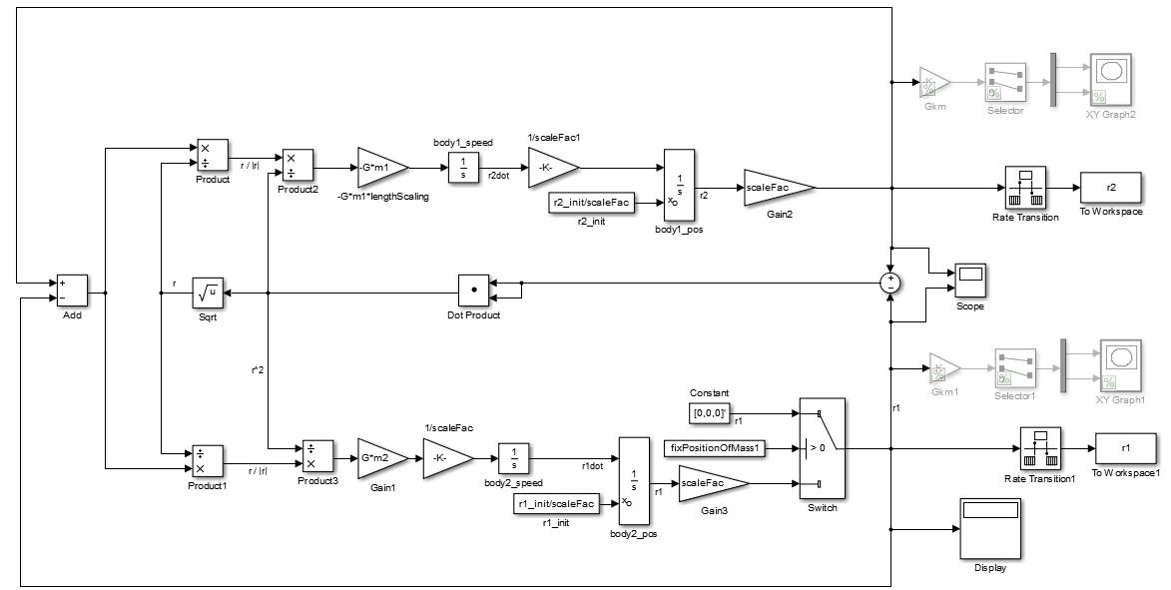






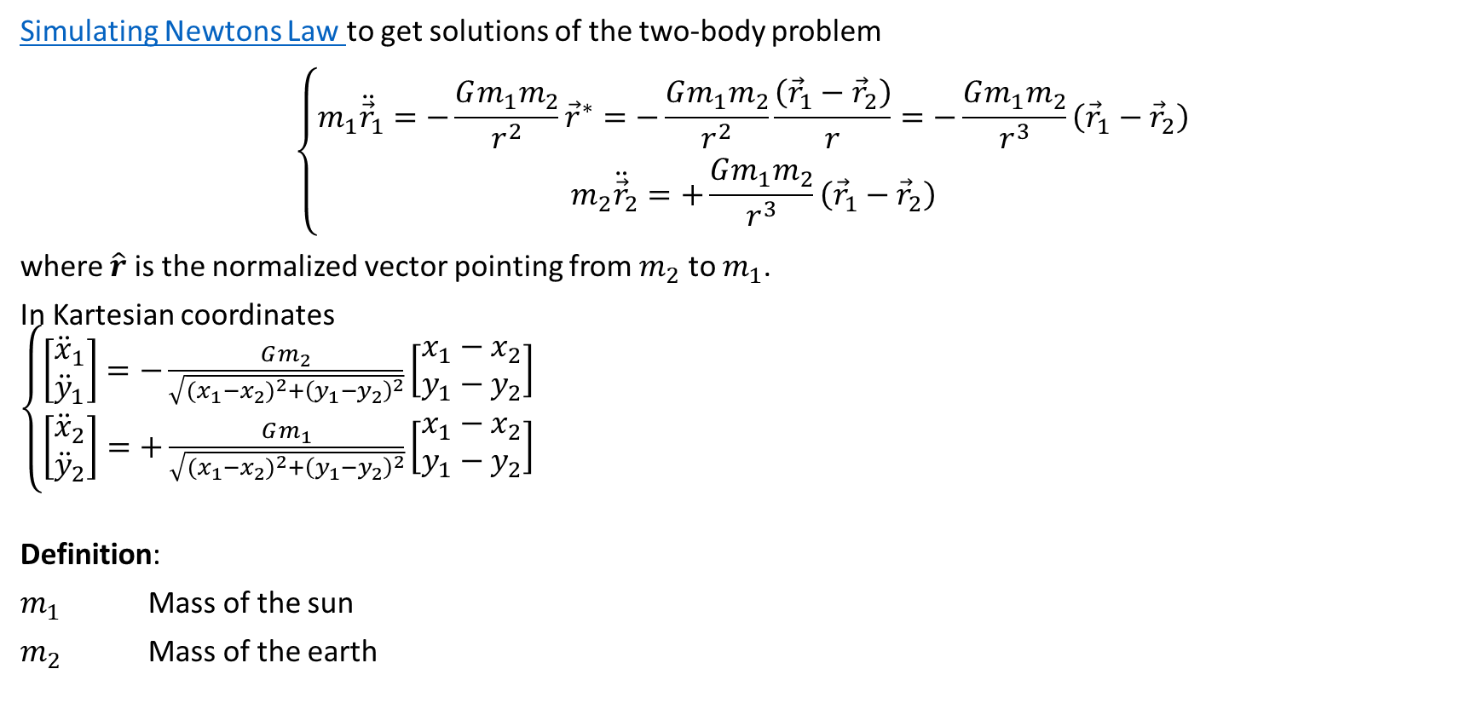

Simulating Newtons Law to get solutions of the two-body problem
$$\left\{\begin{matrix}m_{1}{\ddot{\vec{r}}}_{1}=−\frac{Gm_{1}m_{2}}{r^{2}}{\vec{r}}^{∗}=−\frac{Gm_{1}m_{2}}{r^{2}}\frac{\left({\vec{r}}_{1}−{\vec{r}}_{2}\right)}{r}=−\frac{Gm_{1}m_{2}}{r^{3}}\left({\vec{r}}_{1}−{\vec{r}}_{2}\right) \\ m_{2}{\ddot{\vec{r}}}_{2}=+\frac{Gm_{1}m_{2}}{r^{3}}\left({\vec{r}}_{1}−{\vec{r}}_{2}\right)\end{matrix}\right.$$
where $\hat{r}$ is the normalized vector pointing from $m_{2}$ to $m_{1}$.
In Kartesian coordinates $\left\{\begin{matrix}\left[\begin{matrix}{\ddot{x}}_{1} \\ {\ddot{y}}_{1}\end{matrix}\right]=−\frac{Gm_{2}}{\sqrt{{{(x}_{1}−x_{2})}^{2}+{\left(y_{1}−y_{2}\right)}^{2}}}\left[\begin{matrix}x_{1}−x_{2} \\ y_{1}−y_{2}\end{matrix}\right] \\ \left[\begin{matrix}{\ddot{x}}_{2} \\ {\ddot{y}}_{2}\end{matrix}\right]=+\frac{Gm_{1}}{\sqrt{{{(x}_{1}−x_{2})}^{2}+{\left(y_{1}−y_{2}\right)}^{2}}}\left[\begin{matrix}x_{1}−x_{2} \\ y_{1}−y_{2}\end{matrix}\right]\end{matrix}\right.$
Definition:
$m_{1}$ Mass of the sun
$m_{2}$ Mass of the earth
$$\left|{\vec{r}}^{∗}\right|=1 \\ \left|{\vec{r}}_{1}−{\vec{r}}_{2}\right|=r$$
$$m_{2}$$
$${\vec{r}}_{1}−{\vec{r}}_{2}$$
$${\vec{r}}^{∗}$$
$$m_{1}$$
$${{(x}_{1}−x_{2})}^{2} \\ +{\left(y_{1}−y_{2}\right)}^{2}$$
$$\left[\begin{matrix}x_{1}−x_{2} \\ y_{1}−y_{2}\end{matrix}\right]$$

Slide 6
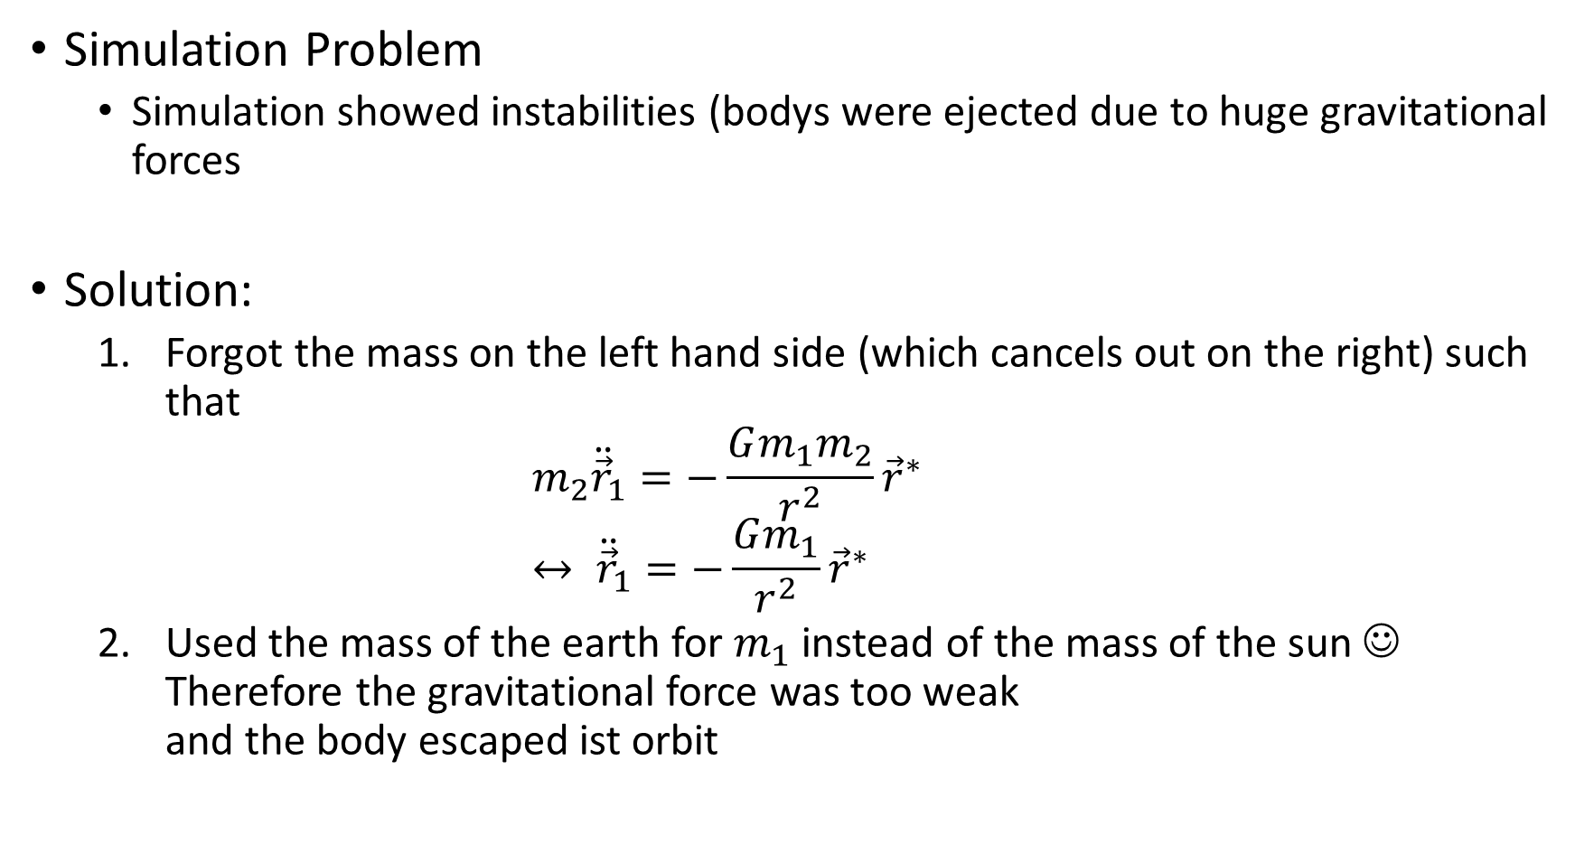
Simulation Problem
Simulation showed instabilities (bodys were ejected due to huge gravitational forces
Solution:
Forgot the mass on the left hand side (which cancels out on the right) such that $m_{2}{\ddot{\vec{r}}}_{1}=−\frac{Gm_{1}m_{2}}{r^{2}}{\vec{r}}^{∗}$ $↔ {\ddot{\vec{r}}}_{1}=−\frac{Gm_{1}}{r^{2}}{\vec{r}}^{∗}$
Used the mass of the earth for $m_{1}$ instead of the mass of the sun ☺ Therefore the gravitational force was too weak and the body escaped ist orbit

Slide 7

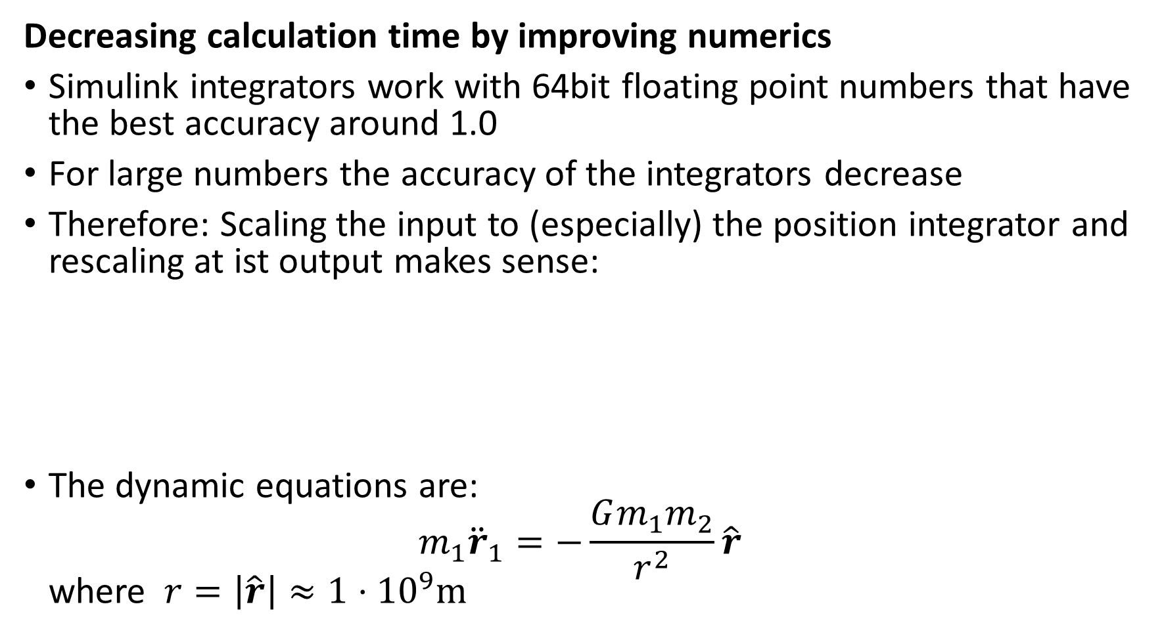
Decreasing calculation time by improving numerics
Simulink integrators work with 64bit floating point numbers that have the best accuracy around 1.0
For large numbers the accuracy of the integrators decrease
Therefore: Scaling the input to (especially) the position integrator and rescaling at ist output makes sense:
The dynamic equations are: $m_{1}{\ddot{r}}_{1}=−\frac{Gm_{1}m_{2}}{r^{2}}\hat{r}$ where $r=\left|\hat{r}\right|≈1⋅{10}^{9}m$

Slide 8


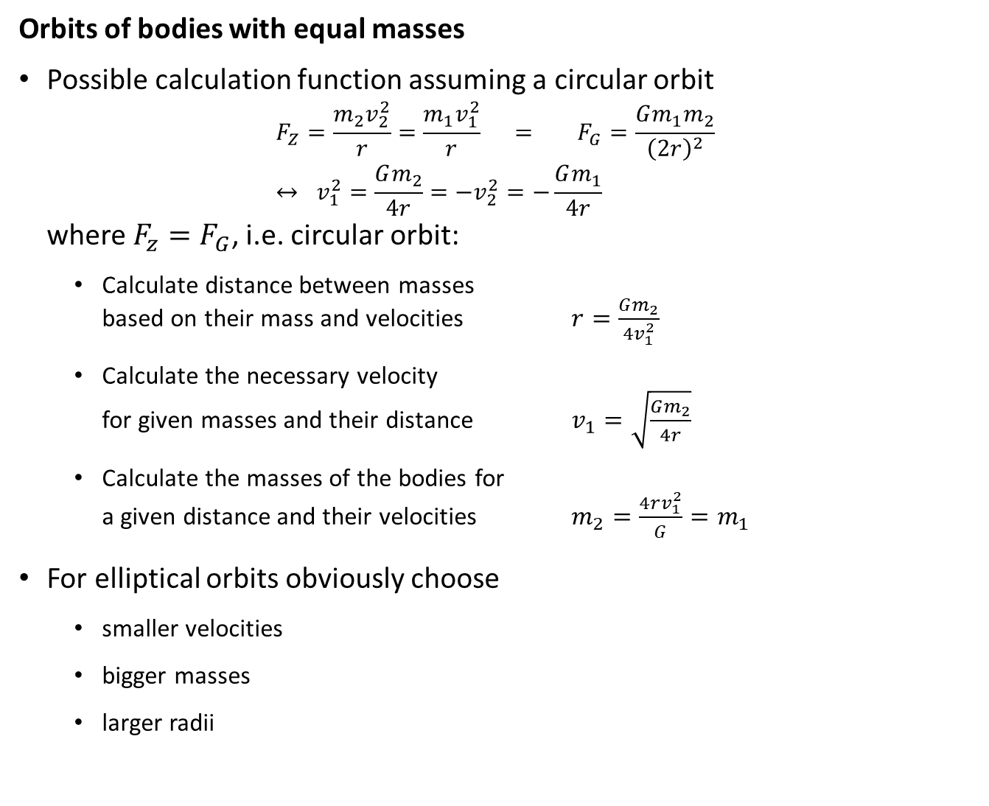



Orbits of bodies with equal masses
Possible calculation function assuming a circular orbit $F_{Z}=\frac{m_{2}v_{2}^{2}}{r}=\frac{m_{1}v_{1}^{2}}{r} = F_{G}=\frac{Gm_{1}m_{2}}{{\left(2r\right)}^{2}}$ $↔ v_{1}^{2}=\frac{Gm_{2}}{4r}=−v_{2}^{2}=−\frac{Gm_{1}}{4r}$ where $F_{z}=F_{G}$, i.e. circular orbit:
Calculate distance between masses based on their mass and velocities $r=\frac{Gm_{2}}{{4v}_{1}^{2}}$
Calculate the necessary velocity for given masses and their distance $v_{1}=\sqrt{\frac{Gm_{2}}{4r}}$
Calculate the masses of the bodies for a given distance and their velocities $m_{2}=\frac{4rv_{1}^{2}}{G}=m_{1}$
For elliptical orbits obviously choose
smaller velocities
bigger masses
larger radii
$$v_{2}$$
$$m_{1}$$
$$r$$
$$m_{2}$$
$$v_{1}$$

Slide 9



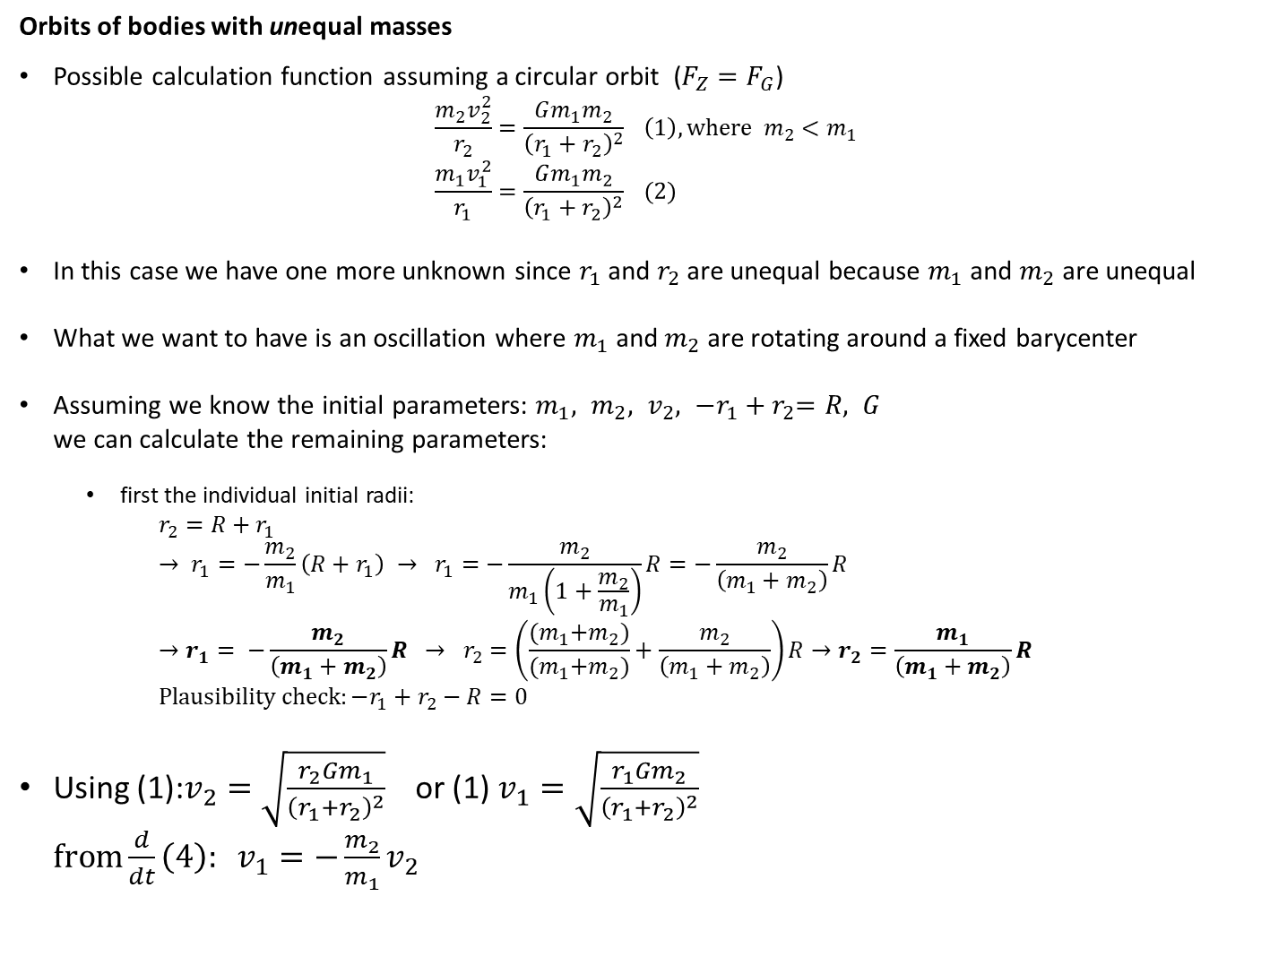

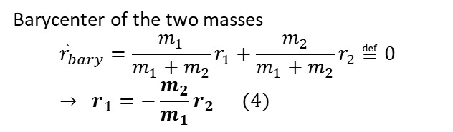
Orbits of bodies with unequal masses
Possible calculation function assuming a circular orbit ($F_{Z}=F_{G}$) $\frac{m_{2}v_{2}^{2}}{r_{2}}=\frac{Gm_{1}m_{2}}{{\left(r_{1}+r_{2}\right)}^{2}} \left(1\right), where m_{2}<m_{1}$ $\frac{m_{1}v_{1}^{2}}{r_{1}}=\frac{Gm_{1}m_{2}}{{\left(r_{1}+r_{2}\right)}^{2}} (2)$
In this case we have one more unknown since $r_{1}$ and $r_{2}$ are unequal because $m_{1}$ and $m_{2}$ are unequal
What we want to have is an oscillation where $m_{1}$ and $m_{2}$ are rotating around a fixed barycenter
Assuming we know the initial parameters: $m_{1}, m_{2}, v_{2}, {−r_{1}+r}_{2}=R, G$ we can calculate the remaining parameters:
first the individual initial radii: $r_{2}=R+r_{1}$ $→ r_{1}=−\frac{m_{2}}{m_{1}}\left(R+r_{1}\right) → r_{1}=−\frac{m_{2}}{m_{1}\left(1+\frac{m_{2}}{m_{1}}\right)}R=−\frac{m_{2}}{\left(m_{1}+m_{2}\right)}R$ $→r_{1}= −\frac{m_{2}}{\left(m_{1}+m_{2}\right)}R → r_{2}=\left(\frac{{(m}_{1}+m_{2})}{{(m}_{1}+m_{2})}+\frac{m_{2}}{\left(m_{1}+m_{2}\right)}\right)R→r_{2}=\frac{m_{1}}{\left(m_{1}+m_{2}\right)}R$ $Plausibility check:−r_{1}+r_{2}−R=0$
Using (1):$v_{2}=\sqrt{\frac{r_{2}Gm_{1}}{{\left(r_{1}+r_{2}\right)}^{2}}}$ or (1) $v_{1}=\sqrt{\frac{r_{1}Gm_{2}}{{\left(r_{1}+r_{2}\right)}^{2}}}$ $from\frac{d}{dt}\left(4\right): v_{1}=−\frac{m_{2}}{m_{1}}v_{2}$
$$v_{2}$$
$$m_{1}$$
$$r_{1}$$
$$r_{2}$$
$$m_{2}$$
$$v_{1}$$
Barycenter of the two masses
$${\overset{⃑}{r}}_{bary}=\frac{m_{1}}{m_{1}+m_{2}}r_{1}+\frac{m_{2}}{m_{1}+m_{2}}r_{2}≝0 \\ → r_{1}=−\frac{m_{2}}{m_{1}}r_{2} (4)$$

