Slide 1
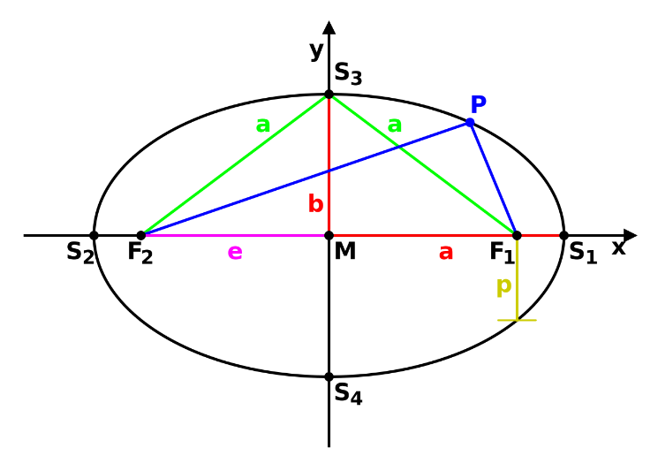
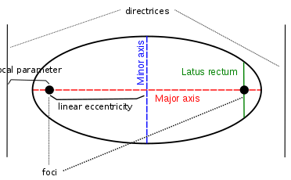
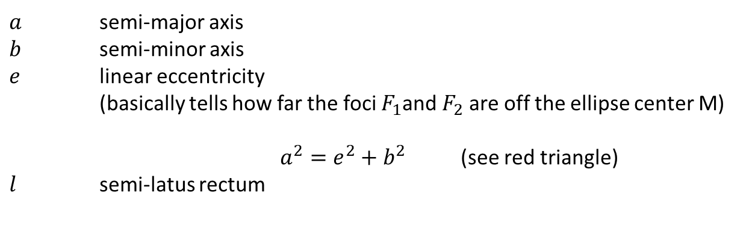
Ellipse basics
$a$ semi-major axis
$b$ semi-minor axis
$e$ linear eccentricity (basically tells how far the foci $F_{1}$and $F_{2}$ are off the ellipse center M)
$a^{2}=e^{2}+b^{2}$ (see red triangle)
$l$ semi-latus rectum

Slide 2
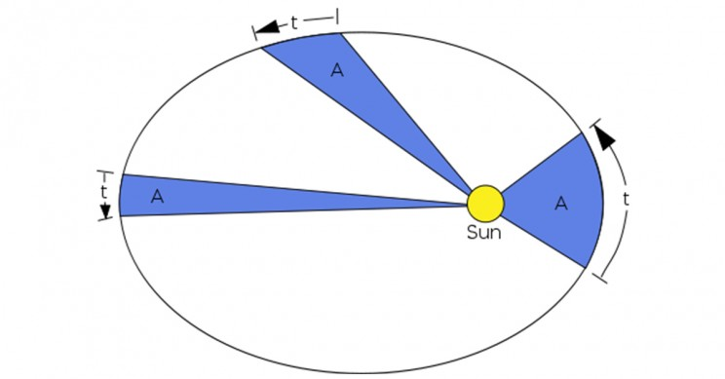


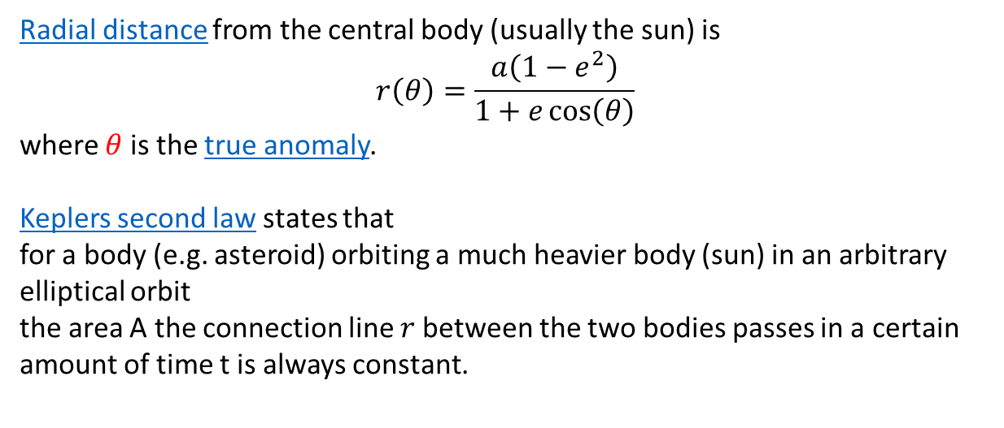
The elliptic orbit shape as a function in polar coordinates
$$r$$
$$θ$$
Radial distance from the central body (usually the sun) is
$$r\left(θ\right)=\frac{a\left(1−e^{2}\right)}{1+e\cos\left(θ\right)}$$
where $θ$ is the true anomaly.
Keplers second law states that for a body (e.g. asteroid) orbiting a much heavier body (sun) in an arbitrary elliptical orbit the area A the connection line $r$between the two bodies passes in a certain amount of time t is always constant.

Slide 3
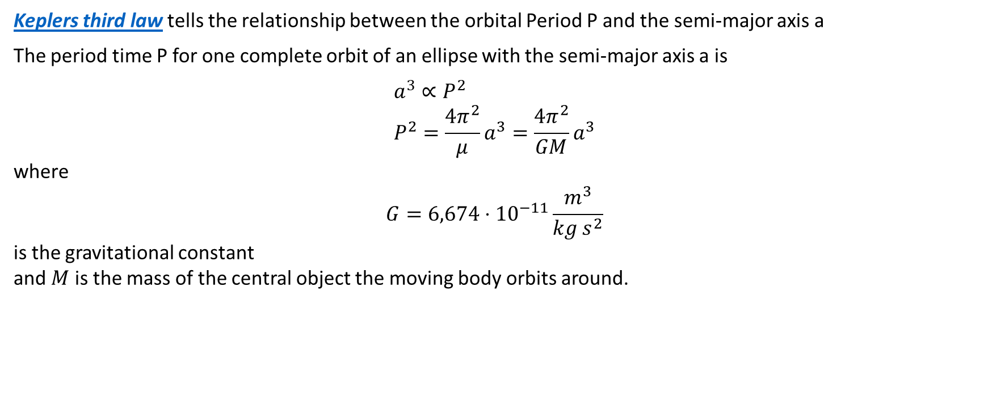



Keplers third law tells the relationship between the orbital Period P and the semi-major axis a
The period time P for one complete orbit of an ellipse with the semi-major axis a is
$$a^{3}∝P^{2} \\ P^{2}=\frac{4π^{2}}{μ}a^{3}=\frac{4π^{2}}{GM}a^{3}$$
where
$$G=6,674⋅{10}^{−11}\frac{m^{3}}{kg{ s}^{2}}$$
is the gravitational constant and $M$ is the mass of the central object the moving body orbits around.
$$b$$
$$a$$
$$t=P$$

Slide 4
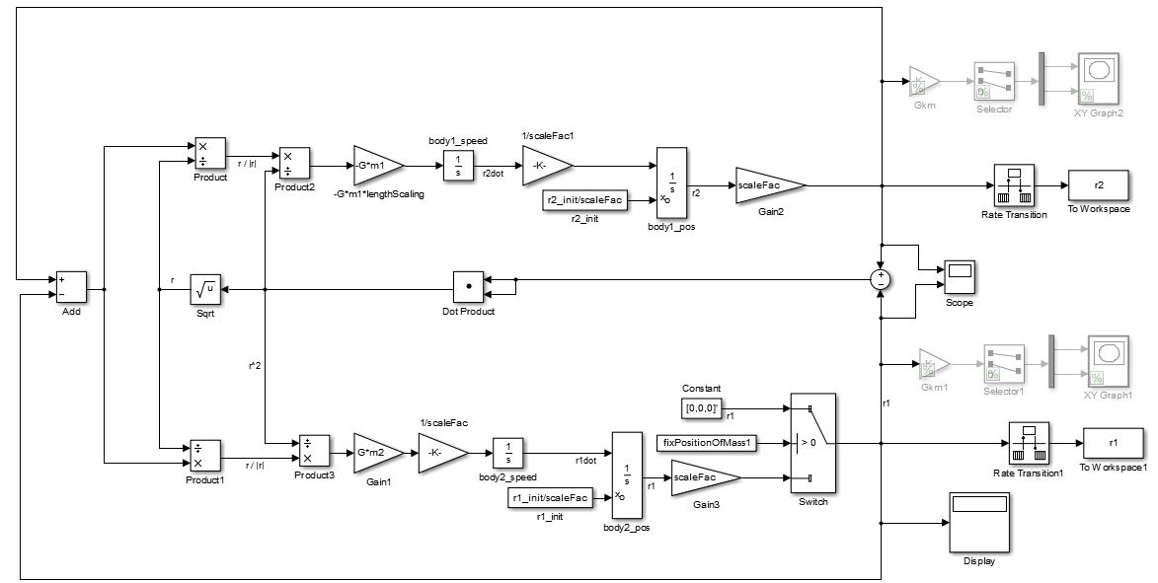






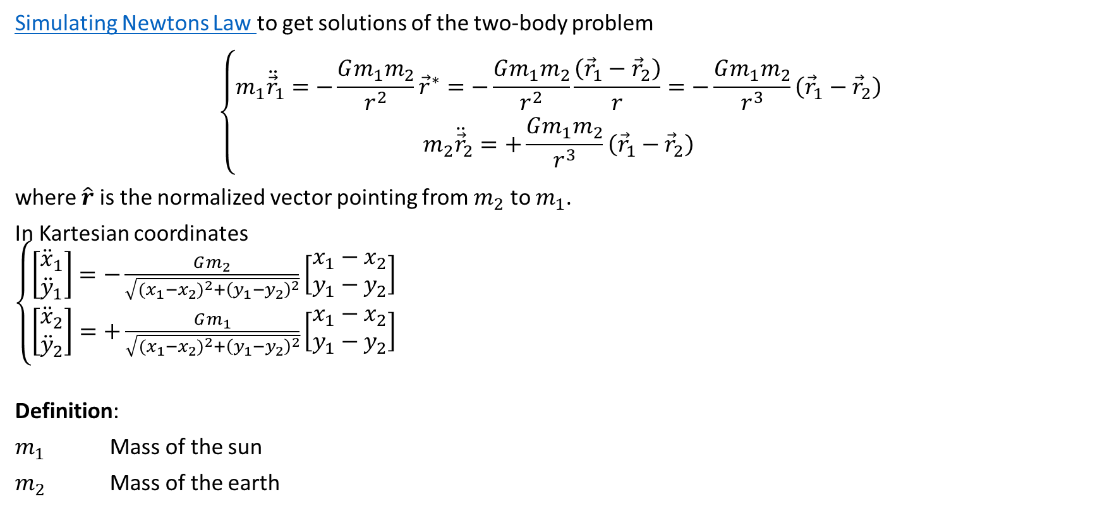

Simulating Newtons Law to get solutions of the two-body problem
$$\left\{\begin{matrix}m_{1}{\ddot{\vec{r}}}_{1}=−\frac{Gm_{1}m_{2}}{r^{2}}{\vec{r}}^{∗}=−\frac{Gm_{1}m_{2}}{r^{2}}\frac{\left({\vec{r}}_{1}−{\vec{r}}_{2}\right)}{r}=−\frac{Gm_{1}m_{2}}{r^{3}}\left({\vec{r}}_{1}−{\vec{r}}_{2}\right) \\ m_{2}{\ddot{\vec{r}}}_{2}=+\frac{Gm_{1}m_{2}}{r^{3}}\left({\vec{r}}_{1}−{\vec{r}}_{2}\right)\end{matrix}\right.$$
where $\hat{r}$ is the normalized vector pointing from $m_{2}$ to $m_{1}$.
In Kartesian coordinates $\left\{\begin{matrix}\left[\begin{matrix}{\ddot{x}}_{1} \\ {\ddot{y}}_{1}\end{matrix}\right]=−\frac{Gm_{2}}{\sqrt{{{(x}_{1}−x_{2})}^{2}+{\left(y_{1}−y_{2}\right)}^{2}}}\left[\begin{matrix}x_{1}−x_{2} \\ y_{1}−y_{2}\end{matrix}\right] \\ \left[\begin{matrix}{\ddot{x}}_{2} \\ {\ddot{y}}_{2}\end{matrix}\right]=+\frac{Gm_{1}}{\sqrt{{{(x}_{1}−x_{2})}^{2}+{\left(y_{1}−y_{2}\right)}^{2}}}\left[\begin{matrix}x_{1}−x_{2} \\ y_{1}−y_{2}\end{matrix}\right]\end{matrix}\right.$
Definition:
$m_{1}$ Mass of the sun
$m_{2}$ Mass of the earth
$$\left|{\vec{r}}^{∗}\right|=1 \\ \left|{\vec{r}}_{1}−{\vec{r}}_{2}\right|=r$$
$$m_{2}$$
$${\vec{r}}_{1}−{\vec{r}}_{2}$$
$${\vec{r}}^{∗}$$
$$m_{1}$$
$${{(x}_{1}−x_{2})}^{2} \\ +{\left(y_{1}−y_{2}\right)}^{2}$$
$$\left[\begin{matrix}x_{1}−x_{2} \\ y_{1}−y_{2}\end{matrix}\right]$$

Slide 5
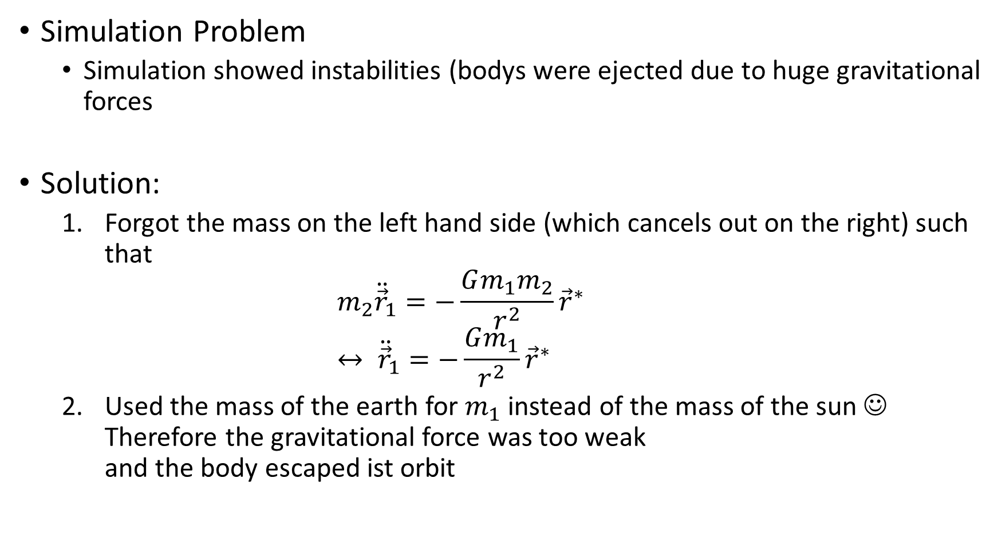
Simulation Problem
Simulation showed instabilities (bodys were ejected due to huge gravitational forces
Solution:
Forgot the mass on the left hand side (which cancels out on the right) such that $m_{2}{\ddot{\vec{r}}}_{1}=−\frac{Gm_{1}m_{2}}{r^{2}}{\vec{r}}^{∗}$ $↔ {\ddot{\vec{r}}}_{1}=−\frac{Gm_{1}}{r^{2}}{\vec{r}}^{∗}$
Used the mass of the earth for $m_{1}$ instead of the mass of the sun ☺ Therefore the gravitational force was too weak and the body escaped ist orbit

Slide 6


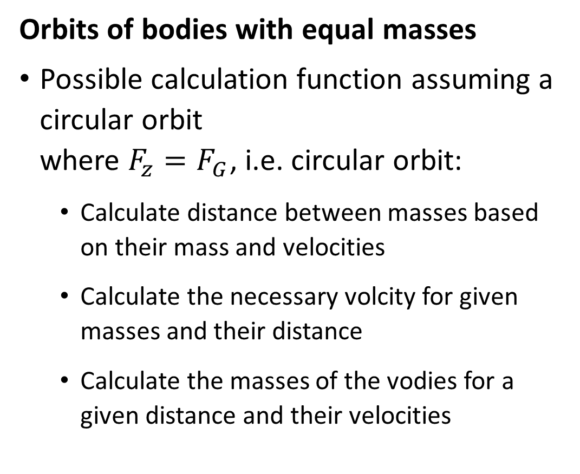



Orbits of bodies with equal masses
Possible calculation function assuming a circular orbit where $F_{z}=F_{G}$, i.e. circular orbit:
Calculate distance between masses based on their mass and velocities
Calculate the necessary volcity for given masses and their distance
Calculate the masses of the vodies for a given distance and their velocities
$$v_{2}$$
$$m_{1}$$
$$r$$
$$m_{2}$$
$$v_{1}$$

