Slide 1
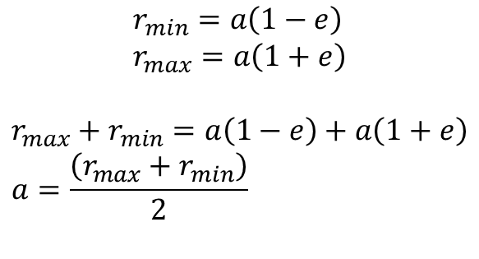
$$r_{min}=a\left(1−e\right) \\ r_{max}=a\left(1+e\right)$$
$$r_{max}+r_{min}=a\left(1−e\right)+a\left(1+e\right) \\ a=\frac{\left(r_{max}+r_{min}\right)}{2}$$

