Slide 1
Controllable Brain Tumor Synthesis
Talha Ibn Mahmud
Elmore Family School of Electrical and Computer Engineering
ECE 60131: Inference and Learning in Generative Models
Course Instructor: Joseph Makin
Course TA: Bilal Ahmed

Slide 2
Objective
Build a controllable generative optimized pipeline that can synthesize brain MRI slices

Slide 3
Objective
Build a controllable generative optimized pipeline that can synthesize brain MRI slices
user-specified
tumor location

Slide 4
Objective
Build a controllable generative optimized pipeline that can synthesize brain MRI slices
user-specified
tumor location
Trained on a latent space

Slide 5
Objective
Build a controllable generative optimized pipeline that can synthesize brain MRI slices
user-specified
tumor location
Trained on a latent space
Evaluate the quality of the generated slices using clinical segmentation metrics
Analyze different relevant generative modeling approaches

Slide 6
Proposed Pipeline
Generative Model
Random Mask with a tumor location
Realistic MRI slice

Slide 7
Selected Methods to Analyze
VAE + Diffusion: A hybrid model that combines a deterministic VAE for structured latent representation with a diffusion model for controllable synthesis while operating in a compressed space
VAE + GAN: Replacing the diffusion with GAN
GAN: A direct conditional GAN that generates brain MRI slices from tumor masks

Slide 8

VAE+Diffusion
At first VAE is trained to learn to reconstruct images.
The encoder takes a 256×256 MRI slice and compresses it into a compact latent code of size 256 × 16 × 16.
The decoder takes that latent code and reconstructs a full 256×256 image.
E
Notes:
Diffusion Model: MONAI’s DiffusionModelUNet.
Input: noisy latent + latent mask (257, 16, 16)
Output: predicted noise (256, 16, 16)
Encoder: 4 layers CNN
Decoder: 4 layer CNN

Slide 9

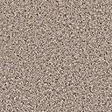

VAE+Diffusion
VAE is frozen now and diffusion model is trained in the latent space.
The mask is downsampled from 256×256 to 16×16 (to match the latent size) and concatenated with the noisy latent as input.
Iteratively denoised the latent 50 steps to get a cleaner latent
Final clean latent is passed to the frozen VAE decoder to produce the 256×256 synthetic MRI
E
Latent Noise
Diffusion
$$∑$$
Downsampling
Mask
Notes:
Diffusion Model: MONAI’s DiffusionModelUNet.
Input: noisy latent + latent mask (257, 16, 16)
Output: predicted noise (256, 16, 16)

Slide 10
VAE + GAN
At first VAE is trained to learn to reconstruct images.
The encoder takes a 256×256 MRI slice and compresses it into a compact latent code of size 256 × 16 × 16.
The decoder takes that latent code and reconstructs a full 256×256 image.
After training the MRI slice and corresponding mask are compressed into latent space for GAN usage.
E
Notes:
Diffusion Model: MONAI’s DiffusionModelUNet.
Input: noisy latent + latent mask (257, 16, 16)
Output: predicted noise (256, 16, 16)
Encoder: 4 layers CNN
Decoder: 4 layer CNN

Slide 11
VAE + GAN
GAN is trained to generate latent image from latent mask input
For inference, random binary mask -> encoder -> latent mask -> GAN -> latent image -> decoder -> synthetic image
E
GAN
Mask
Notes:
Diffusion Model: MONAI’s DiffusionModelUNet.
Input: noisy latent + latent mask (257, 16, 16)
Output: predicted noise (256, 16, 16)

Slide 12
GAN
GAN
On the GAN model, the network directly learns how to generate the original image from the binary mask input
Notes:
Generator: U-Net-like CNN (4 downsampling + 4 upsampling blocks).
Input: mask (256×256) → Output: synthetic image (256×256).
Discriminator: PatchGAN-style CNN.
Input: [image, mask] (2×256×256) → Output: real/fake score.

Slide 13
Experimental Setup
Medical Segmentation Decathlon – Task 01 (Brain Tumor) derived from the BraTS (Brain Tumor Segmentation) Challenge data.
Had 484 3D MRI data, each with 4 MRI modalities (chose FLAIR)
Used the 2D axial slices and corresponding binary tumor masks
Total number of slices: 30103
http://medicaldecathlon.com/

Slide 14
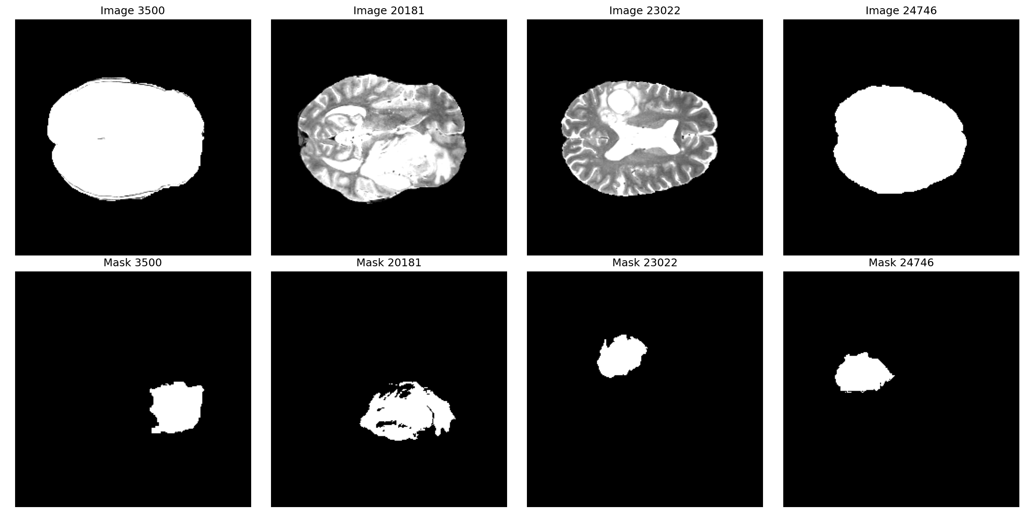
Sample Images and Masks

Slide 15
Evaluation Metric
Main idea: If the reconstructed image is good enough, a segmentation model should be able to segment the tumor close to the given mask.
A U-net segmentation model was pre-trained on the dataset, and then used to segment the reconstructed image
HD95 and Normalized Dice score are measured.

Slide 16
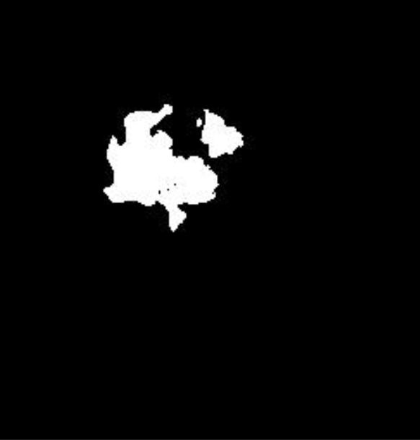
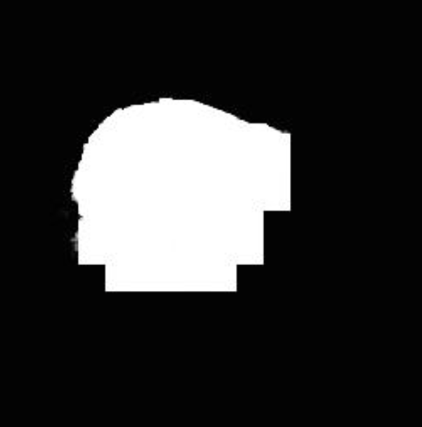
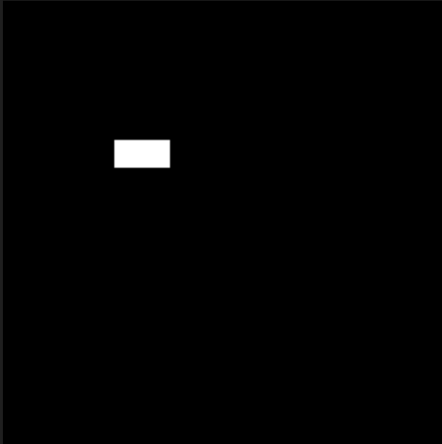
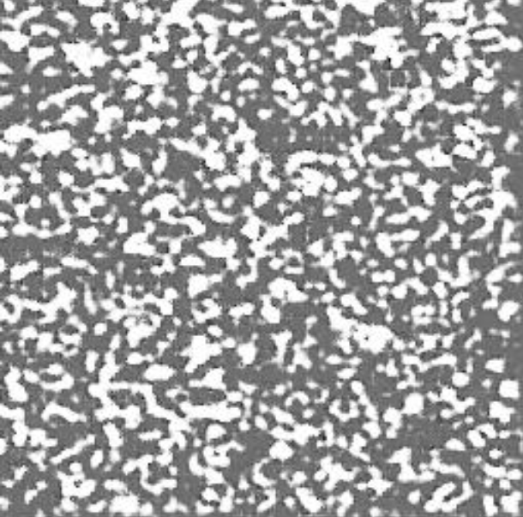
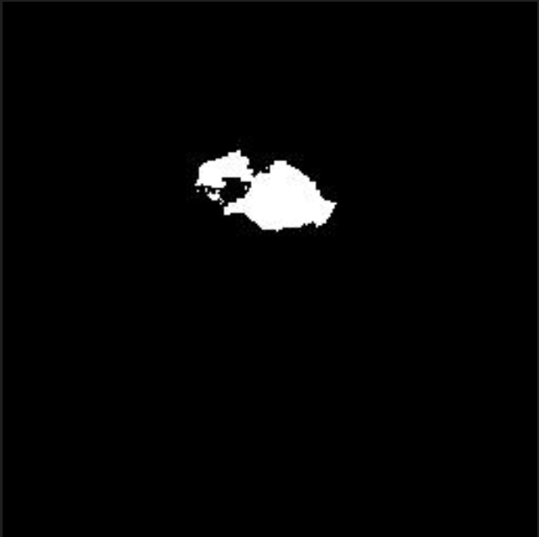
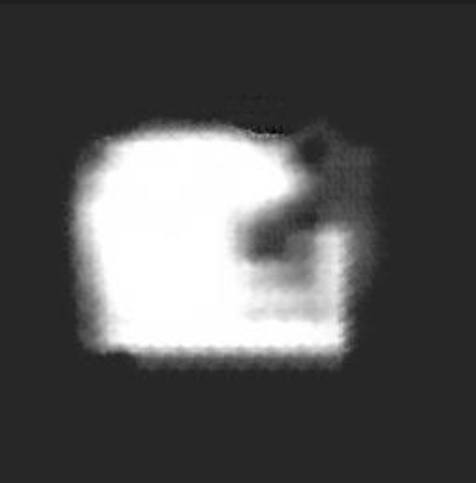
Qualitative Result
GAN + Diffusion
GAN
GAN+VAE

Slide 17
Quantitative Result
Method | HD95 | NSD
VAE+Diffusion | 143.17 | 1.33%
VAE+GAN | 72.14 | 5.52%
GAN | 33.65 | 7.60%
Direct GAN outperforms the other two methods on HD95 and NSD — best tumor alignment with conditioning mask.
VAE + Diffusion performed worst —poor convergence?

Slide 18
Thank you!

