Slide 1
Capstone Project: Identify the best area in Toronto to open a shop

Slide 2
Introduction:
We would like to open a shop, therefore we examine in which area would be the most suitable in Toronto for this purpose.

Slide 3
Data:
Toronto neighborhoods broken down by postal code
https://en.wikipedia.org/wiki/List_of_postal_codes_of_Canada:_M
Load Toronto geospatial coordinates and merge to Toronto Postal Code Data
http://cocl.us/Geospatial_data
Toronto neighborhoods populations broken down by postal code
https://www12.statcan.gc.ca/census-recensement/2016/dp-pd/hlt-fst/pd-pl/Tables/File.cfm?T=1201&SR=1&RPP=9999&PR=0&CMA=0&CSD=0&S=22&O=A&Lang=Eng&OFT=CSV
Toronto neighborhoods average after tax income broken down by postal code https://www12.statcan.gc.ca/census-recensement/2016/dp-pd/prof/search-recherche/change-geo.cfm?Lang=E&Geo1=FSA

Slide 4
Methodology:
K-Means Clustering:
K-means clustering algorithm computes the centroids and iterates until we it finds optimal centroid. It assumes that the number of clusters are already known. It is also called flat clustering algorithm. The number of clusters identified from data by algorithm is represented by ‘K’ in K-means.
In this algorithm, the data points are assigned to a cluster in such a manner that the sum of the squared distance between the data points and centroid would be minimum. It is to be understood that less variation within the clusters will lead to more similar data points within same cluster.

Slide 5
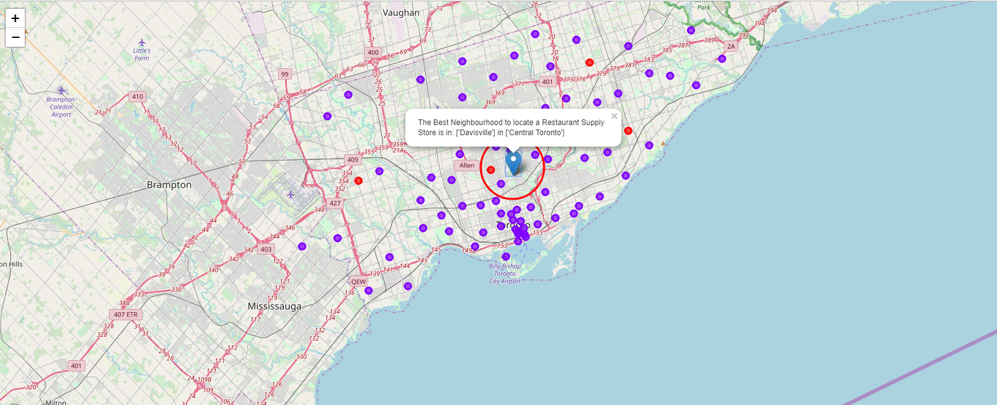
Results:
The exact Address to locate would be: 268 Balliol Street, ON M4S 1C2, Canada or lat: 43.6991598, lng: -79.3878871

Slide 6
Results:
As we built our list of neighborhoods with Restaurant venues exclusively we discovered most neighborhoods were similar and the greatest concentration of restaurants was in Central Toronto and downtown Toronto. This might seem obvious but it would also appear that these are some of the most affluent neighborhoods in Toronto so there appears to be correlation. By Locating in the general vicinity of the Exact location my friend could be geographically centered in this cluster and poised to service his restaurant customer base with greatest efficiency.
When we built our our K-Means dataset we used Silhouette analysis to tell us there was a lot of similarity between neighborhoods and the most common restaurants contained with in. Really there was only 2 types of cluster or neighborhoods in greater Toronto. The vast majority of those were in 1 cluster. So Toronto restaurants might be many but they are very homogeneously located near the center of Toronto.
Of the 103 Toronto Neighborhoods gathered only 55.3% or 57 Neighborhoods are above the median after-tax income. 37.8% or 39 Neighborhoods are below he median after-tax income. 6.7% or 7 neighborhoods did not register as it appears their populations are too low. It appears that the greatest concentration of affluence is near central Toronto. We decided to keep all neighborhoods in the dataset regardless of income of population as the majority were close enough.

Slide 7
Conclusion:
This analysis is only a base of the project. Further examination would be adivsable in order to review more aspects of the opening.

