Slide 1

MALAVIYA NATIONAL INSTITUTE OF TECHNOLOGY, JAIPUR
Advance Programming Lab Project
MOVIE HOUSE
Submitted to-
Praveen Kumar Chandaliya

Slide 2
Group Details
Name - Ashish Goyal
Id - 2016ucp1100
Batch - A (1,2)
Name – Abhishek Tibrewal
Id - 2016ucp1103
Batch - A (1,2)

Slide 3
Content
Features
Data gathering
Tools and technologies used
E-R Diagram
Relational Schemas
Database Queries
Glimpse of our Desktop application
References

Slide 4
Features
Movie House is a desktop application on which user can purchase movies and watch them after buying.
Admin login Facility is there.
Admin can add movie details after successful login.
Admin can remove movie.
User Registration is there.
User can access movie house after successful login
Password is encrypted using MD5 encryption technique
so that no one can understand password from the database directly

Slide 5
Features
User can see his/her profile.
User can update his/her profile.
User can add money using his card number and cvv information.
User can change/update his password .
User can watch trailer of the selected movie in the home page.
User can add movies to the cart.
User can delete movies from the cart.
User can see his/her collection of movies.

Slide 6
Data gathering
The data is gathered from various resources:
Trailer of movies from YouTube.
Movie Description, Genre, IMDB rating from
https://www.imdb.com/
Cover Image and reference images are downloaded from google.com

Slide 7
Tools and technologies used
JavaFX
Eclipse IDE
Scene Builder
Xampp server
Mysql
JDBC

Slide 8
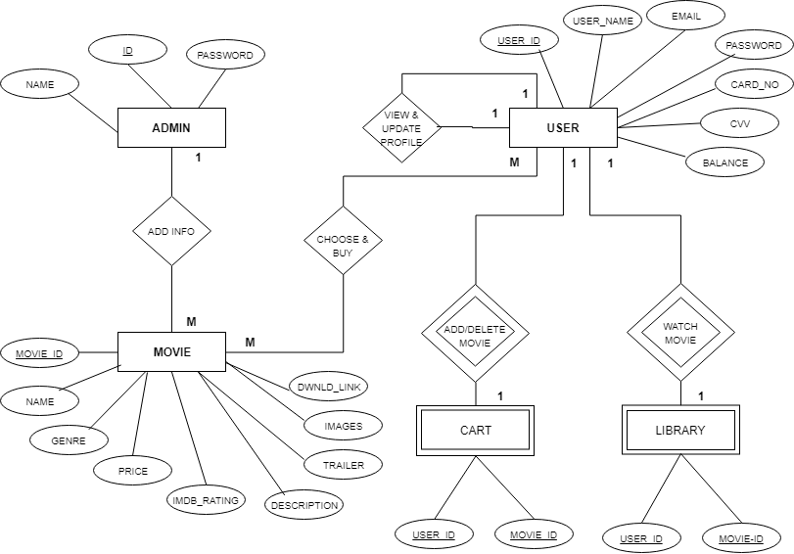
E-R Diagram

Slide 9
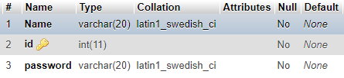
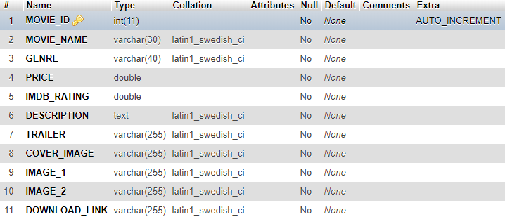
Relational Schemas
Admin
Movie

Slide 10

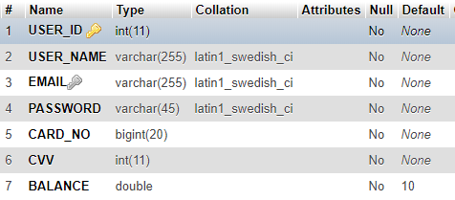

Cart
User
Purchased

Slide 11
Database Queries
Insert Query
Select Query
Delete Query
Update Query

Slide 12
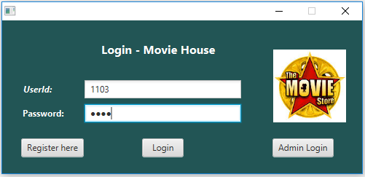
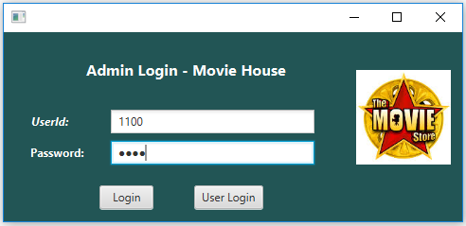
Glimpse of our Desktop application

Slide 13
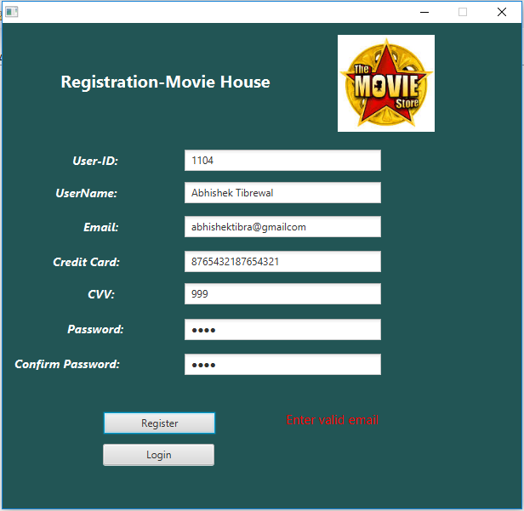

Slide 14
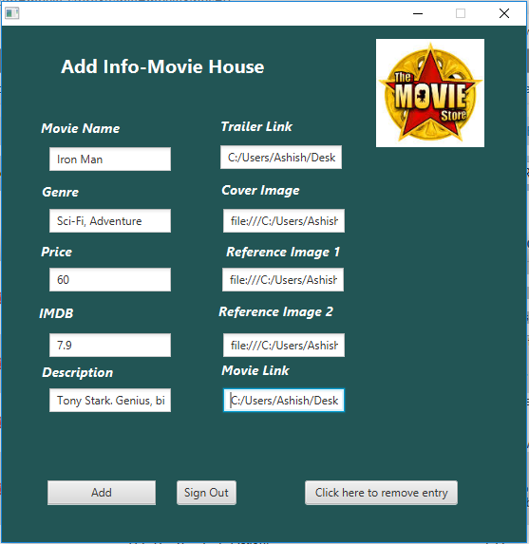

Slide 15
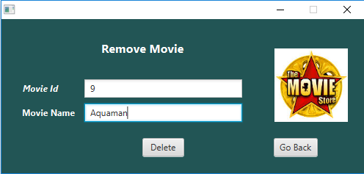

Slide 16
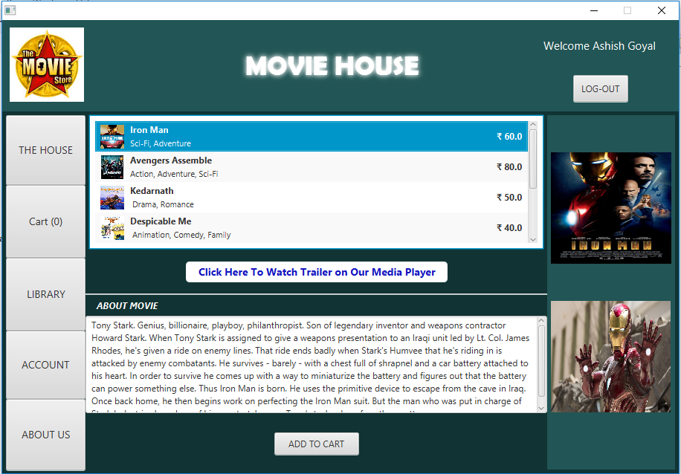

Slide 17
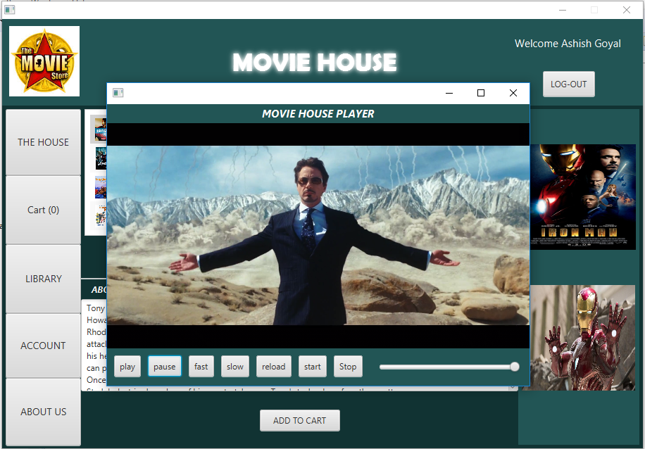

Slide 18
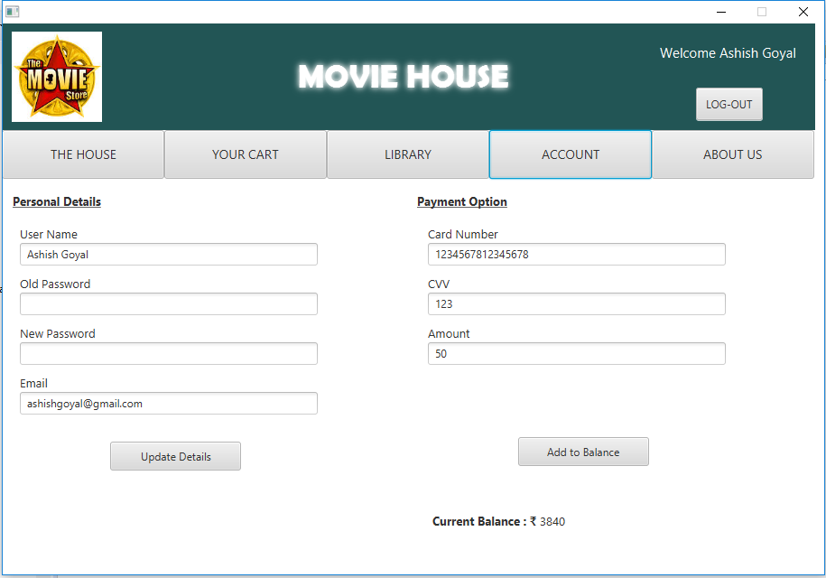

Slide 19
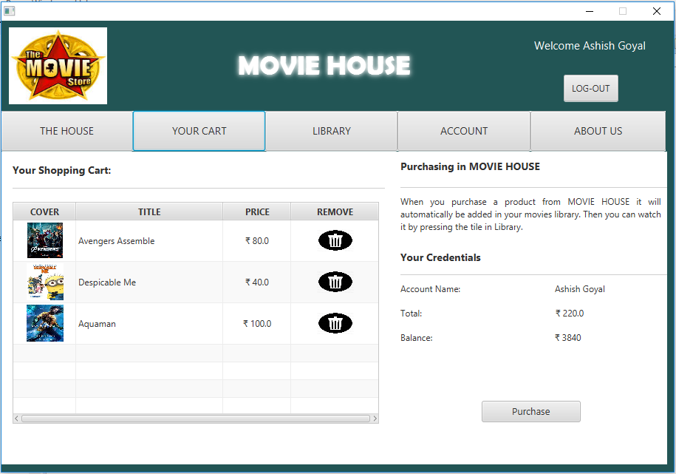

Slide 20
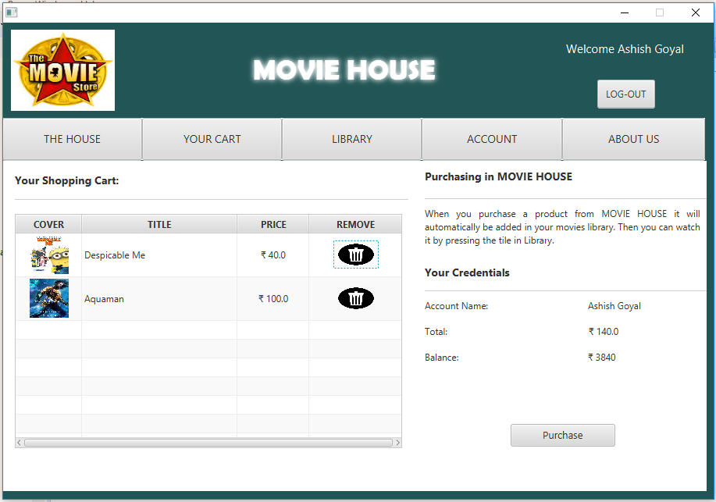

Slide 21
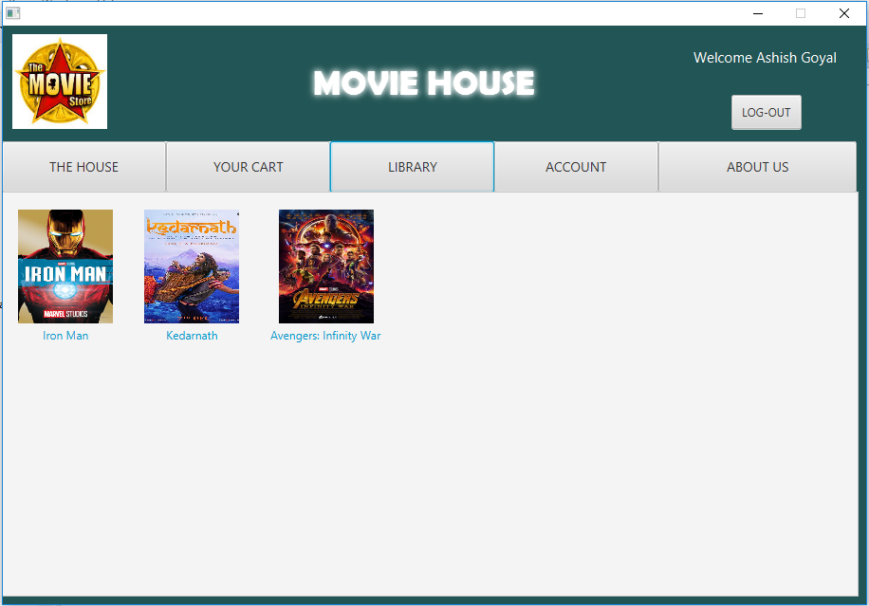

Slide 22
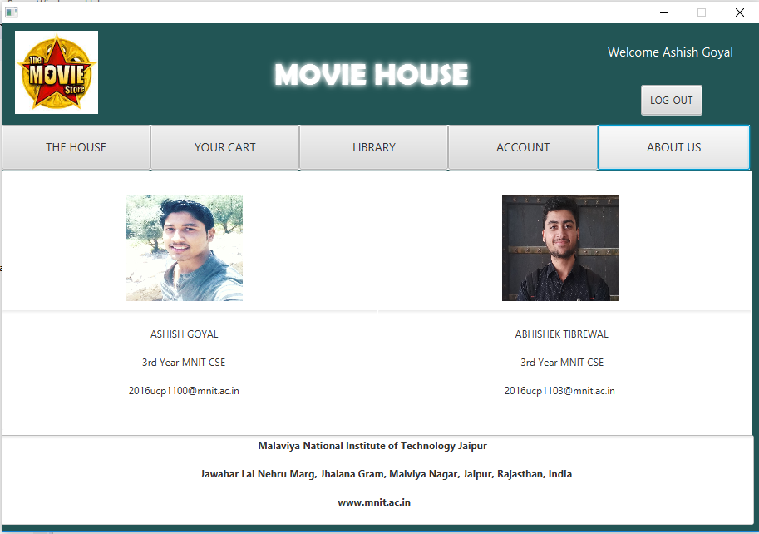

Slide 23
References
javapadho-slideshare-JDBC.pdf
ProgrammingKnowledge Youtube Channel
https://www.javatpoint.com/javafx-tutorial
https://www.tutorialspoint.com/javafx/

