Slide 1
Welcome weary traveler. You have now taken your first step into the beyond, welcome to the Royal Road!
By a Data Scientist named Marketne Noel

Slide 2

About
Royal Road® is the home of web novels and fan fiction. This project's purpose is to determine whether a machine learning model can determine the rating of a novel. Essentially provide a rating for newly added unrated novels.
Can an algorithm rate a novel?

Slide 3
Data
Titles | Genres | Follower | Number of Pages
Number of Chapters | Chapter 1 | Chapter 2 | Chapter 3
Chapter 5 | Chapter 5 | Date Last Updated | Number of Views
Rating | Summary
All data was acquired from Royal Road's ongoing fiction novels on March 29, 2021 and a total of 2716 novels was collected, with the following features:
Can an algorithm rate a novel?

Slide 4
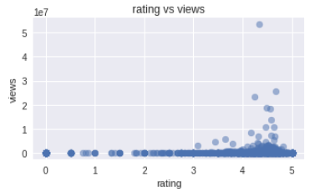
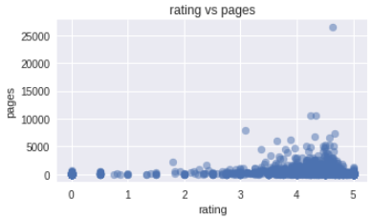
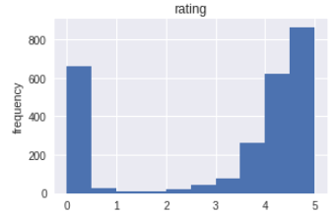
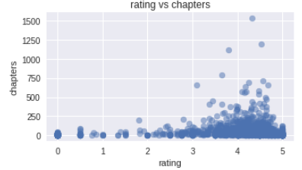
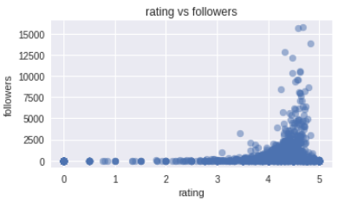
EDA
Can an algorithm rate a novel?

Slide 5
More EDA
 | title | summary | ch1 | ch2 | ch3 | ch4 | ch5
0 | Beware Of Chicken | Jin Rou wanted to be a cultivator who defie... | Beware of Chicken In which a transmigrator ... | I jolted awake to Big D’s furious battle cr... | Bi De knew fury. One of the red ones had ve... | There were many ways Meiling expected her d... | Jin surely could have left first thing in t...
 | title | tags | followers | rating | pages | views | chapters | date_last_updated
0 | Beware Of Chicken | [adventure, comedy, fantasy, romance, male, ma... | 13806 | 4.83 | 476 | 2623581 | 68 | 2021-03-29
Feature | Transformed
Tags | Made into dummy variables.
Chapters | Vectorized (tfid & NMF) to 10
Summary | Vectorized (tfid & NMF) to 10
Rating | Binarized (Threshold 4.0 stars)
Date Last Update | Days last updated
Can an algorithm rate a novel?

Slide 6
Models
Random Forest Regressor
Random Forest Classifier
R-Squared: 51%
R-squared explains how well the model is at being accurate. A score of 100% means that it is never wrong. Our score of 51% means that half of all novel ratings predicted by the model is accurate.
F1-Score: 79%
F1-Score computes accuracy of binary outcomes i.e. (Good or Bad). In this case the novel rating is divided into two groups, greater than 4 stars or less. We are simply trying to rate novels as good or bad. A F1-Score of 100% means that the model is never wrong. Our score of 79% means that the model can almost always determine weather a book is good.
Can an algorithm rate a novel?

Slide 7
Conclusion
It is possible for an algorithm to rate a novel simply by its' content. Specifically for Royal Road. The key Genres that users look for in a novel is as followed:
CH2 Topic 2: LitRPG | CH3 Topic 2: LitRPG | CH4 Topic 3: Trasformation | CH4 Topic 2: LitRPG | CH5 Topic 2: LitRPG
Numeric-word | numeric-word | back | Numeric-word | Numeric-word
skill | skill | could | skill | skill
level | level | like | level | level
class | mana | around | point | point
system | stats | one | system | class
point | system | tree | stats | stats
stats | point | eye | status | one
attribute | status | body | attribute | hp
status | stat | head | increase | system
Can an algorithm rate a novel?

Slide 8
Can an algorithm rate a novel?

