Slide 1

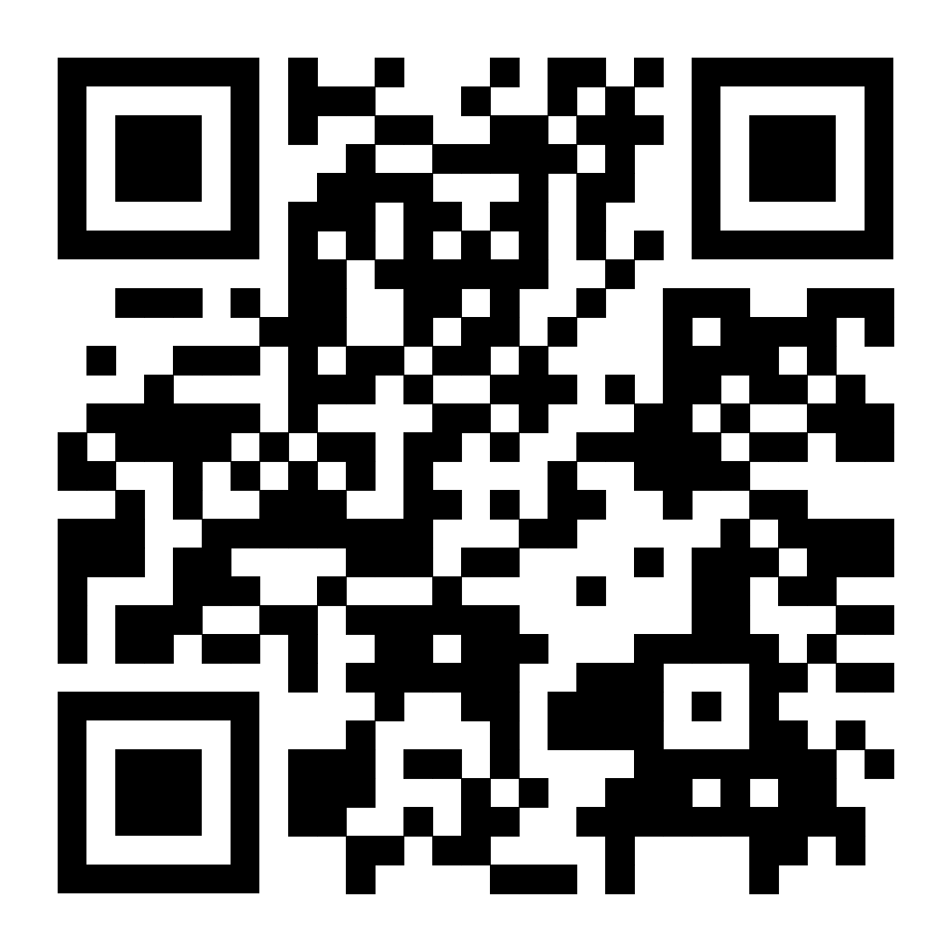
Scan the QR Code to view the Order of Program
or visit
https://ticatelier.github.io/gms-oop/index.html

