Slide 1
ORCHESTRATION
WEB
SERVICE
WEB
SERVICE
WEB
SERVICE

Slide 2
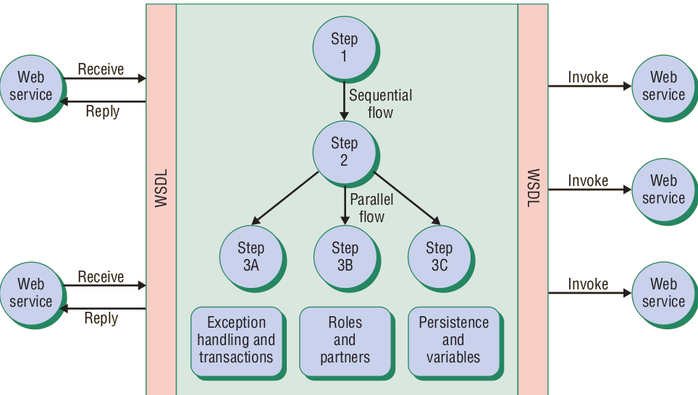
BPEL PROCESS FLOW [WSOC]

