Slide 1


MEETING IS
STARTING
SOON
FOLLOW US!
@tidaltamu

Slide 2
t i d a l t a m u
TETHERED INFORMATICS & DATA ANALYTICS LAB
Notes:
Follow us on Twitter and Instagram @tidaltamu
Join our discord and slack, links provided in email

Slide 3
Regularization
Carson Duffy and Ishaan Grewal

Slide 4
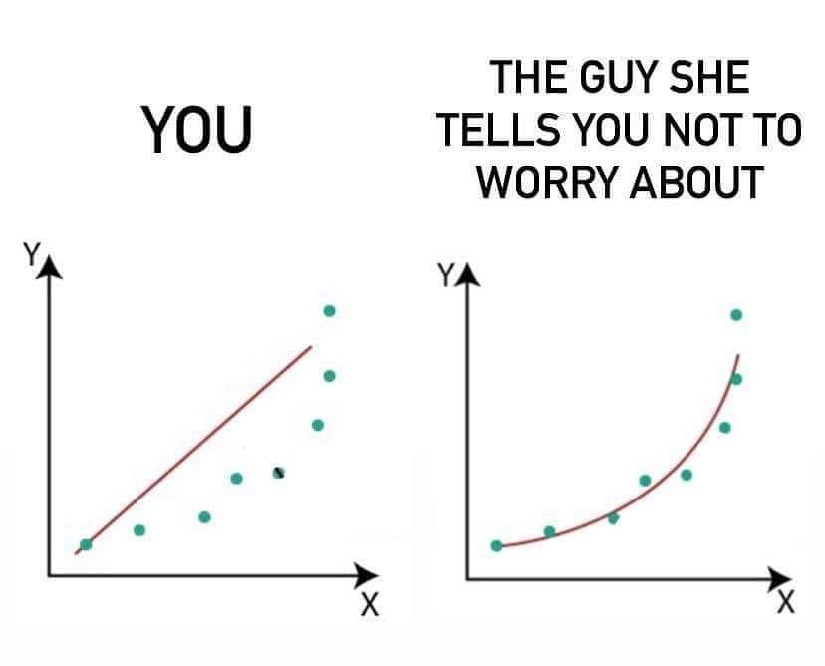
Polynomial Regression
Notes:
Linear regression doesn’t work great for all datasets
For data like this a polynomial would fit the data much better
How do we train a polynomial to fit data?

Slide 5
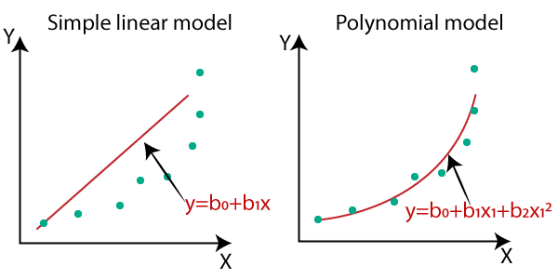
Polynomial Regression
Notes:
Polynomial regression works the exact same way in terms of cost function and gradient descent, but the hypothesis is different
We create extra features (x^2, x^3, etc.)
Using more features creates a better fit, it can also lead to other problems like overfitting

Slide 6
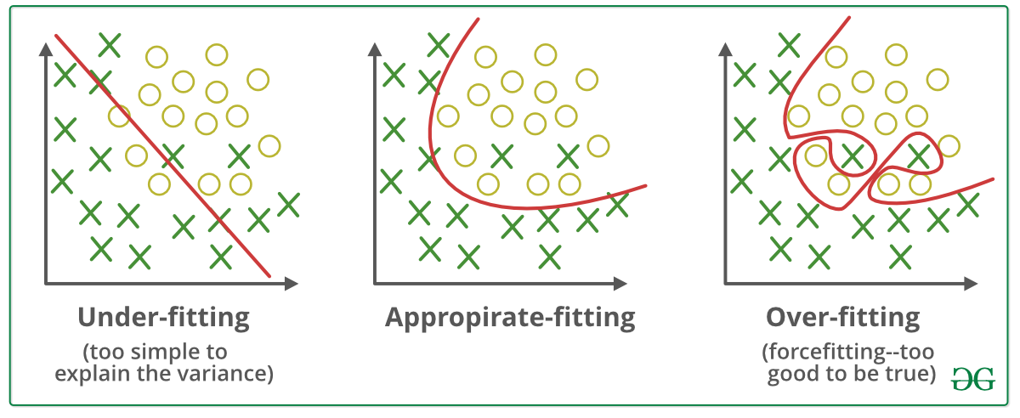
Underfitting vs. Overfitting
Notes:
Underfitting occurs when not enough features are used
Overfitting occurs when too many features are used
Fits training examples well, but doesn’t work for testing data
Lowers the accuracy of our model
How do we fix?
We could reduce the number of features (manually or with an algorithm)
Regularization

Slide 7
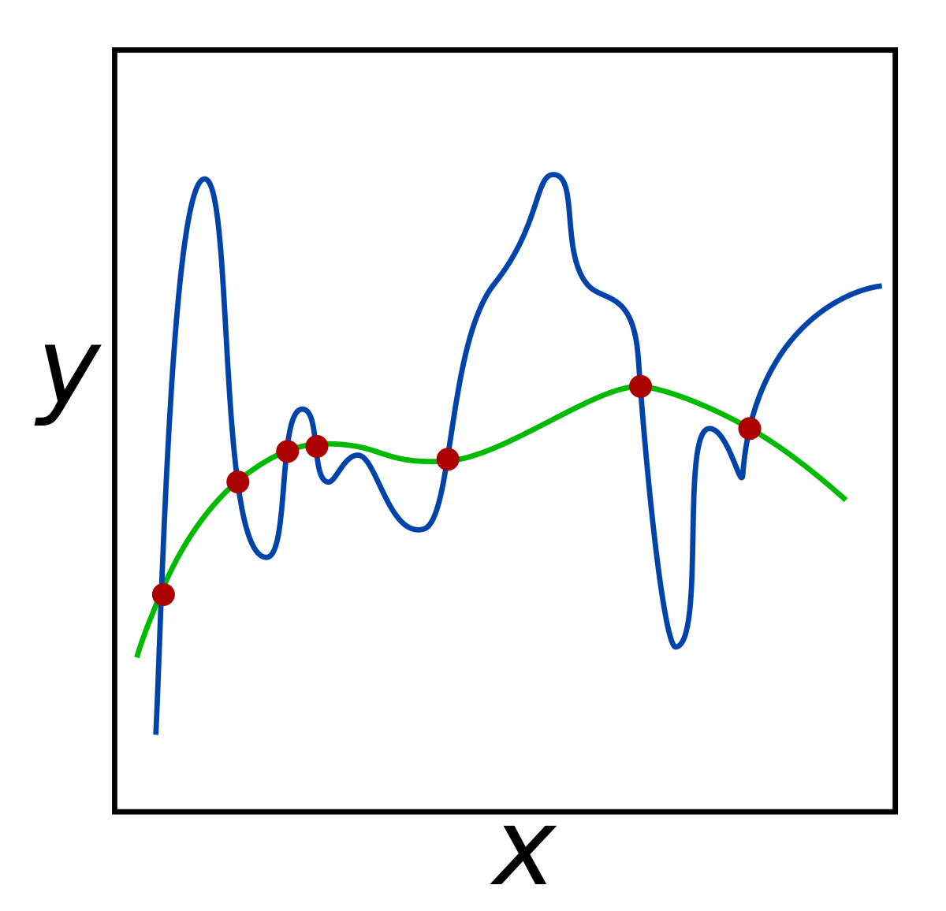
Regularization
Notes:
The process of modifying parameters to prevent overfitting
Idea is to lower the value of some parameters in order to make our hypothesis “simpler”
Blue hypothesis is before regularization, green hypothesis is after regularization

Slide 8
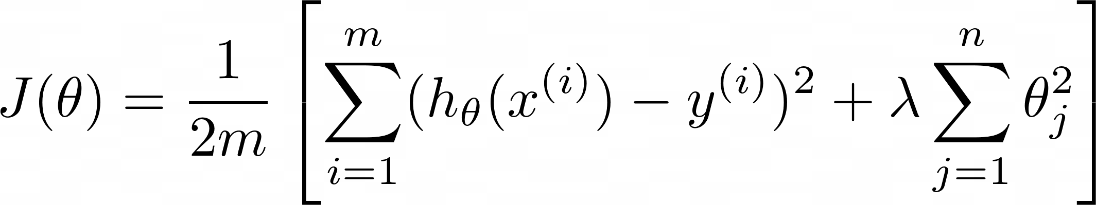
Regularized Linear Regression (Cost Function)
Notes:
To regularize, we will modify our cost function
m is the number of data entries, n is the number of features
First term is mean squared error (normal cost function for linear regression)
Second term is the regularized term
Lambda - regularization parameter, controls how large or small the parameters are
Large value of lambda will increase cost, vice versa
Large lambda can result in underfitting

Slide 9
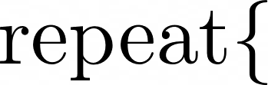
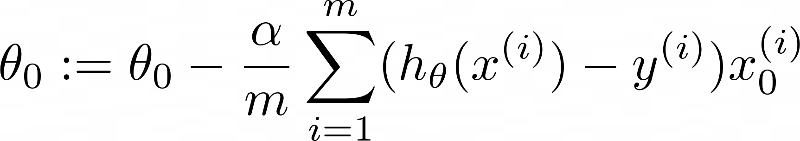
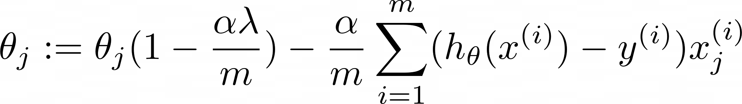
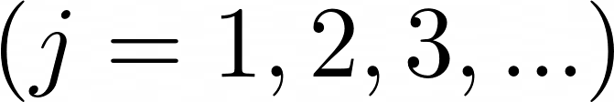

Regularized Linear Regression (Gradient Descent)
Notes:
(1 - alpha*lambda/m) will shrink theta_j by a small amount

Slide 10
Regularized Logistic Regression (Cost Function)

Slide 11
Regularized Logistic Regression (Gradient Descent)
Notes:
Same as linear regression

Slide 12
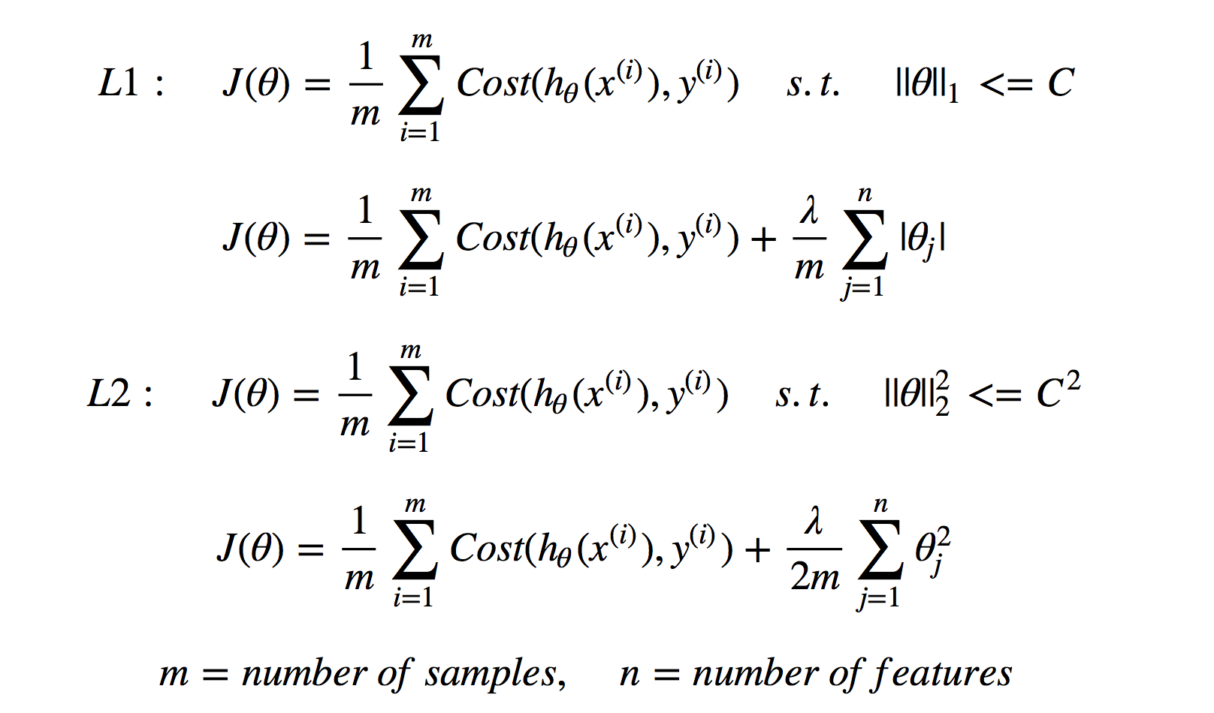
L1 vs. L2 Regularization
Notes:
Both types work similarly
L1: absolute value of coefficient is taken
L2: square of coefficient is taken
lambda/2m because when the derivative is taken, the exponent on theta_j is multiplied to the front, cancelling out

Slide 13
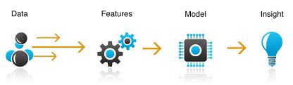
Feature Engineering

Slide 14
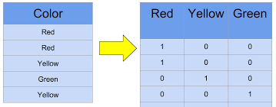
One Hot Encoding
Real world data is often categorical
Many machine learning algorithms require numerical data
One hot encoding is one way to tackle this problem

Slide 15
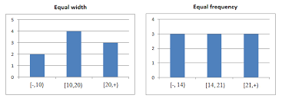
Binning (Equal Width Binning)

Slide 16
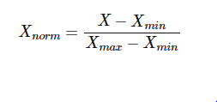
Normalization (MinMax Scaling)
Normalization is a scaling technique in which values are shifted and rescaled so that they end up ranging between 0 and 1

Slide 17
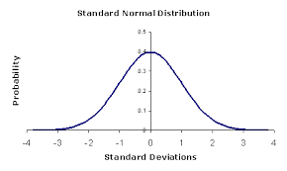
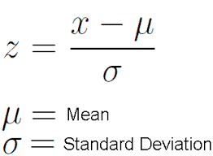
Standardization (z-score normalization)
Standardization is another scaling technique where the values are centered around the mean with a unit standard deviation. This means that the mean of the attribute becomes zero and the resultant distribution has a unit standard deviation.

Slide 18
Dealing with Missing Values
Replace with mode or mean
Predict value
Deleting rows

