Slide 1
Deep Neural Networks

Slide 2
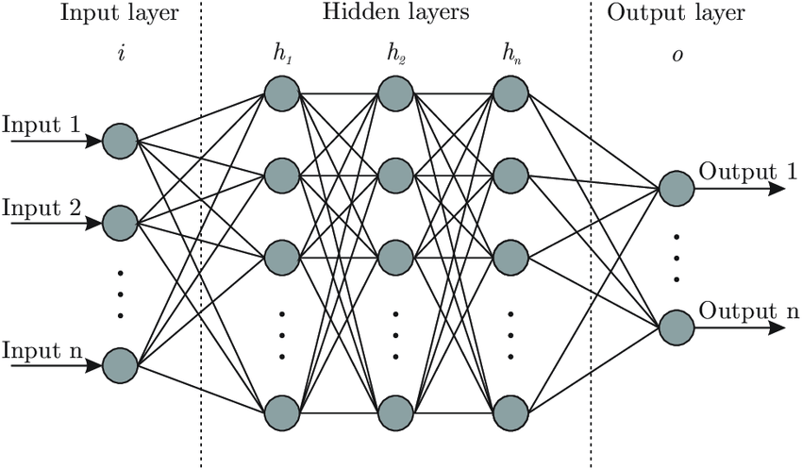
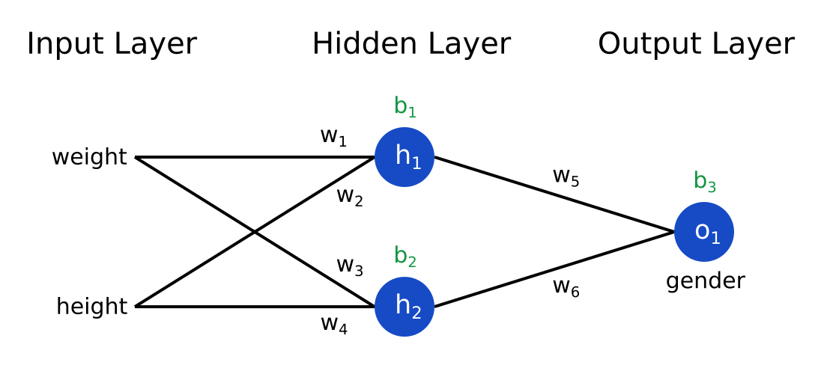
Deep Learning- Neural Networks

Slide 3
Training a Deep Network
Preprocessing
Constraining to relevant data
Normalization
Split dataset into training and testing sets
Dictate model parameters
Feed training data into model
Training features
Training labels
Then run test set to determine accuracy
Test features
Test labels

Slide 4
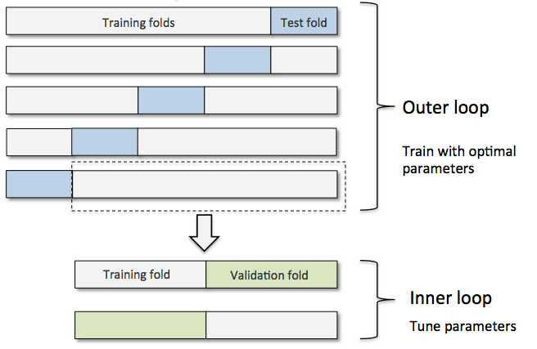
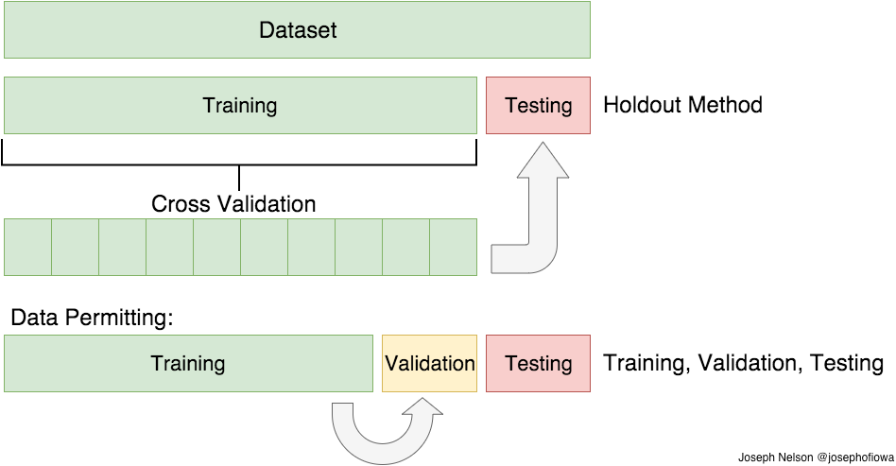
Train Test Split
Notes:
Usually a test set will be about 20% of a dataset though it varies based on dataset size and needs

Slide 5
Model Parameters
Determine number of hidden layers
Loss function
Optimizer
Metrics
Notes:
Loss function- measures accuracy of model during training, minimized with optimizers
Can be numerous functions, MSE (mean squared error) is common for regression
Optimizer- how model updates based on data and loss function
Metrics- used to monitor training and testing

Slide 6
Feed Data into Model
Training + Testing

Slide 7
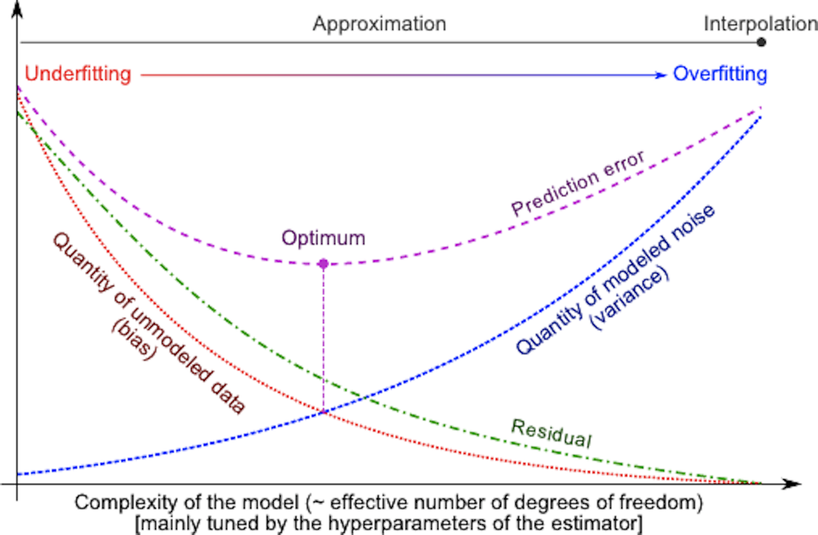
Bias vs. Variance

Slide 8
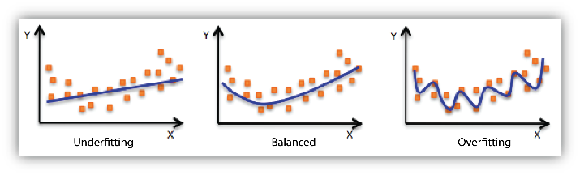
Overfitting (high variance) and Underfitting (high bias)

Slide 9
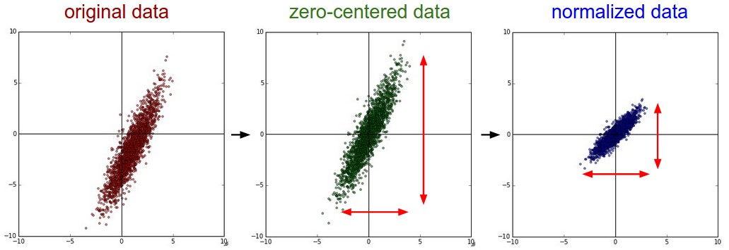
Normalization
Notes:
Used to normalize the displacement of the data
Reduces the overfitting of a neural network
Many potential methods, dropout and batch normalization

Slide 10
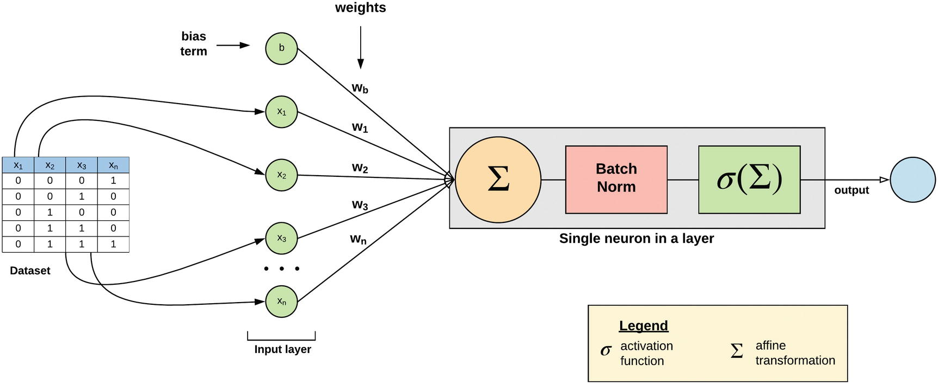
Batch Normalization
Notes:
Left
Top- we see where we apply batch
Bottom-normalize activation function- mean, std, learned as part of model
Right-
top= see distribution of values across multiple hidden layers, distribution of values no batch change significantly between iterations of inputs and within each epoch
we see subsequent layers in the network without batch see varying distribution of input data
Change in distribution with batch is negligible

Slide 11
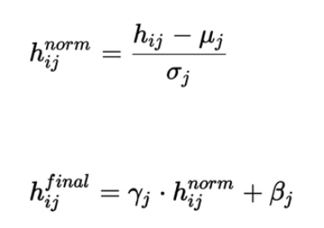
Batch Normalization
Notes:
Left
Top- we see where we apply batch
Bottom-normalize activation function- mean, std, learned as part of model
Right-
top= see distribution of values across multiple hidden layers, distribution of values no batch change significantly between iterations of inputs and within each epoch
we see subsequent layers in the network without batch see varying distribution of input data
Change in distribution with batch is negligible

Slide 12
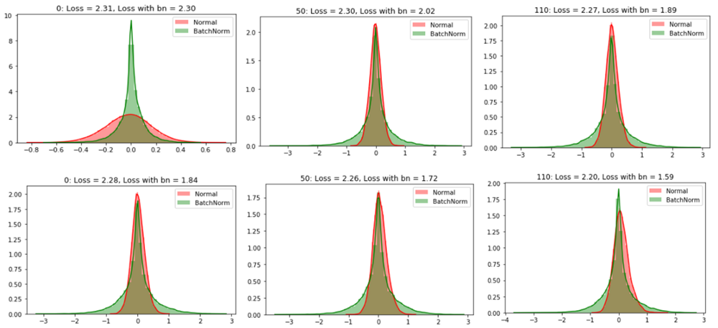
Batch Normalization
Notes:
Left
Top- we see where we apply batch
Bottom-normalize activation function- mean, std, learned as part of model
Right-
top= see distribution of values across multiple hidden layers, distribution of values no batch change significantly between iterations of inputs and within each epoch
we see subsequent layers in the network without batch see varying distribution of input data
Change in distribution with batch is negligible

Slide 13
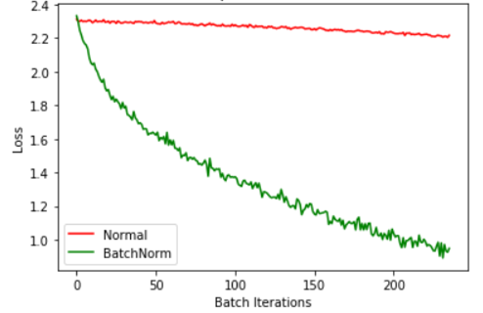
Batch Normalization
Notes:
Left
Top- we see where we apply batch
Bottom-normalize activation function- mean, std, learned as part of model
Right-
top= see distribution of values across multiple hidden layers, distribution of values no batch change significantly between iterations of inputs and within each epoch
we see subsequent layers in the network without batch see varying distribution of input data
Change in distribution with batch is negligible

Slide 14
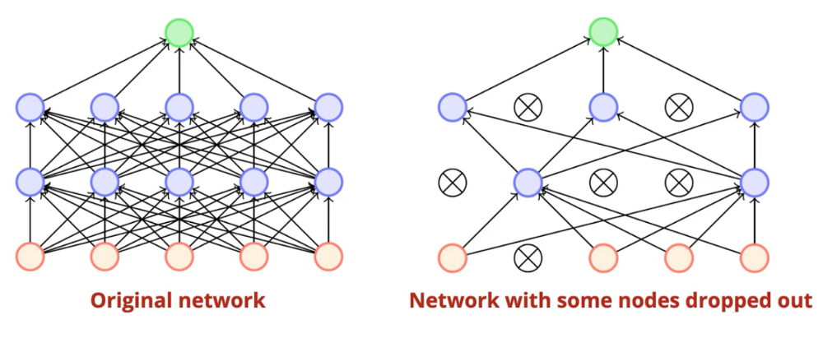
Dropout Normalization
Notes:
Randomly deactivates neurons at each training step
Train data on the network with dropped out nodes
Is subsequent iterations, the hidden neurons are deactivated by dropout changes and probabilistic behavior
Using this method we can simulate an ensemble of NN”s with different architectures

Slide 15
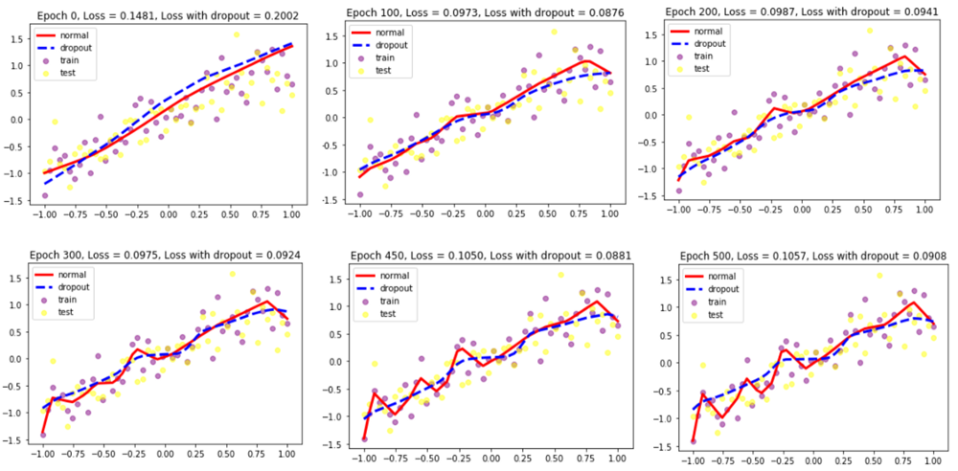
Dropout Normalization
Notes:
Randomly deactivates neurons at each training step
Train data on the network with dropped out nodes
Is subsequent iterations, the hidden neurons are deactivated by dropout changes and probabilistic behavior
Using this method we can simulate an ensemble of NN”s with different architectures
Reduces overfitting of a network
Reduces the overfitting of a neural network
Reduces the overfitting of a neural network

