Slide 1


MEETING IS
STARTING
SOON
FOLLOW US!
@tidaltamu

Slide 2
t i d a l t a m u
TETHERED INFORMATICS & DATA ANALYTICS LAB
Notes:
Follow us on Twitter and Instagram @tidaltamu
Join our discord and slack, links provided in email

Slide 3
Introduction to Python, Numpy, Pandas, and Matplotlib
Carson Duffy and Ishaan Grewal
Notes:
Do polls
Programming experience: https://strawpoll.com/regfdrgkj
Python experience: https://strawpoll.com/wgbxs8kjk
These tools/packages serve as the foundation for
Tidaltamu workshops and projects
Many aspects of data science

Slide 4

What is Python?
Notes:
Programming language
Easy to read, easy to use, easy to learn
Interpreted language - directly executes when run
Because it is so widely used
Python likely already has a package for most data science and machine learning applications

Slide 5
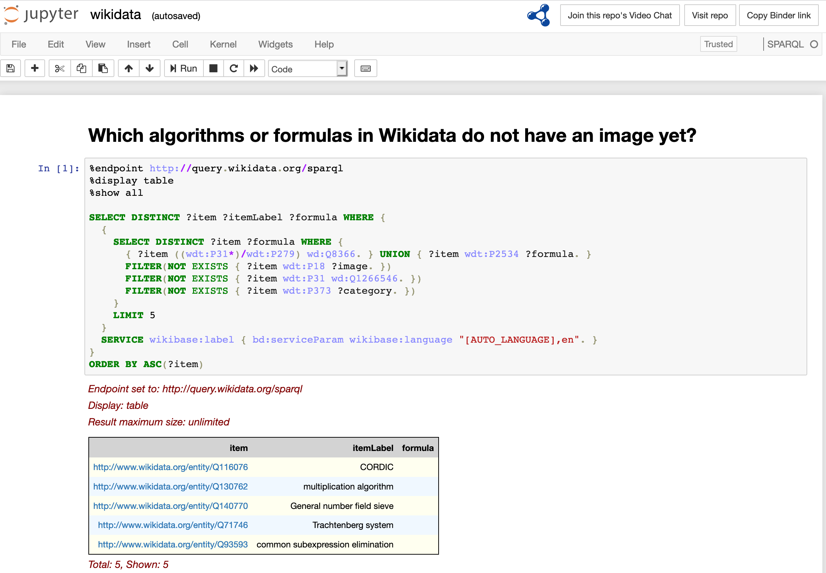
What is a Jupyter Notebook?
Notes:
A document that contains code, its output, and markdown sections
Allows data scientists to clearly describe their thought process and results
You can see the output of the program as it progresses
Comes with Anaconda, which is a piece of Data Science software that contains python and a multitude of important Data Science packages
Installing Anaconda can be tricky and time-consuming

Slide 6


What is Google Colab?
Notes:
Google’s implementation of Jupyter Notebook
Instead, you open Google Drive, start a Colab file, and write code
Python and all of its packages already come installed
Walkthrough getting started with colab
Howdy World

Slide 7

What is NumPy?
Notes:
Numpy is Python’s package for vectors, matrices, and high-level mathematics operations
Numpy’s array functionality is very robust and allows for effective data manipulation
Provides support for linear algebra operations

Slide 8
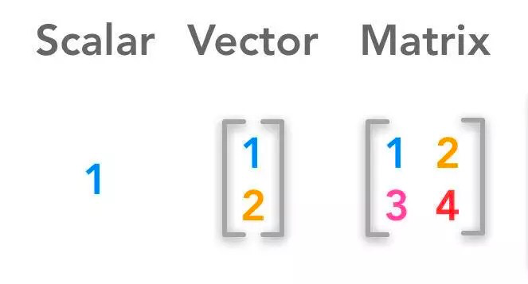
Linear Algebra Review
Notes:
Linear algebra deals with groups of numbers

Slide 9
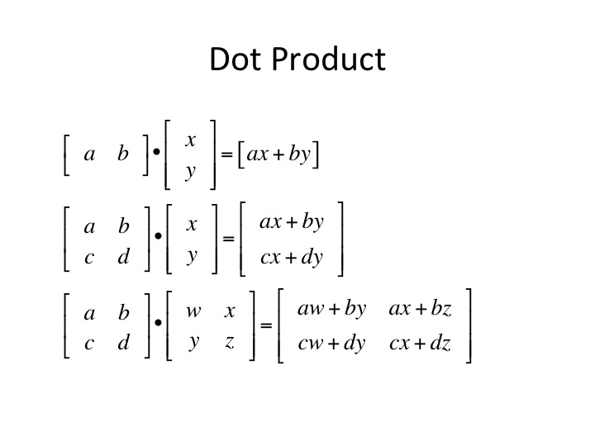
Linear Algebra Review
Notes:
Cover dot product examples, how to do them

Slide 10
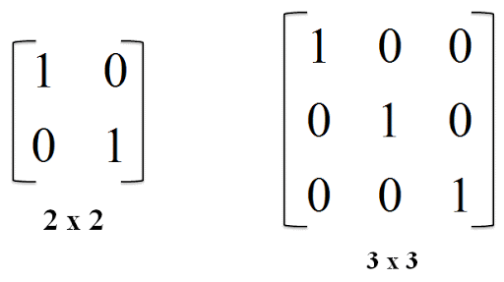
Linear Algebra Review
Notes:
Identity matrix has ones on the diagonal and zeros everywhere else
Any matrix multiplied by an identity matrix is itself
A matrix multiplied by its inverse is the identity matrix

