Slide 1


MEETING IS
STARTING
SOON
FOLLOW US!
@tidaltamu

Slide 2
t i d a l t a m u
TETHERED INFORMATICS & DATA ANALYTICS LAB
Notes:
Follow us on Twitter and Instagram @tidaltamu
Join our discord and slack, links provided in email

Slide 3
Machine Learning Models
Saini Ye and Carson Duffy

Slide 4
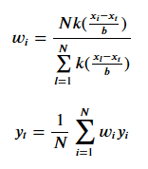

Kernel Regression
Gaussian Kernel Equation
Notes:
Linear regression does not always work
Kernel: a similarity function that takes two inputs and splits out how similar they are
Non-parametric - calculates the target y by performing computations directly on the input x
Different types: Gaussian Kernel Regression
Each constructed kernel can be viewed as a normal distribution with mean value xᵢ and standard deviation b

Slide 5
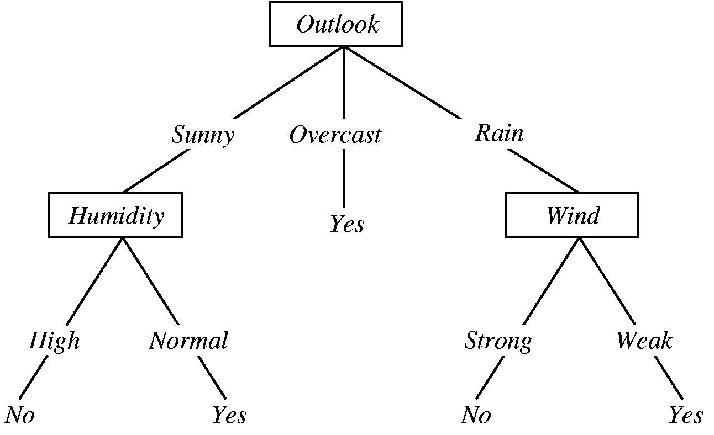
Decision Tree
Notes:
One of the predictive modelling approaches used in machine learning
Flowchart-like structure: each internal node represents a test on a feature
Each leaf node represents a class label (aka the decision taken after computing all features)
Branches represent conjunctions of features that lead to those class label.
Example on the slide: the basic flow of decision tree for decision making with labels (Rain (Yes), No Rain(No)
Constructed via an algorithmic approach that identifies ways to split a data set based on different conditions.
Also non-parametric (just like kernel regression)

Slide 6
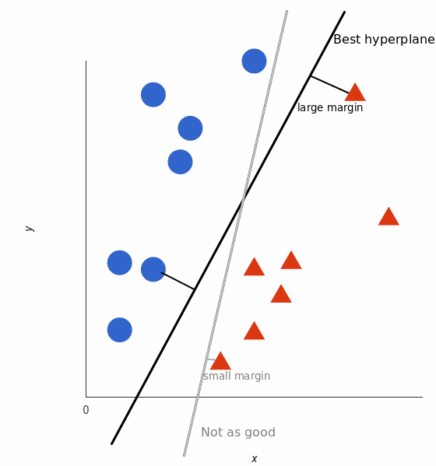
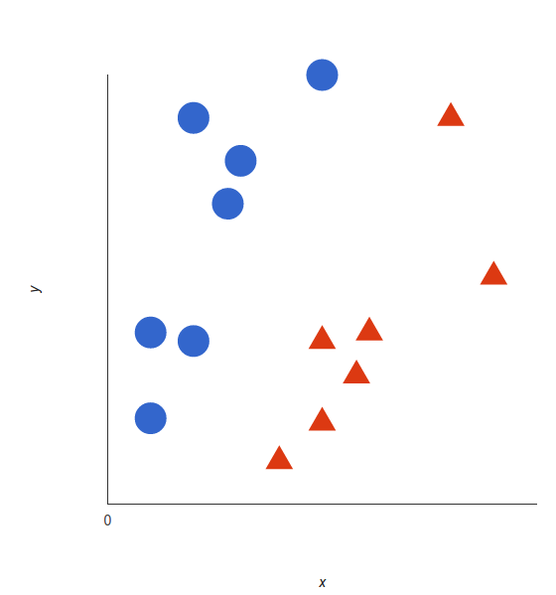
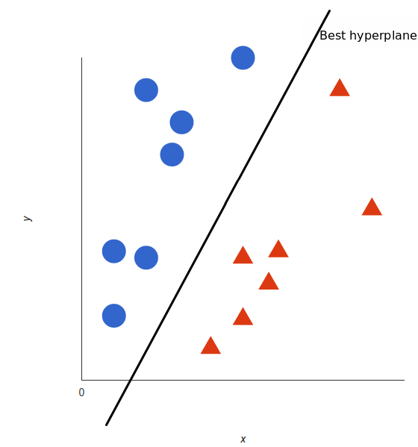
Support Vector Machine (SVM)
Notes:
A supervised machine learning model that uses classification algorithms for two-group classification problems
After giving an SVM model sets of labeled training data for each category, they’re able to categorize new text.
A simple example on the slide:
Two tags, red and blue with two features x and y. We want a classifier that, given a pair (x,y) coordinates, outputs if it’s either red or blue. Figure 1 shows the plot with already labeled training data on a plane.
Figure 2: SVM takes these data points and outputs the hyperplane that best separates the tags. The black line is called the decision boundary. (in 2D, it’s just a line, 3D, it could be a plane)
Anything that falls to one side of it will classify as blue, and the other will be red
We want the best hyperplane for an relative accurate outputs. For SVM, the best will be the one that maximizes the margins from both tages.
On figure 3: the hyperplane (in this case it’s a line) whose distance to the nearest element of each tag is the largest

Slide 7
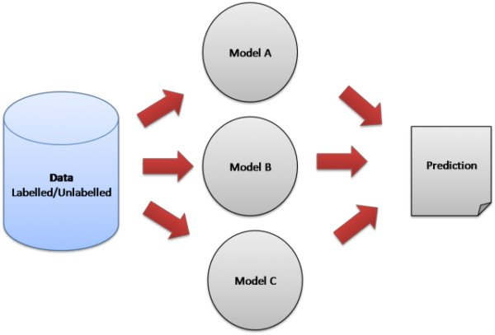
Ensemble Learning
Notes:
The process of using multiple models in conjunction to make predictions
Reduces the chance of an unlucky selection of training data, which leads to inaccurate predictions
Each model in an ensemble is known as a classifier or a learner
Ensemble learning in everyday life:
Read multiple reviews for restaurants or bars
Reduces chance of
Influence by picky eaters
Unqualified employee prepared the food incorrectly
Asking for advice
Reduces chance of
Being advised by someone with loose understanding of the situation
Poor advice
In machine learning:
Model selection
Inadequate amount of data
Data Fusion
Confidence Estimation
Training Multiple Models - sometimes a problem is too complex for one classifier to accurately solve
http://www.scholarpedia.org/article/Ensemble_learning

Slide 8
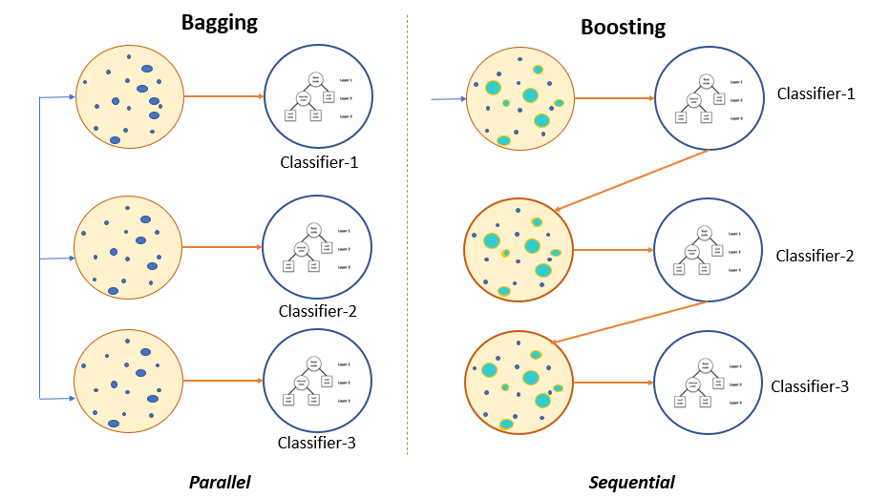
Bagging and Boosting
Notes:
Two types of ensemble learning methods
Differ in how data is selected and how/when the models are trained
We will dive into the theory behind each

Slide 9
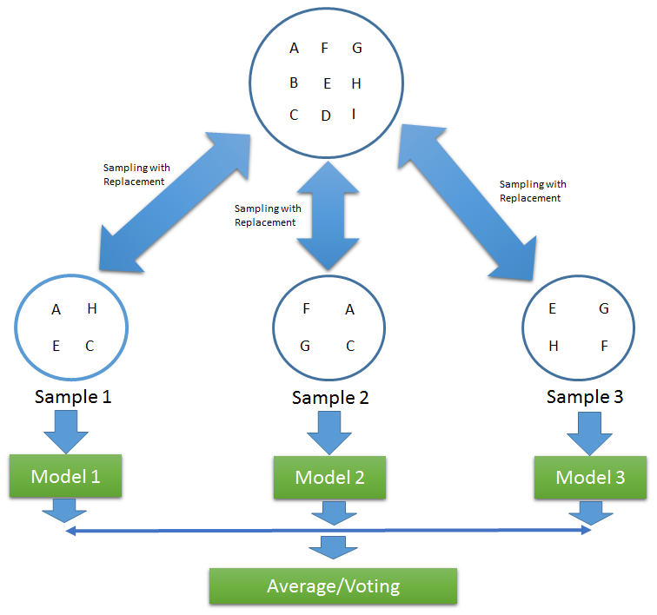
Bagging
Notes:
Also called Bootstrap Aggregation
Multiple learners are created, each with similarly-sized samples of data from the dataset
Sampling with replacement is used: if the data is used, it is not taken from the dataset
Some data points may be used multiple times, others not at all (unlikely)
Each learner is trained in parallel, or at the same time
The output of each model is averaged and reported as the prediction for the ensemble

Slide 10
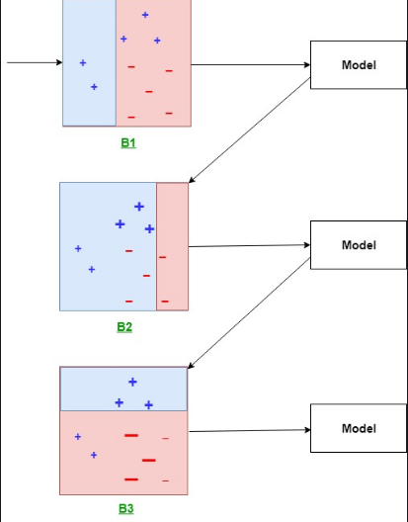
Boosting
Notes:
A bit more complicated than bagging
Models are trained sequentially
One model is created, trained, and tested
The data used in the next model is weighted based on the accuracy of the previous model
Weights are increased for data that is classified incorrectly (show in diagram)
Future learners will focus more on those data points during their training
The output of each model is averaged as well, but it’s a weighted average
An extra step is included at the end to determine the effectiveness of the ensemble
If the error of the ensemble is below a certain level, it is kept
If not, the weights of the data points are adjusted and more learners are created

Slide 11
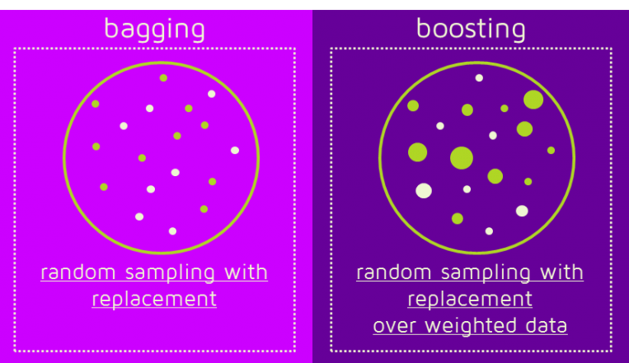
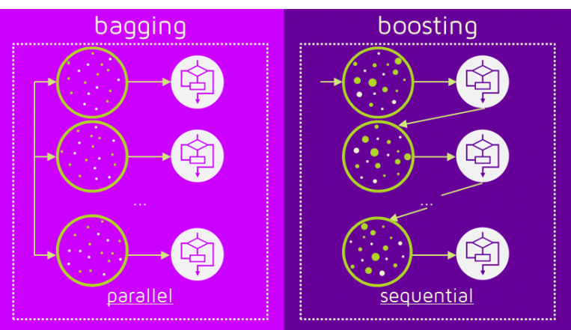
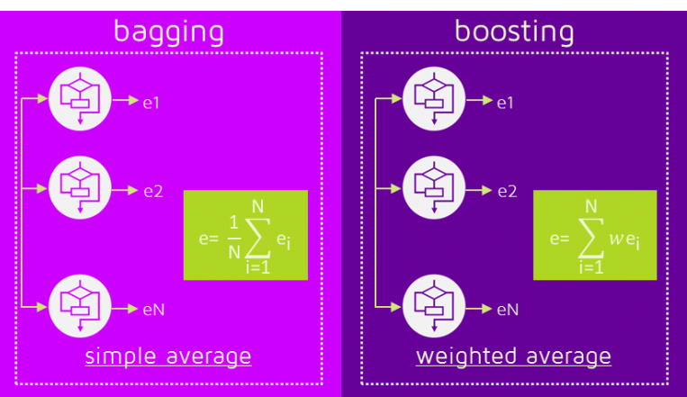
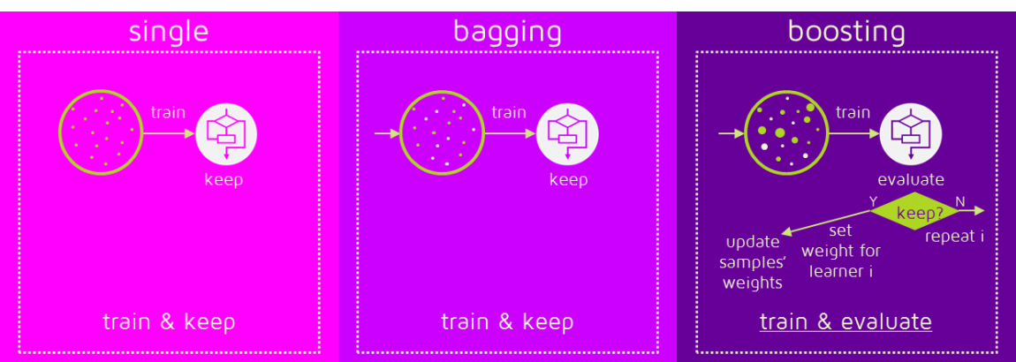
Bagging vs. Boosting
Notes:
“Let’s compare the two”
Which is better?
Depends on the data
Both are good at reducing variance, so the resulting model is more stable
Boosting is great for reducing bias (solving underfitting)
Bagging is great for reducing variance (solving overfitting)
https://quantdare.com/what-is-the-difference-between-bagging-and-boosting/

Slide 12
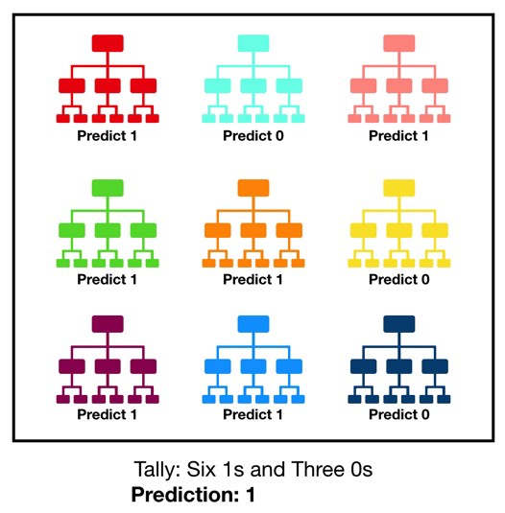
Random Forest
Notes:
A Random Forest is an ensemble of Decision Trees
Uses Bagging
Protects against decision tree inaccuracies
Each tree has a different sample of the dataset
https://towardsdatascience.com/understanding-random-forest-58381e0602d2

Slide 13
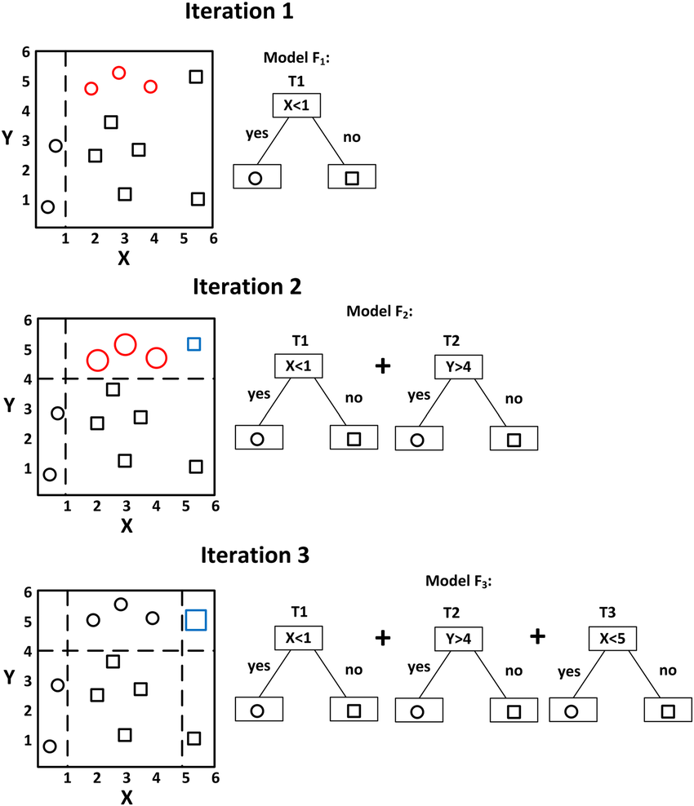
Gradient Boosting
Notes:
Can be thought of as Random Forest with Boosting
Walk through diagram
The weights are added using gradients in the loss function of each tree, gives gradient boosting its name

