Slide 1
Advance Lecture 1:
Stochastic Gradient Descent
John Broucek & Trey Royalty

Slide 2
We’ll get started soon!

Slide 3
Agenda
Anomaly Detection
Supervised vs. Unsupervised Learning
Gradient Descent

Slide 4
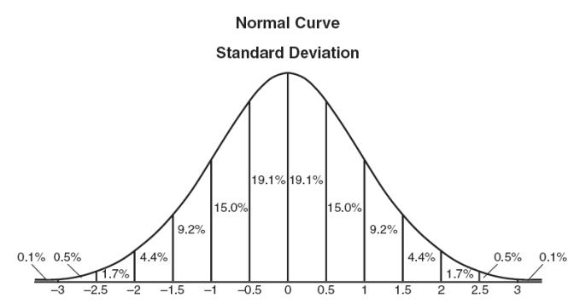
Gaussian Distribution
Fundamental Bell curve
Assumes certain percentages of data points will be found within N number of standard deviations from the mean
Further from the mean = less data points and thus higher N

Slide 5
What is an example of a Gaussian Distribution?

Slide 6
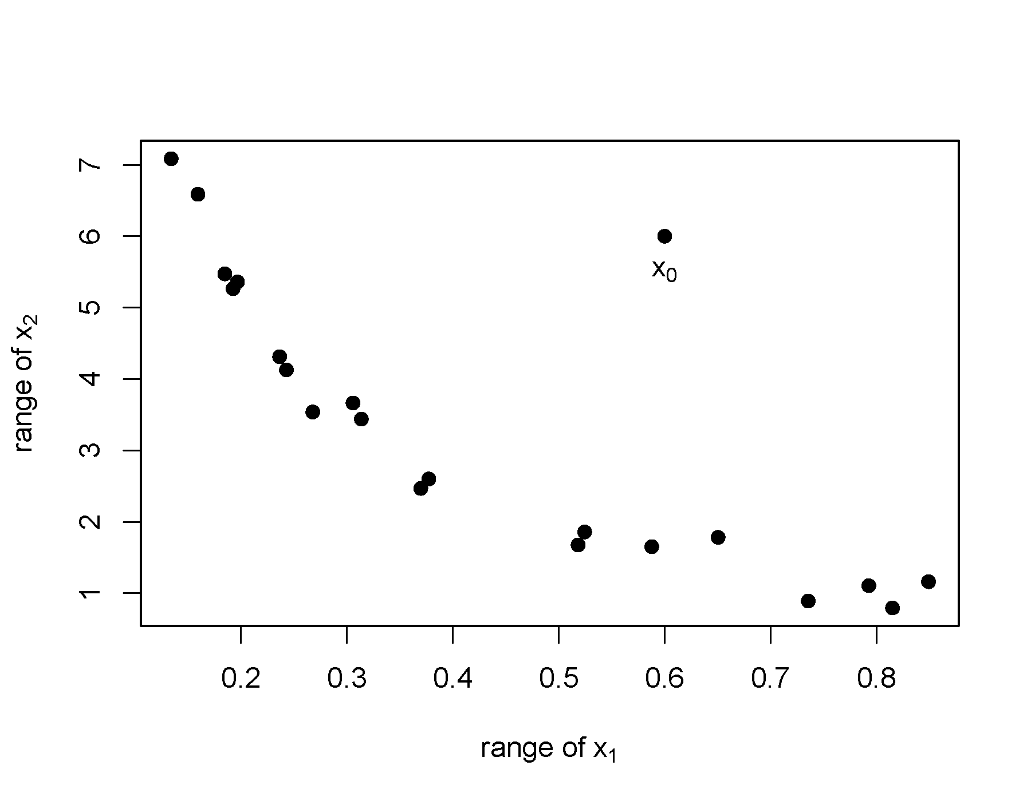
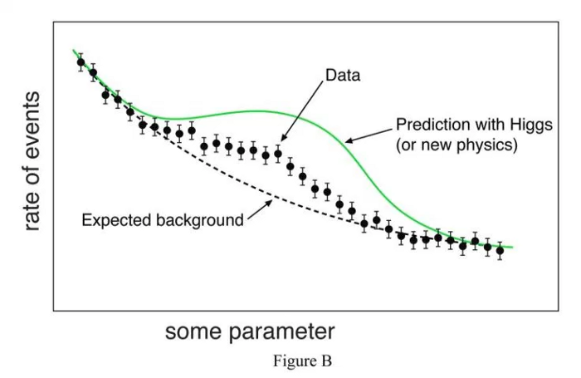
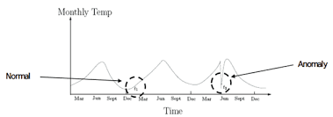
Outliers/Anomalies
Univariate
Found by looking at distribution in single feature space
Multivariate
Found looking at n-feature space
Types
Point, Contextual, Collective
Notes:
Point- when one data point deviates significantly from expected lines
Contextual-
Collective- when you observe large amount of data displacment from the expectation
Could be discovery of a new trend or phenomena
These are the result of traditional errors in the data or expected results from experimental procedures

Slide 7
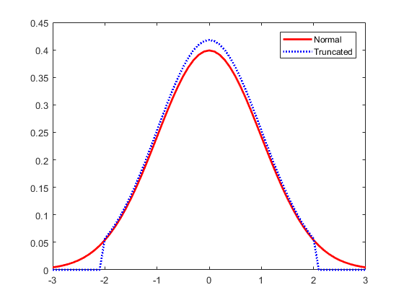

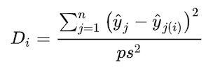
Methods of Detection
Z-score/Extreme Value Analysis (Parametric)
A set of probabilistic models that vary on multiple features
Linear Regression Models
Cook’s Distance
P: number of variables
s^2: mean squared error of regression model
Cutoffs values: usually 2(p+1)/n for small sample size, 3(p+1)/n for large sample size
Additional methods exist but we won’t go into more detail
https://towardsdatascience.com/a-brief-overview-of-outlier-detection-techniques-1e0b2c19e561
https://towardsdatascience.com/a-short-journey-of-outlier-detection-bdf143464a92
Notes:
Z-score
Uses gaussian distributions to assign how many standard deviations is from the mean
If data doesn’t fit the gaussian distribution, we can scale the data to make it
This is a built in function to python
Thresholds pick a number of deviations not to exceed and alter the points within the distribution to make 100% of points fit it, this creates truncation error by removing outliers from beyond the data set
Cook’s Distance
Measures scores by finding squared errors between i-th fitted values predicted by an estimator
Includes the i-th observation and fitted value predicted by the estimator based on the exclusion of the i-th data point for every i--th point

Slide 8
When would I want to use Z-score deviation detection?
Notes:
Enables us to find predictability of finding the data point
If mean is known, we can draw observations from it
Heights, determining the outlier of such a dataset

Slide 9
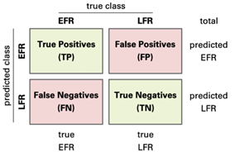
Evaluating Anomaly Detection System
Unsupervised
Confusion Matrix can be used to represent predicted values
Use inclusion exclusion principle
Include unknown values in the cross validation and testing sets to better see where the anomalous trends start to come into play
May find occurrences of labels existing in the dataset to generate easier methods of evaluating the anomaly detection
This then becomes a question of classification
More Information
https://towardsdatascience.com/unsupervised-learning-for-anomaly-detection-44c55a96b8c1
https://medium.com/balabit-unsupervised/how-to-evaluate-unsupervised-anomaly-detection-for-user-behavior-analytics-88f3d5de2018
Notes:
We are technically predicting the class the data falls within when we perform anomaly detection
Splitting data into anomalous data and those that are obviously not
Use inclusion exclusion principle

Slide 10
What is the difference between supervised learning and anomaly detection?

Slide 11
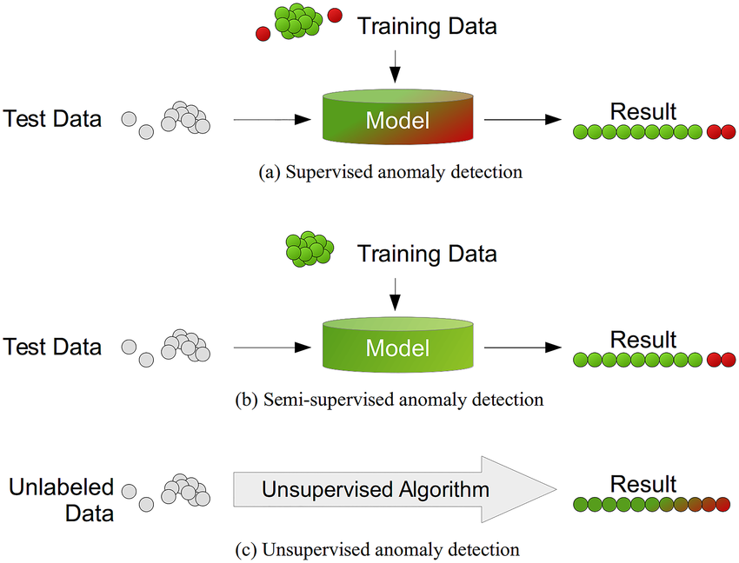
Anomaly Detection
Supervised Learning
Locates outliers and extreme points that significantly deviate from other data
Examination of the points can lead to discovery or removal of datasets
If done correctly, should distinguish between signal from the noise to avoid false positives
No labels present for a model to train on
Unsupervised Learning
Model is trained on labeled data to predict the unseen data
Requires knowledge of what constitutes a “good” or “bad” data point
Generally considered to have higher accuracy due to the labeling
More Information
https://www.crunchmetrics.ai/blog/Is-anomaly-detection-supervised-or-un-supervised/#:~:text=Anomaly%20detection%2C%20also%20known%20as,deviating%20from%20the%20remaining%20data.&text=Supervised%20learning%20is%20the%20scenario,will%20predict%20the%20unseen%20data.
Notes:
Semi-supervised learning

Slide 12
What do you think is semi-supervised learning?

Slide 13
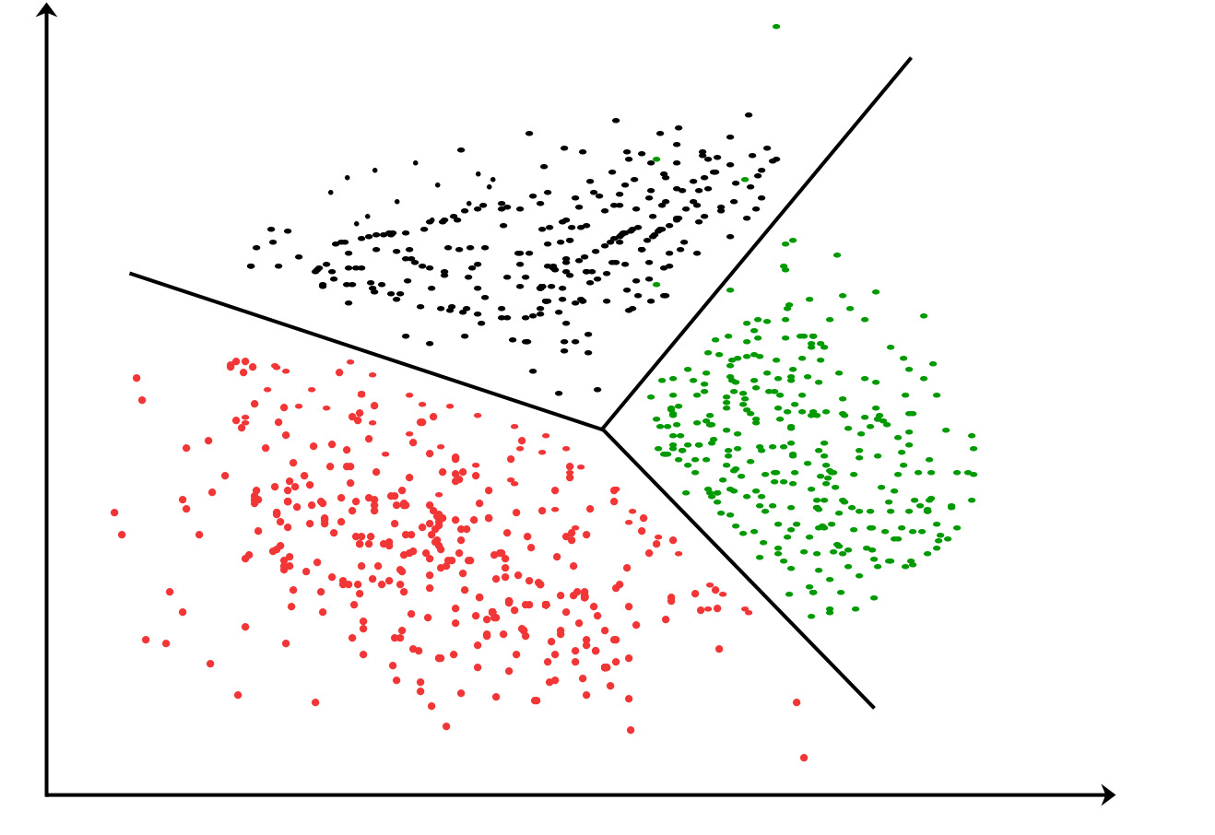
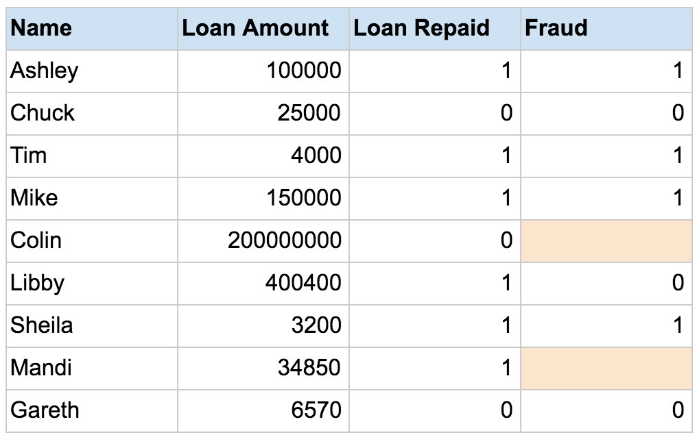
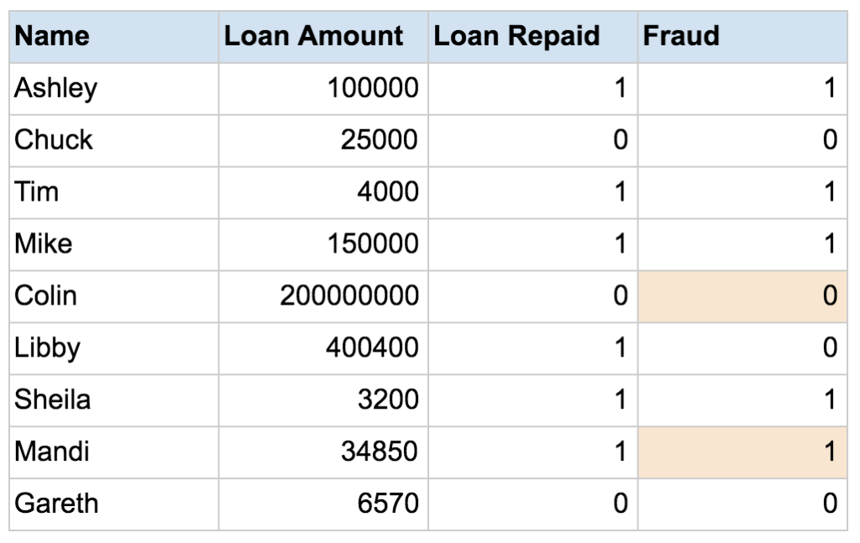
Semi-Supervised Learning
More Information
https://www.datarobot.com/wiki/semi-supervised-machine-learning/
Notes:
If not enough labeled data exists, only some data points have labeled values for the output variable
Can use the semi-supervised to label the data using unsupervised classification methods, then use supervised learning on the newly generated dataset

Slide 14
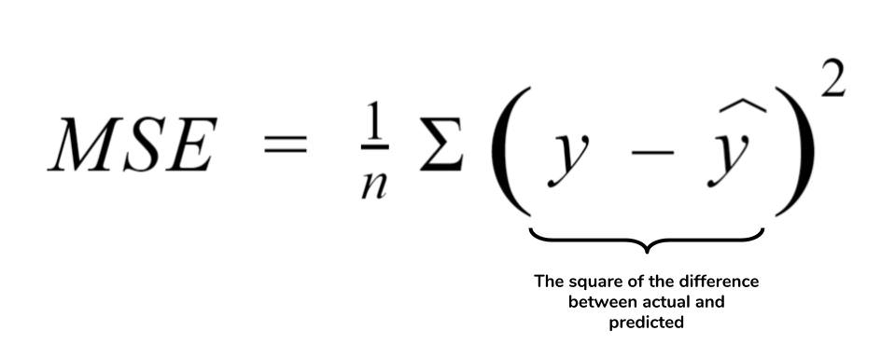
Loss Function
https://colab.research.google.com/github/d2l-ai/d2l-en-colab/blob/master/chapter_optimization/sgd.ipynb
https://colab.research.google.com/drive/17iTEhaFUu0pXe-6_7ODipYBVxGgEmOAq

Slide 15
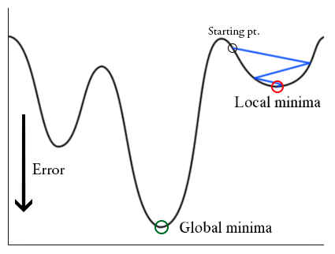
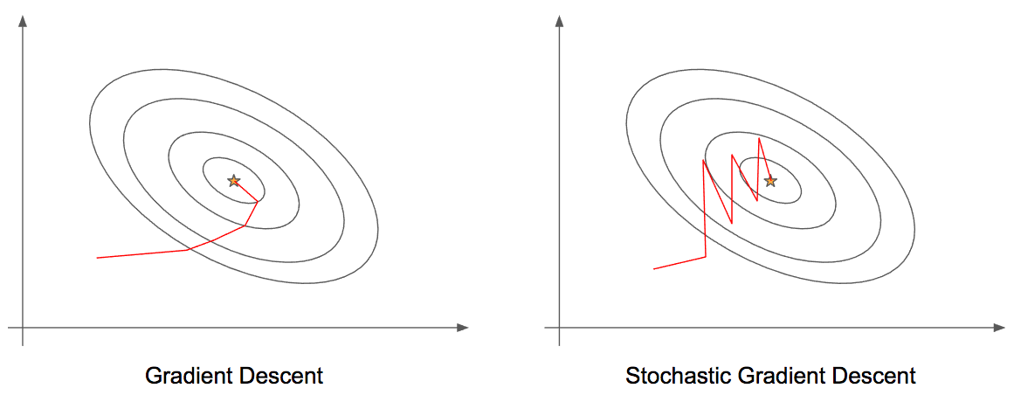
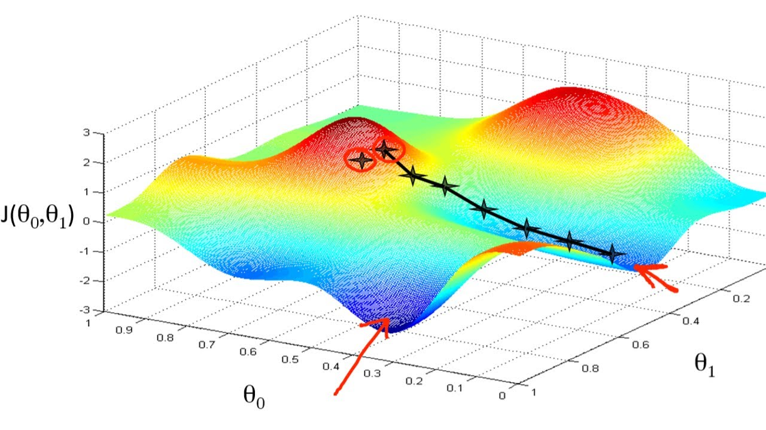
Batch Gradient Descent
All training data
Average gradient for all samples
Works for smaller datasets
Works well for smooth error spaces

Slide 16
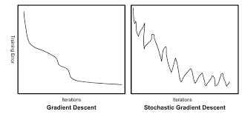
Stochastic Gradient Descent (SGD)
Takes one sample at a time
Faster
Better for larger datasets
Lends itself to more fluctuations
Noisier gradients can help jerk out of local minima

Slide 17
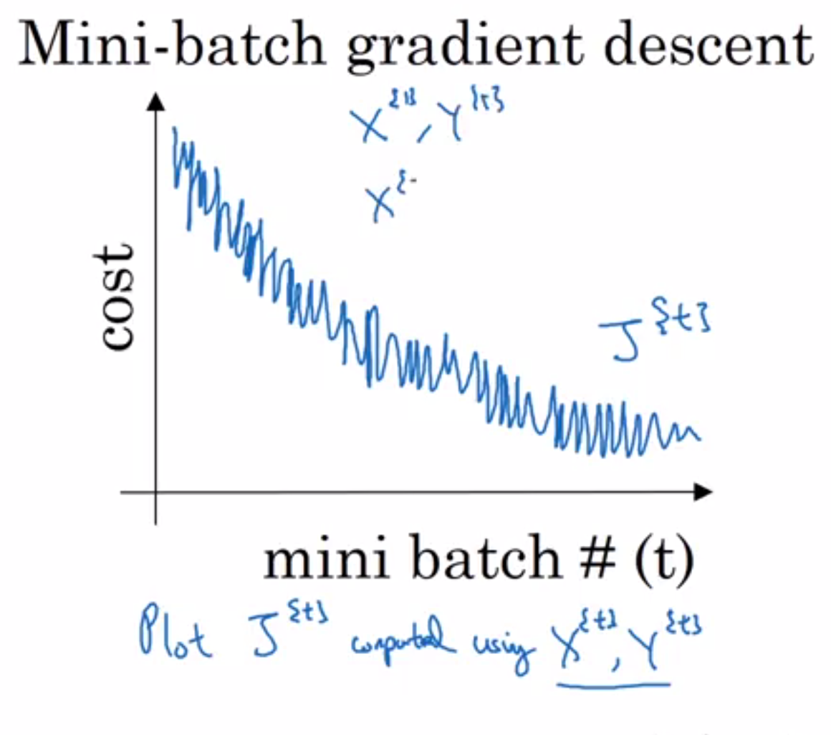
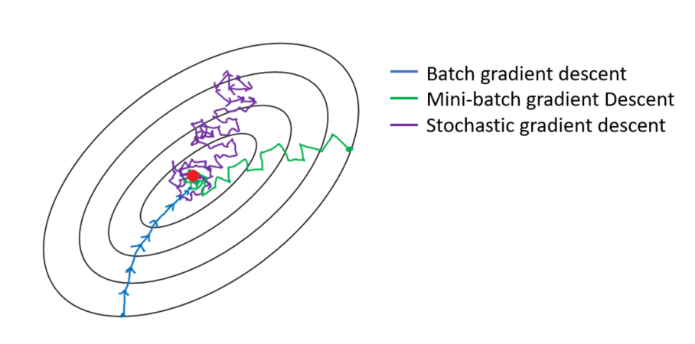
Mini-Batch Gradient Descent
Mixture of Batch and Stochastic
Less fluctuations than Stochastic
Less space than Batch
Aim to be correct size to move towards global minima

