Slide 1
We’ll get started soon!

Slide 2
Introduction to
Neural Networks
John Broucek & Trey Royalty

Slide 3
Neural Networks
Notes:
Can anyone tell me briefly what a neural network is?

Slide 4
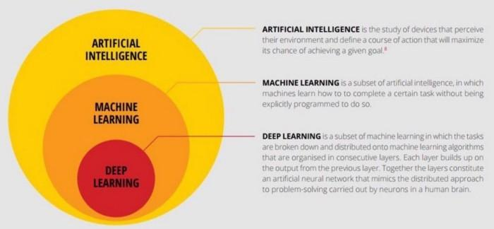
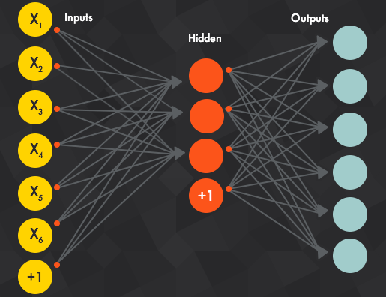
What are Neural Networks?
Notes:
Deep learning is a method by which we use concepts of machine learning and AI to develop an algorithm inspired by the function of the human brain

Slide 5
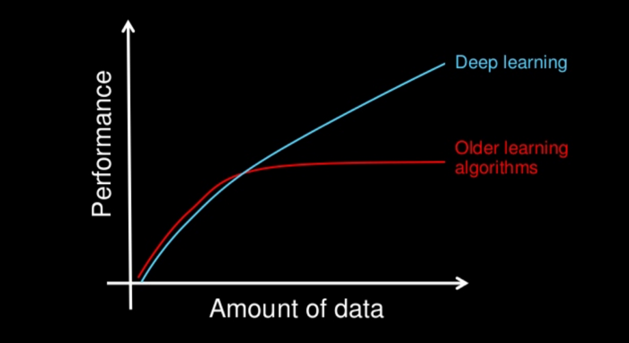
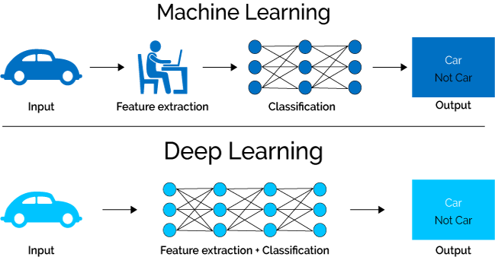
Why do we use deep learning?
Notes:
Faster
Deep learning does feature extraction for us compared to more manual methods of feature extraction in ML
Feature extraction by hand requires knowledge of the dataset but introduces human bias into the model

Slide 6
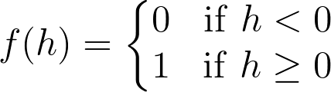
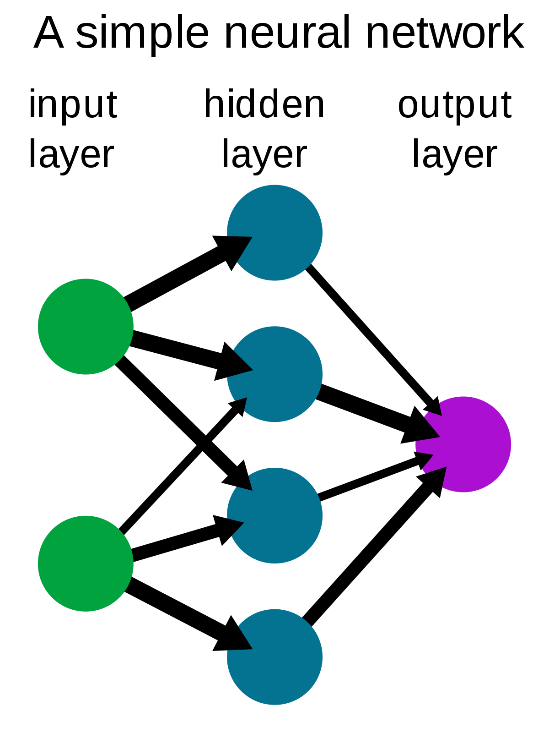
Building blocks of neural networks
Linear/Logistic Regression
Activation Functions
Weights & Bias
y=mx+b
Notes:
Linear regression, fitting on a linear line
Logistic regression, used when one or more independent variables determine the outcome of the dataset, favorable or unfavorable
Activation functions- functions that decide given the input what is the output
For example, if a linear combination is less than zero, the activation function returns less than 0, but returns a 1 if linear combination is equal to zero
Weights- each arrow is assigned a weight as it joins the data at the hidden layer, they begin as random values but get reassigned as the neural network determines error and how weights will increase or decrease our observed final error, this becomes much more complex with more layers
This assignment is during the process called training the neural network
Bias is the b quantity

Slide 7
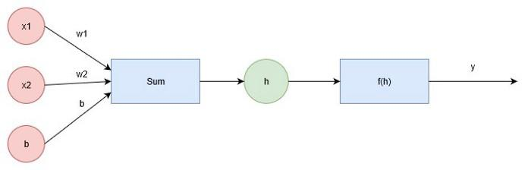
Neural Network Architecture
Notes:
X1, x2 are inputs, b is the bias
Sum in the linear combination of the weighted values
H is the input of the neural network
f(h) is the activation function
Y is the output as a result of the output function

Slide 8


Equations
Does this look familiar?
Sigmoid Functions
Bounded between 0 and 1 (favorable or unfavorable probability of success)
Can be used as an activation function
Notes:
Should look familiar, this is the equation of a linear regression model

Slide 9
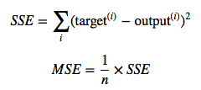
Understanding model evolution & error
During training the model evolves as it begins to understand biases and weights on the inputs and how their categorical changes affect the output
Reducing our variance between runs and validating our model requires error analysis
Error
Multiple different methods
Mean Squared Error (MSE)- modified Sum Squared Error (SSE)

Slide 10
Code Implementation

Slide 11
Using the neural network
Once we train the model, we can then run through inputs to predict outputs on the trained set
These outputs will

