Slide 1


MEETING IS
STARTING
SOON
FOLLOW US!
@tidaltamu

Slide 2
t i d a l t a m u
TETHERED INFORMATICS & DATA ANALYTICS LAB
Notes:
Follow us on Twitter and Instagram @tidaltamu
Join our discord and slack, links provided in email

Slide 3
Dealing with Noise, Model Performance Assessment, Error Analysis
Ishaan Grewal and Saini Ye

Slide 4
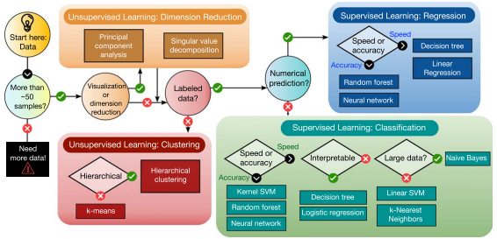
What to do in the case of non-linear data?

Slide 5
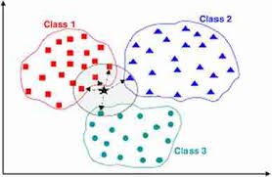
K-Nearest Neighbors

Slide 6
Model Performance Assessment
Comparing Test and Train y values
Confusion Matrix
Grid Search for Hyperparameter tuning

Slide 7
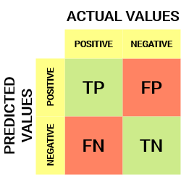
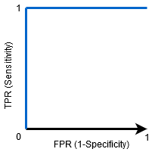
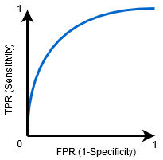
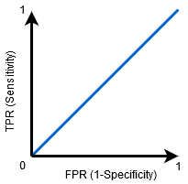
Area under the ROC Curve (AUC)
Notes:
ROC - Receiver Operator Characteristic
The evaluation metric for binary classification problems
A probability curve that plots the TPR against FPR at various threshold values and essentially separates the ‘signal’’ from the ‘noise’
can be extended to evaluate multi-class classification problems
AUC - area under the curve
The measure of the ability to a classifier to distinguish between classes
Term names recall from confusion matrix:
TPR (the vertical) - sensitivity / true positive rate
FPR (the horizontal) - false positive rate
What do the graphs tell us about?
The higher the AUC, the better the performance of the model at distinguishing between the positive and negative classes
The first graph, when AUC = 1
→ the classifier is able to perfectly distinguish between all the positive and the negative class points correctly.
→ if the AUC had been 0, then the signs will be flipped, which mean the classifier would be predicting all Negatives as Positives, and all Positives as Negatives.
The second graph, when AUC is in between 0.5 and 1
→ there is a high probability that the classifier will be able to distinguish the positive class values from the negative class values.
→ why? Because the classifier is able to detect more numbers of True positives and true negatives than false negatives and false positives.
The third graph, when AUC is 0.5
→ the classifier is not able to distinguish between Positive and Negative class points
→ means either the classifier is predicting random class or constant class for all the data points
Helps visualizing how well our machine learning classifier is performing
Works only for binary classification problems, but can be extended to evaluate multi-class classification problems

Slide 8
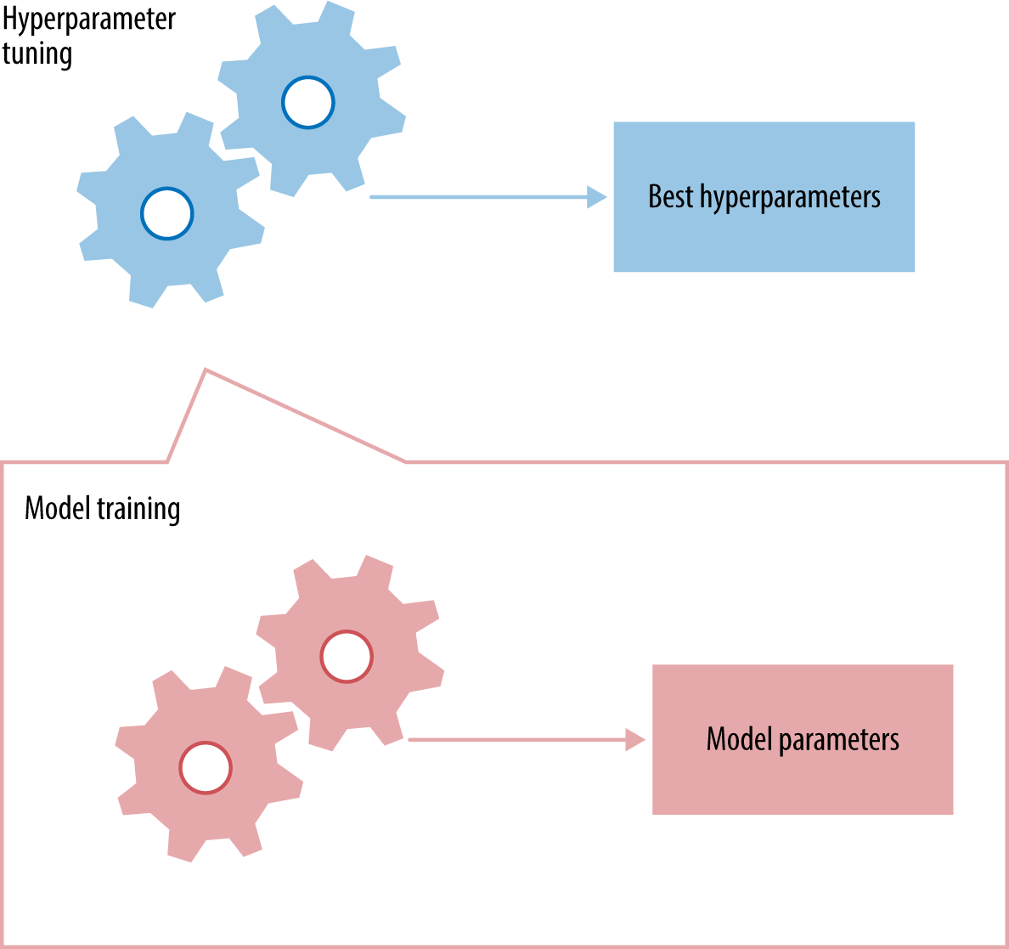
Hyperparameter Tuning
Notes:
→ Parameters which define the model architecture
Hyperparameters != model parameters
→ hyper: cannot be directly trained from the data, they are usually fixed before the actual training begins
→ model parameters are learned during training when we optimize a loss function using sth like gradient descent (previous topics)
→ the process of searching for the idea model architecture is called hyperparameter tuning
Models can have many hyperparameters, the two best strategies for Hyperparameter tuning are grid search CV and Randomized search.

Slide 9
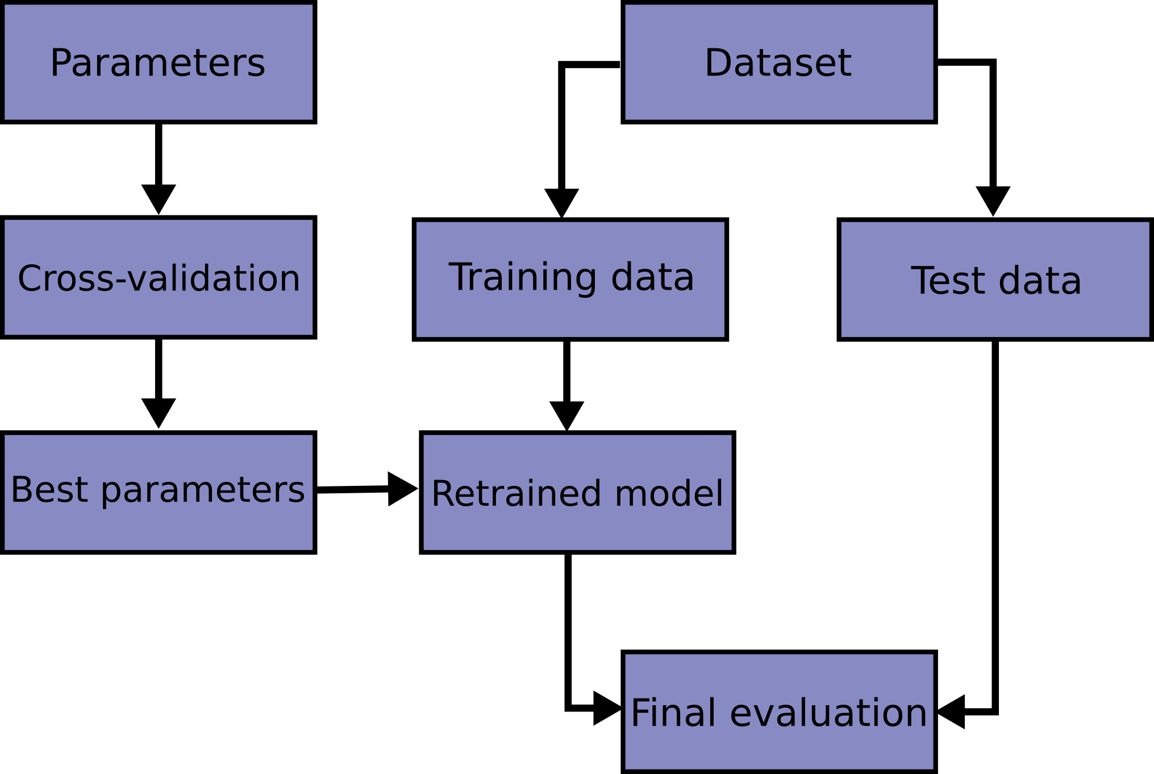
Cross-Validation
Notes:
A statistical method used to estimate the performance (or accuracy) of machine learning models
Here is a flowchart of typical cross validation workflow in model training
//
Different types, classified into two broad categories:
Non-Exhaustive
Do not compute all ways of splitting the original data
Exhaustive Methods
Test on all possible ways to divide the original data into a training and a validation sett.

Slide 10
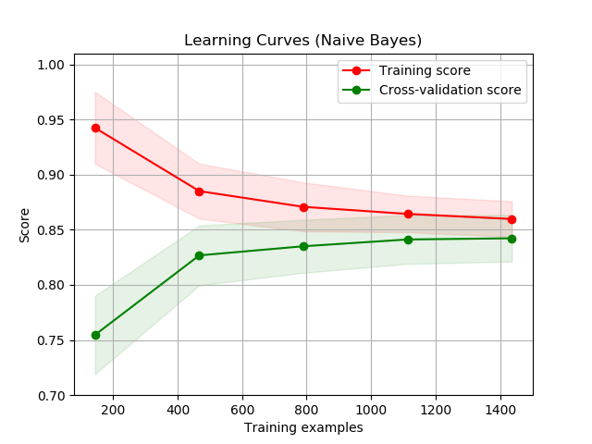
Error Analysis
Notes:
Make our models better
Refer to the graph on the slide
Multiple types or errors associated with machine learning and predictive analytics
In-sample / resubstitution errors
Rates may be very low and seem to be indicative of a high-performing model, but keep in mind that this may be due to overfitting, which would result in a model that is unable to generalize well to new data
Out-of-sample
The error rates found on a new data set, and are the most important since they represent the potential performance of a given predictive model on new and unseen data.
Keep in mind that when evaluating a model for use on non-training or new data, prediction performance and error analysis should only be done on test data.
Generally speaking, model performance en training data tends to be optimistic, and therefore data errors will be less than those involving test data.
** There are tradeoffs between the types of errors that we must consider and need to make decision on.

Slide 11
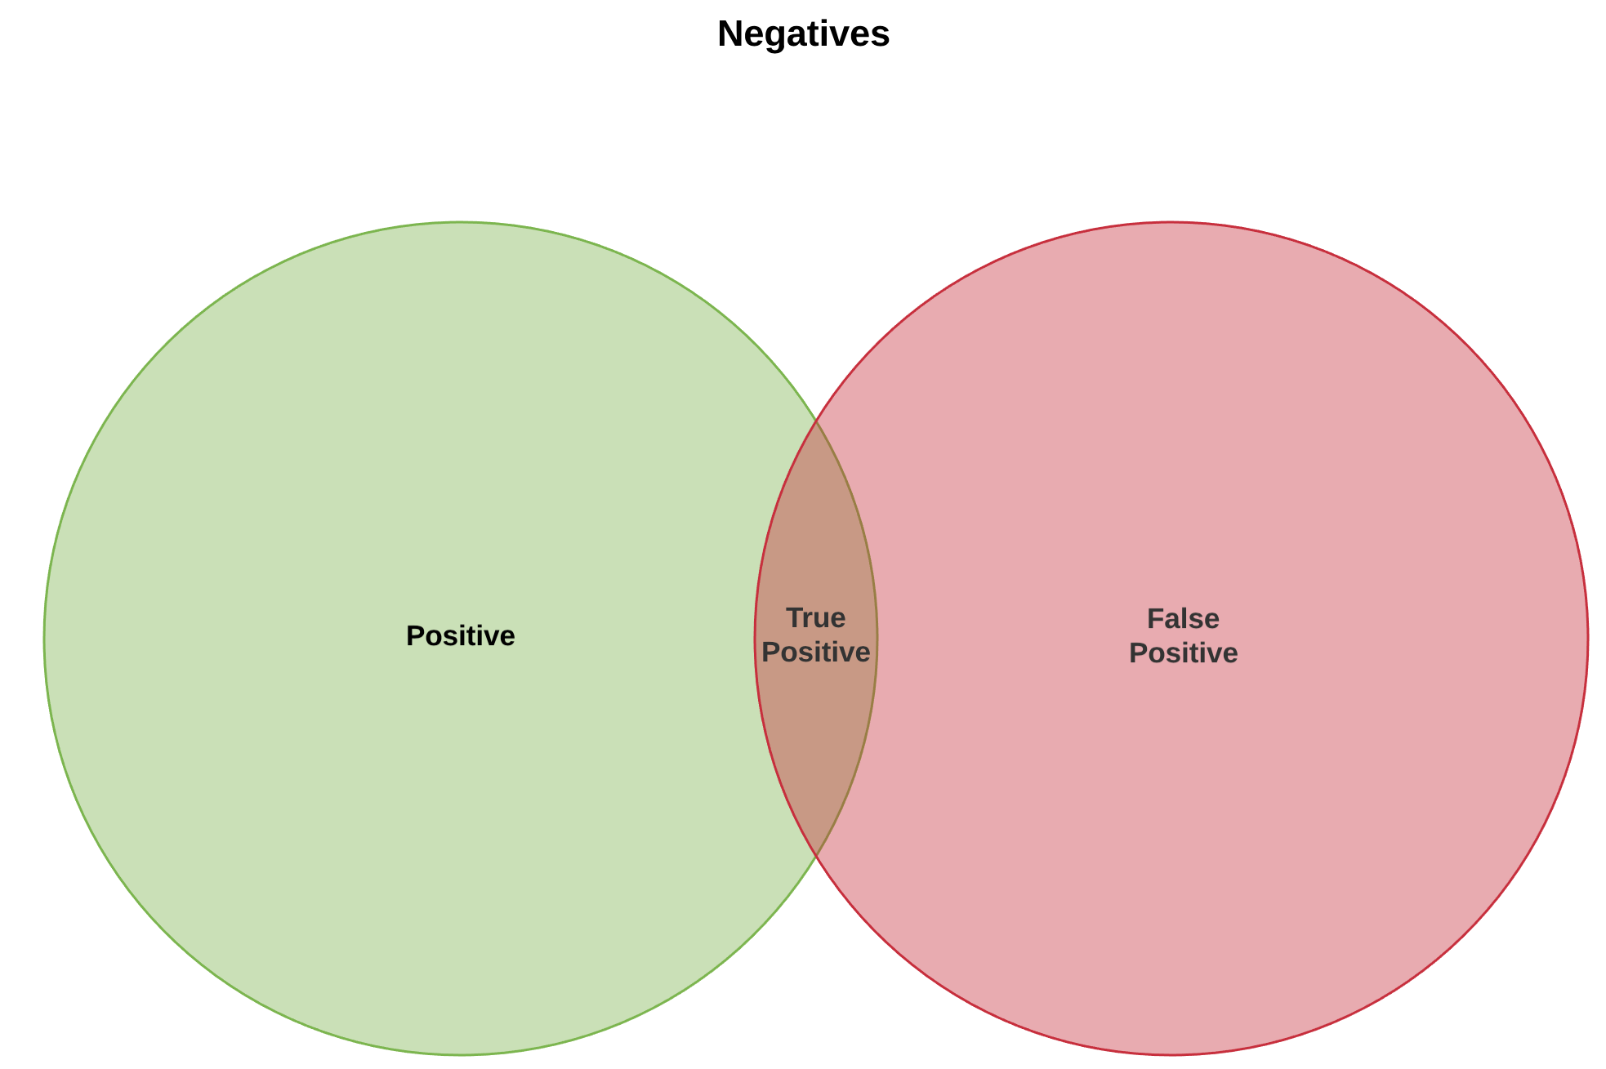
Error Metrics for Skewed Classes
Notes:
Skewed classes basically refer to a dataset, where he number of training example belonging to one class far exceeds the number of training example belonging to the other class

Slide 12
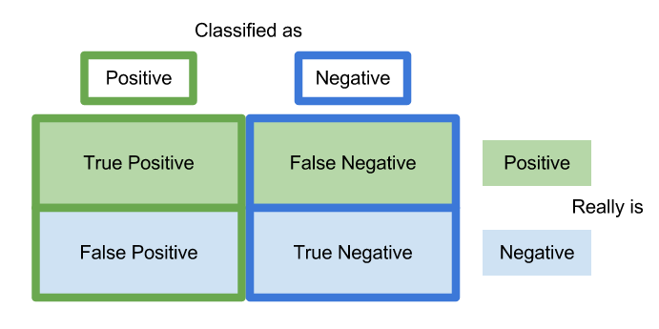
Trading Off Precision and Recall
Notes:
In a binary classification, one of the following four scenarios may occur,
True Positive (TP): the model predicts 1 and the actual class is 1
True Negative (TN): the model predicts 0 and the actual class is 0
False Positive (FP): the model predicts 1 but the actual class is 0
False Negative (FN): the model predicts 0 but the actual class is 1
Precision = TP / (TP + FP), defines all the predictions of 1, which ones are correct
Recall = TP . (TP + FN), defines all the actual 1, which ones did not model predict correctly.
// trade of on next slide

Slide 13
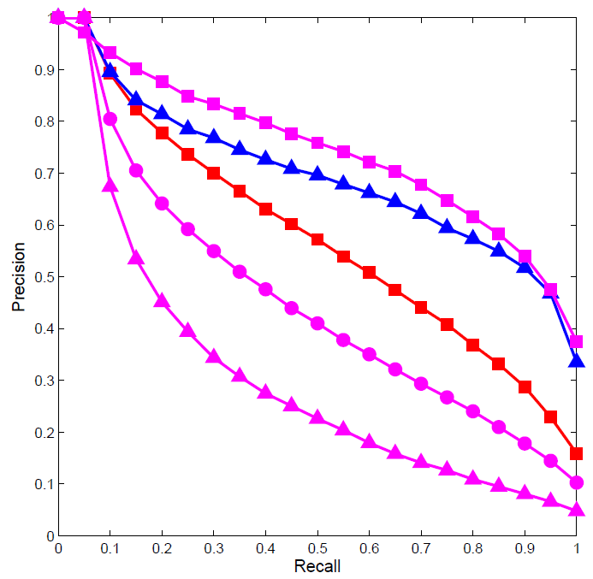
Trading Off Precision and Recall
Notes:
Trade off:
By changing the threshold value for the classifier confidence, we can adjust the precision and recall for the model.
The graph on the slide: a precision-recall tradeoff curve may look like one among this (they are inversely proportional with each other)
How to choose a better pair of precision and recall?
→ the one with higher average. (could got deeper, but not today)

