Slide 1


MEETING IS
STARTING
SOON
FOLLOW US!
@tidaltamu

Slide 2
Bayesian Belief Networks
Ben Rudzinski
Sainikhil Naru

Slide 3
Probabilistic Graphical Models
-A probabilistic graphical model (PGM) is a way of representing a probabilistic model with a graph structure.
-The nodes in the graph represent random variables and the edges that connect the nodes represent the relationships between the random variables.
-Use conditional independence
-Employ graph algorithms for inference learning
Notes:
Represents a probability distribution
Independence refers to a random variable that is unaffected by all other variables. A dependent variable is a random variable whose probability is conditional on one or more other random variables.
Conditional independence describes the relationship among multiple random variables, where a given variable may be conditionally independent of one or more other random variables. This does not mean that the variable is independent per se; instead, it is a clear definition that the variable is independent of specific other known random variables.
A probabilistic graphical model, such as a Bayesian Network, provides a way of defining a probabilistic model for a complex problem by stating all of the conditional independence assumptions for the known variables, whilst allowing the presence of unknown (latent) variables.
As such, both the presence and the absence of edges in the graphical model are important in the interpretation of the model.
Inference learning is to make decisions considering the probabilities

Slide 4
Common PGMs
The Hidden Markov Model (HMM) is a graphical model where the edges of the graph are undirected, meaning the graph contains cycles.
Bayesian Networks are more restrictive, where the edges of the graph are directed, meaning they can only be navigated in one direction.
Directed Acyclic Graphs (DAG) cannot have cycles like Hidden Markov Models.
Notes:
Directed graphs are useful for expressing causal relationships between random variables, whereas undirected graphs are better suited to expressing soft constraints between random variables.

Slide 5
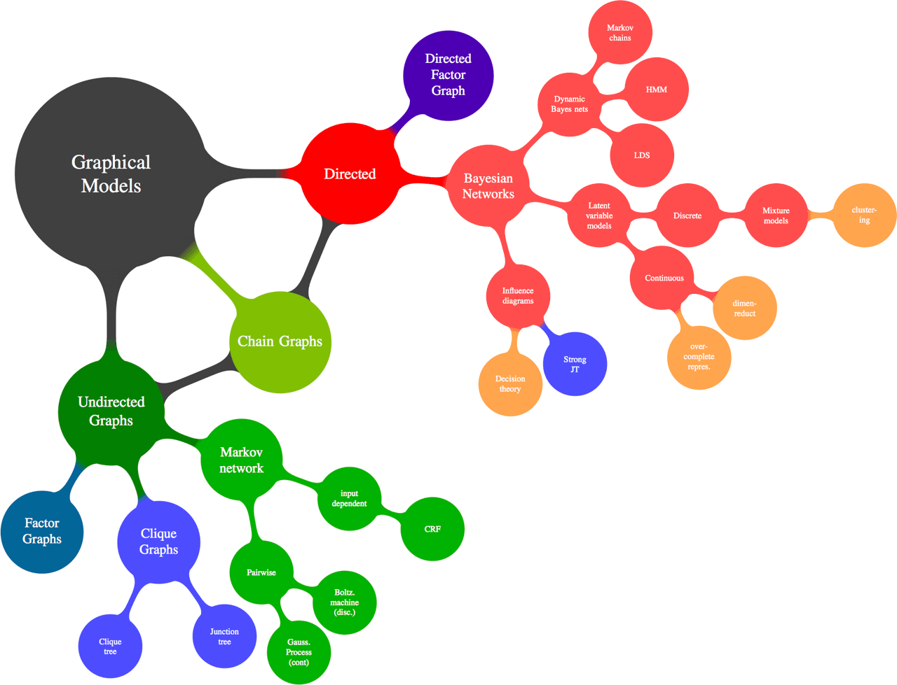
Notes:
Derivation of graphical models

Slide 6
Bayesian Belief Networks (BBN)
BBN or just Bayesian Networks
-A Bayesian Network captures the joint probabilities of the events represented by the model.
-Bayesian networks use conditional independence
Notes:
Bayesian probability is the study of subjective probabilities or belief in an outcome, compared to the frequentist approach where probabilities are based purely on the past occurrence of the event.
The networks are not exactly Bayesian by definition, although given that both the probability distributions for the random variables (nodes) and the relationships between the random variables (edges) are specified subjectively, the model can be thought to capture the “belief” about a complex domain.

Slide 7
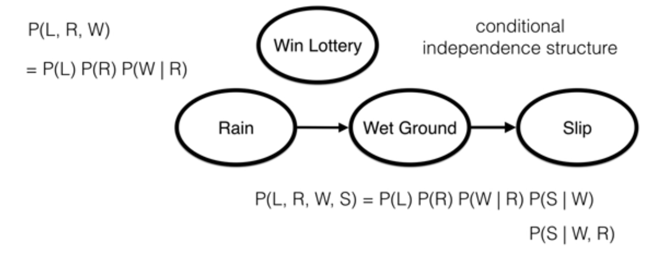
Bayesian Belief Networks (BBN)

Slide 8
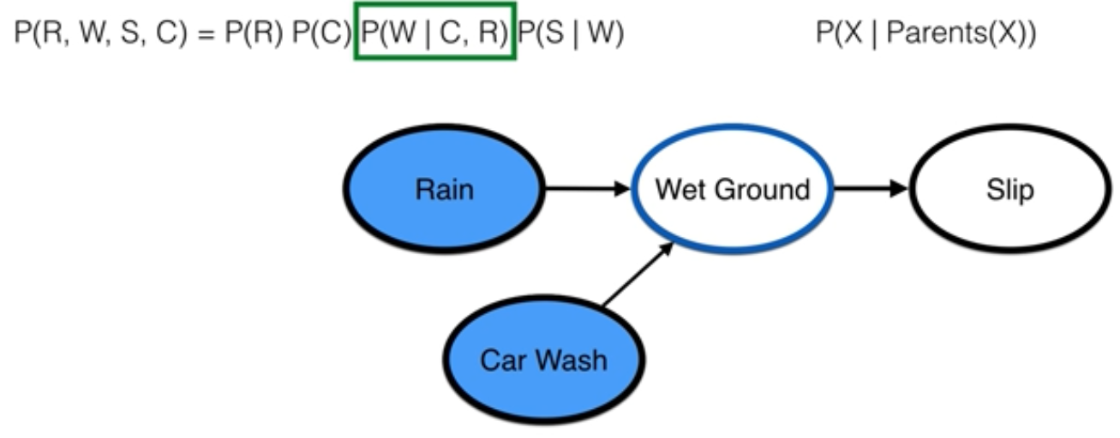
Bayesian Belief Networks (BBN)

Slide 9
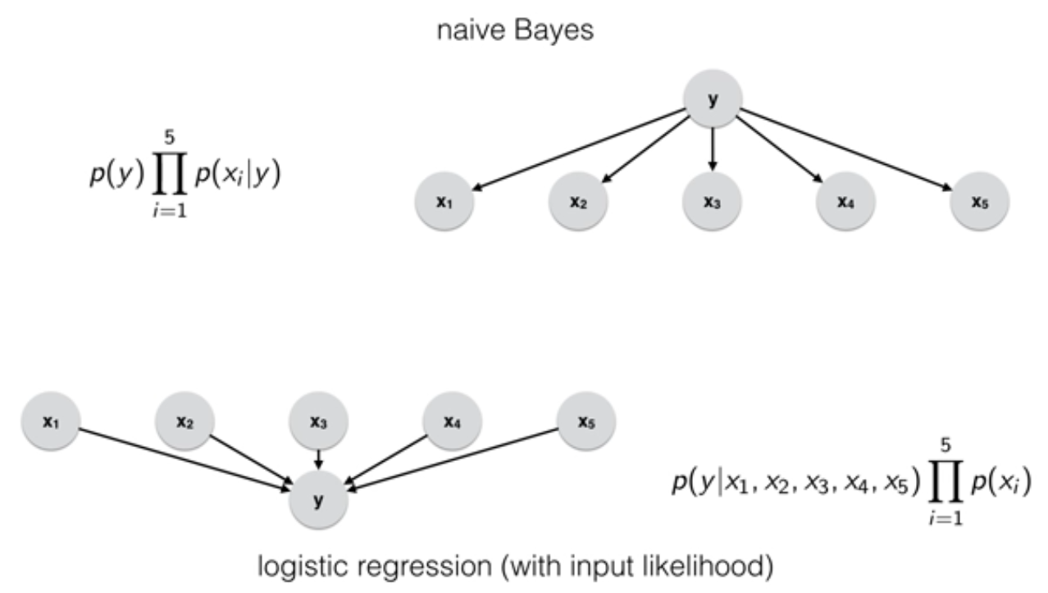
Bayesian Belief Networks (BBN)

Slide 10
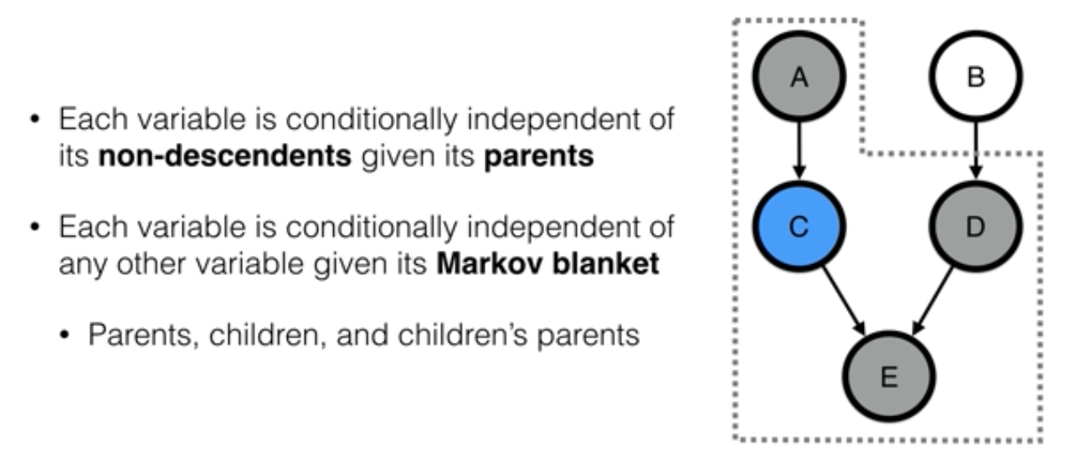
Bayesian Belief Networks (BBN)
Notes:
-E is independent of A and B
-Enumeration and variable elimination can be used in BBNs to reduce the complexity of a problem, we wont go into those due to time constraints

Slide 11
Bayesian Neural Networks (BNN)
Implementation of BBN ideology into a NN
Uncertainty propagation (predictive/forward and retrospective/reverse)
Uncertainty (probabilities) are given to weights in a NN
https://tensorchiefs.github.io/dl_book/
https://docs.pymc.io/notebooks/bayesian_neural_network_advi.html
https://colab.research.google.com/github/papercup-open-source/tutorials/blob/master/intro_bnn/Bayesian_neural_networks_Part_1.ipynb
https://colab.research.google.com/github/papercup-open-source/tutorials/blob/master/intro_bnn/Bayesian_neural_networks_Part_2.ipynb
https://towardsdatascience.com/bayesian-neural-networks-2-fully-connected-in-tensorflow-and-pytorch-7bf65fb4697

Slide 12
BBN/BNN Extra Information
https://www.saedsayad.com/docs/Bayesian_Belief_Network.pdf
https://www.probabilisticworld.com/bayesian-belief-networks-part-1/
https://www.javatpoint.com/bayesian-belief-network-in-artificial-intelligence
https://people.cs.pitt.edu/~milos/courses/cs2001/cs2001-2.pdf

