Slide 1


MEETING IS
STARTING
SOON
FOLLOW US!
@tidaltamu

Slide 2

Special Topics 3:
Optimization

Slide 3
Contents
Optimization
Loss Functions
Linear Regression/Multivariate Linear Regression
Polynomial Regression
Gradients
Hyperparameters
Hypothesis

Slide 4
What is Optimization?
The process of finding a set of inputs to a function to obtain a maximum or minimum evaluation.

Slide 5
Types of Optimization
Bracketing Algorithms
Local Descent Algorithms
First-Order Algorithms
Second-Order Algorithms
We will mainly focus on the last two as they have the most practical use.

Slide 6
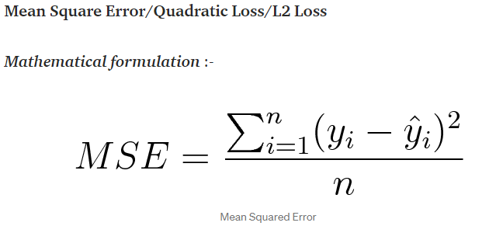
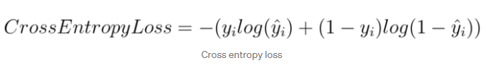
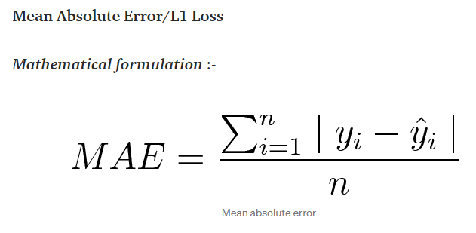
Loss
A measure of how good our model is doing.
It is what we use to calculate the how much we should change our model.
Common types of Loss functions:
Regression Classification

Slide 7
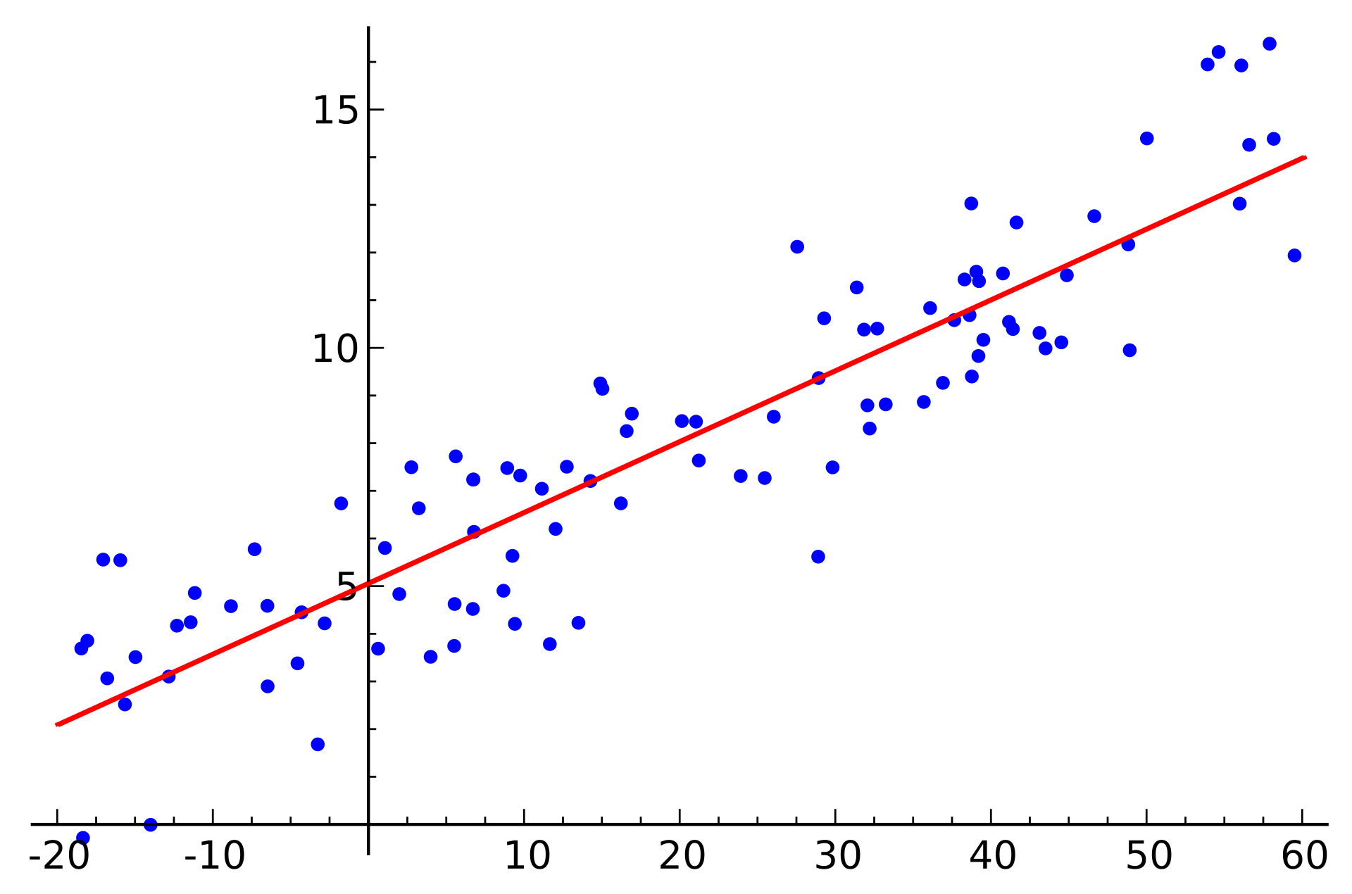
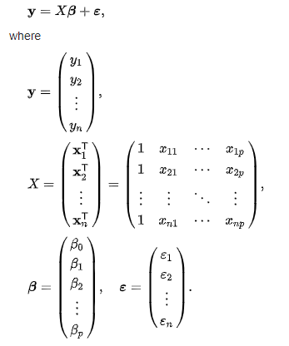




Linear Regression
A linear model to predict a relationship between scalar independent and dependent values.
Can also be written as
Multivariate Linear Regression
Notes:
https://en.wikipedia.org/wiki/Linear_regression#:~:text=In%20statistics%2C%20linear%20regression%20is,as%20dependent%20and%20independent%20variables).

Slide 8
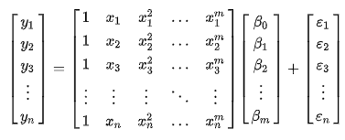
Polynomial Regression
Very similarly to Linear Regression

Slide 9
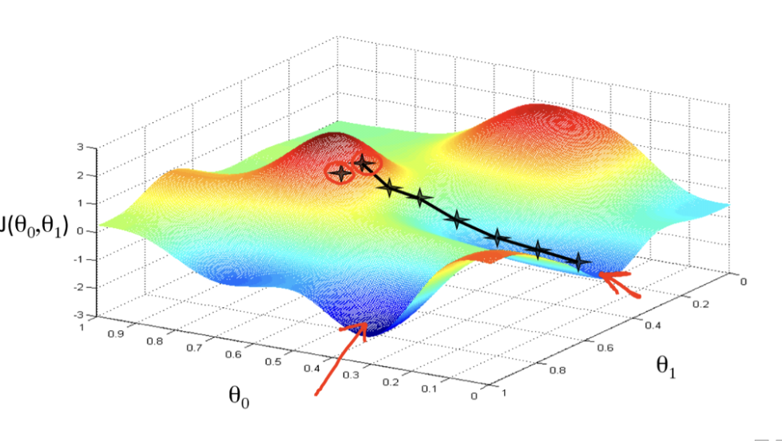
Gradients
Objective is to get to the point with minimum Loss (J).
θ=θ−η⋅∇_θ J(θ)
Essentially an application of the Chain rule.

Slide 10
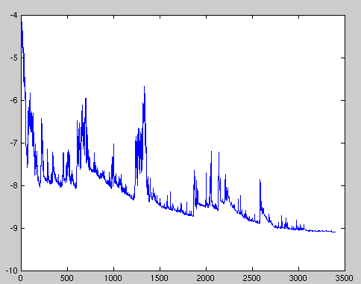
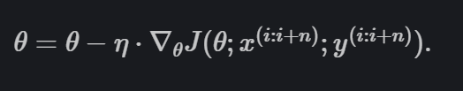

Stochastic Gradient Descent vs Batch Gradient Descent
SGD
Takes gradient for EACH training example (x,y)
Usually jumps up and down; is unstable
BGD
Takes gradient for a set of training examples

Slide 11
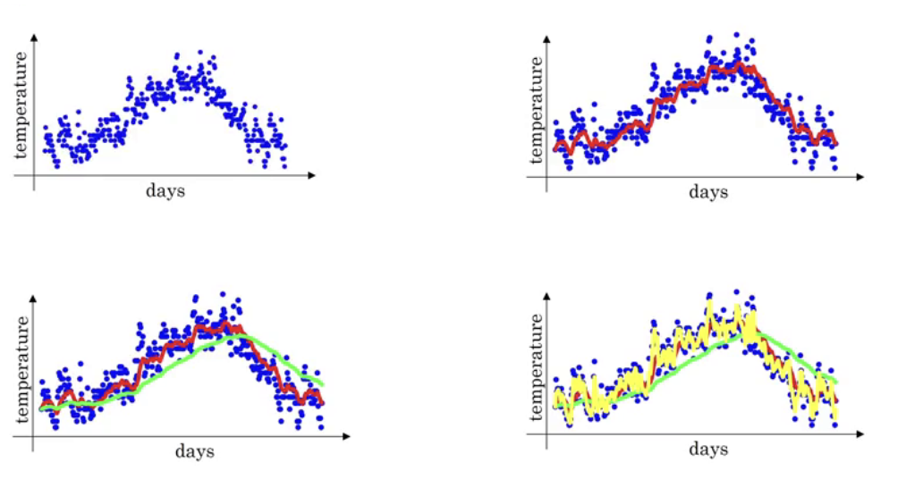
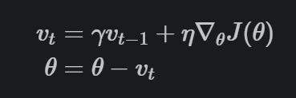
Stochastic Gradient Descent with Momentum
Essentially taking a weighted average
Calculate “moment” and use it to change parameters
Notes:
https://towardsdatascience.com/demystifying-optimizations-for-machine-learning-c6c6405d3eea

Slide 12

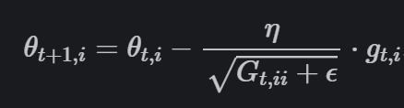
AdaGrad
for each parameter, we store the sum of squares of all its historical gradients
Specific learning rate for each parameter
Adapt learning rates: smaller for parameters associated readily and larger for parameters associated less
Good to use on sparse data
GloVe word embeddings were trained
Notes:
https://ruder.io/optimizing-gradient-descent/

Slide 13
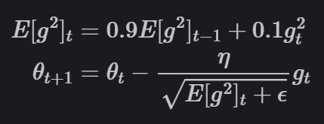
RMSProp
Similar to AdaGrad but we use the previous gradient in this one
Central idea of RMSprop is keep the moving average of the squared gradients for each weight
Notes:
https://towardsdatascience.com/demystifying-optimizations-for-machine-learning-c6c6405d3eea

Slide 14
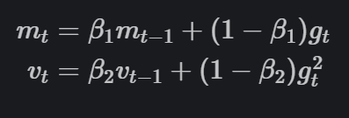
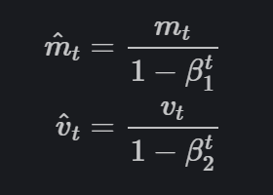
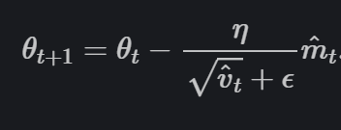
Adam
“In addition to storing an exponentially decaying average of past squared gradients v_t like Adadelta and RMSprop, Adam also keeps an exponentially decaying average of past gradients m_t, similar to momentum.”
Notes:
https://towardsdatascience.com/demystifying-optimizations-for-machine-learning-c6c6405d3eea

Slide 15
Also See Variations:
Nesterov accelerated gradient
Adadelta
AdaMax
Nadam
AMSGrad

