Slide 1


MEETING IS
STARTING
SOON
FOLLOW US!
@tidaltamu

Slide 2

Special Topics 3:
Transformers

Slide 3
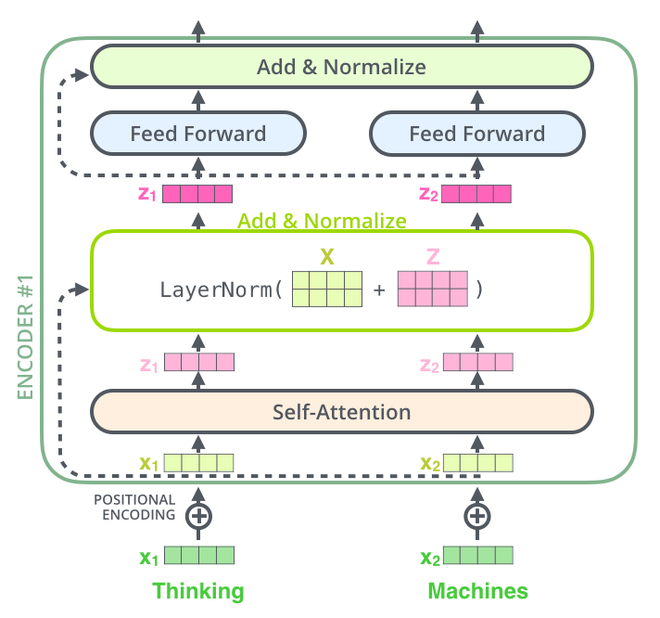
Attention
researchers created a technique for paying attention to specific words.
Which part of sentence should get more attention
For example: When I’m transcribing an audio recording, I listen carefully to the segment I’m actively writing down.
Neural networks can achieve this same behavior using attention, focusing on part of a subset of the information they are given

Slide 4
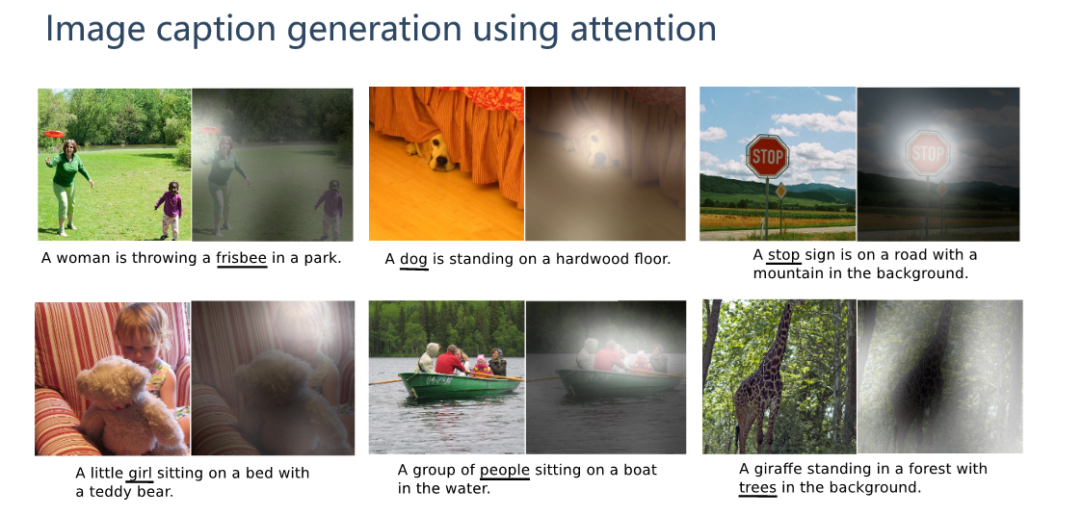

Slide 5
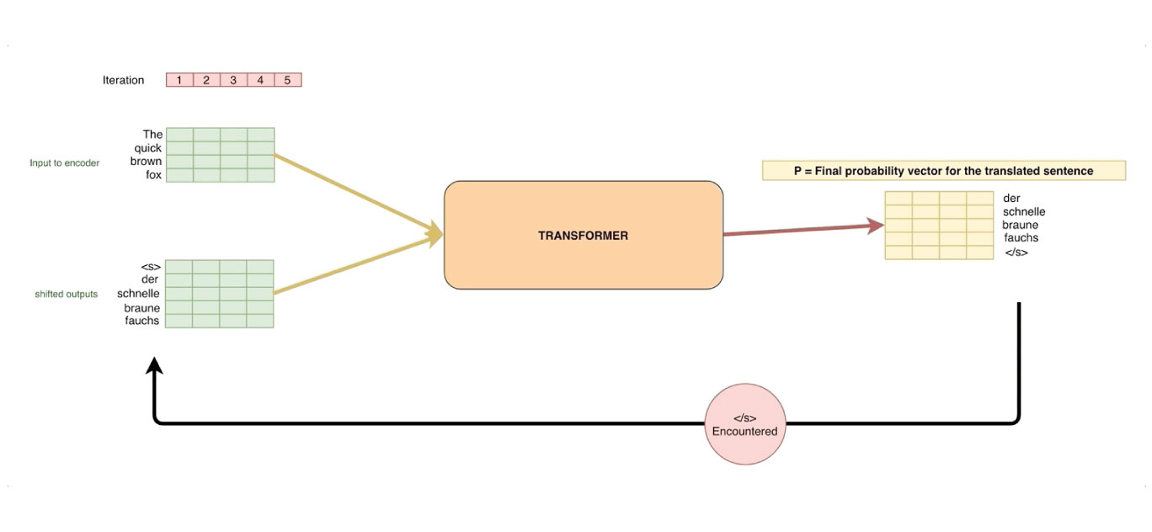
What are Transformers?
Huge improvements when compared to LSTM and RNN
sequence-to-sequence architecture
transforms a given sequence of elements, such as the sequence of words in a sentence, into another sequence.
good at translation
Consist of encoder and decoder
Transformer is a model that uses attention to boost the speed. More specifically, it uses self-attention.

Slide 6
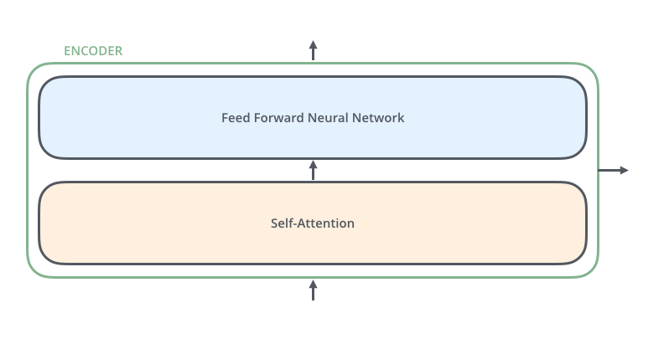
How do they work
consist of an Encoder and a Decoder.
The encoder processes each item in the input sequence, it compiles the information it captures into a vector (called the context). After processing the entire input sequence, the encoder sends the context over to the decoder, which begins producing the output sequence item by item.
Each encoder consists of two layers: Self-attention and a feed Forward Neural Network.

Slide 7
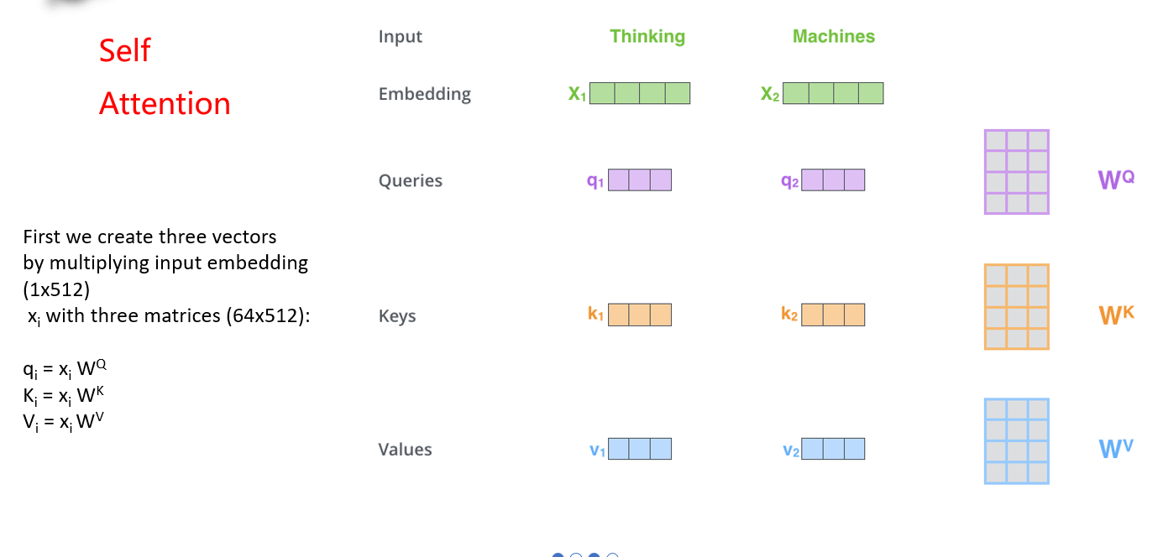

Slide 8
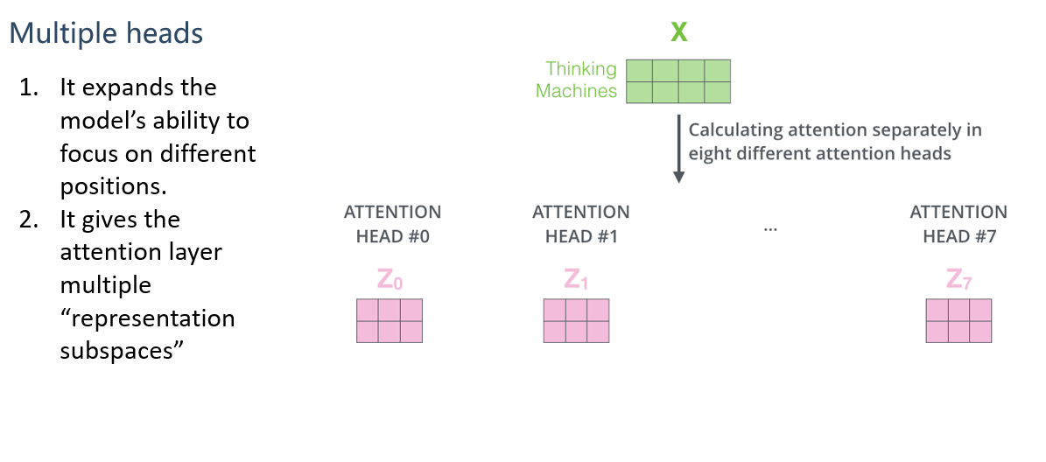

Slide 9
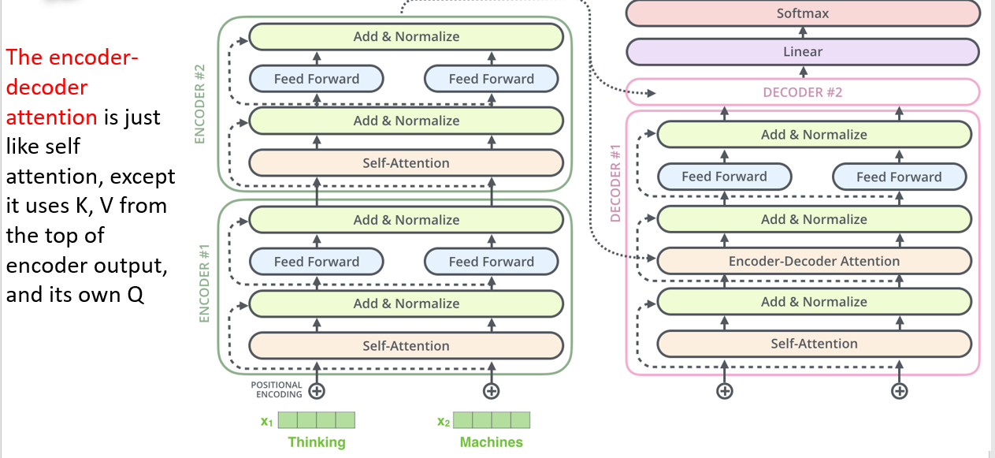

Slide 10
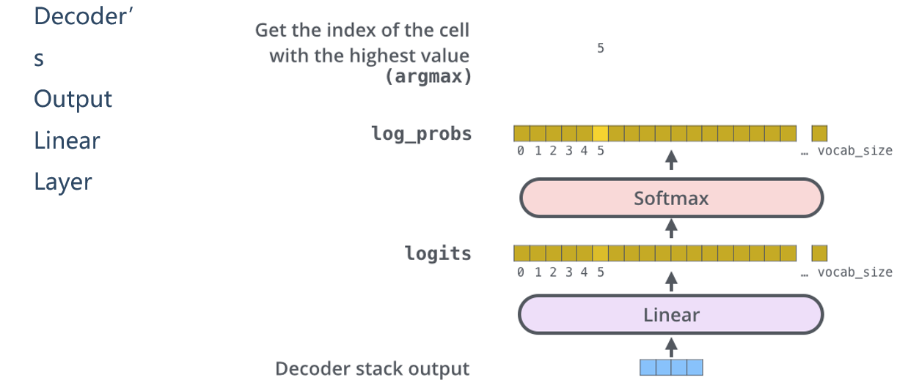

Slide 11
References
https://towardsdatascience.com/transformers-141e32e69591
https://jalammar.github.io/visualizing-neural-machine-translation-mechanics-of-seq2seq-models-with-attention/
http://jalammar.github.io/illustrated-transformer/
https://medium.com/inside-machine-learning/what-is-a-transformer-d07dd1fbec04

