Slide 1
Small UAV Visual Navigation Concept Development
NATO TIDE Hackathon 2023

Slide 2
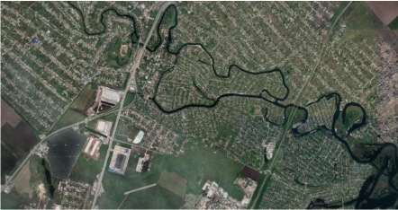
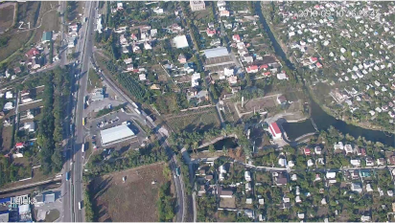
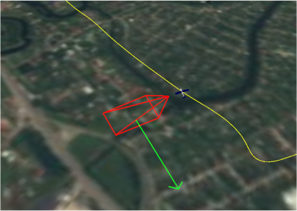
Hackathon Solution Overview
Read sensor data
Both the current camera image, as well as information about altitude and camera attitude.
Get reference mapping for approximate area
Using a generous search area around the previous location
Use Siamese Neural Network to determine location of camera view on reference mapping
Correct for offset caused by camera not looking straight down
Rinse and repeat!
Each iteration is largely independent to previous iteration, which limits error propagation.

Slide 3
Proposed Architecture Diagram
Drone Images
Deployed architecture designed to be suitable for running on drone hardware (e.g. NVIDIA Jetson).
Model training can be done in Azure, AWS, or on-prem.
To train an effective model, more data is required and a longer training period. Ideally, this data would consist of paired aerial and drone imagery. This wasn’t available during the Hackathon, so the model performance is limited.
Model Training
Aerial Images
Image rectification (or perspective correction) is likely to significantly improve performance, but wasn’t achievable on the timescales of the Hackathon.
Read Sensors
Image Rectification
Locate Image
Correct Offset
Extract Map
Drone Autopilot
Connecting up the algorithm to the drone autopilot should be relatively easy, but has not been done during the Hackathon.

