Slide 1

Introduction to Java Microservices Part 1 : Classic Monolith
Evolution from classic monolith application to microservices
with Spring Boot / Spring Cloud / JPA / NoSQL / Kafka / CQRS

Slide 2

Training Goals
The goal of this training is to review modern approaches to build and support distributed applications and services.
Find the best ways to make fast and efficient:
Development process
And the software
Become familiar with most popular Spring services
Touch Cloud technologies
Review CQRS pattern
Make acquaintance with Docker and Kubernetes

Slide 3

We are building brand new internet service
I would like to propose you a small game. Imagine that we work together in a startup. We have the idea to build new service that will allow people to travel together cheap and convenient. We have to integrate car sharing, hotel booking, flight search engine, blog and customer support services.
Let’s think how to reach a success.
How people will interact with your service?
What programming languages/technologies do you like to use?
What database?
How are you going to release & deploy it? How often?
How many people to hire? How many teams?
What Software Development Methodology to use?
How we will extend our system in 3 years?
What if our technologies become legacy?
What if we have competitors who are going to go live with their product in a half year?

Slide 4
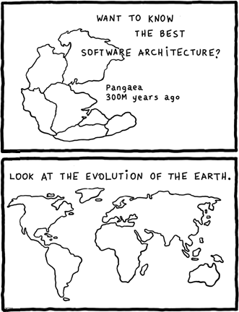
Monolith vs Microservices
The monolithic architecture pattern is the traditional architectural style. The monolith application built as a single, autonomous unit. While this style has been an integral part of many businesses, its numerous limitations and issues are motivating more and more to make the switch to microservices.
The main idea behind microservices is that some types of applications are easier to build and maintain when they are broken down into many small pieces that work together. Each component has its own small team working on it so they are completely decoupled and separated from each other, allowing each service to run its own unique process and communicate autonomously without having to rely on the other teams or applications as a whole.

Slide 5

Monolith Development
Monolith
Build Test Deploy Monitor
Large teams require complex coordination
Application is more complex because of many dependencies
Release cycles might be longer because of code conflicts
Vertical scalability is dominant*
As result - long release lifecycle
*Vertical scaling means that you scale by adding more power (CPU/RAM/HDD) to an existing machine.
Horizontal scaling means that you scale by adding more machines into your pool of resources whereas

Slide 6
Microservices Development
Microservices
Build Test Deploy Monitor
Build Test Deploy Monitor
Build Test Deploy Monitor
Build Test Deploy Monitor
With small teams working on a microservice, it contributes to much more developer freedom and independence.
Small teams that are working in parallel can iterate faster than large teams.
If one of the components fails, developers can spin up it’s copy while the rest of the application continues to function independently.
Because of small nature services are scaled horizontally

Slide 7
Monolithic Architecture Benefits
Application Server
Well known “classic” architecture approach
Easy to design
Easy to understand
Easy to debug
Easy to deploy
Easy to scale
Easy to maintain
Good to start new Proof of Concept projects
Good for small-to-mid size applications)
Good for single development team
User Interface
Business Logic
Data/ORM
Relational DB

Slide 8

Monolithic Architecture Drawbacks
The large monolithic application can be difficult to understand and modify because of complex dependencies
Large code base slows down the IDE
Large application starts and works slowly.
Continuous Delivery is difficult because long build/test/deploy cycle
Because all modules are running within the same process, a bug in any module, such as a memory leak, can potentially bring down the entire process.
A monolithic architecture forces developers to be married to the technology stack which was chosen at the start of development
Development scaling requires significant coordination efforts
Vertical application scaling can be costly and not always possible because of expensive hardware.
Horizontal scaling might be difficult because of expensive high availability (HA) technologies and complex load balancing
Requires long term commitment to a technology stack

Slide 9
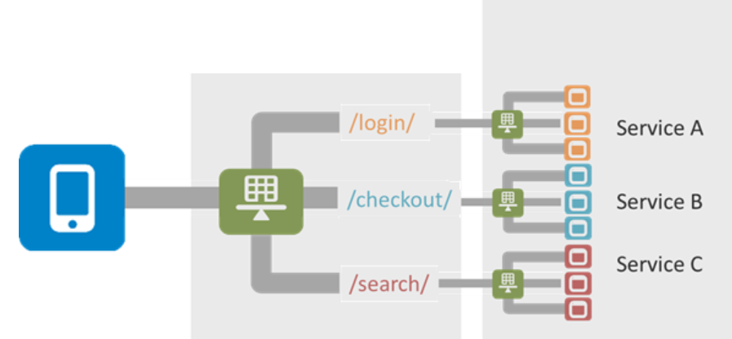
Microservices Benefits
New features development doesn’t break existing code.
Services could be created using different languages and technologies until they share the same API protocols.
Small isolated services are way easier to test.
Scalability & maintenance of small components is simple. You can scale horizontally only heavily used services.
Refactoring and modernization of existing components is easier because both old and new versions can coexist in production.
Beta testers could use new version while existing customer could continue using “classic” application until it’s EOL period.
Horizontal scaling

Slide 10

Microservices Drawbacks
Smaller Is Not Faster. Every service is connected through remote calls. Such calls take time, especially when many services are called in at once.
Significant DevOps efforts are required to monitor & support infrastructure and often deployments.
It is often hard or impossible to implement distributed transactions in Microservices. There is Eventual Consistency model comes to help. However it might have significant impact on the style of interaction with users in the system.
Significant efforts are required to plan and keep interfaces consistency between microservices. If one team changes the protocol – other services might stop working.
Microservices are modeled as isolated units that manage a reduced set of problems. However, in reality fully functional systems rely on the cooperation and integration of its parts. Often it is hard to make microservices truly independent.
One important question you should ask yourself when working with separate microservices inside a problem domain is: “Are these services talking too much with each other?” If so, consider to merge them to a single service. Microservices should be small, but no smaller than necessary to be convenient.

