Slide 1
Introduction to Java Microservices Part 3 : Spring Cloud Services
Evolution from classic monolith application to microservices
with Spring Boot / Spring Cloud / JPA / NoSQL / Kafka / CQRS

Slide 2

Pain of decomposition
Netflix estimates that it uses around 700 microservices to control each of the many parts of what makes up the entire Netflix service for around 98 million paying subscribers in 190 countries.
Each service exposes some REST endpoints available to other services and UI
Imagine you should keep all those IP addresses & exposed ports in some configuration file
Imagine you tells your Angular developer he should integrate 15 of exposed services from different servers…
Imagine you have 3 environments like
DEV / QA / PROD …
Notes:
https://medium.com/refraction-tech-everything/how-netflix-works-the-hugely-simplified-complex-stuff-that-happens-every-time-you-hit-play-3a40c9be254b

Slide 3

Spring Cloud to the rescue
Spring Cloud Config – distributed configuration
Netflix Zuul – API gateway proxy
Netflix Eureka - service discovery
Feign Clients – simple REST calls
And many other cloud services…
Notes:
The Beginner’s Guide To Spring Cloud: https://www.youtube.com/watch?v=aO3W-lYnw-o

Slide 4
Spring Cloud Config
Notes:
https://cloud.spring.io/spring-cloud-config/multi/multi__spring_cloud_config_server.html
https://medium.com/@danismaz.furkan/spring-cloud-config-with-file-system-backend-c18ae16b7ad5

Slide 5
Zuul – API gateway proxy
Notes:
https://medium.com/@coding4carnage/duplicate-cors-headers-with-zuul-proxy-and-spring-boot-security-205f85a7fefe

Slide 6
Eureka - service discovery

Slide 7
Feign Client

Slide 8
Simple Demo Monolith Application
UI Layer
API Gateway
Exposed REST
Cloud Configuration
Services Registry
User Service
Email
Service
Feign REST
DB
DB

Slide 9
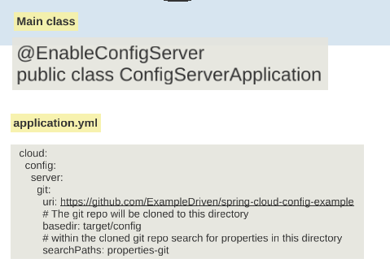
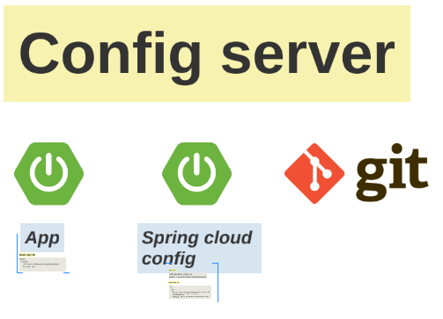
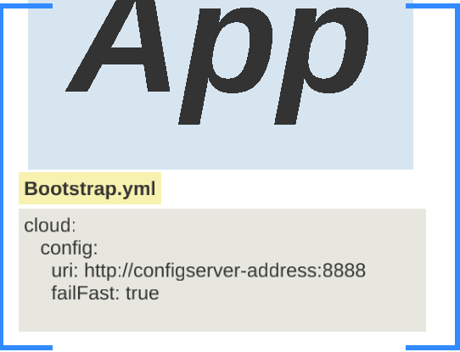
Microservices Infrastructure
Services Registry
Feign Client
API Gateway
Configuration Service

