Slide 1
Introduction to Java Microservices Part 5 : Docker
Evolution from classic monolith application to microservices
with Spring Boot / Spring Cloud / JPA / NoSQL / Kafka / CQRS

Slide 2
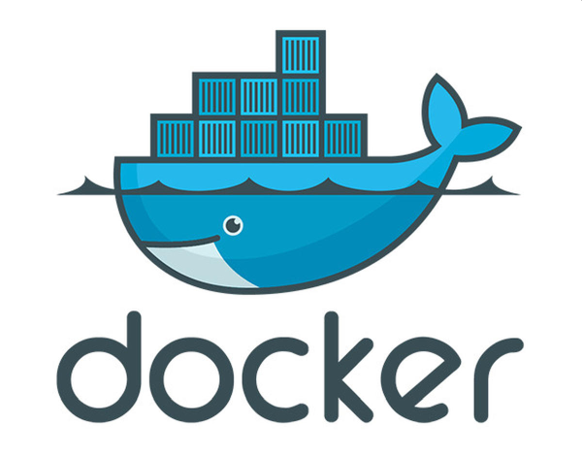
Docker
Docker is a set of platform as a service (PaaS) products that use OS-level virtualization to deliver software in packages called containers. Docker can package an application and its dependencies in a virtual container. But it is much more lightweight than Virtual Machine, because Docker containers share all operation system resources between containers, however, still can effectively isolate executed processes.
If you are going to implement and deploy a microservices project, then you rather will not survive without becoming familiar with Docker. That tool becomes important not only to easy prepare & build project environments but also to seamlessly deploy new releases to different environments like DEV/QA/STAGE/PROD. Thanks to Docker we can run several microservices on the single computer or deploy them to cloud without significant configuration efforts.
In the past, typical J2EE web applications were deployed to Application Servers like Weblogic, Jboss or Tomcat as WAR archives. Application Server can host several web applications and support them with different services like handling database connection pools or session management. It was required because memory was expensive and single application server was able to share resources with many applications. The drawback of such an approach is often complex and expensive setup and whole system fragility.
Nowadays, thanks to Microservices approach, each application can work as independent process. Docker in return can simplify application/process configuration by wrapping all required infrastructure services and configurations independently for each application. Having lots of independent processes rather than a huge monolith process is also much easier to monitor and understand which service is using up memory, network, disk or CPU etc.

