Slide 1

Introduction to Java Microservices Part 2 : Spring Boot
Evolution from classic monolith application to microservices
with Spring Boot / Spring Cloud / JPA / NoSQL / Kafka / CQRS

Slide 2
What is Spring Boot?
Spring Boot is a convention over configuration framework that allows us to set up a production-ready setup of a Spring project
Spring Initializr – online wizard to generate production ready application skeletons
Starters: provide the required dependencies according to project type and transitively resolves dependencies issues.
Automatic configuration: Spring Boot enables you to quickly stand-up applications in an easy and clean fashion. Best of all, there is very little of the potentially tricky Spring configuration that could otherwise be required.
Each Spring Boot web application includes an embedded web server.
Monitoring & Health check tools

Slide 3
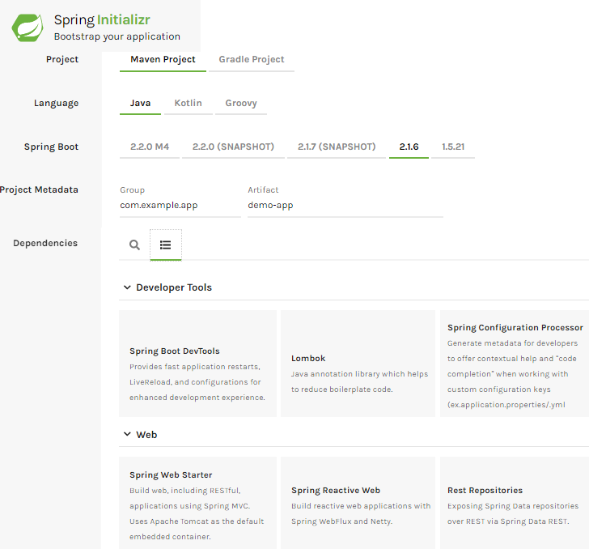
Spring Initializr: start.spring.io
Creating your application with the Initializr ensures that you are picking up the tested and approved dependencies that will work well with Spring auto-configuration.
Setup project type maven/gradle/java/Kotlin…
Set project group and artifact
Generates maven or gradle project with all required dependencies
Add dependencies
Spring web starter
Rest repositories
Spring Security
Spring Data JPA
Spring for Apache Kafka
Java Mail Sender
Spring Boot Actuator

Slide 4



Spring Boot Starters
Starters are a set of convenient dependency descriptors
Spring Boot provides built-in starters which makes development easier and rapid. For example, if we want to get started using Spring and JPA for database access, just include the spring-boot-starter-data-jpa dependency in your project.
Starter should follow a naming pattern like: spring-boot-starter-*, where * is a particular type of application.
You can add starters manually to maven or gradle build file
A Starter for building web, including RESTful, applications using Spring MVC. Uses Tomcat as the default embedded container
Starter for using Spring Data JPA with Hibernate
A Starter for testing Spring Boot applications with libraries including JUnit, Hamcrest, and Mockito
Notes:
https://www.baeldung.com/spring-boot-starters
http://appsdeveloperblog.com/a-list-of-spring-boot-starters/

Slide 5
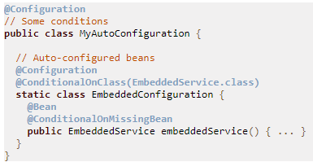
Automatic Configuration
One of the flagship features of Spring Boot is its use of Auto-configuration. This is the part of Spring Boot that makes your code simply work. It gets activated when a particular jar file is detected on the classpath.
That feature is crucial for starters. Because they are activated and configured by Spring Boot automatically if you add dependencies to maven or gradle.
You can create your own auto configuration that will be activated if your module is added to project dependencies
Spring Boot checks for the presence of a META-INF/spring.factories file within your published jar. The file should list your configuration classes under the EnableAutoConfiguration key, as shown in the following example:
org.springframework.boot.autoconfigure.EnableAutoConfiguration=com.app.config.AutoConfiguration
The @ConditionalOnClass and @ConditionalOnMissingClass annotations let @Configuration classes be included based on the presence or absence of specific classes.
Notes:
https://www.e4developer.com/2018/08/06/spring-boot-best-practices/
https://docs.spring.io/spring-boot/docs/current/reference/html/boot-features-developing-auto-configuration.html

Slide 6
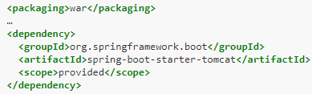
Embedded Server
Each Spring Boot web application includes an embedded web server.
For servlet stack applications you can explicitly select server:
spring-boot-starter-tomcat
spring-boot-starter-jetty
For reactive stack applications:
spring-boot-starter-webflux
spring-boot-starter-reactor-netty
In main standalone applications, the main HTTP port defaults to 8080; we can easily configure Boot to use a different port:
server.port=8083
You can easily tune the logging levels in the main properties file:
logging.level.org.springframework.web: DEBUG
logging.level.org.hibernate: ERROR
You can even deploy Spring Boot application to existing J2EE server and remove embedded Tomcat from war:

Slide 7
Application Configuration variants
Properties file: application.properties or YAML format files: application.yml
Profile-specific Properties: map beans to different environments:
dev
test
prod
Profiles can be activated:
Command line: -Dspring.profiles.active=dev
Environment variable: export spring_profiles_active=dev
Maven profile: <spring.profiles.active>dev</spring.profiles.active>
Configurations are loaded in very particular order to allow overriding of values. Properties are considered in the following order:
Properties attribute on your tests: @TestPropertySource(locations="classpath:test.properties")
Command line arguments: java -jar app.jar –myParam=“MyParamValue"
Java System properties: System.getProperties()
Profile-specific outside of your packaged jar: application-{profile}.properties
Profile-specific inside jar: application-{profile}.properties
Properties outside of jar: application.properties
Properties inside of jar: application.properties
Notes:
https://docs.spring.io/spring-boot/docs/current/reference/html/common-application-properties.html
https://docs.spring.io/spring-boot/docs/current/reference/html/boot-features-external-config.html

Slide 8
Application Configuration locations
SpringApplication loads properties from files in the following locations and adds them to the Spring Environment
file: ./config/application.properties
file: ./application.properties
classpath root: /config/application.properties
classpath root: application.properties
If you do not like application.properties as the configuration file name, you can switch to another file name by specifying a spring.config.name environment property:
java -jar myproject.jar --spring.config.name=myproject

Slide 9
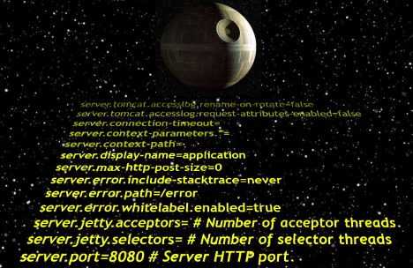
Spring Boot Configurations
Depending on included starters there are more than 300 Spring configuration parameters are defined by default
In most cases you should just find and modify existing configuration to enable/disable/change behavior of most features

Slide 10
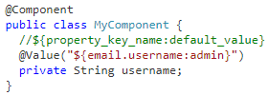
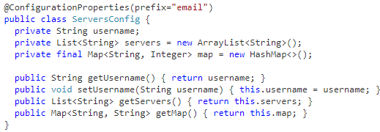
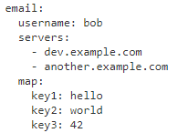
Application Configuration Example
Direct access to config parameter from component
Type-safe Configuration: Spring Boot provides an alternative method of working with properties that lets strongly typed beans govern and validate the configuration of your application

Slide 11
Simple Demo Monolith Application
Spring Boot with Embedded Tomcat
Lets start with some simple example of monolithic service
It will not be complex but we can easily split it to (at least two) microservices
We will not implement UI part because microservices is about backend
Database doesn’t matter. Let’s use H2 to setup environment quickly.
The same Spring services will be reused later, when monolith will be split to microservices.
REST Controller
Service Layer
DI + Config
CRUD Repository
H2 Database

Slide 12

Application Structure
Real applications are complex. In our training we will just mimic real services.
User service is about creating and query user data.
Email service should send activation email when new user is created.
Create User
Send Email
Query User
User Controller

Slide 13
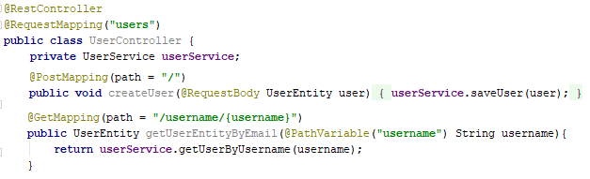
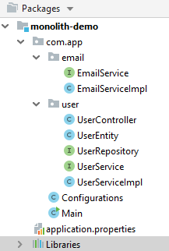
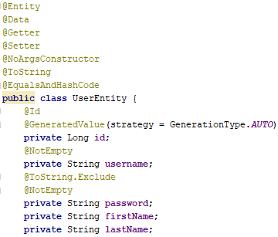
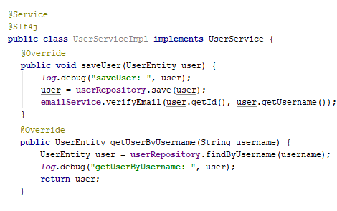
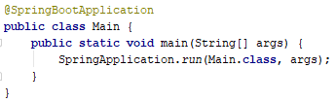
Application Structure
REST Controller
Data Entity
User Service

Slide 14
Controller/Service/Repository
In REST applications controllers are responsible of request mapping. Controllers are by default singletons and should be stateless!
Service layer provides code modularity, the business logic and rules are specified here. Typical roles:
Data validation
Data transformation between DTO & Model Entities
Business decision-making
Process routing (work-flow logic)
DAO & Repository encapsulates the details of the persistence layer and provide a CRUD interface for entities.

Slide 15
Controller annotations
Lets break down some of the Spring annotations.
@RestController – combines @Controller and @ResponseBody. Identifies that all methods in said controller return objects as opposed to views.
@RequestMapping – maps HTTP requests to the given endpoint into the method
@RequestParam – pulls a parameter from the request (in this case ‘name’) into a String that can be manipulated in the method

Slide 16
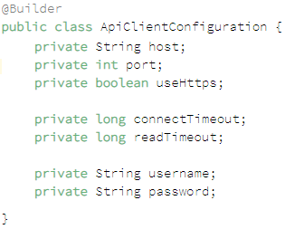
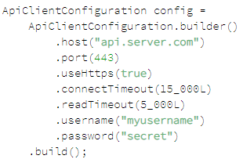
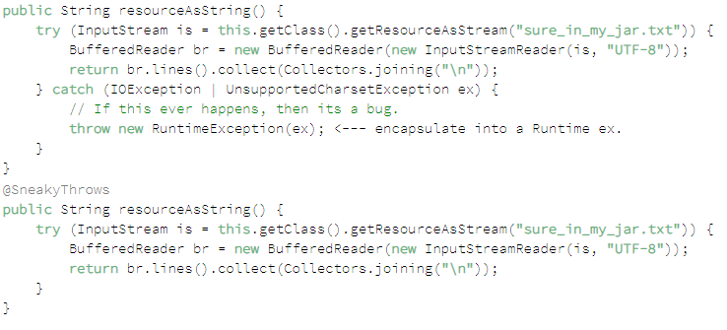
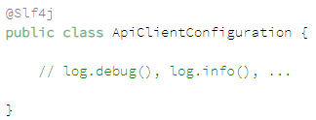

Lombok
Getters/Setters, Constructors
Lazy Getter
ToString:
EqualsAndHashCode:

Slide 17
Run Application
You can use Maven 3 or Gradle to build and run the application
Also you can run it from your IDE as standard main application
Call gradle bootRun or mvn spring-boot:run
To test application you can use some REST client like Restlet Client
. ____ _ __ _ _
/\\ / ___'_ __ _ _(_)_ __ __ _ \ \ \ \
( ( )\___ | '_ | '_| | '_ \/ _` | \ \ \ \
\\/ ___)| |_)| | | | | || (_| | ) ) ) )
' |____| .__|_| |_|_| |_\__, | / / / /
=========|_|==============|___/=/_/_/_/
:: Spring Boot :: (v2.1.6.RELEASE)
2019-07-19 22:03:29.903 INFO 3448 --- [ main] com.app.Main : Starting Main on DESKTOP-C5N7SHO with PID 3448 (C:\projects\springboot-cloud-demo-one\user-service\target\classes started by user in C:\projects\springboot-cloud-demo-one\user-service)
2019-07-19 22:03:29.942 INFO 3448 --- [ main] com.app.Main
2019-07-19 22:03:54.466 INFO 3448 --- [ main] o.s.b.w.embedded.tomcat.TomcatWebServer : Tomcat started on port(s): 8081 (http) with context path ''
2019-07-19 22:03:54.477 INFO 3448 --- [ main] com.app.Main : Started Main in 26.751 seconds (JVM running for 29.685)

Slide 18
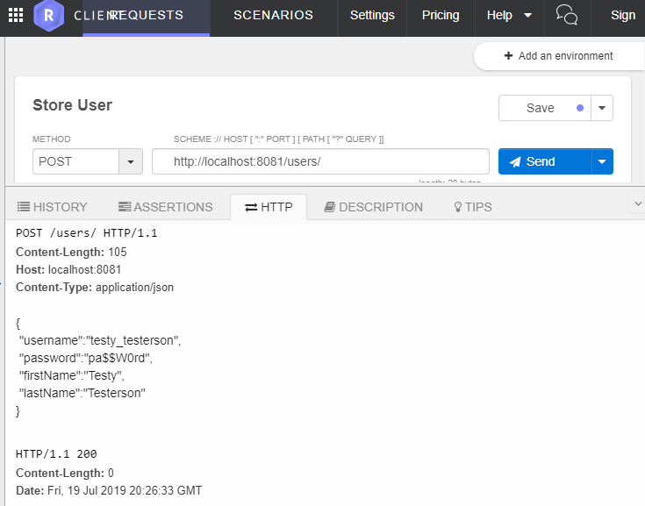
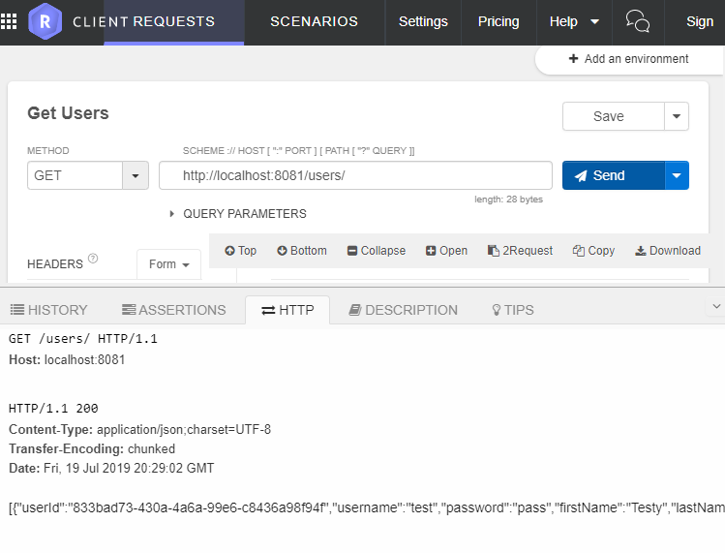
Test Application
To create user you should send HTTP POST to:
http://localhost:8081/users/ {"username":"testy_testerson", "password":"pa$$W0rd", "firstName":"Testy", "lastName":"Testerson"}
To list all users you should send HTTP GET to:
http://localhost:8081/users/

Slide 19
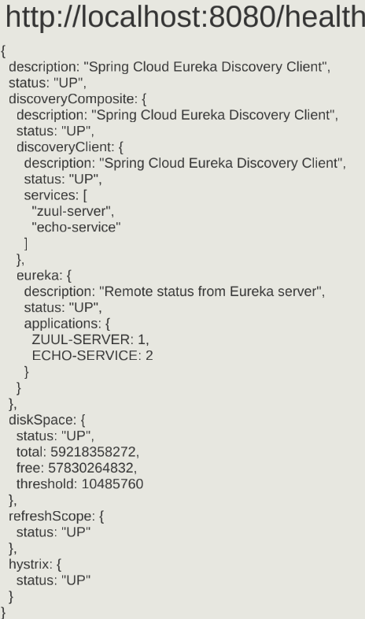
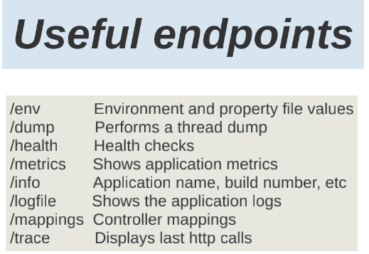
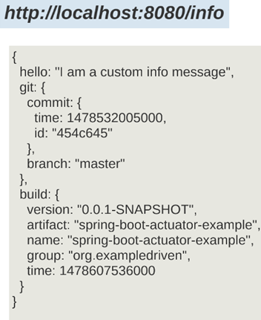
Actuator

Slide 20
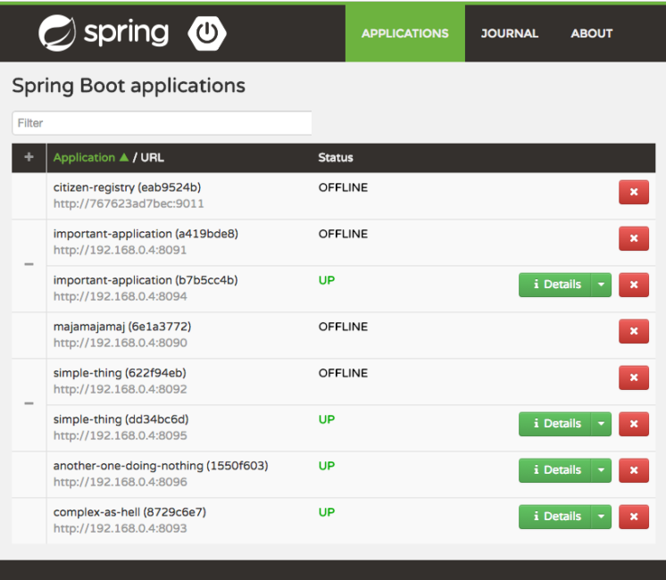




Spring Boot Admin
Spring Boot Admin is a web application, used for managing and monitoring Spring Boot applications. Each application is considered as a client and registers to the admin server. Behind the scenes, the magic is given by the Spring Boot Actuator endpoints.
first of all, we need to create a simple Spring Boot web application and add the following Maven dependencies for Config Server and all clients:
Server Clients
Notes:
https://www.baeldung.com/spring-boot-admin

Slide 21
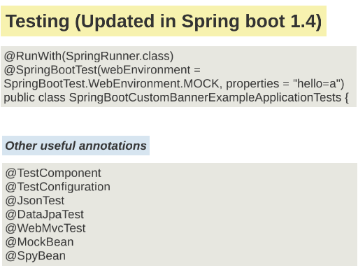
Unit Tests
TODO

Slide 22
Best Practices
Make your database a detail – abstract it from the core logic: Database logic should be abstracted away from the Service. Ideally, you don’t want a Service to know what database it is talking to.
Keep your business logic free of Spring Boot code: With the lessons from the “Clear Architecture” in mind, you should also protect your business logic. It is common for services to become libraries. These are much easier to create if you don’t have to remove a lot of Spring annotations from your code.
Constructor Injection: One way to keep your business logic free from Spring Boot code is to rely on Constructor Injection. Not only is the @Autowired annotation optional on constructors, you also get the benefit of being able to easily instantiate your bean without Spring.
In Spring Boot- Controllers and Services are by default Singletons. That introduces possible concurrency problems if you are not careful.

