Slide 1
Introduction to Java Microservices Part 3 : Spring Cloud Services
Evolution from classic monolith application to microservices
with Spring Boot / Spring Cloud / JPA / NoSQL / Kafka / CQRS

Slide 2
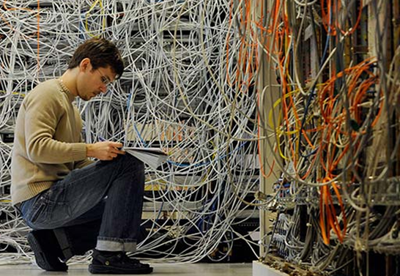
Pain of decomposition
Netflix estimates that it uses around 700 microservices to control each of the many parts of what makes up the entire Netflix service for around 98 million paying subscribers in 190 countries.
Each service exposes some REST endpoints available to other services and UI
Imagine you should keep all those IP addresses & exposed ports in some configuration file
Imagine you tells your Angular developer he should integrate 15 of exposed services from different servers…
Imagine you have 3 environments like
DEV / QA / PROD …
Notes:
https://medium.com/refraction-tech-everything/how-netflix-works-the-hugely-simplified-complex-stuff-that-happens-every-time-you-hit-play-3a40c9be254b

Slide 3

Spring Cloud to the rescue
Spring Cloud Config – distributed configuration
Netflix Zuul – API gateway proxy – single access point
Netflix Eureka - service discovery
Feign Clients – simple REST calls
between microservices
And many other cloud features…
Notes:
The Beginner’s Guide To Spring Cloud: https://www.youtube.com/watch?v=aO3W-lYnw-o

Slide 4
Simple Demo Monolith Application
After decomposition to microservices our monolith application will looks like:
API gateway is single exposed access point. Which could protect from unauthorized requests to services that not expected to be exposed.
All configurations are centralized in Config Server
Services Registry helps microservices to find each other.
Feign Client allows simple REST communication between microservices with minimum coding efforts. It also uses Services Registry to find services by their names (zero configuration approach)
UI Layer
Single endpoint exposed
API Gateway
Exposed REST
Cloud Configuration
Services Registry
User Service
Email
Service
Feign REST client
DB
DB

Slide 5
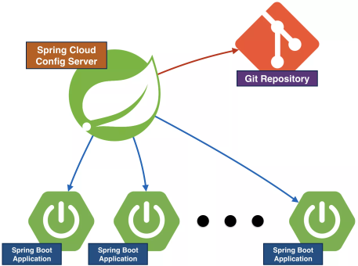
Spring Cloud Config Server
Spring Cloud Config provides server-side and client-side support for externalized configuration in a distributed system.
With the Config Server, you have a central place to manage external properties for applications across all environments.
It supports following features:
Keep configurations at GIT / SVN / Classpath / File system
Supports multiple configuration profiles like
DEV
QA
PROD
Supports many configs like one/many unique configuration file per microservice
Various of authentication mechanisms to protect the configuration data when retrieving.
Notes:
https://cloud.spring.io/spring-cloud-config/multi/multi__spring_cloud_config_server.html
https://medium.com/@danismaz.furkan/spring-cloud-config-with-file-system-backend-c18ae16b7ad5

Slide 6
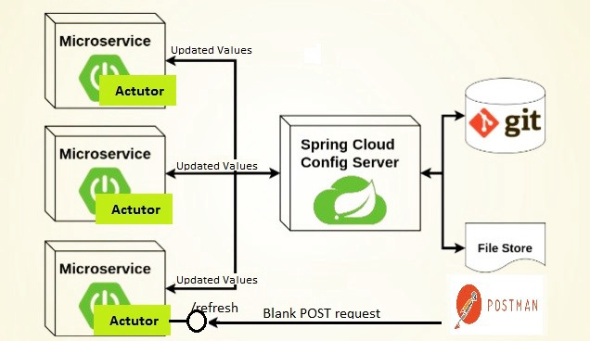
Spring Cloud Config Server
Update the configuration in GitHub for example and Config Server will automatically refresh the content. But client application wont refresh its configuration automatically without triggering the application to reload configurations.

Slide 7
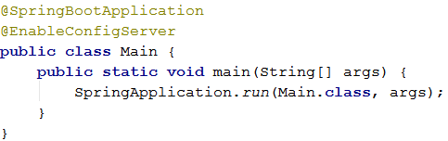

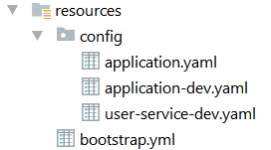
How to create cloud config server?
First of all you have to create config server application:
Now let’s create configs. For example in classpath:
application.yaml is sent to clients if they not specify environment
application-dev.yaml is used if client started with profile specified: Like: mvn clean spring-boot:run -Dspring.profiles.active=dev
user-service-dev.yaml is used for service user-service with dev profile
bootstrap.yaml contains server configs
Notes:
https://cloud.spring.io/spring-cloud-config/reference/html/

Slide 8

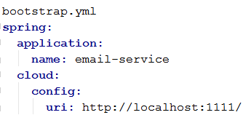
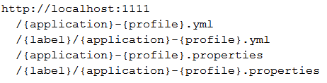
How to configure microservice client
Add config-server dependencies:
As you know usually configurations are stored in application.properties or yaml. But also spring supports bootstrap.properties & yaml configuration file. Which is used like application.properties but starts before it.
It is advised to keep here local application specific configurations, which are not expected to be loaded by spring cloud config. For example application name and link to config server. Everything else might be loaded after connection to configuration server.
You can check what configurations will be loaded from server from your browser. Just navigate to one of config files like:
Where {application} is service name
{profile} is dev/qa/prod
Like: http://localhost:1111/user-service-dev.yml

Slide 9
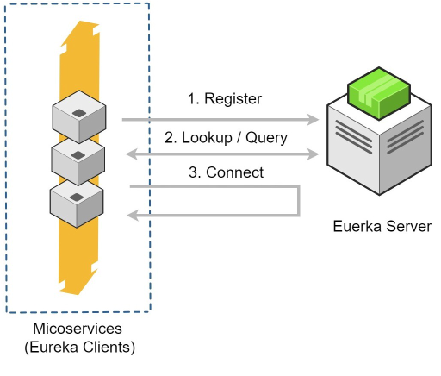
Eureka Discovery Server
The microservice style of architecture is not so much about building individual services so much as it is making the interactions between services reliable and failure-tolerant.
A service registry is a phone book for your microservices. Each service registers itself with the service registry and tells the registry where it lives (host, port, node name)
Service registration is handled by the Eureka client component. At runtime, the client registers the service and periodically sends heartbeats to renew its leases.
Notes:
http://jasonwilder.com/blog/2014/02/04/service-discovery-in-the-cloud/

Slide 10

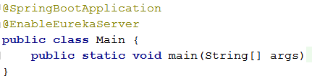
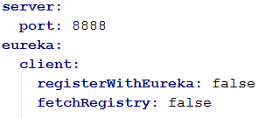
How to create Discovery Server?
First of all you have to create Discovery Server application:
Dependencies:
Main Annotation:
Configuration: application.yml

Slide 11

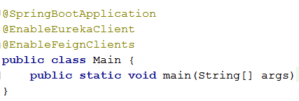
How to configure clients to connect to Eureka
First of all you have to create Discovery Server application:
Dependencies:
Main Annotation:
Configuration: application.properties

Slide 12
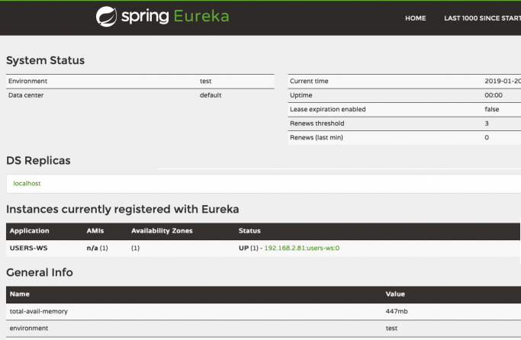
Run Eureka Service Discovery
Run as normal Spring Boot application
Check Eureka using your browser. Navigate to localhost:8888
If other services started and registered you will see them in the list:

Slide 13

Zuul – API gateway proxy
Zuul is a JVM-based router and server-side load balancer from Netflix.
Zuul looks-up for all instances of requested service from the Eureka discovery server and does server-side load balancing.
When Zuul receives a request, it picks up one of the physical locations available and forwards requests to the actual service instance.
Zuul can be used to check authentication & authorization before forward request to the services
Notes:
https://medium.com/@coding4carnage/duplicate-cors-headers-with-zuul-proxy-and-spring-boot-security-205f85a7fefe
https://www.baeldung.com/zuul-load-balancing

Slide 14

Zuul – API gateway proxy
By default all applications registered with Eureka will be able to be used on the Zuul gateway service by using the same path but prepending it with the name of the application.
For example, if zuul is configured to start using port 80 and we have a service endpoint like http://localhost:8124/users/id on user-service, then you’ll be able to call it http://localhost/user-service/users/id
You can make custom routing. For example config like:
Will route request http://localhost/api/user/users/id to the user-service

Slide 15
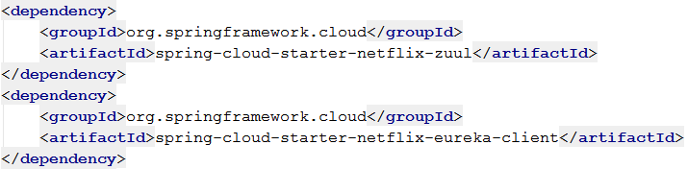
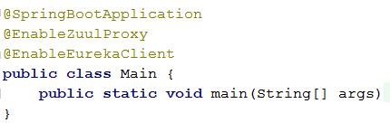
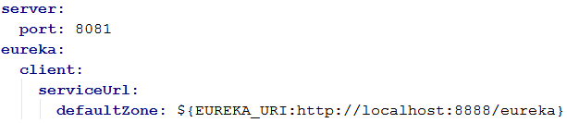
How to create ZUUL API Gateway?
First of all you have to create API Gateway Boot application:
Dependencies:
Main Annotation:
Configuration: application.yml

Slide 16
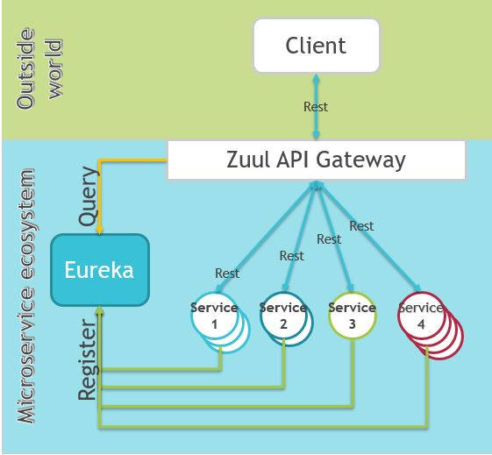
Run ZUUL API Gateway
Run as normal Spring Boot application
Now when you have your RESTful Web Services registered with Eureka Discovery Server you should be able to send HTTP requests to any of the two web services registered and receive expected response.
http://localhost:8081/user-service/users/
http://localhost:8081/email-service/
As you see you can access all services using same host and port.
You don’t need to bother about assigned IP and ports, the job is done by Zuul and Eureka
Notes:
http://appsdeveloperblog.com/zuul-api-gateway-tutorial/

Slide 17
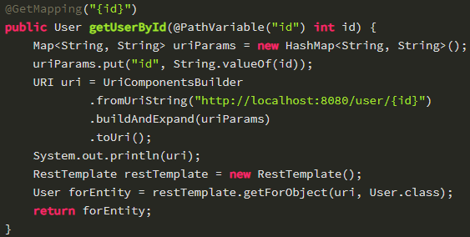
Feign Client
Without Feign you sould use RestTemplate to call other services.
That requires a lot of boilerplate coding and configurations to build service url
Feign makes writing web service clients easier.

Slide 18
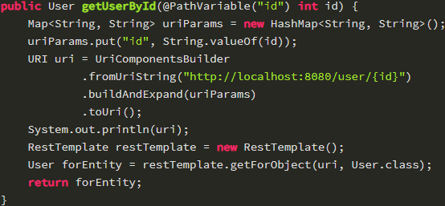
Feign Client
Without Feign you sould use RestTemplate to call other services.
That requires a lot of boilerplate coding and configurations to build service URL
Feign is a Java to HTTP client binder.
Developers can use declarative annotations to call rest services instead of writing repetitive boilerplate code.
Feign uses Eureka to find other services by name. Don’t need to build URL anymore.
Eureka
Services Registry
Feign REST client
User Service
Email
Service

Slide 19

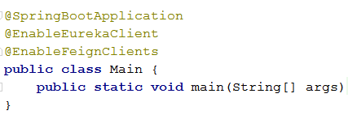

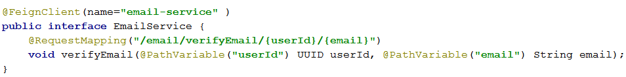
How to enable Feign Client
Dependencies:
Main Annotation:
Configuration: application.yml
Interface to another microservice:

Slide 20
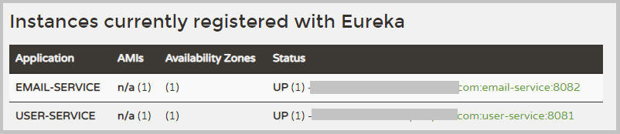
Home Work - Task 1
Try to run
configserver
registry-service
user-service
email-service.
Navigate to Eureka endpoint localhost:8888 and check assigned addresses and ports.
Now shut-down everything and run only registry-service, user-service and email-service.
Navigate to Eureka and check assigned ports. Why they are changed?

