Slide 1
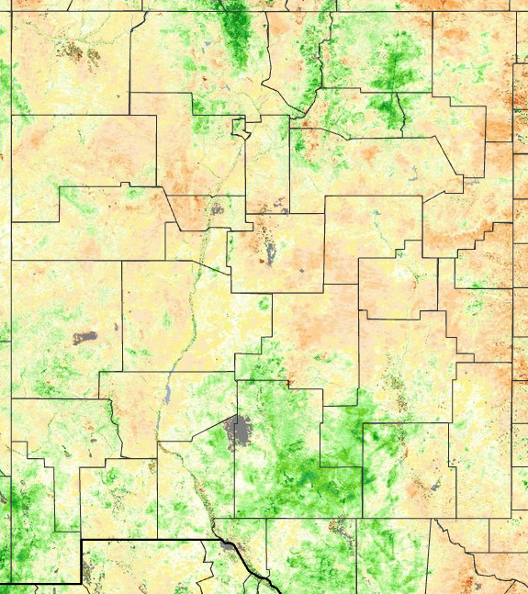
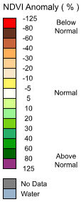
Terra MODIS 8-day Normalized Difference Vegetation Index (NDVI) Anomaly %
May 12, 2026 – May 19, 2026
An NDVI anomaly is the difference between the average NDVI for a given timeframe (above) in a year and the average NDVI for the same month across 2001-2024.

Slide 2
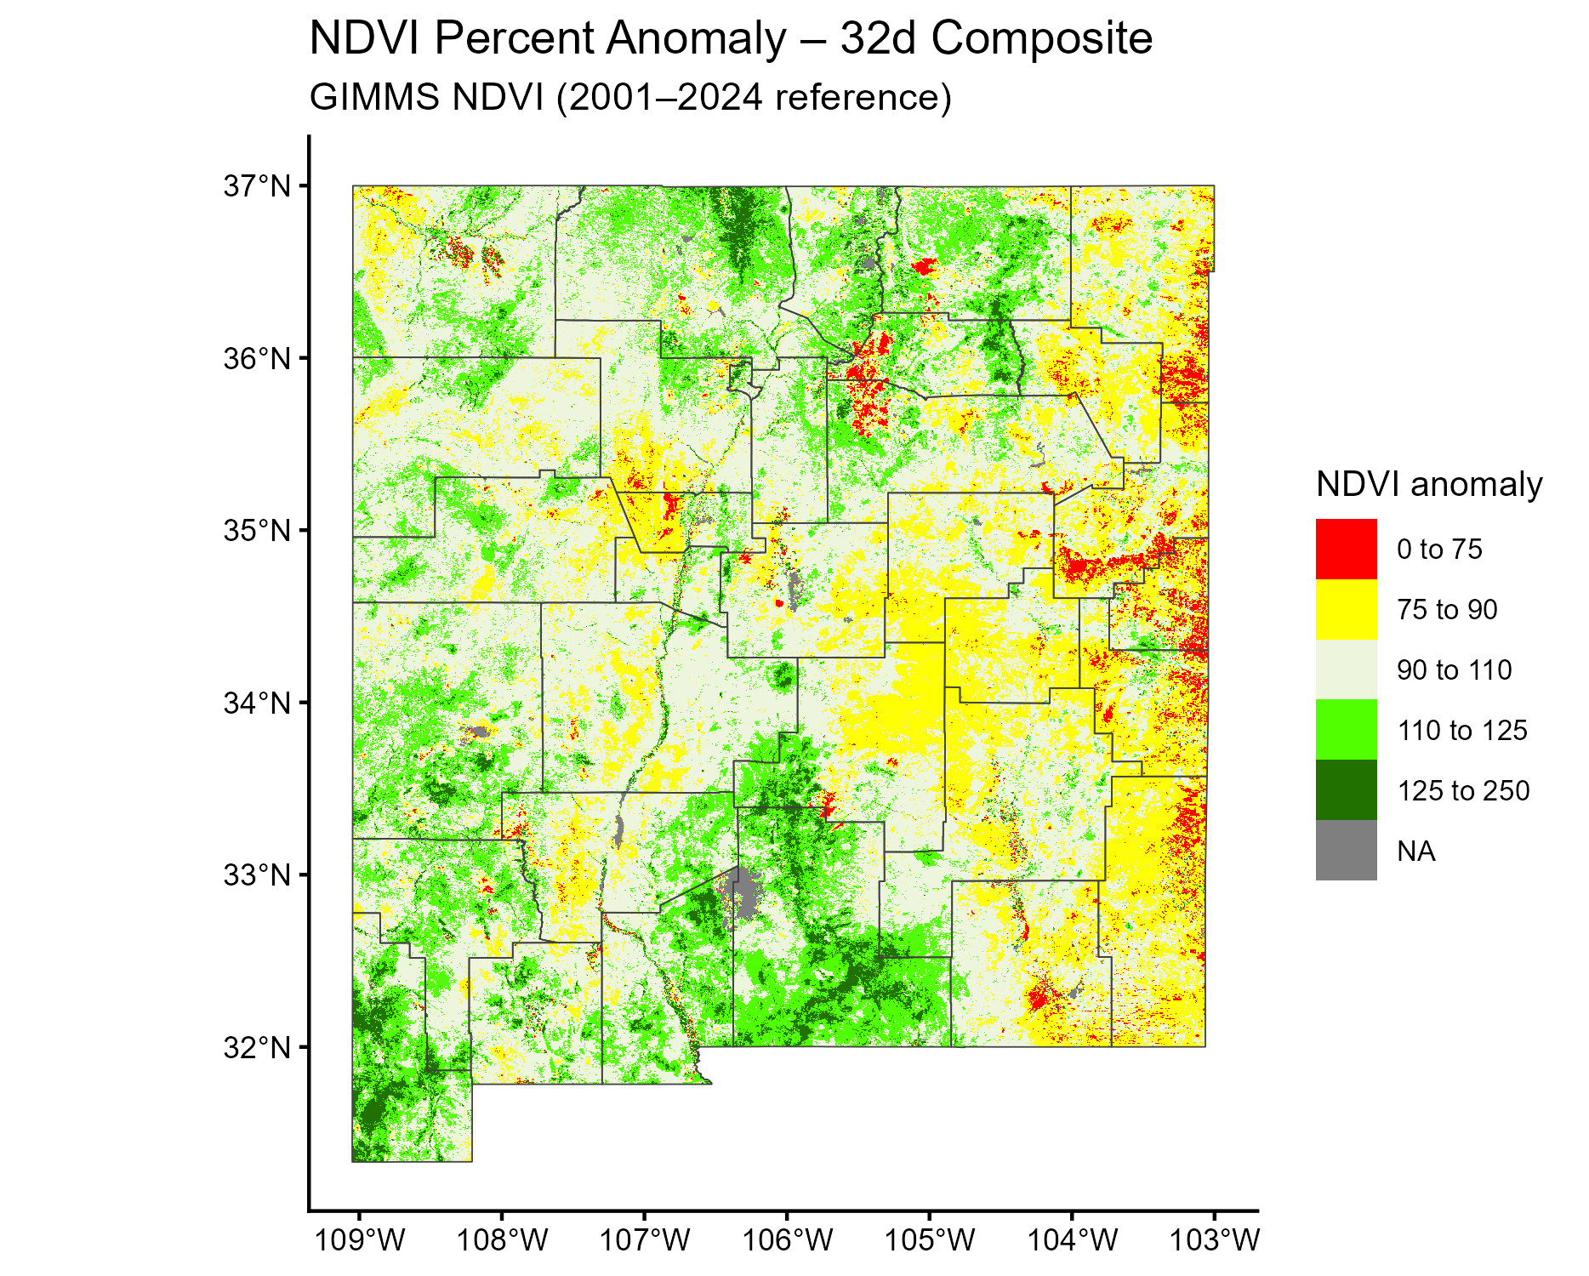
32-day composite
May 19, 2026
Most sensitive to short pulses of greenness, especially in arid rangelands and desert grasslands.

Slide 3
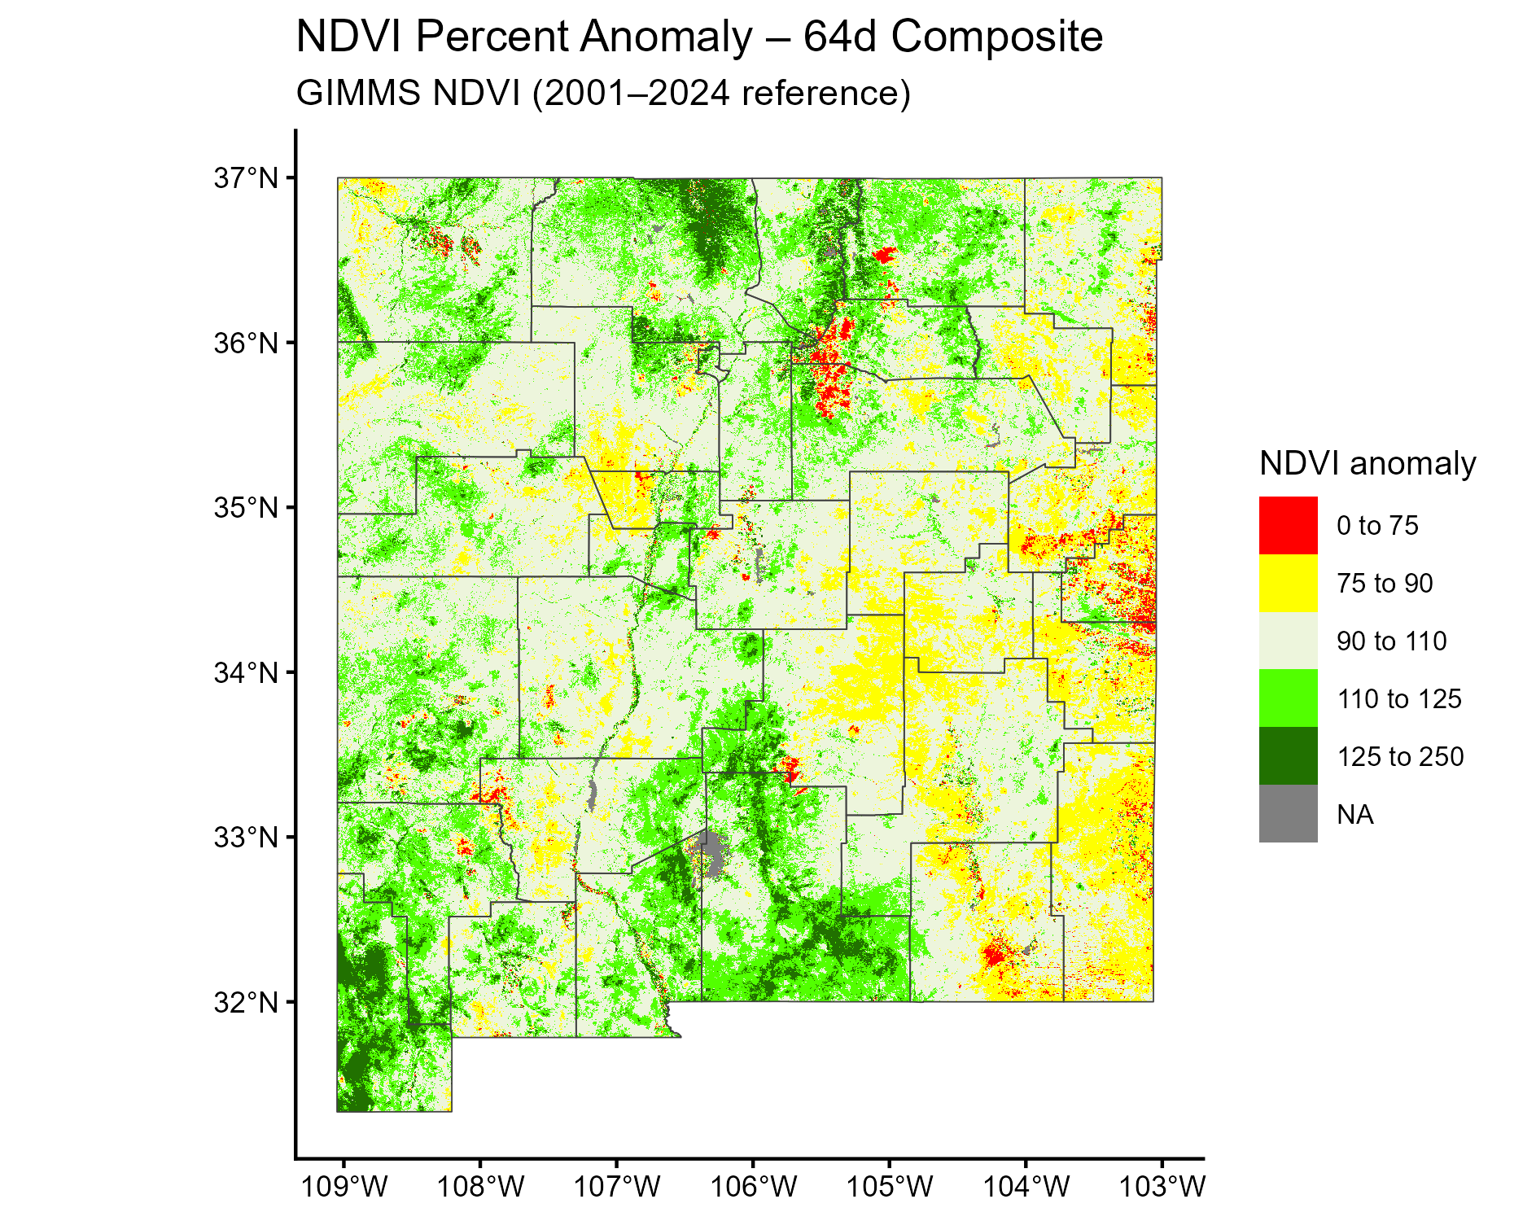
64-day composite
May 19, 2026
Reduces sensitivity to short-term fluctuations but still reacts to broad precipitation patterns.

Slide 4
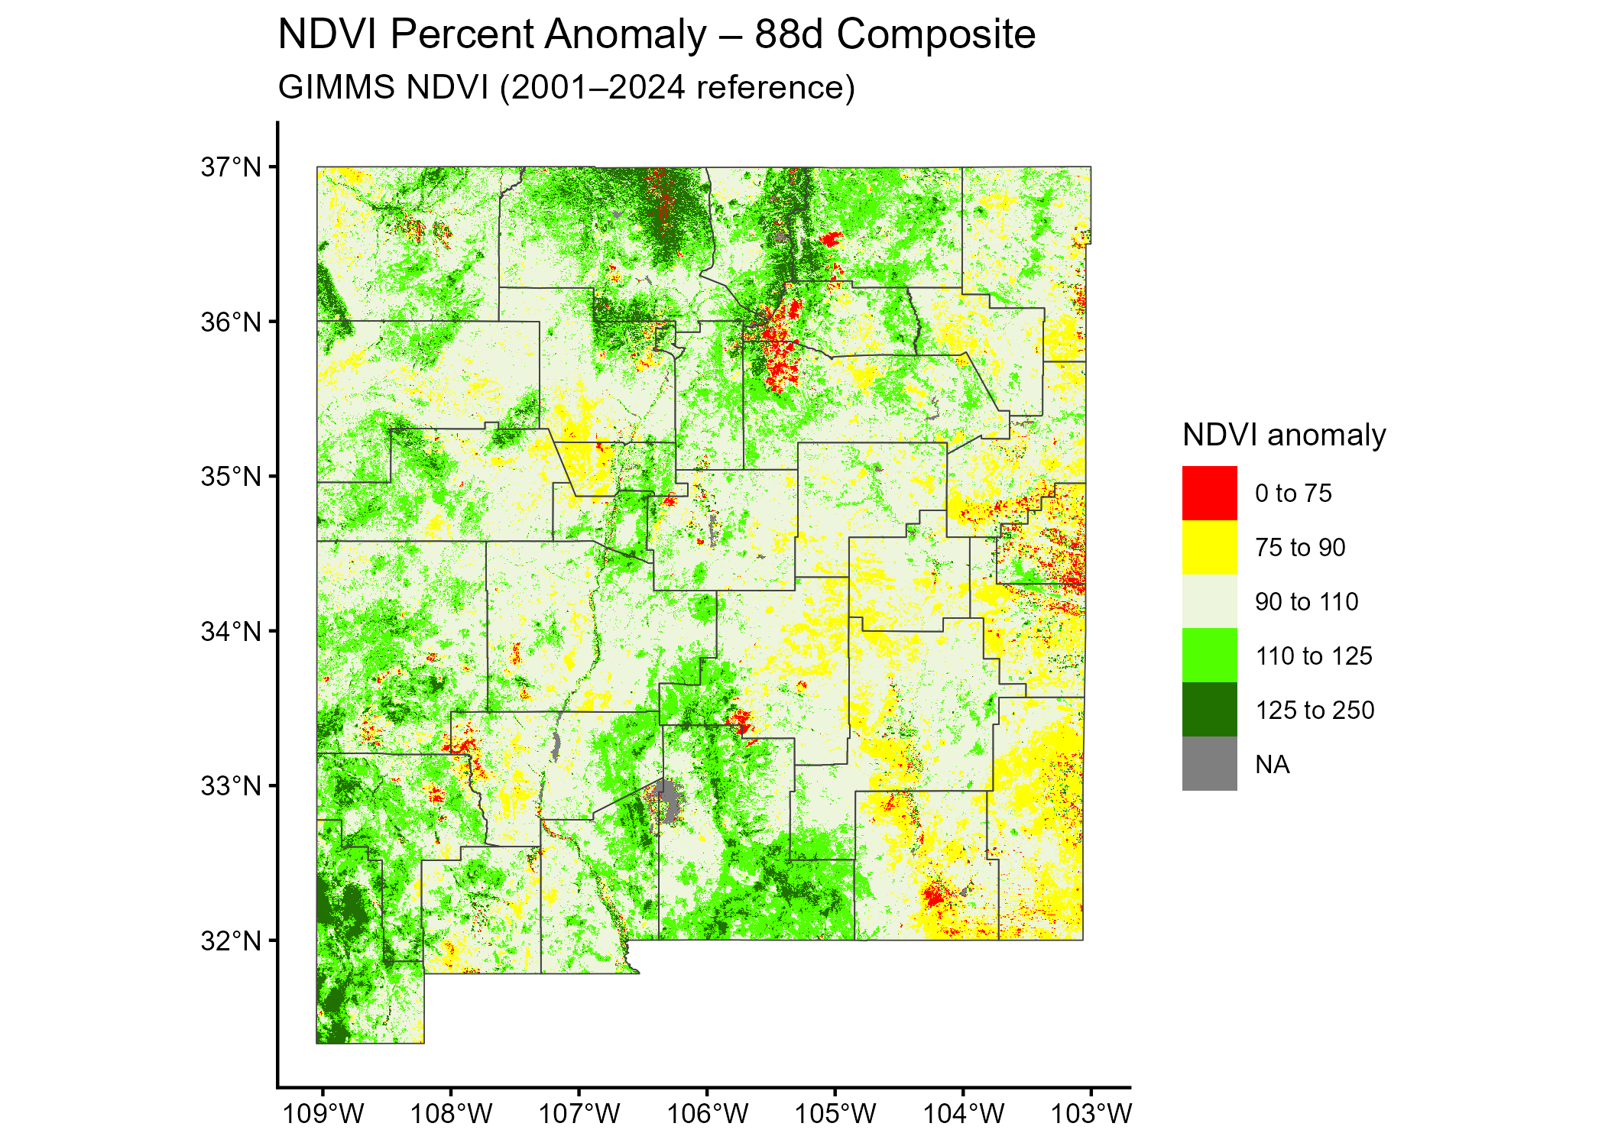
88-day composite
May 19, 2026
Represents quarterly, season-integrated vegetation anomaly. Best for seasonal-to-interannual comparisons

