Slide 1

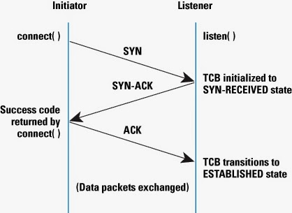
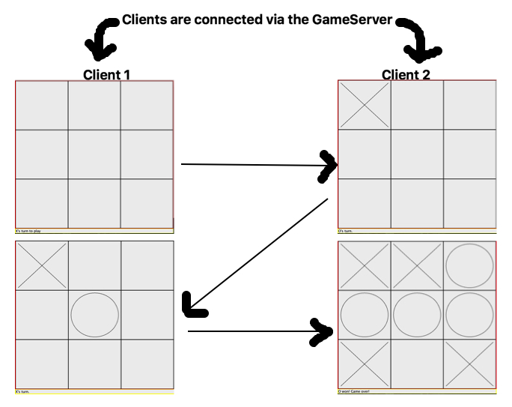
Tic-Tac-Toe & the Transmission Control Protocol
Fujii Maika, Madden Tommy, Tidgewell Dillon
Schmid College of Science and Technology, Chapman University, Orange, CA 92868
Introduction
The Transmission Control Protocol
How TCP Works
The aim of this project was to investigate the aspects and use of the Transmission Control Protocol in a practical way by making a Tic Tac Toe game which matched up players randomly via a universal server.
TCP, or Transmission Control Protocol, is a reliable form of communication, where a persistent connection is made between an initiator and a listener. This connection is made with a three way handshake, consisting of a SYN message, a SYN-ACK message, and an ACK.
Abstract
a
Can a Tic Tac Toe game be developed which allows for multiple games to be played on the same server, while on different sockets; and if so, how can this be done maintaining principles of reliability? As a team, we plan to build a Tic-Tac-Toe game that utilizes the networking concept of TCP socket connections to allow players to connect via the Internet. By housing an ArrayList of TCP Socket connections, a main GameServer will randomly pair users up and have them play a game of Tic Tac Toe. The game will not begin until they are all ready to play, so that players can engage in a tournament style competition to see who is the best of everyone involved.
How to Play
First the GameServer must be running to ensure that there is a medium for the clients to communicate. Then, when a specified number of GameClients connect to that GameServer, the players are matched up randomly with other players who are connected to the server. Then, the GUI appears for each client, with a button saying, “Play”. When this is pressed, the TicTacToe game comes up, and the players take turns picking spaces on the board.
b
Contributions
By creating this Tic Tac Toe multiplayer game, our group aims to expand our personal horizons when it comes to how TCP connections are made. By allowing for multiple games to be played on the same network, but using different sockets, our group will give users the ability to compete to be the best Tic Tac Toe player on the Wi-Fi network. By developing this game, our group plans to learn more about the fundamentals of networking and learn how to utilize those TCP connections in a reliable way, validating input however necessary and allowing for the user to set their own preferences in our GUI system as well.
Conclusion
In Summary, as a connection-orientated delivery service, it is necessary for a connection to be established between clients through the server. With TCP, a reliable service is provided and can be used for a variety of different applications.
Notes:
1

