Slide 1


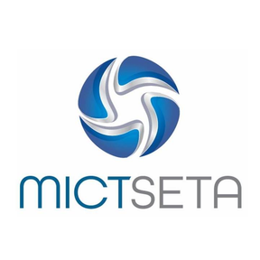



GovSync
GOVSYNC
WHERE CITIZENS AND GOVERNMENT SYNC.
Meet the Team
Sangesonke njameni (Project Manager & Programmer)
Cj may (Developer)
Tidimatso malatji (Business Analyst)
Luthando ndlaku (Business Analyst)
Lakheni nogula (Developer)

Slide 2
Problem Statement
South Africans struggle with public services because of long queues, no waiting time information, poor issue reporting, no feedback, slow handling of requests, and no live updates.
This leads to wasted time, frustration, poor service, low trust in government, and people not knowing what is happening with services or their reports.

Slide 3
Solution
The solution is a web and mobile-based AI platform that helps citizens and government services work better together.
People can report problems using pictures, and AI will automatically identify and send them to the right department. The system will also predict queue times, help users book appointments, and guide them to less busy locations.
It will show live updates on reported issues and send government news, making services faster, more transparent, and easier to use.

Slide 4
Commercialization strategies
The app will generate revenue by licensing the platform to government departments and municipalities through subscription or service fees, offering a SaaS model where municipalities pay monthly or annual fees based on usage and features, while citizens can access basic features for free with the option to pay for premium features such as priority alerts and advanced predictions
.

Slide 5
Competitors
Existing platforms like Snap Send Solve and SeeClickFix allow users to report municipal issues and track progress.
However, they mainly focus on reporting and lack advanced AI features, queue prediction, and full service integration.

Slide 6
Uniqueness(Competitive Advantage)
The GovSync Platform is an all-in-one solution that combines issue reporting, AI automation, queue prediction, and real-time updates in a single system.
Unlike competitors, it uses AI to classify, prioritize, and route issues automatically while also helping users avoid long queues at services like the Department of Home Affairs.

Slide 7
Target Market
The primary target market includes South African citizens who rely on public services and municipalities responsible for service delivery.
Secondary users include government departments and local municipalities seeking to improve efficiency, transparency, and citizen engagement.

Slide 8



GOVSYNC
WHERE CITIZENS AND GOVERNMENT SYNC.
Q & A
Thank You
Presented by :
Group 14 (GovSync)

