Slide 1
Intro to Linux Server & CCR
SESSION 02
By: Ningji Wei
October 15, 2018

Slide 2
About Last Session
Note1 : first time login CCR, you need to reset your password in
CCR Identity Management Portal
Note2 : CCR Help Center (https://ubccr.freshdesk.com/support/home)
Note3 : Video of session 1 has been uploaded in YouTube
Search: Linux Server CCR

Slide 3
Course Checklist
Basics:
know how to finish common tasks in CCR
Advanced Tools:
more convenient and efficient
✓
Connect to CCR
Filesystem Operations
not now ...
CCR Operations
File Transfer

Slide 4
Contents:
Introduction to Linux Server & CCR
Linux Basics (Commands & Tricks)
Run Jobs in CCR
SSH & Git
Tmux (Multitasking)
Vim (Universal IDE)

Slide 5
Basic Linux Commands Recap
Usage | Command
Change directory | $ cd PATH
List contents | $ ls PATH
Print | $ echo STRING
Create file | $ touch FILE
Create folder | $ mkdir FOLDER
Remove file/folder | $ rm [-r] FILE/FOLDER
Move file/folder | $ mv [-r] FILE/FOLDER
Copy file/folder | $ cp [-r] FILE/FOLDER
Trick | Hotkey
Auto complete | tab
Show candidates | tab twice
Jump to the start of the line | C-a
Jump to the end of the line | C-e
Move cursor | left/right
Fast move cursor | C-left/C-right
Prev/Next command | up/down
Practice:
1. create folder prac1, prac2
2. create files test1.dat, test2.dat, test3.dat, na.info in folder prac1

Slide 6
New Trick: Wildcards
Wildcards | Symbol | Meaning | Examples
Star Wildcard | * | string with arbitrary length | $ ls *.txt $ rm *exp*.dat
Question Mark Wildcard | ? | exactly one character | $ ls *.???
Square Brackets Wildcard | [xyz] | any letter in brackets | $ ls *.[xyz]? $ ls [a-cst]* $ ls jones[0-9][a-z][A-Z]
Practice:
3. copy all files with .dat format in folder prac1 to folder prac2
4. remove all files in prac1
5. remove folder prac1

Slide 7
TOO MANY COMMANDS!!!
How to remember?
Where to search?
DON’T try to remember, just use
Just like learning how to type on keyboard
If forget the command and parameters, just search it
$ man CMD # manual for CMD
$ CMD --help # help info for CMD
Google

Slide 8
Text Editors
There are many text editors in Linux
Among all, vi and emacs are the most popular two
Emacs vs vi debate was one of the original “holy wars” in free software community
There are parody religions called Church of Emacs and Cult of vi…
Both are heavyweight editors, take some time to get used to
Nano on the contrary is the easiest to use and learn
Today we introduce nano
In future sessions, vim will be introduced
If you are emacs supporers, don’t fight me…
$ nano # create new file
$ nano FILE # create/open FILE
Practice:
1. create a new file
2. write something
3. save as “first.conf” and close
4. open “first.conf”, do some changes
5. save and close
All the commands are in the bottom of the app, where “^” means ctrl

Slide 9
Well Done!
Basics:
know how to finish common tasks in CCR
✓
Connect to CCR
✓
Filesystem Operations
CCR Operations
File Transfer

Slide 10
Contents:
Introduction to Linux Server & CCR
Linux Basics (Commands & Tricks)
Run Jobs in CCR
SSH & Git
Tmux (Multitasking)
Vim (Universal IDE)

Slide 11

What is CCR
A group of computers connected by network
Form a more powerful machine

Slide 12
Logic Structure of CCR
cluster1
partition1
node1
= a single computer
All nodes use one shared file system
CCR
cluster2
partition2
node2
...
...
...
mae
isecc
cpn-p26-[07-18]
the partition for ISE
login computer
the place when you log in

Slide 13
Different Ways of Running Jobs in CCR
1. run jobs in the login computer
User
Good testing environment
Very restrictive time limit
Lower computation power
Login computer
Cluster: mae Partition: isecc
2. run jobs in a node interactively
Node 1
...
Node k
...
Node 12
Specify time limit
Higher computation power
Run single script a time
Cancel job when disconnected
Special testing environment
3. run jobs in the partition by script
Specify Time Limit
Higher computation power
Can submit an array of script
Unaffected by the connection
Good running environment
No interactive environment

Slide 14
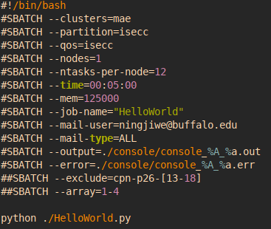
Hello World
0. In the login computer, create file: HelloWorld.py
Step 1: use nano, add one line: print(‘Hello World!’)
1. Run HelloWorld.py in the login computer
Step1: $ python HelloWorld.py
2. Run HelloWorld.py in a node interactively
Step 1: jump to a computation node (computer):
$ fisbatch --clusters=mae --partition=isecc --nodes=1
--ntasks-per-node=12 --time=00:05:00 --exclusive
check indeed in a different environment: $ uname -n
Step 2: $ python HelloWorld.py
3. Run HelloWorld.py in isecc partition by script
“#!” means this line is a shebang, always first row
“#SBATCH” means this line is a sbatch option
in other cases, “#” means this line is a comment
IMPORTANT: create the folder for output & error
Step 1: create a batch script: task.bat
Step 2: $ sbatch task.bat

Slide 15
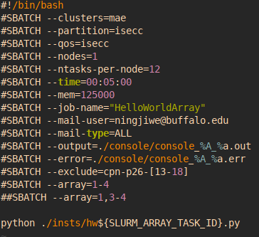
Using Array in Script
!!NOTE: Only in method 3, using sbatch with script
Step 1: create a list of instances whose names only differ in number, example:
hw1.py, hw2.py, … , hw4.py
Step 2: edit the script tasks.sh
Step 3: $ sbatch tasks.sh
${VAR} is a variable
--array=1-4 is an array of values to replace
array representation example:
--array=1,5-9,11,14-18,32-99
may occupy all 12 nodes
use --exclude to specify nodes that DON’T use

