Slide 1
Intro to Linux Server & CCR
SESSION 03
By: Ningji Wei
October 23, 2018

Slide 2
Well Done!
Basics:
know how to finish common tasks in CCR
✓
Connect to CCR
✓
Filesystem Operations
CCR Operations
File Transfer

Slide 3
Logic Structure of CCR
cluster1
partition1
node1
= a single computer
All nodes use one shared file system
CCR
cluster2
partition2
node2
...
...
...
mae
isecc
cpn-p26-[07-18]
the partition for ISE
login computer
the place when you log in

Slide 4
Different Ways of Running Jobs in CCR
1. run jobs in the login computer
User
Good testing environment
Very restrictive time limit
Lower computation power
Login computer
Cluster: mae Partition: isecc
2. run jobs in a node interactively
Node 1
...
Node k
...
Node 12
Specify time limit
Higher computation power
Run single script a time
Cancel job when disconnected
Special testing environment
3. run jobs in the partition by script
Specify Time Limit
Higher computation power
Can submit an array of script
Unaffected by the connection
Good running environment
No interactive environment

Slide 5
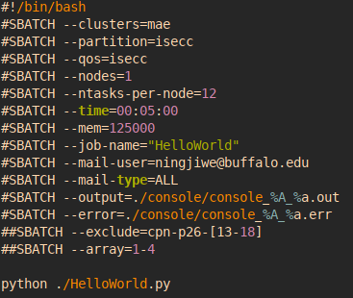
Hello World
0. In the login computer, create file: HelloWorld.py
Step 1: use nano, add one line: print(‘Hello World!’)
1. Run HelloWorld.py in the login computer
Step1: $ python HelloWorld.py
2. Run HelloWorld.py in a node interactively
Step 1: jump to a computation node (computer):
$ fisbatch --clusters=mae --partition=isecc --nodes=1
--ntasks-per-node=12 --time=00:05:00 --exclusive
check indeed in a different environment: $ uname -n
Step 2: $ python HelloWorld.py
3. Run HelloWorld.py in isecc partition by script
“#!” means this line is a shebang, always first row
“#SBATCH” means this line is a sbatch option
in other cases, “#” means this line is a comment
IMPORTANT: create the folder for output & error
Step 1: create a batch script: task.bat
Step 2: $ sbatch task.bat

Slide 6
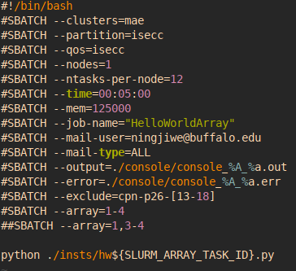
Using Array in Script
!!NOTE: Only in method 3, using sbatch with script
Step 1: create a list of instances whose names only differ in number, example:
hw1.py, hw2.py, … , hw4.py
Step 2: edit the script tasks.sh
Step 3: $ sbatch tasks.sh
${VAR} is a variable
--array=1-4 is an array of values to replace
array representation example:
--array=1,5-9,11,14-18,32-99
may occupy all 12 nodes
use --exclude to specify nodes that DON’T use

Slide 7
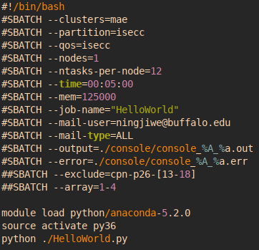
Load Necessary Modules
Some commands are not in the environment when we log in.
We need to load the corresponding modules first.
Some module commands:
$ module avail # show all available modules
$ module avail NAME # search NAME in modules
$ module load NAME # load module NAME
$ module list # show all loaded modules
$ module unload NAME # unload module NAME
Example: use python3 to run HelloWorld.py:
step1: search python related modules
step2: switch to python3 environment
step3: run HelloWorld.py
Load modules in script:
simply add all needed commands

Slide 8
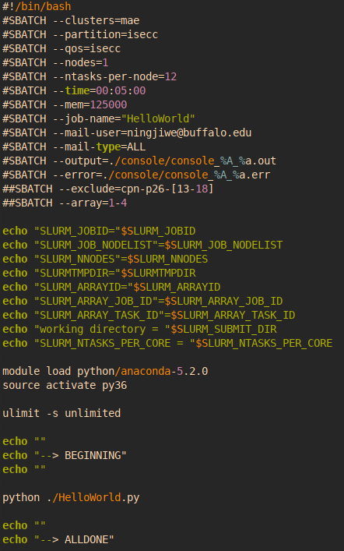
A More Sophisticated Script
Sbatch options part are the same, after that:
Print useful information
Load modules
Remove size limit on the instruction stack
Main commands separator
Main commands
Main commands separator

Slide 9
CCR Commands Summary
Usage | Command
Check nodes info | $ sinfo -M mae -p isecc
Check queue info | $ squeue -M mae -p isecc
Cancel job | $ scancel -M mae JOBID
Start script job | $ sbatch SCRIPT
Start interactive job | $ fisbatch OPTIONS...
Search module | $ module avail NAME
Load module | $ module load NAME
List loaded modules | $ module list
Unload module | $ module unload NAME
Tricks | Command/Hotkey
Run command repeatedly | $ watch CMD PARAMs
Kill foreground process | C-c
Suspend foreground process | C-z
Resume process suspended by C-z | fg
Help monitoring running jobs:
watch squeue -M mae -p isecc
More about script: https://ubccr.freshdesk.com/support/solutions/articles/5000688140-submitting-a-slurm-job-script
More CCR commands:
https://ubccr.freshdesk.com/support/solutions/articles/5000686927-batch-computing-slurm-workload-manager-

Slide 10
Well Done!
Basics:
know how to finish common tasks in CCR
✓
Connect to CCR
✓
Filesystem Operations
✓
CCR Operations
File Transfer

Slide 11
Transfer Files
GUI Method:
WinSCP, Filezilla...
Terminal Method (in local Linux env):
$ scp [-r] LOCAL SERVER # copy from local to server
$ scp [-r] SERVER LOCAL # copy from server to local
How to specify a path in server?
USERNAME@DOMAIN:PATH
example: ningjiwe@vortex.ccr.buffalo.edu:~/bin
Problems:
1. slow when using VPN
2. sometimes sync is more convenient

Slide 12
Sync Files (Git and Github)
What is git:
Version control system for tracking changes in computer files.
It will create a “.git” folder in the target folder, which will record all the changes for the files in that folder.
What is Github:
A online service for syncing all the git records.
We can use Git + Github to sync project folders between local and server.
It is fast, safe, and sync the folder between local and remote.
https://git-scm.com/docs/gittutorial
http://rogerdudler.github.io/git-guide/

Slide 13
Well Done!
Basics:
know how to finish common tasks in CCR
✓
Connect to CCR
✓
Filesystem Operations
✓
CCR Operations
✓
File Transfer

Slide 14
Contents:
Introduction to Linux Server & CCR
Linux Basics (Commands & Tricks)
Run Jobs in CCR
Intro to Advanced Session
Advanced Tools

Slide 15
Linux:
Is About Free and Open
How can I learn stuff to use certain
interface /
application /
workflow?
How can I tweak the computer to make it adapt to what I want?
transition of mentality
To achieve this:
MOST IMPORTANT:
Choices on apps
Almost everything is configurable
Almost everything is open source
Code it yourself (sometimes just one line of code)
Ask yourself, what you like, what you want
Search it online
Practice it on your own!

Slide 16
Let’s Connect to CCR Again
What I want:
Connect to CCR with one simple command: $ ccr
No need to input password, but also keep the communication safe
How to achieve:
Create an one line script
Make it executable: $ chmod +x ccr
Add the folder to path: $ export PATH=$PATH:~/bin
** Use ssh-key to generate key pairs, for safe but easy login
(https://www.debian.org/devel/passwordlessssh)
# Shell script & Shebang
# File permission
# Environment Variables
# Asymmetric cryptography
It is not difficult at all!
The most important is your willingness to practice your idea!

Slide 17
Contents:
Introduction to Linux Server & CCR
Linux Basics (Commands & Tricks)
Run Jobs in CCR
Intro to Advanced Session
Advanced Tools

Slide 18


Remember Our Goal
After the workshop
File manager
Coding IDE
Job monitor
Resources monitor
Debug
call me Linux server ninja warrior
Toolset:
The flow:
Text Editor: Vim
File Manger: Midnight Commander
Resources monitor: Htop
Console Debugger: gdb, jdb, pdb ...
Many other tools...
Introduce basic functionality
Demonstrate the potential
Given the link for full introduction

