Slide 1
Intro to Linux Server & CCR
SESSION 04
By: Ningji Wei
November 15, 2018

Slide 2
Well Done!
Basics:
know how to finish common tasks in CCR
✓
Connect to CCR
✓
Filesystem Operations
✓
CCR Operations
✓
File Transfer

Slide 3
Contents:
Introduction to Linux Server & CCR
Linux Basics (Commands & Tricks)
Run Jobs in CCR
Intro to Advanced Session
Advanced Tools

Slide 4
Linux:
Is About Free and Open
How can I learn stuff to use certain
interface /
application /
workflow?
How can I tweak the computer to make it adapt to what I want?
transition of mentality
To achieve this:
MOST IMPORTANT:
Choices on apps
Almost everything is configurable
Almost everything is open source
Code it yourself (sometimes just one line of code)
Ask yourself, what you like, what you want
Search it online
Practice it on your own!

Slide 5
Let’s Connect to CCR Again
What I want:
Connect to CCR with one simple command: $ ccr
No need to input password, but also keep the communication safe
How to achieve:
Create an one line script
Make it executable: $ chmod +x ccr
Add the folder to path: $ export PATH=$PATH:~/bin
** Use ssh-key to generate key pairs, for safe but easy login
(https://www.debian.org/devel/passwordlessssh)
# Shell script & Shebang
# File permission
# Environment Variables
# Asymmetric cryptography
It is not difficult at all!
The most important is your willingness to practice your idea!

Slide 6
Contents:
Introduction to Linux Server & CCR
Linux Basics (Commands & Tricks)
Run Jobs in CCR
Intro to Advanced Session
Advanced Tools

Slide 7


Remember Our Goal
After the workshop
File manager
Coding IDE
Job monitor
Resources monitor
Debug
call me Linux server ninja warrior
Toolset:
Resources monitor: Htop
File Manger: Midnight Commander
Multitasking: Tmux
Text Editor: Vim
Console Debugger: gdb, jdb, pdb ...

Slide 8
System Monitoring App: Htop
Functionalities & Features:
Open by $ htop
Read off different system status
Four regions of the interface
Clickable
Kill tasks
Visualize system info in different ways (show timer)
Tips for learning new app:
Search “AppName cheat sheet”, “AppName user guide”...
Just learn several most useful things at a time
Cheat sheet for htop:
https://www.maketecheasier.com/power-user-guide-htop/

Slide 9
File Manager: Midnight Commander
Functionalities & Features:
Open by $ mc
View, create, copy, move, delete folders/files
Clickable
Change layout
Redefine hotkeys
Useful keyboard shortcuts:
C-o: switch between mc and console
Tab: jump between panels
C-t/Insert: select/unselect item
Alt-.: show/hide hidden files
Function keys
Cheat sheet for mc:
https://www.cheatography.com/hank/cheat-sheets/midnight-commander/

Slide 10
Things We Can Do Now
We can only do these things one by one!
What We Want?
Command line (bash)
Edit files (nano)
Monitor jobs (with watch command)
Check system status (htop)
Manage files (midnight commander)
Multiple panes (in a window)
Maximize/minimize panes
Copy/paste texts between panes
Multiple windows (in a session)
Multiple sessions
Recoverable sessions

Slide 11
Terminal Multiplier: Tmux
Functionalities & Features:
Open by $ tmux
Create sessions, windows and panes.
Session Operations
Start new session: $ tmux
Detach session: C-b d
Start new session with name: $ tmux new -s NAME
Attach recent session: $ tmux a
Attach specific session: $ tmux a -t NAME
List sessions: $ tmux ls
Kill specific session: $ tmux kill-ses -t NAME
Kill all sessions but the current: $ tmux kill-ses -a
Kill all sessions: $ tmux kill-server
In Session: Command Prefix
Prefix before all command: C-b

Slide 12
Terminal Multiplier: Tmux
Remember Linux is all about what you want!
Pane Operations (With Command Prefix)
Vertical split: %
Horizontal split: ”
Kill pane: x
Jump between panes: arrow keys
Move pane left: {
Move pane right: }
Zoom in/out current pane: z
Auto change layouts: space
Resize pane: hold prefix key + arrow keys
Auto-start Session with Layouts and Apps
Write a short bash script with handful lines
https://stackoverflow.com/questions/5609192/how-to-set-up-tmux-so-that-it-starts-up-with-specified-windows-opened

Slide 13
Terminal Multiplier: Tmux
Window Operations (With Command Prefix)
Create window: c
List windows: w
Next window: n
Previous window: p
Kill window: &
Go to window by number: 0 … 9
Clipboard (Copy & Paste between panes)
Cheat sheet for tmux:
https://gist.github.com/MohamedAlaa/2961058
http://tmuxcheatsheet.com/

Slide 14
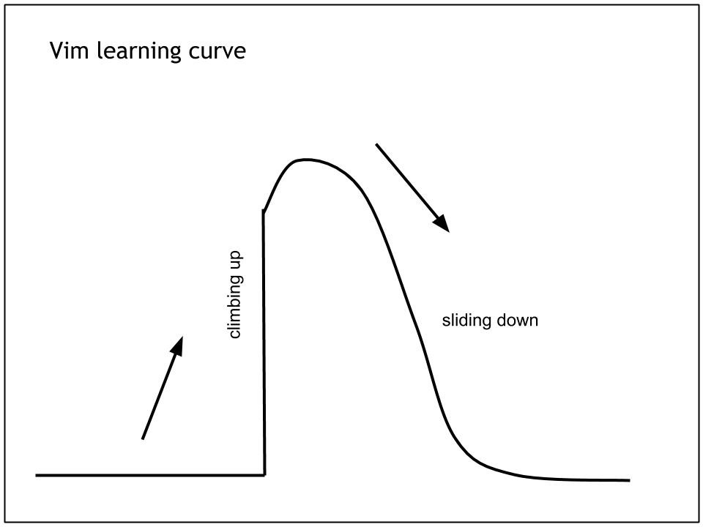
Text Editor / All Around IDE: Vi
Vi represents a class of text editors:
Vi: original editor, almost in every Linux environment
Vim: vi improved
Gvim: vim with GUI
Neovim: the future of vim (according to their website)
You can start with any of them, and you’ll know how to use the rest naturally
Vi and vim are available in CCR.
Vim is not easy to get started with (same with Emacs),
Courtesy: https://pascalprecht.github.io/2014/03/18/why-i-use-vim/

Slide 15
Text Editor / All Around IDE: Vi
But it is an app that reward you a lot along the way
Initial release: 1976
Still on the top of the list in almost all comparisons of text editorshttps://www.slant.co/topics/10214/~linux-text-editors
It is everywhere, all platform.
It is fast and efficient.
It is can be a full-featured IDE for almost every language.
It can be a full-featured IDE for LaTeX.
You can configure it as simple / fancy / efficient as you want.
And after certain point,
you just want to use it for every possible task for the rest of your life
According to Slate, Emacs and Vi are “Among the longest-lived applications of all time.” The Wikipedia entry on the differences between Emacs and Vi describes the Holy War between the two applications which has raged since the late-1970s.
Both editors require learning their respective commands, which means you won’t be able to open them and get right to work. But expert users of either seem to make their editor of choice perform magic, often without even leaving their keyboard’s home row.
https://medium.com/linode-cube/emacs-nano-or-vim-choose-your-terminal-based-text-editor-wisely-8f3826c92a68

Slide 16
What Makes Vim Special: Three Concepts
Concept 1: Mode, do different things in different modes
Normal mode: navigation and manipulation of text.
Insert mode: inserting new text
Visual mode: text selection, copy (yank) & paste, operator on blocks
Command-line mode: input command
Full introduction: https://guide.freecodecamp.org/vim/modes/
Concept 2: Text Objects & Motions, manipulate text naturally (Influence many other apps)
Command Structure: <command><number><text object or motion>.
Number: how many times to repeat the command.
Command: an operation, d(elete), c(hange), y(ank)
Text object: w(ord), s(entence), p(aragraph), iw(inner word), aw(a word), is, as, ip, ap, i), a).
Example:
  daw: delete a word
  c2w: change 2 words
  ya): yank a round brackets
Full introduction: http://springest.io/vim-motions-and-command-language

Slide 17
What Makes Vim Special: Three Concepts
Concept 3: Plugin, add extra power
Syntax highlighting (different languages)
Auto-completion (different languages)
Linting (code analysis for different languages)
Different color styles
Git integration
Fuzzy file finder / file tree
Multi-cursors, change multiple things at the same time
Visual mode: text selection, copy (yank) & paste, operator on blocks
Command-line mode: input command
Full introduction: https://medium.com/@huntie/10-essential-vim-plugins-for-2018-39957190b7a9
Many other tools: https://vimawesome.com/
Package manager: https://github.com/junegunn/vim-plug
How to Learn So Many Things?
Use it.
Don’t push too much. Learn several things a time.
Enjoy the process…
And, try the vim tutor app, $ vimtutor

Slide 18
How to Debug?
Debug Tools
gdb: c++ debug app, https://darkdust.net/files/GDB%20Cheat%20Sheet.pdf
jdb: java debug app, https://docs.oracle.com/javase/7/docs/technotes/tools/solaris/jdb.html
pdb: python debug app, https://appletree.or.kr/quick_reference_cards/Python/Python%20Debugger%20Cheatsheet.pdf
Many others ...

Slide 19
The end
This is the start of a new journey
Explore more!
Try more!
Experiment more!
And make more mistakes...
Most importantly
HAVE FUN!

Slide 20
THANK YOU!
There may be a followup email for a short survey for this course.

