Slide 1
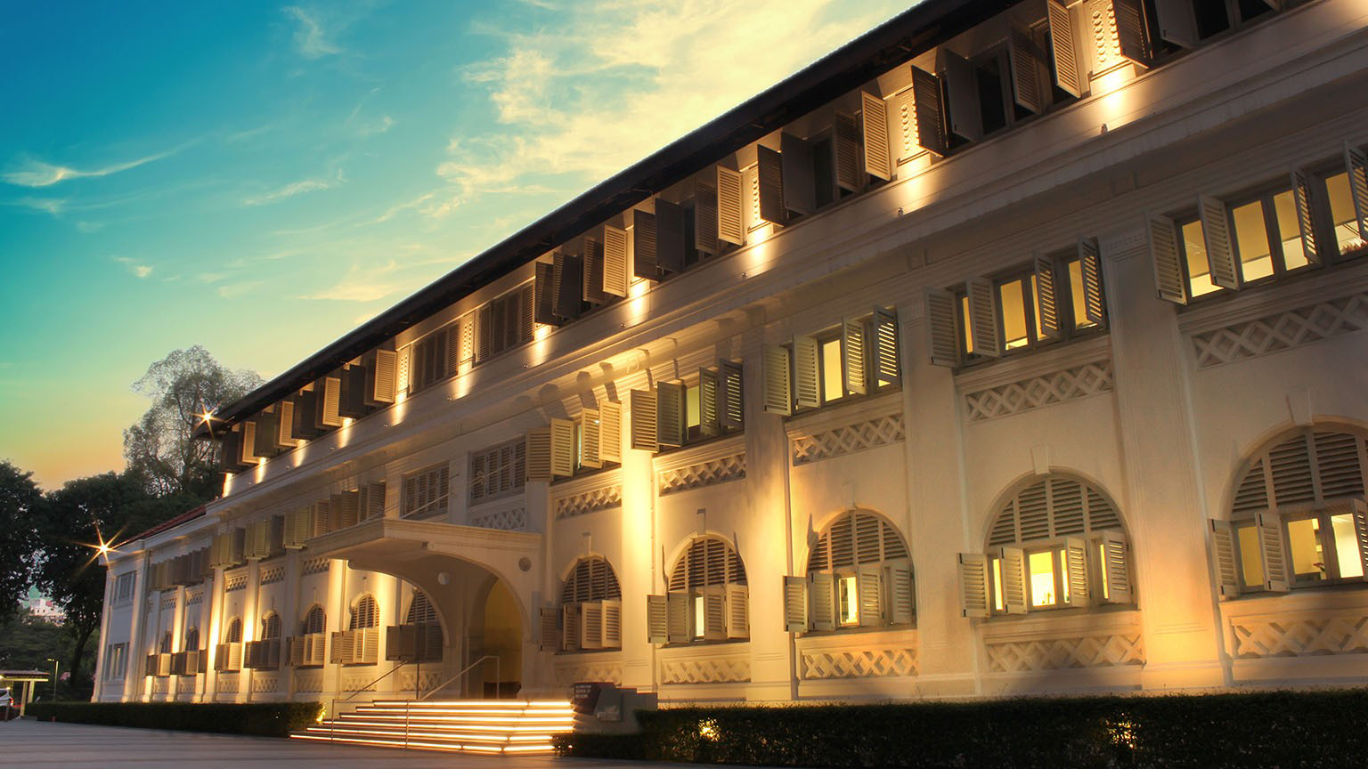



TidyMass: An Object-oriented Reproducible Analysis Framework for LC-MS Data
Xiaotao Shen, Ph.D.
Nanyang Assistant Professor
Lee Kong Chian School of Medicine &
School of Chemistry, Chemical Engineering and Biotechnology
Nanyang Technological University, Singapore
May 29th, 2024
xiaotao.shen@ntu.edu.sg
xiaotaoshen1990
shen-lab.org
github.com/jaspershen

Slide 2
Outline
TidyMass: An Object-Oriented Reproducible Analysis Framework for LC-MS Data
Concept of Design
mass_dataset class object
Reproducible Analysis Using TidyMass
Case Study: A Blood Metabolome Atlas of Rhesus Macaques
Notes:
There are two parts of my presentation todays. First part is the metID, and the second part I want to talk something something I am still working on. So let’s get it started with the part 1.

Slide 3
Outline
TidyMass: An Object-Oriented Reproducible Analysis Framework for LC-MS Data
Concept of Design
mass_dataset class object
Reproducible Analysis Using TidyMass
Case Study: A Blood Metabolome Atlas of Rhesus Macaques
Notes:
There are two parts of my presentation todays. First part is the metID, and the second part I want to talk something something I am still working on. So let’s get it started with the part 1.

Slide 4
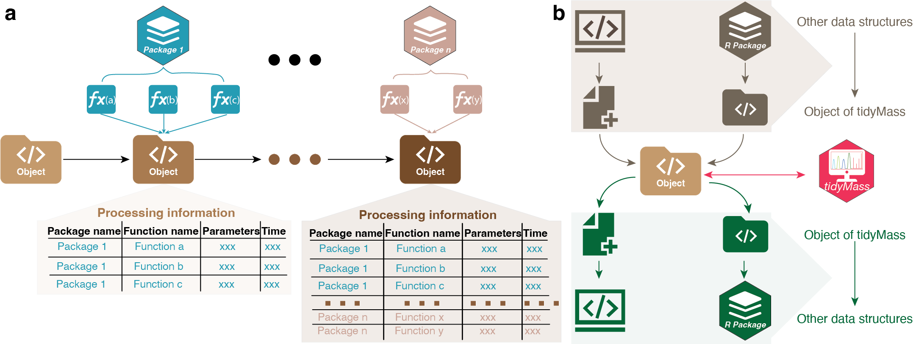

Study Design And Overview

Slide 5
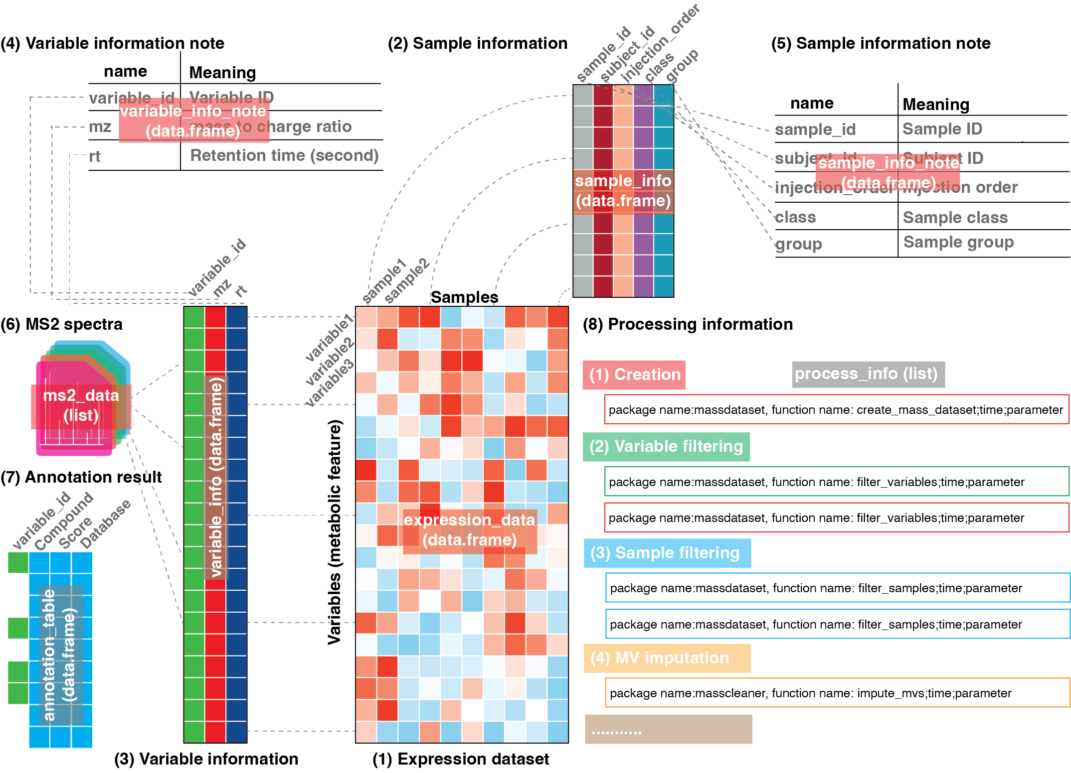
“mass_dataset” in TidyMass

Slide 6
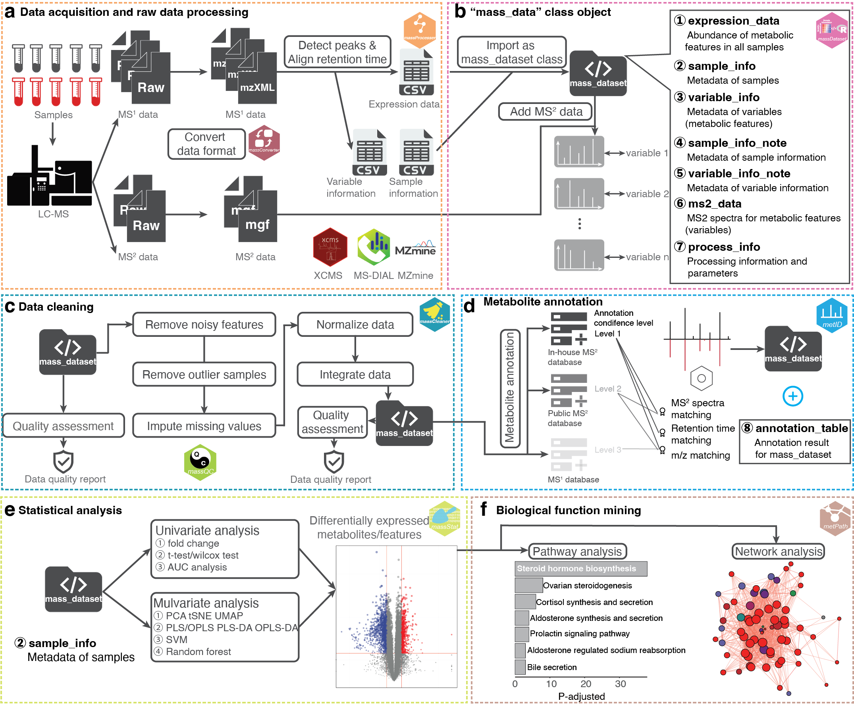
Workflow of TidyMass

Slide 7



Acknowledgments
Prof. Jake Goodman
(Good University)
Prof. Jiaoshou Hao
(Jialidun University)
Prof. Chole Shen
(Great University)
Jake lab
Dr. Liang Hao
Dr. Yue Yue
Dr. Chen Chen
Dr. Brittany Brittany
Dr. Alireza Alireza
Dr. Sara Sara
Dr. Yael Yael
Dr. Ariel Ariel
Dr. Kevin Kevin
Mr. Basil Basil
Jake lab
Dr. Ryan Ryan
Dr. Daniel Daniel
Dr. Daniel J. Daniel
Dr. Zhou Zhou
Dr. Gao Gao
Dr. Sai Sai
Dr. Si Si
Mr. Ian Ian
Jialidun University
Dr. Wang Wang
Dr. Kevin Kevin
Dr. Jessalyn Jessalyn
Great University
Dr. Hong Hong

Slide 8
Thank You For Your Attention!
Q&A
Xiaotao Shen, Ph.D.
Nanyang Assistant Professor
Lee Kong Chian School of Medicine &
School of Chemistry, Chemical Engineering and Biotechnology
Nanyang Technological University, Singapore
xiaotao.shen@ntu.edu.sg
xiaotaoshen1990
shen-lab.org
github.com/jaspershen

