Slide 1


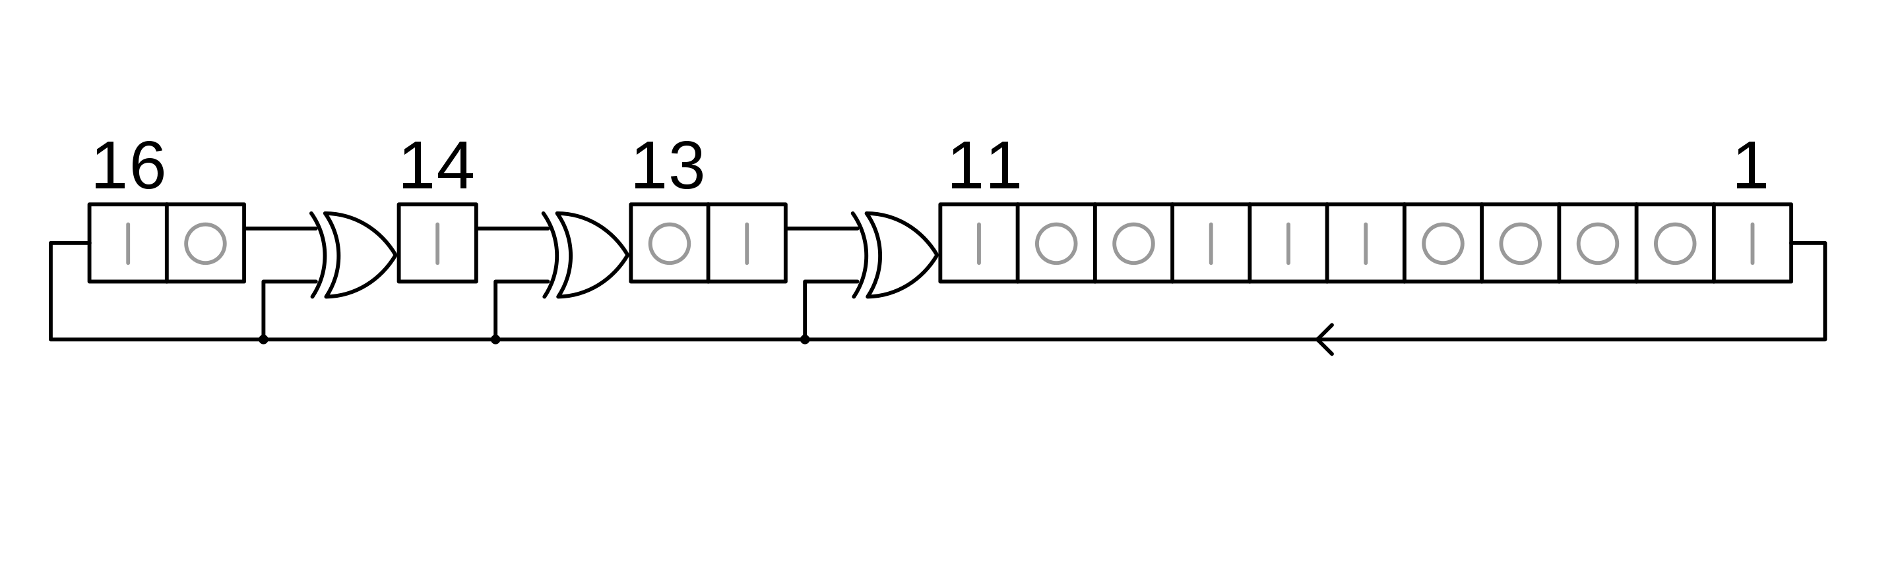




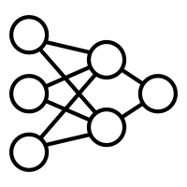


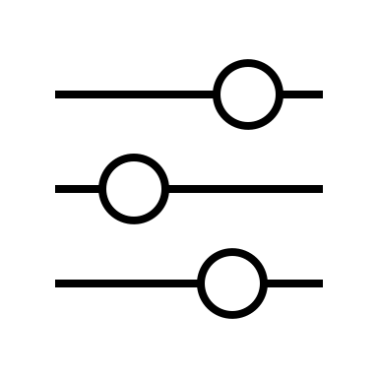

S → w | w ( S ) | ( ) | w = S | [ S ] …
S → S if S else S | S for S in S
d = sum([foo(i] for i in vals])
d = sum([foo(i) for i in vals])

