Slide 1




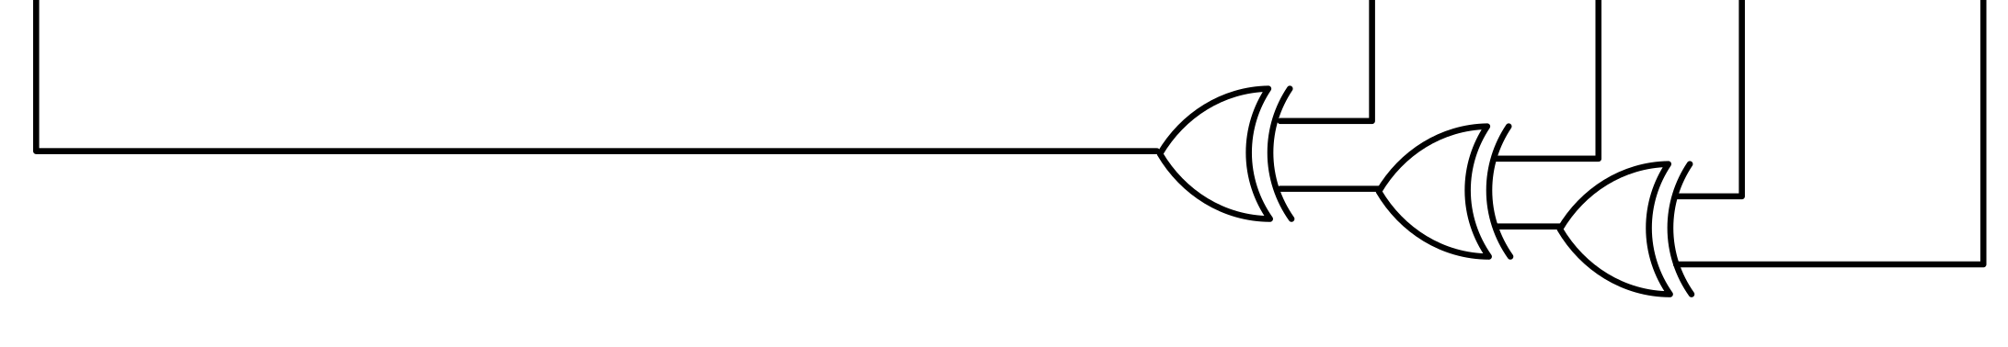


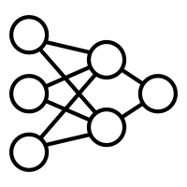





d = sum([foo(i] for i in vals))
S → ID | ID ( S ) | S , S
S → S | [ S ] | S . S | ( S )
S → S if S else S | S for S in S
①
①
③
②
②
⑤
④
d = sum([foo(i) for i in vals])
⑥

