Slide 1
Predicting Yelp Rating Based on Social Network
Final Project
Group member:
Yanfu Zhang
Tiecheng Su

Slide 2


Intro: Background & Goals
Recommender system
Predicting Yelp rating with past rating
Notes:
Amazon, books Netflix, movies

Slide 3
Data Pruning
Yelp Dataset Challenge
City: Pittsburgh
Choose restaurants and users with num. of review>10
Users | 651
Business | 803
Reviews | 16425
Training set 90% Test set 10%
Notes:
sparse

Slide 4

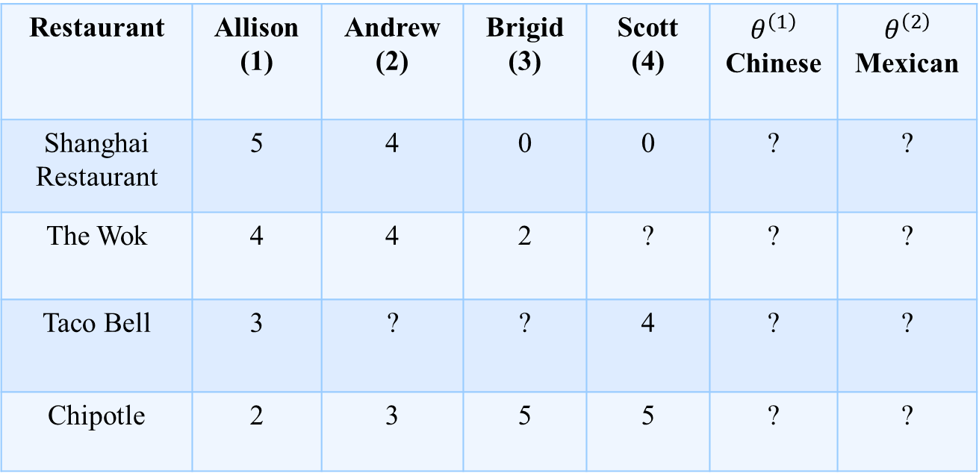
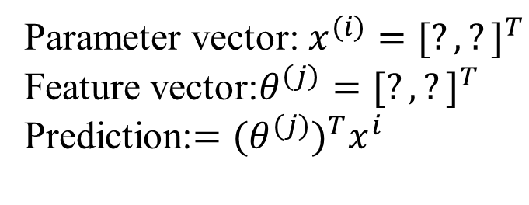
Problem motivation
User rates restaurants using one to five stars
Restaurant | Allison (1) | Andrew (2) | Brigid (3) | Scott (4) | $$θ^{\left(1\right)}$$ Chinese | $$θ^{\left(2\right)}$$ Mexican
Shanghai Restaurant | 5 | 4 | 0 | 0 | ? | ?
The Wok | 4 | 4 | 2 | ? | ? | ?
Taco Bell | 3 | ? | ? | 4 | ? | ?
Chipotle | 2 | 3 | 5 | 5 | ? | ?
Parameter vector: $x^{(i)}={[?,?]}^{T}$
Feature vector:$θ^{\left(j\right)}={[?,?]}^{T}$
Prediction:$=({θ^{(j)})}^{T}x^{i}$
Notes:
Learn features user 1-4 given data missing automatically parameter vector

Slide 5
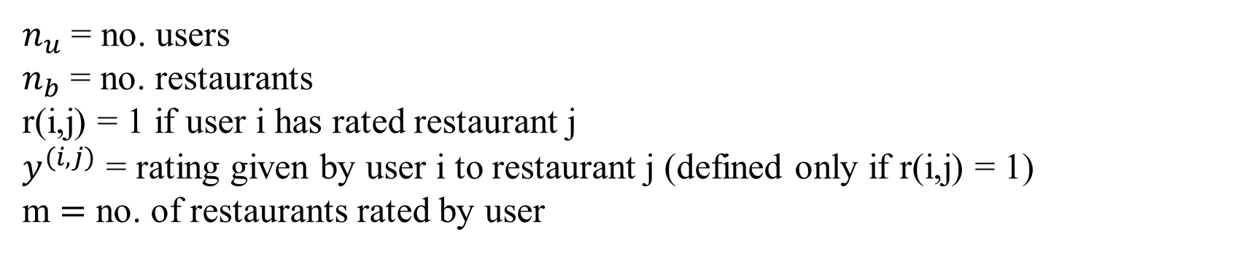
Collaborative filtering optimization objective
$n_{u}$ = no. users
$n_{b}$ = no. restaurants
r(i,j) = 1 if user i has rated restaurant j
$y^{(i,j)}$ = rating given by user i to restaurant j (defined only if r(i,j) = 1)
m $=$ no. of restaurants rated by user
For each restaurant j and user i, learn a parameter $θ^{(j)}$ and $x^{i}$. Predict user i as rating restaurant i with ${\hat{y}}^{(i,j)}=({θ^{(j)})}^{T}x^{i}$
Cost function
$$J\left(x^{\left(1\right)},…x^{\left(n_{u}\right)},θ^{\left(1\right)},…θ^{\left(n_{b}\right)}\right)=\frac{1}{2m}\sum_{\left(i,j\right):r\left(i,j\right)=1}{{({\hat{y}}^{\left(i,j\right)}−y^{(i,j)})}^{2}}+\frac{λ}{2m}\sum_{i=1}^{n_{u}}{\sum_{k=1}^{n}{{(x_{k}^{(i)})}^{2}}}+\frac{λ}{2m}\sum_{j=1}^{n_{b}}{\sum_{k=1}^{n}{{(θ_{k}^{(j)})}^{2}}}$$
Notes:
Training set minimize regularization term actual rating

Slide 6
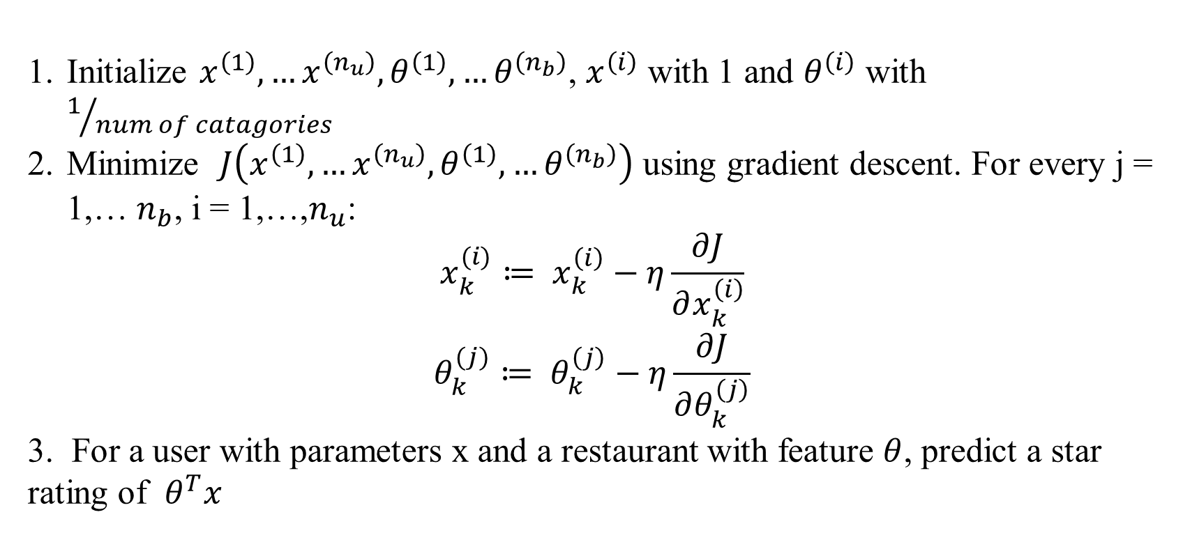
Collaborative filtering algorithm
Initialize $x^{\left(1\right)},…x^{\left(n_{u}\right)},θ^{\left(1\right)},…θ^{\left(n_{b}\right)}$, $x^{\left(i\right)}$ with 1 and $θ^{\left(i\right)}$ with $1/{num of catagories}$
Minimize $J\left(x^{\left(1\right)},…x^{\left(n_{u}\right)},θ^{\left(1\right)},…θ^{\left(n_{b}\right)}\right)$ using gradient descent. For every j = 1,… $n_{b}$, i = 1,…,$n_{u}$:
$$x_{k}^{(i)}≔ x_{k}^{\left(i\right)}−η\frac{∂J}{∂x_{k}^{\left(i\right)}}$$
$$θ_{k}^{(j)}≔ θ_{k}^{\left(j\right)}−η\frac{∂J}{∂θ_{k}^{\left(j\right)}}$$
3. For a user with parameters x and a restaurant with feature $θ$, predict a star rating of $θ^{T}x$

Slide 7
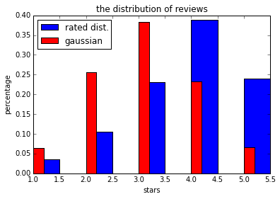
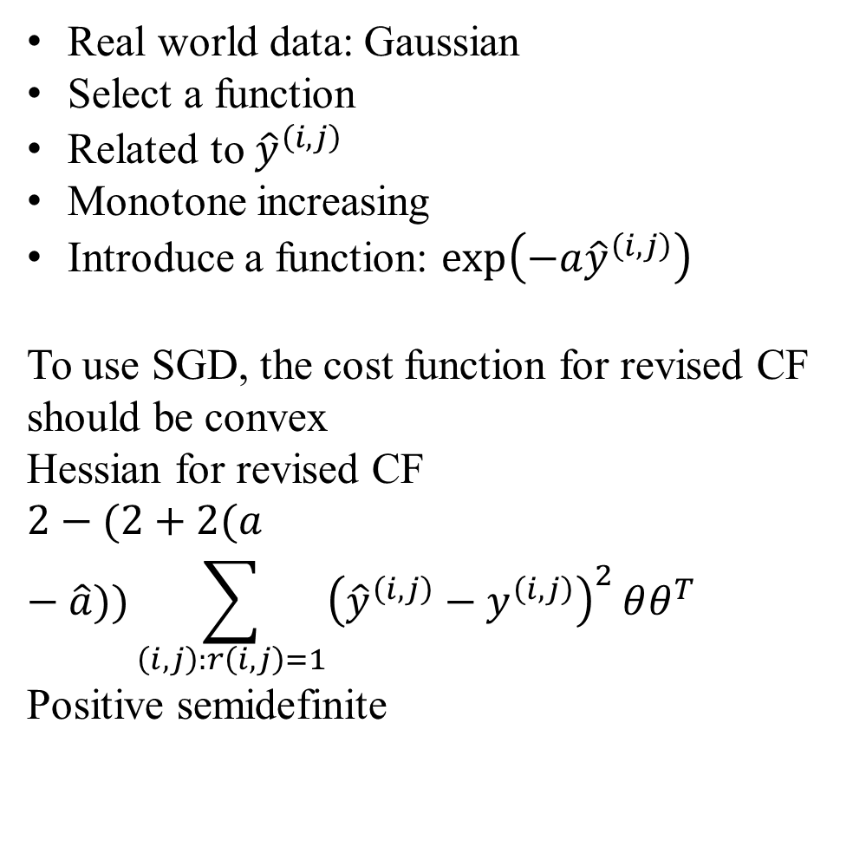
Revision for real world data
Real world data: Gaussian
Select a function
Related to ${\hat{y}}^{\left(i,j\right)}$
Monotone increasing
Introduce a function: $\exp\left(−a{\hat{y}}^{\left(i,j\right)}\right)$
To use SGD, the cost function for revised CF should be convex
Hessian for revised CF
$$2−(2+2(a−\hat{a}))\sum_{\left(i,j\right):r\left(i,j\right)=1}{{\left({\hat{y}}^{\left(i,j\right)}−y^{\left(i,j\right)}\right)}^{2}}θθ^{T}$$
Positive semidefinite

Slide 8
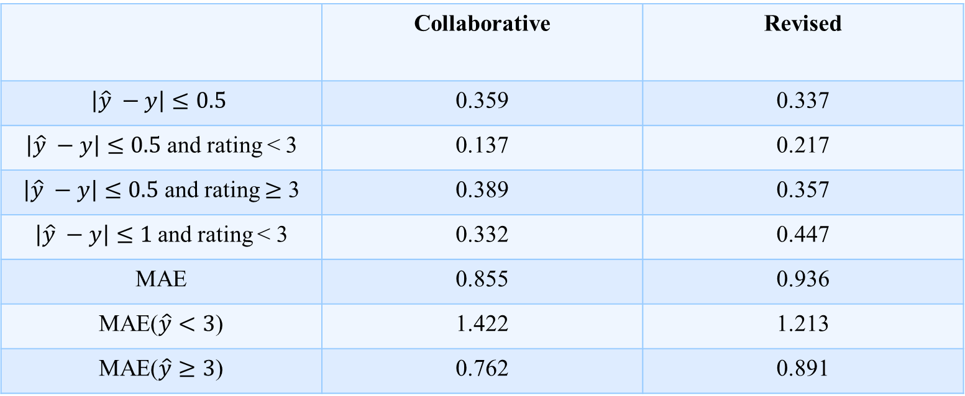
Result
 | Collaborative | Revised
$$\left|\hat{y} −y\right|≤0.5$$ | 0.359 | 0.337
$\left|\hat{y} −y\right|≤0.5$ and rating < 3 | 0.137 | 0.217
$\left|\hat{y} −y\right|≤0.5$ and rating $≥$ 3 | 0.389 | 0.357
$\left|\hat{y} −y\right|≤1$and rating < 3 | 0.332 | 0.447
MAE | 0.855 | 0.936
MAE($\hat{y}<3$) | 1.422 | 1.213
MAE($\hat{y}≥3$) | 0.762 | 0.891
Notes:
Mean absolute error the average absolute deviation of predictions to the ground truth data

Slide 9
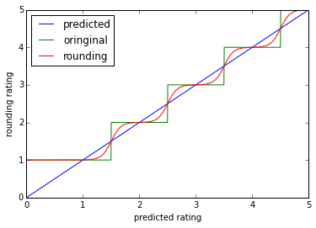
Rounding
Introduce rounding :${\hat{y}}^{\left(i,j\right)}=1+\sum_{k=1}^{4}{{[1+exp⁡({\left(−θ^{\left(j\right)}\right)}^{T}x^{i}−C_{k})]}^{−1}}$
Notes:
Equal interval

Slide 10
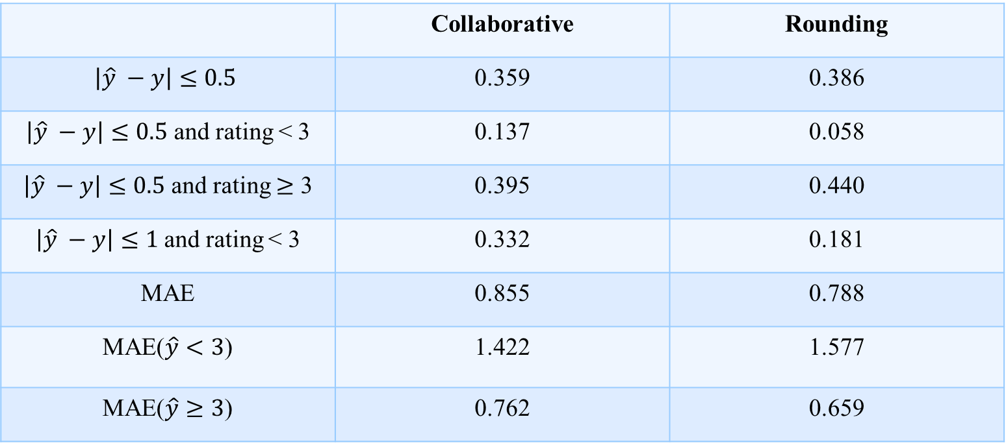
Rounding result
 | Collaborative | Rounding
$$\left|\hat{y} −y\right|≤0.5$$ | 0.359 | 0.386
$\left|\hat{y} −y\right|≤0.5$ and rating < 3 | 0.137 | 0.058
$\left|\hat{y} −y\right|≤0.5$ and rating $≥$ 3 | 0.395 | 0.440
$\left|\hat{y} −y\right|≤1$and rating < 3 | 0.332 | 0.181
MAE | 0.855 | 0.788
MAE($\hat{y}<3$) | 1.422 | 1.577
MAE($\hat{y}≥3$) | 0.762 | 0.659

Slide 11

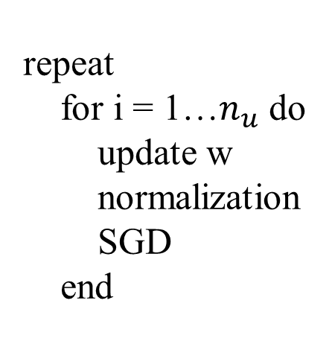
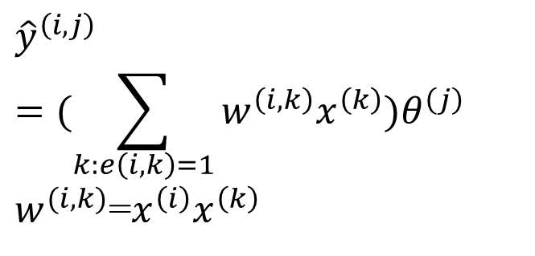
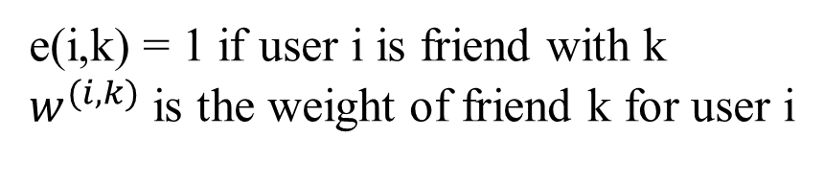
Influence of friends
e(i,k) = 1 if user i is friend with k
$w^{(i,k)}$ is the weight of friend k for user i
$${\hat{y}}^{\left(i,j\right)}=(\sum_{k:e\left(i,k\right)=1}{w^{\left(i,k\right)}x^{\left(k\right)})θ^{\left(j\right)}}$$
$w^{(i,k)}$=$x^{\left(i\right)}x^{\left(k\right)}$
repeat
for i = 1…$n_{u}$ do
update w
normalization
SGD
end
Slightly improve the performance
Notes:
Inner product

Slide 12
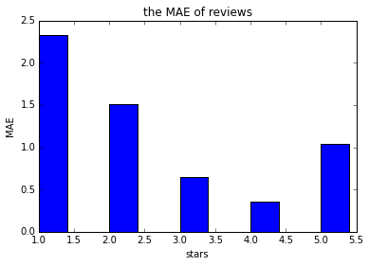
Algorithm analysis & future work
5 star revise with average rating
High MAE for low rating:
Average rating
Rating of friends
Average rating of user himself
Future works
Other models
Social network influence
Notes:
Small probability event

