Slide 1
Platform for Investigating Privacy Concerns In Intelligent Voice Assistant
RAHUL LAO

Slide 2
Virtual Voice Assistant
A virtual assistant, also called AI assistant or digital assistant, is an application program that understands natural language voice commands and completes tasks for the user.

Slide 3
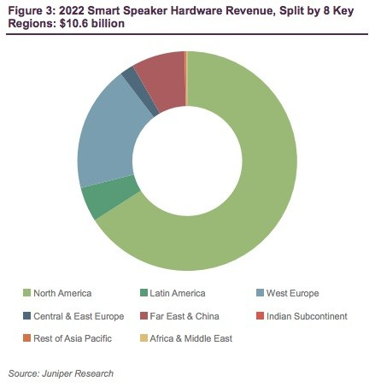
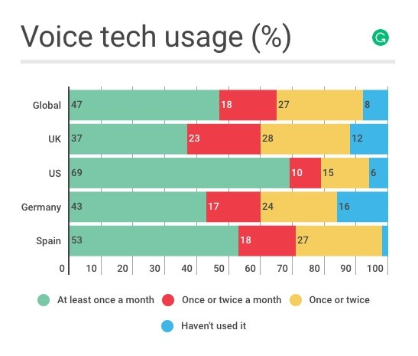
Revenue And Usage (%)

Slide 4
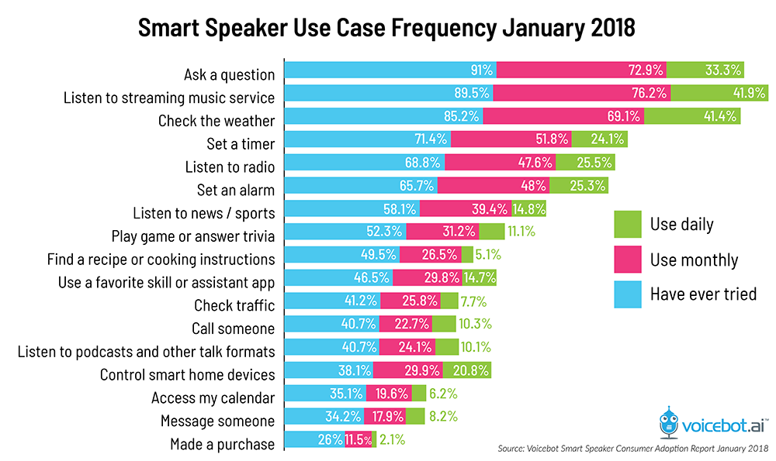
Use Cases

Slide 5
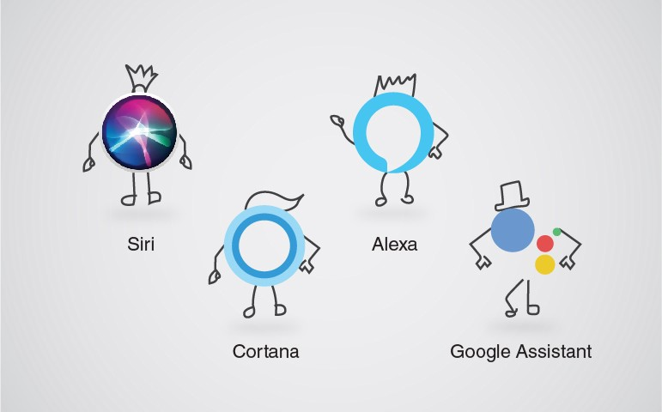
The Big Four

Slide 6
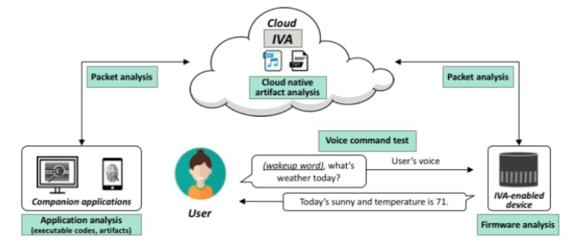
IVA Eco System

Slide 7
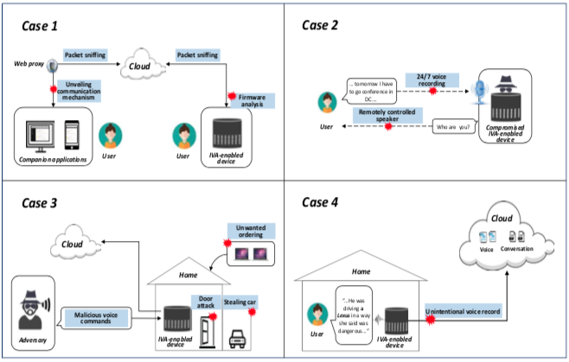
Rogue IVA

Slide 8
Privacy Concerns
Who actually owns user‘s data?
What exactly can and can‘t the digital assistant vendors do?
Can the vendor give any third parties access to user data?
What level of technical skill might be sufficient to hack into user data?
Is there a retention policy for user data?
Can a user allow another user to access their data?

Slide 9
Goal
Our goal is to develop a platform that can be used to capture user voice commands which can be later used to perform studies related to privacy issues with intelligent voice assistants.

Slide 10
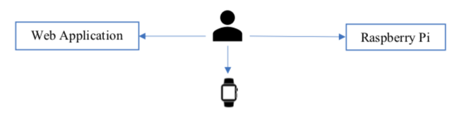
Main Components Of The Platform

Slide 11
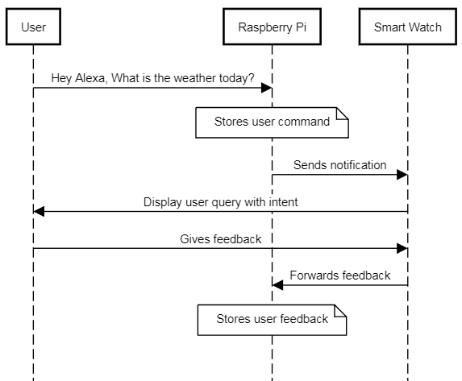
Sequence Diagram

Slide 12
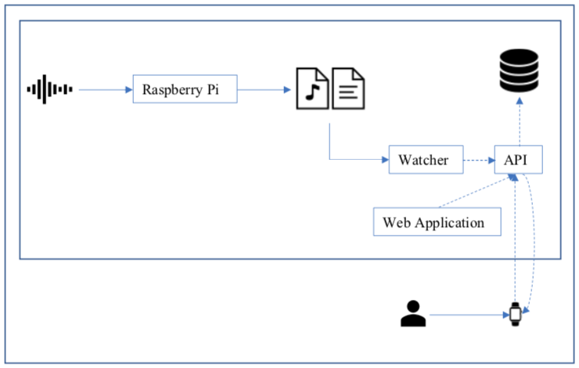
First Draft Of Platform Workflow

Slide 13
Thank You

