Slide 1
Tie Fighters “git” movin’
An Introduction to git and GitHub

Slide 2
What is a VCS
Version Control System
Stores and tracks changes to your code
Locally…think track changes in Microsoft Word
Centralized…think library
Distributed…well…this is git

Slide 3
Why use a VCS
People make mistakes
Helps track down specific changes to find bugs
Allows multiple people to contribute

Slide 4



What is git?
The best of both worlds
A distributed version control system
Created for the development on the Linux kernel by Linus Torvalds

Slide 5
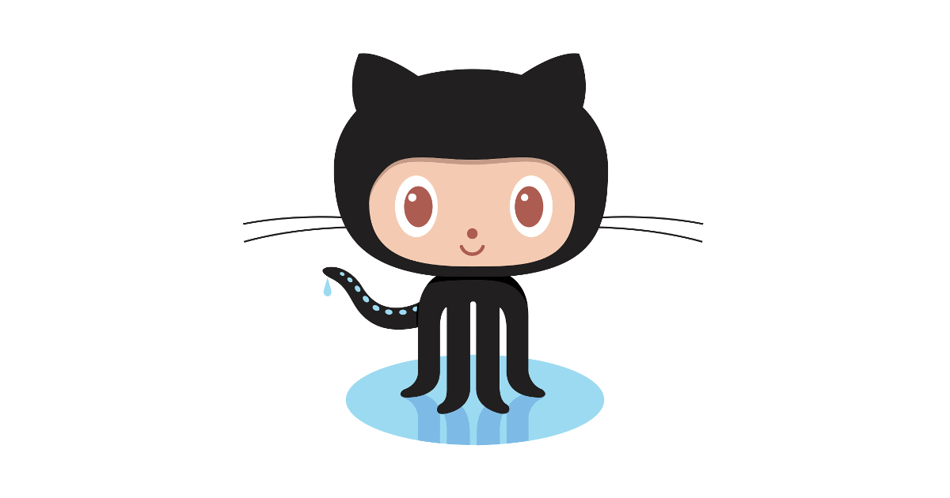
What is GitHub
Largest online hosting platform of git repositories (not the only one)
Bought by Microsoft in 2018 for $7.5 billion

Slide 6
Set up a GitHub Account
You can set up a free account at https://github.com/
Add your account to https://github.com/tiefighters7804

Slide 7
Basic git Commands
clone
status
pull
checkout
branch
add
commit
push
More info at https://git-scm.com/doc

